Slide 1
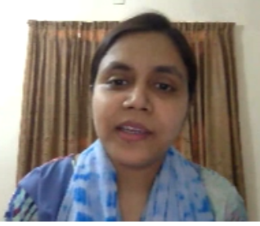

Integration
(Part – 3)
(Integration by parts and Integration by partial fraction)
Shirin Sultana
Lecturer
Department of GED
Daffodil International University

Slide 2

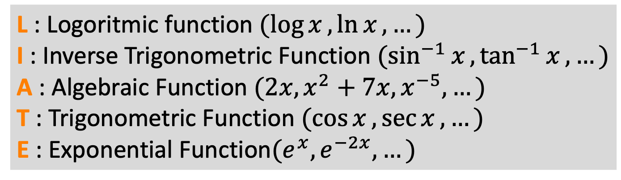
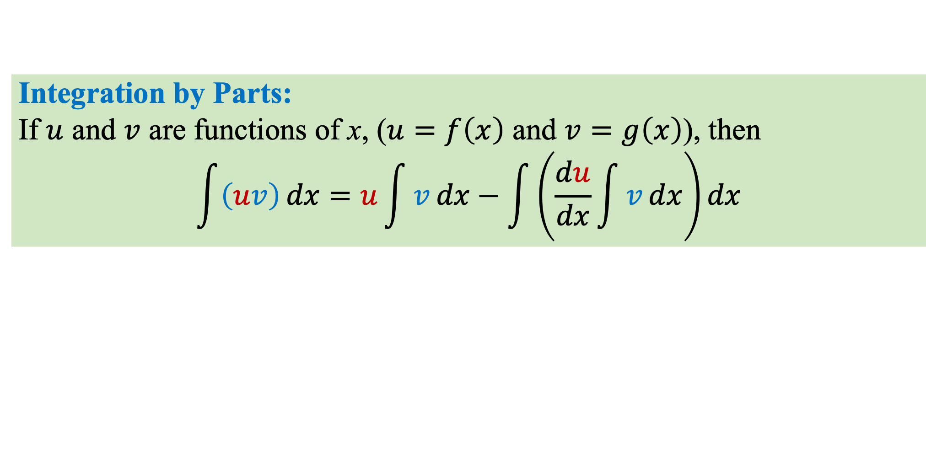
Integration by Parts:
If $u$ and $v$ are functions of x, ($u=f\left(x\right)$ and $v=g\left(x\right)$), then
$$\int{\left(uv\right)}dx=u\int{v}dx−\int{\left(\frac{du}{dx}\int{v}dx\right)}dx$$
Guideline for selecting $u$ and $v$:
L I A T E
L : Logoritmic function $(\log{x},\ln{x},…)$
I : Inverse Trigonometric Function $(\sin^{−1}{x},\tan^{−1}{x},…)$
A : Algebraic Function $(2x, x^{2}+7x, x^{−5},…)$
T : Trigonometric Function $(\cos{x},\sec{x},…)$
E : Exponential Function$(e^{x},e^{−2x},…)$
Choose $“u”$ to be the function that comes first in this list

Slide 3
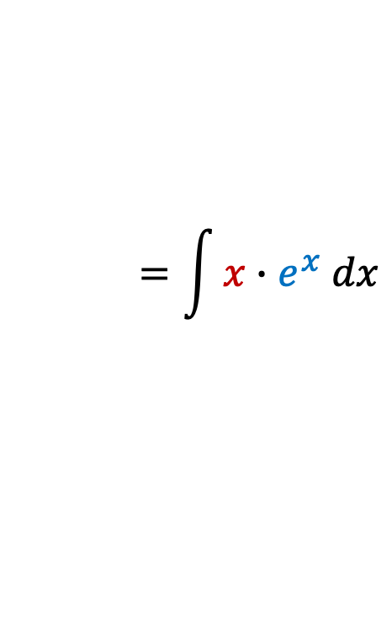
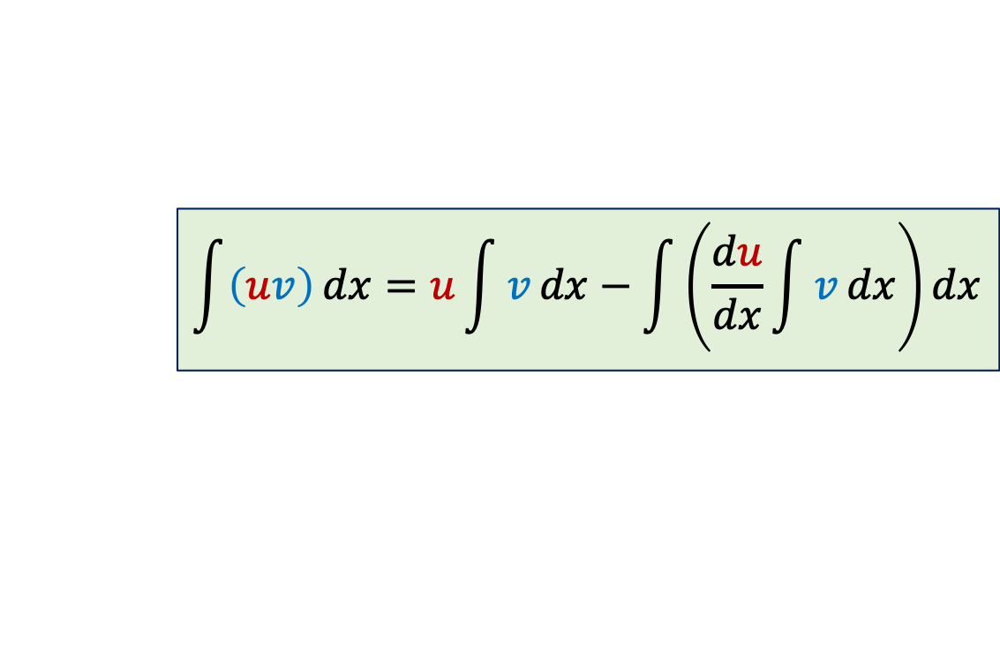

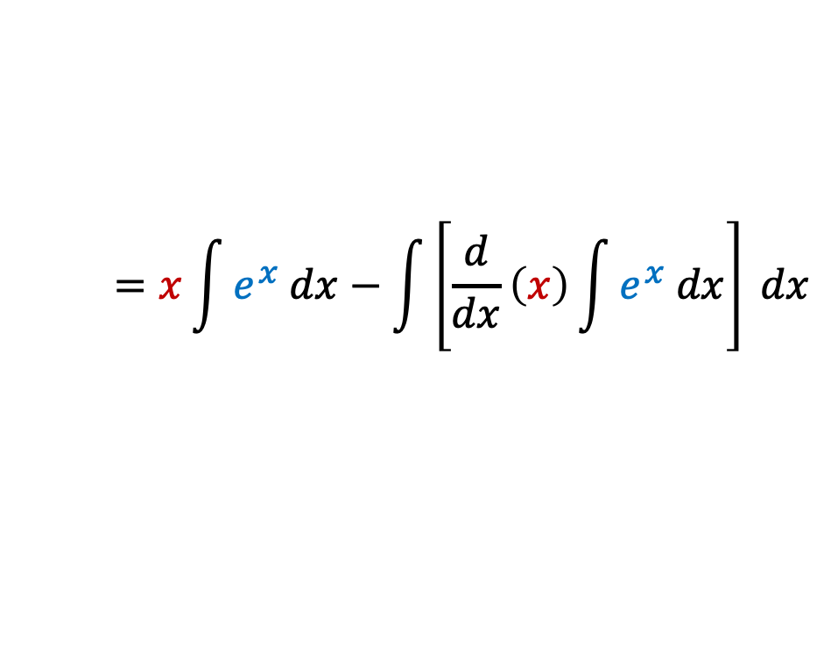
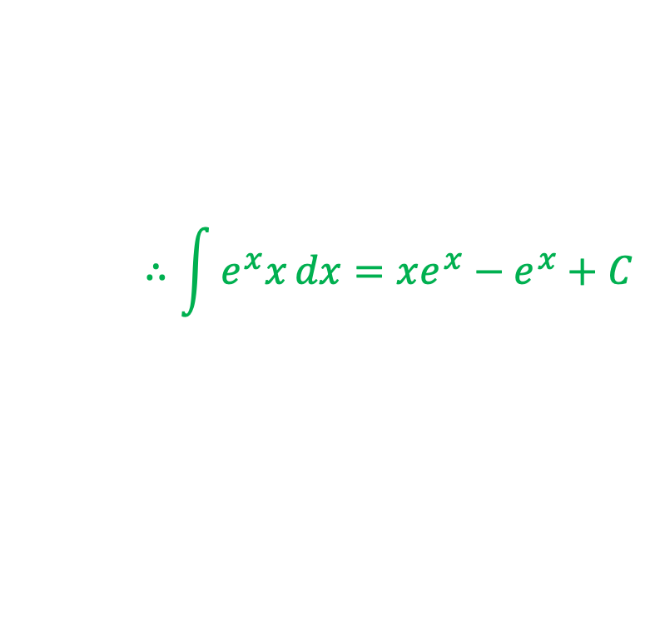
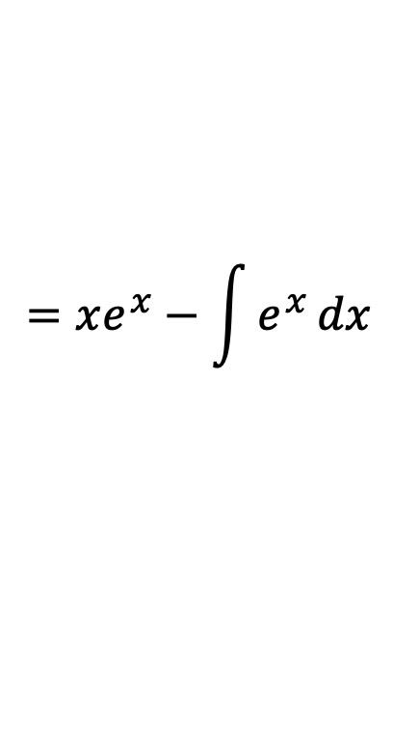
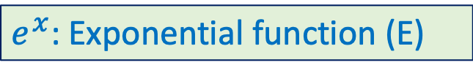

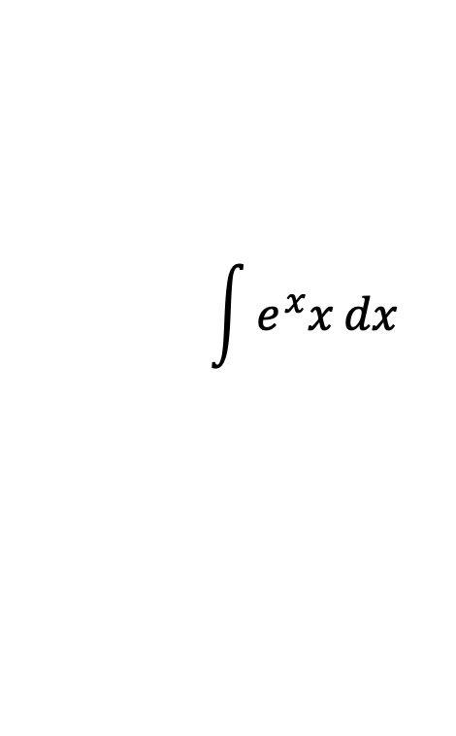
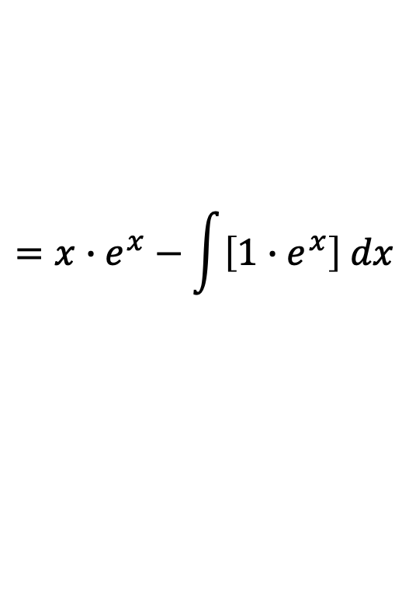
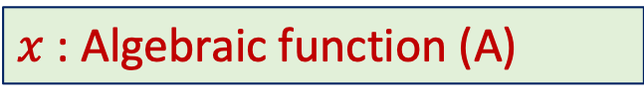
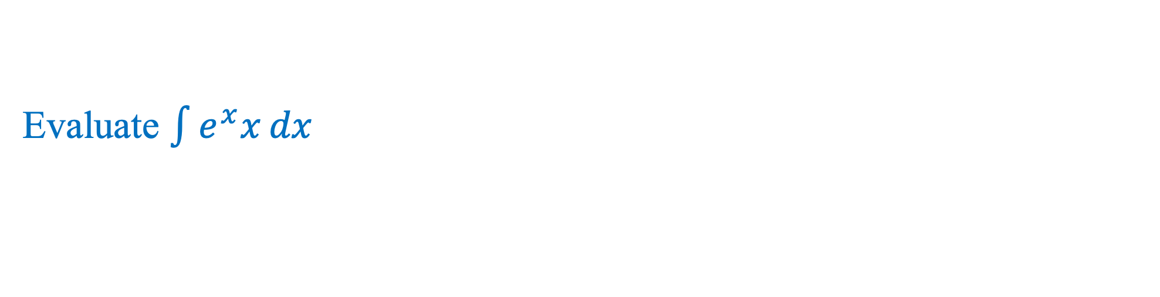
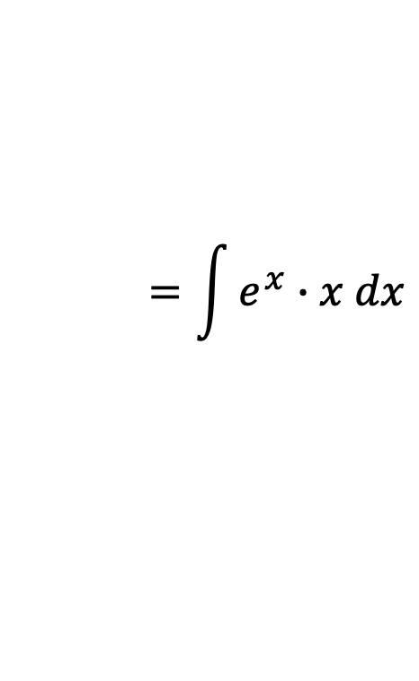

Evaluate $\int{e^{x}x}dx$
$$\int{\left(uv\right)}dx=u\int{v}dx−\int{\left(\frac{du}{dx}\int{v}dx\right)}dx$$
$$=\int{e^{x}∙x dx}$$
$$\int{e^{x}x}dx$$
$$=\int{x∙e^{x} dx}$$
Here,
$$=x\int{e^{x} dx}−\int{\left[\frac{d}{dx}\left(x\right)\int{e^{x} dx}\right] dx}$$
L I A T E
L : Logoritmic function
I : Inverse Trigonometric Function
A : Algebraic Function
T : Trigonometric Function
E : Exponential Function
$$=x∙e^{x}−\int{\left[1∙e^{x}\right] dx}$$
$$=xe^{x}−\int{e^{x}}dx$$
$$=xe^{x}−e^{x}+C$$
$$∴\int{e^{x}x}dx=xe^{x}−e^{x}+C$$
$$u=x$$
$x$ : Algebraic function (A)
$$v=e^{x}$$
$e^{x}$: Exponential function (E)

Slide 4

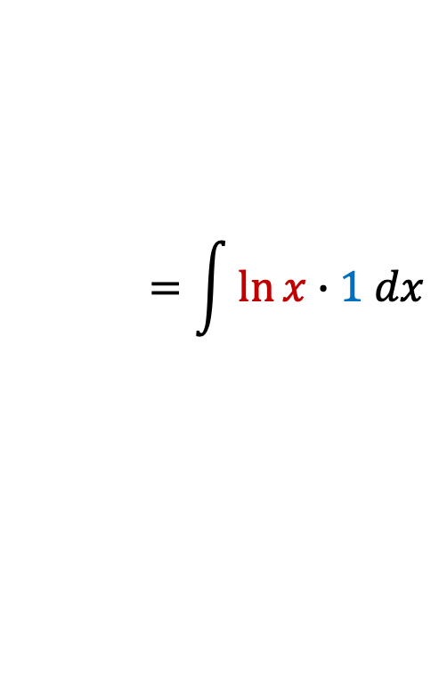
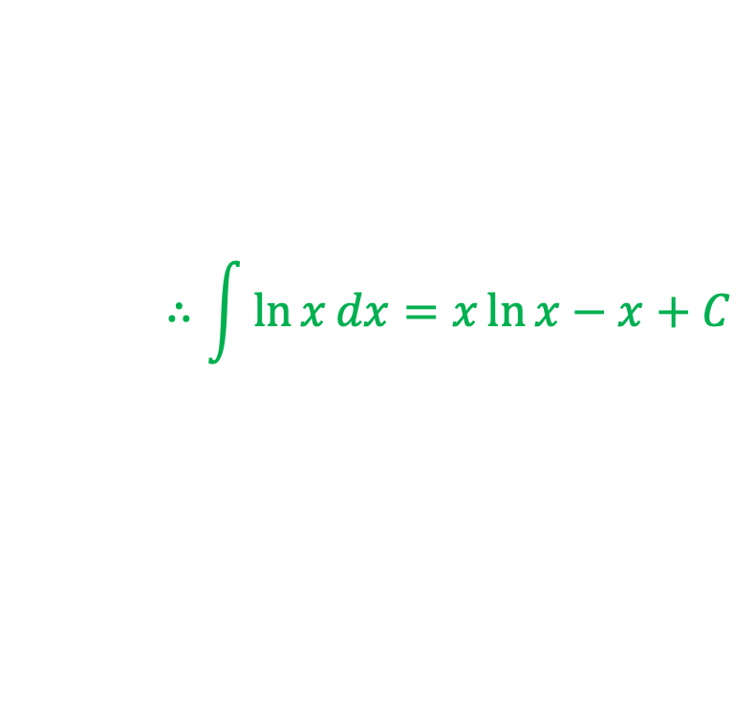
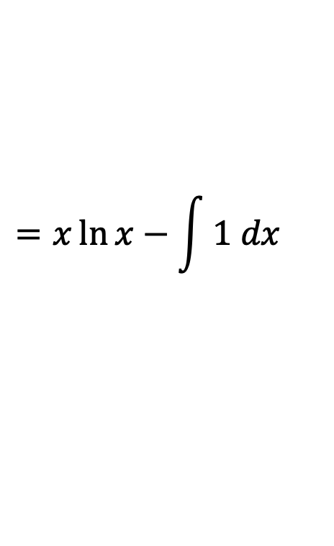


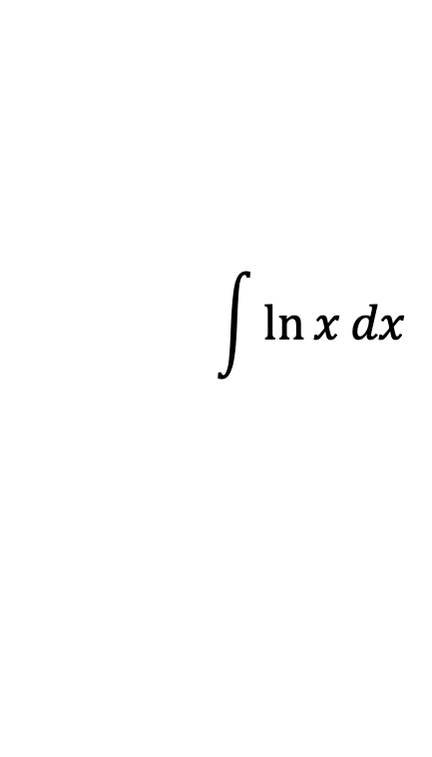
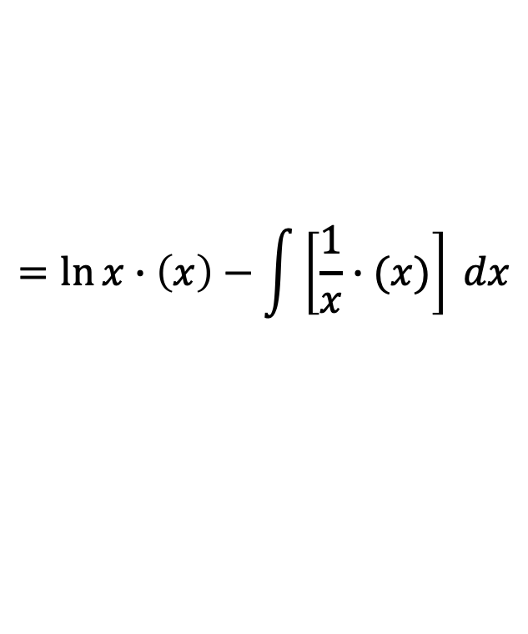
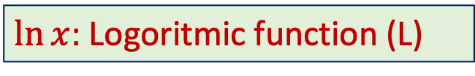
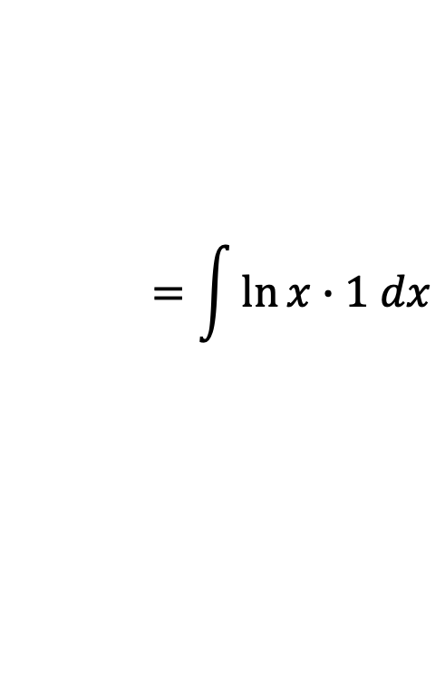

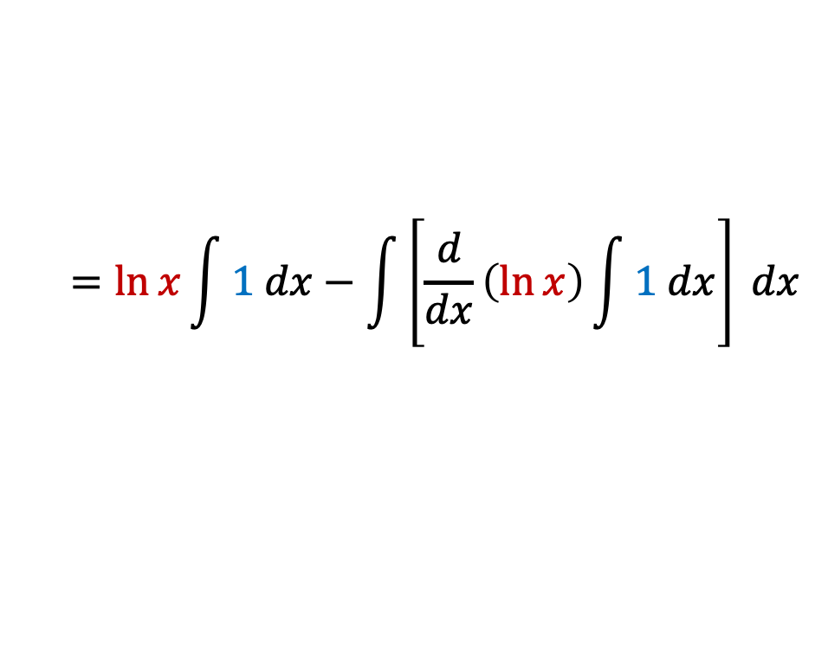

Evaluate $\int{\ln{x}dx}$
$$\int{\left(uv\right)}dx=u\int{v}dx−\int{\left(\frac{du}{dx}\int{v}dx\right)}dx$$
$$\int{\ln{x}dx}$$
$$=\int{\ln{x}∙1 dx}$$
$$=\int{\ln{x}∙1 dx}$$
Here,
$$=\ln{x}\int{1 dx}−\int{\left[\frac{d}{dx}\left(\ln{x}\right)\int{1 dx}\right] dx}$$
L I A T E
L : Logoritmic function
I : Inverse Trigonometric Function
A : Algebraic Function
T : Trigonometric Function
E : Exponential Function
$$=\ln{x}∙\left(x\right)−\int{\left[\frac{1}{x}∙(x)\right] dx}$$
$$=x\ln{x}−\int{1 dx}$$
$$=x\ln{x}−x+C$$
$$∴\int{\ln{x}dx}=x\ln{x}−x+C$$
$$u=\ln{x}$$
$\ln{x}$: Logoritmic function (L)
$$v=1$$
$1$: Algebraic function (A)

Slide 5

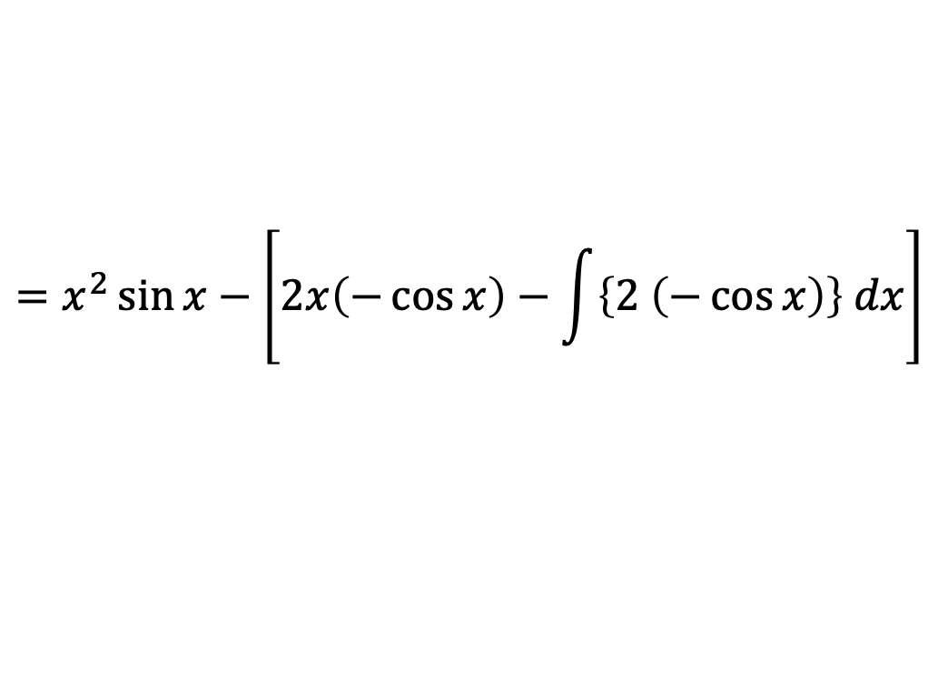
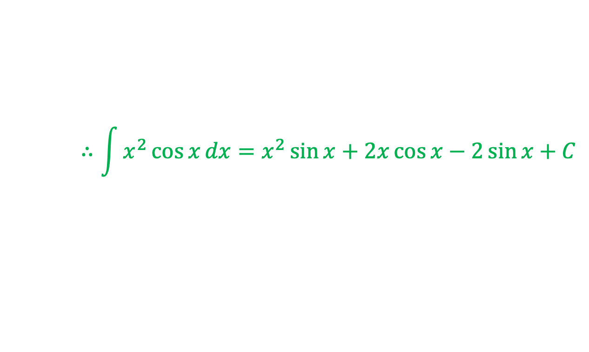
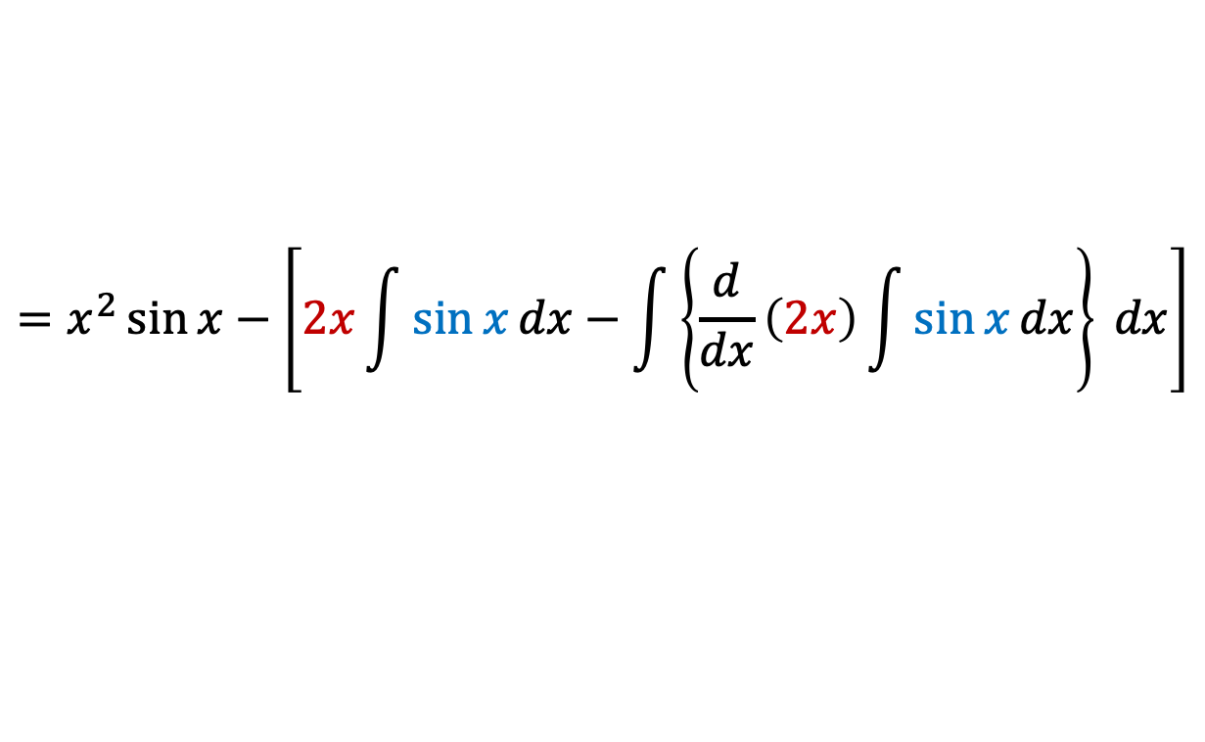
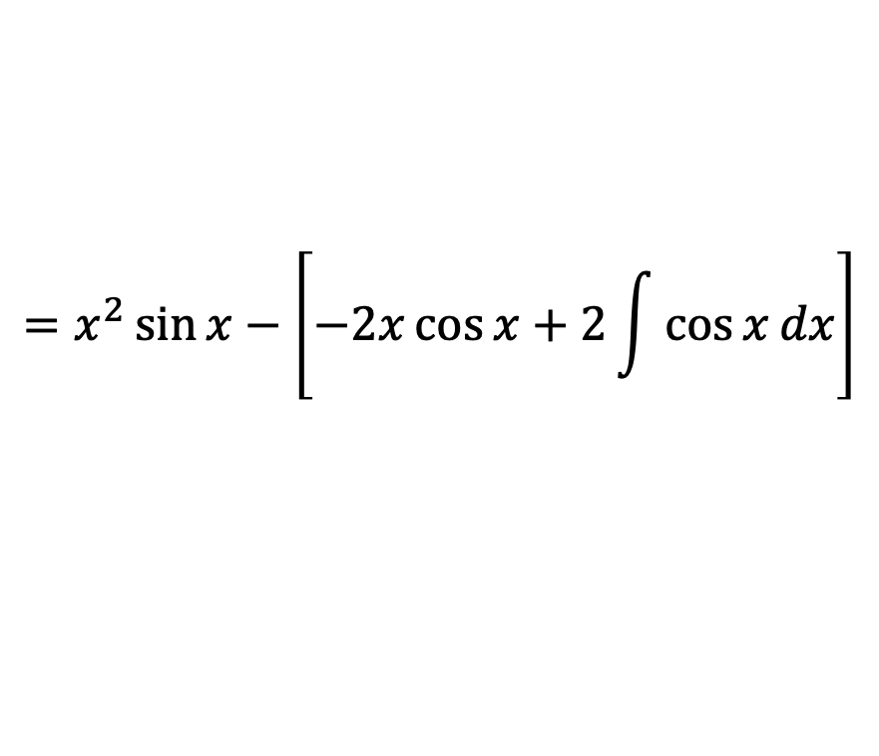

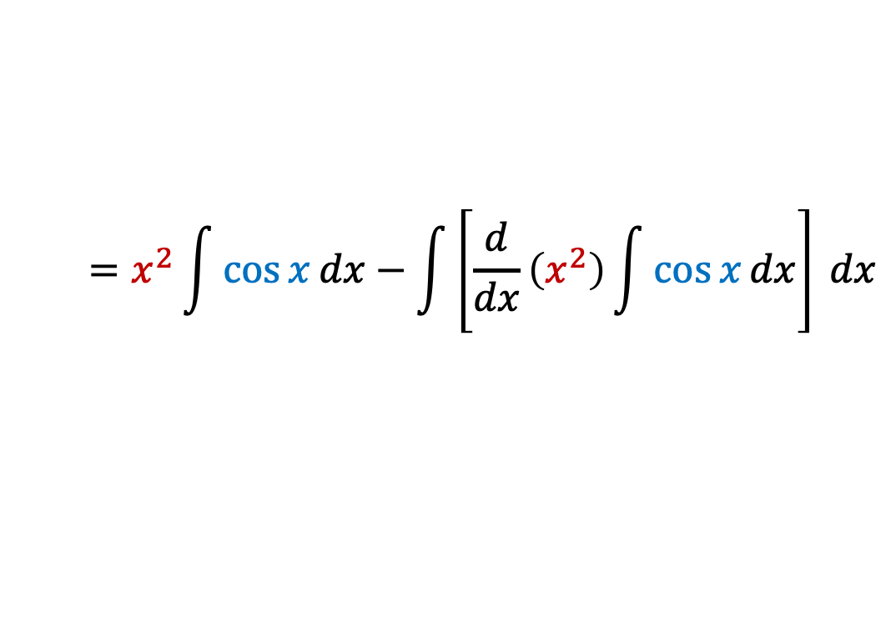
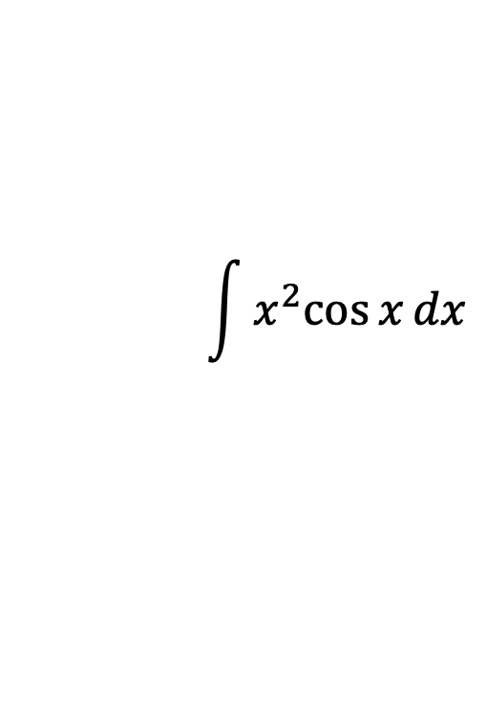
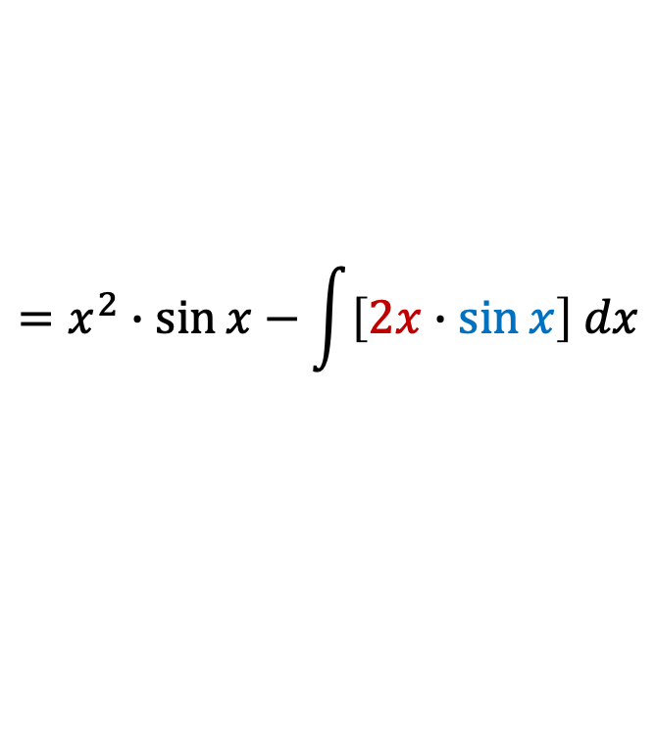

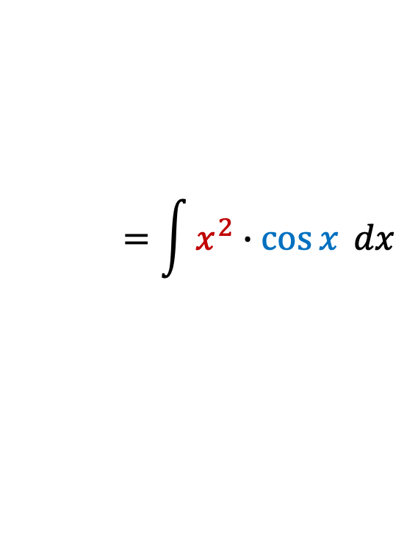
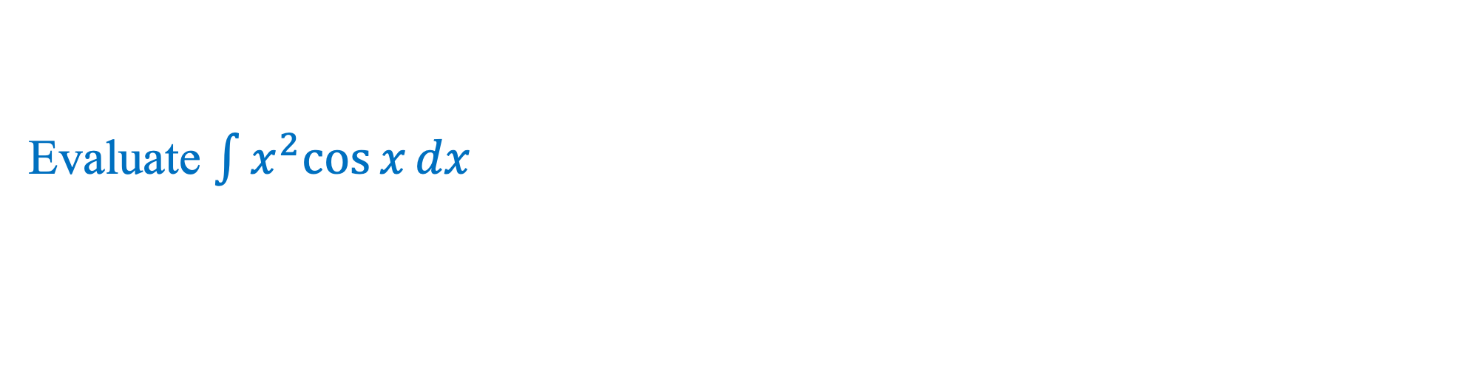
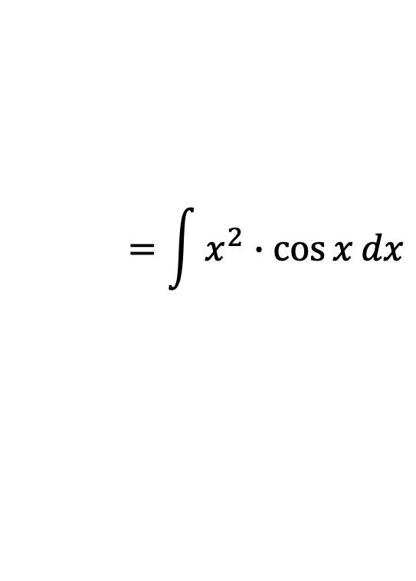

Evaluate $\int{x^{2}cos{x}}dx$
$$\int{\left(uv\right)}dx=u\int{v}dx−\int{\left(\frac{du}{dx}\int{v}dx\right)}dx$$
$$\int{x^{2}cos{x}}dx$$
$$=\int{x^{2}∙cos{x}}dx$$
$$=\int{x^{2}∙\cos{x} dx}$$
Here,
$$=x^{2}\int{\cos{x}dx}−\int{\left[\frac{d}{dx}\left(x^{2}\right)\int{\cos{x}dx}\right] dx}$$
L I A T E
$$=x^{2}∙\sin{x}−\int{\left[2x∙\sin{x}\right] dx}$$
L : Logoritmic function
I : Inverse Trigonometric Function
A : Algebraic Function
T : Trigonometric Function
E : Exponential Function
$$=x^{2}\sin{x}−\left[2x\int{\sin{x}dx}−\int{\left\{\frac{d}{dx}\left(2x\right)\int{\sin{x}dx}\right\} dx}\right]$$
$$=x^{2}\sin{x}−\left[2x\left(−\cos{x}\right)−\int{\left\{2 \left(−\cos{x}\right)\right\} dx}\right]$$
$$=x^{2}\sin{x}−\left[−2x\cos{x}+2\int{\cos{x}dx}\right]$$
$$u=x^{2}$$
$x^{2}$ : Algebraic function (A)
$$v=\cos{x}$$
$\cos{x}$: Trigonometric function (T)
$$∴\int{x^{2}\cos{x}}dx=x^{2}\sin{x}+2x\cos{x}−2\sin{x}+C$$

Slide 6
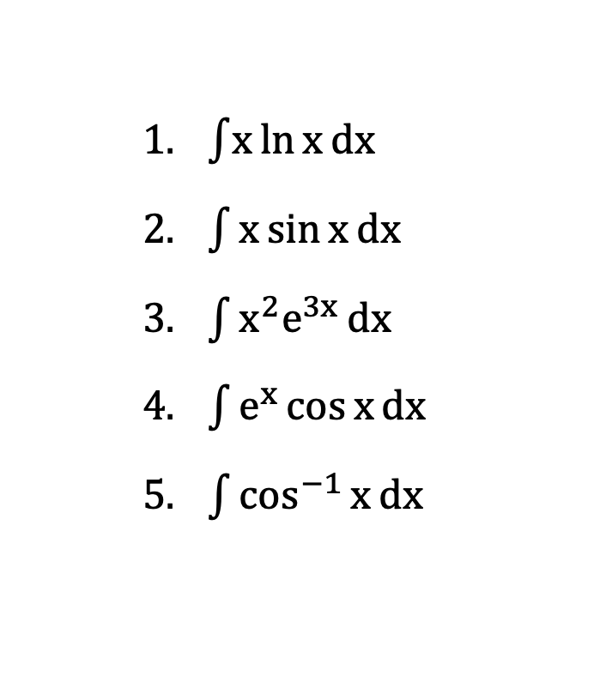
Exercise
Evaluate the followings:
    $\int{x}\ln{x}dx$
    $\int{x\sin{x}}dx$
    $\int{x^{2}e^{3x}}dx$
    $\int{e^{x}\cos{x}}dx$
    $\int{\cos^{−1}{x}}dx$

Slide 7
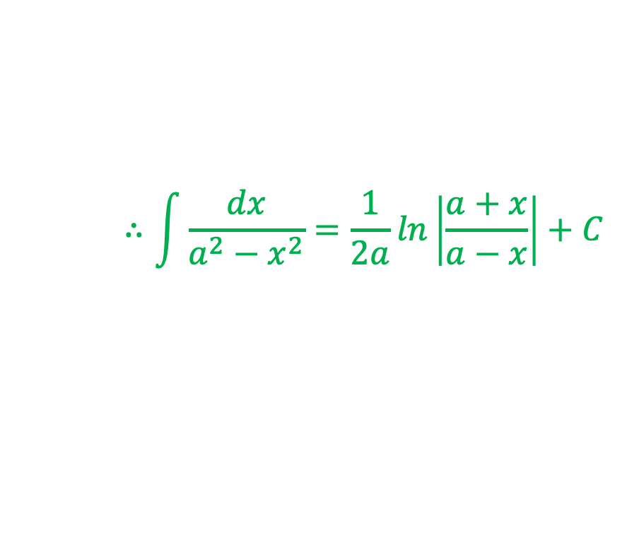

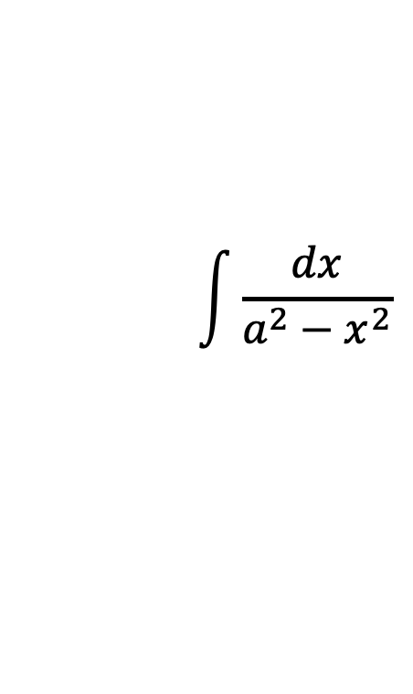
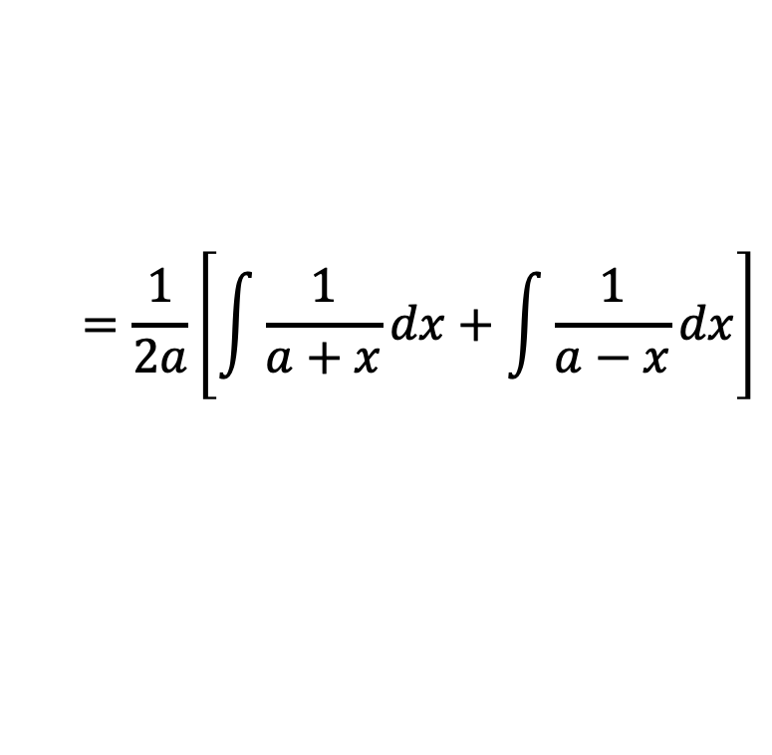
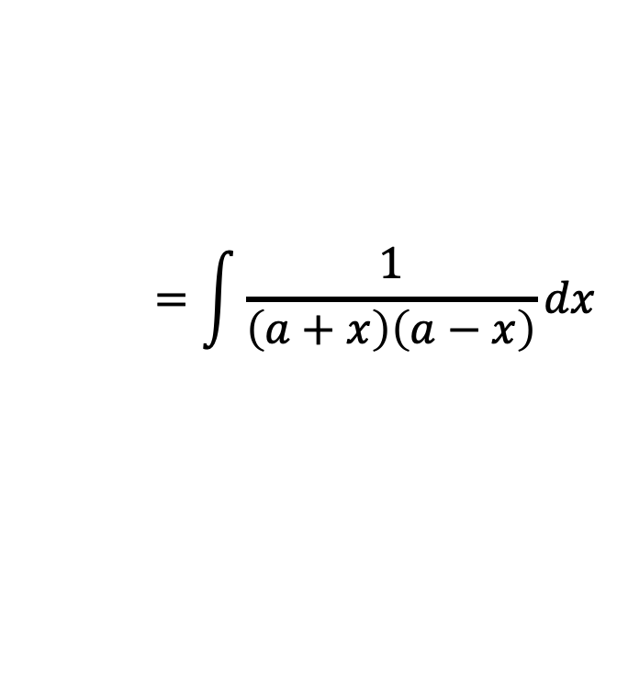
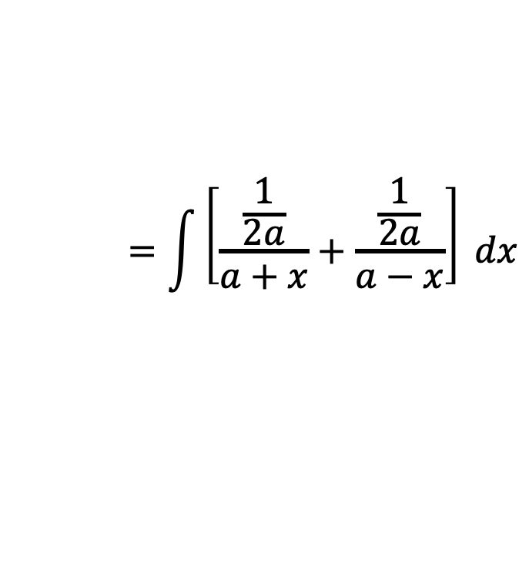
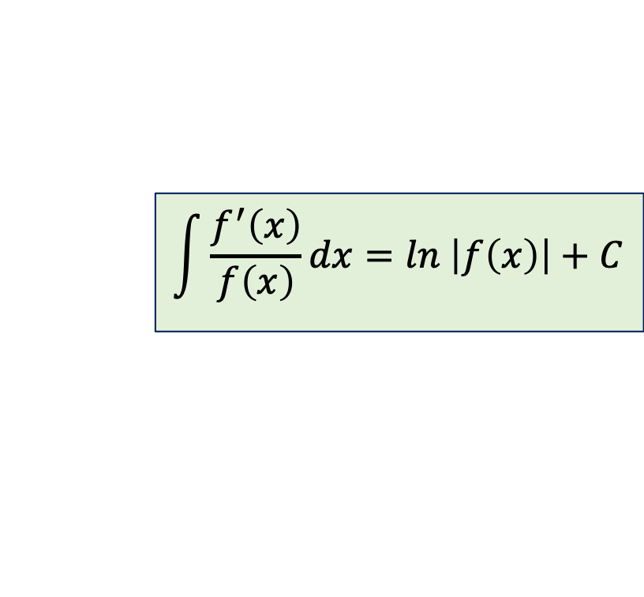
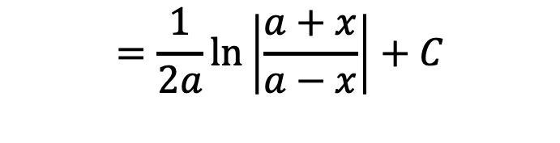
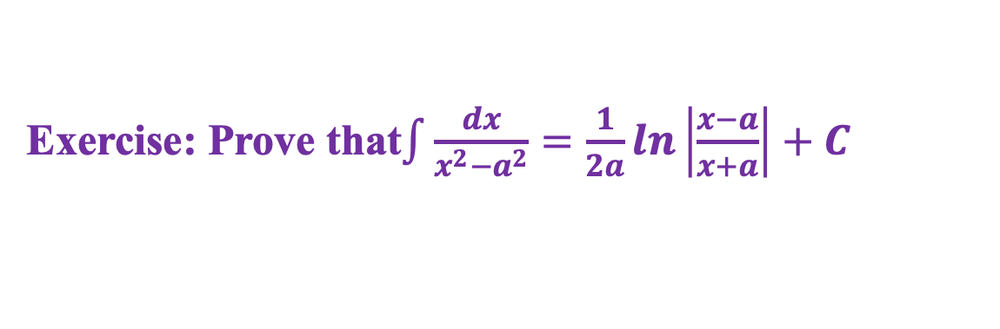
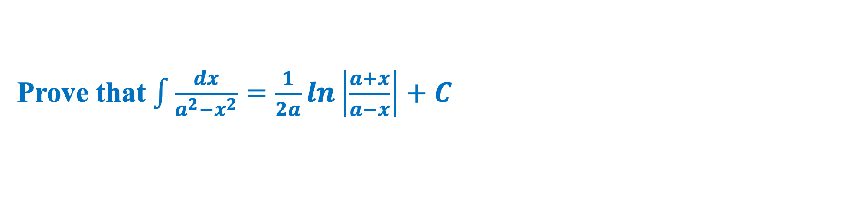
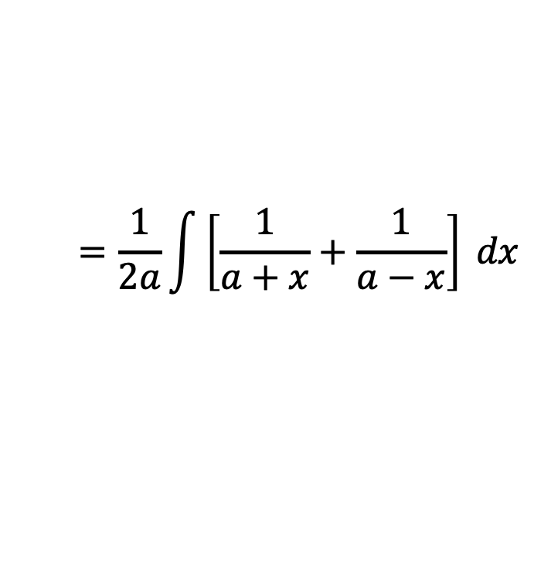
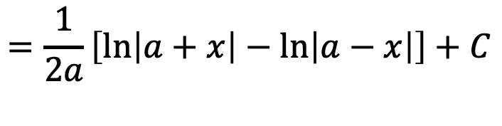
Prove that $\int{\frac{dx}{a^{2}−x^{2}}}=\frac{1}{2a}ln\left|\frac{a+x}{a−x}\right|+C$
Integration by Partial Fraction:
$$\int{\frac{f^{′}\left(x\right)}{f\left(x\right)}}dx=ln \left|f\left(x\right)\right|+C$$
Proof
$$\int{\frac{dx}{a^{2}−x^{2}}}$$
$$=\int{\frac{1}{\left(a+x\right)\left(a−x\right)}}dx$$
Now,
$$⟹\int{\frac{dx}{a^{2}−x^{2}}}=\frac{1}{2a}\left[\int{\frac{1}{a+x}}dx−\int{\frac{−1}{a−x}}dx\right]$$
$$=\int{\left[\frac{\frac{1}{2a}}{a+x}+\frac{\frac{1}{2a}}{a−x}\right] }dx$$
$$=\frac{1}{2a}\left[\ln\left|a+x\right|−\ln\left|a−x\right|\right]+C$$
$$=\frac{1}{2a}\int{\left[\frac{1}{a+x}+\frac{1}{a−x}\right] }dx$$
$$=\frac{1}{2a}\ln\left|\frac{a+x}{a−x}\right|+C$$
$$=\frac{1}{2a}\left[\int{\frac{1}{a+x}}dx+\int{\frac{1}{a−x}}dx\right]$$
$$∴\int{\frac{dx}{a^{2}−x^{2}}}=\frac{1}{2a}ln\left|\frac{a+x}{a−x}\right|+C$$
Exercise: Prove that$\int{\frac{dx}{x^{2}−a^{2}}}=\frac{1}{2a}ln\left|\frac{x−a}{x+a}\right|+C$

Slide 8
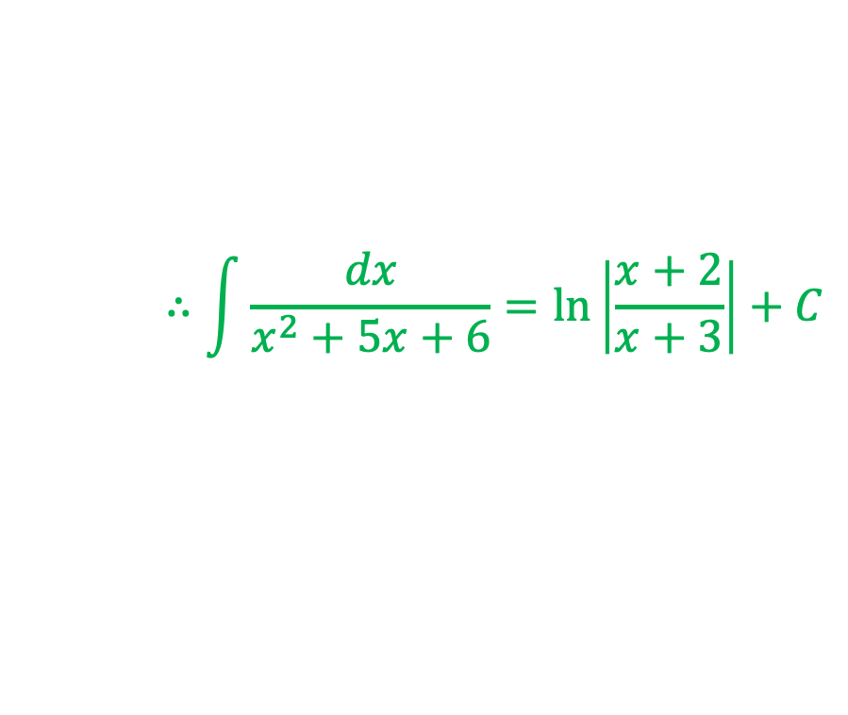
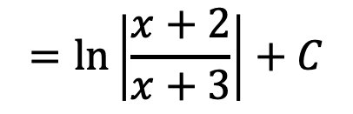
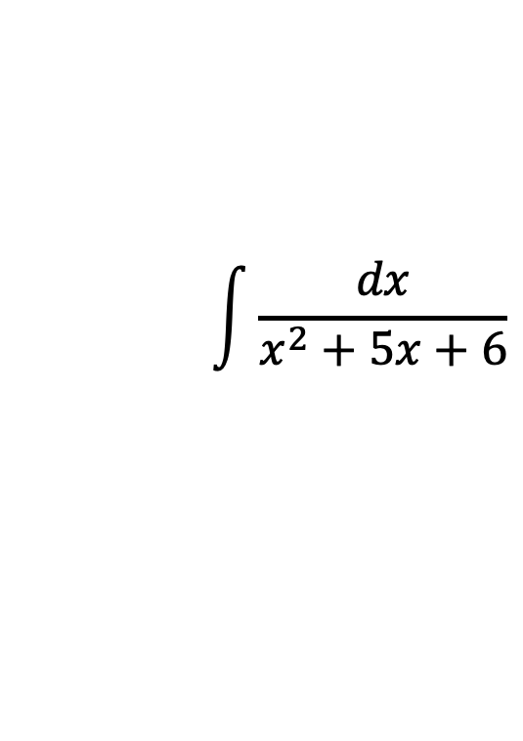

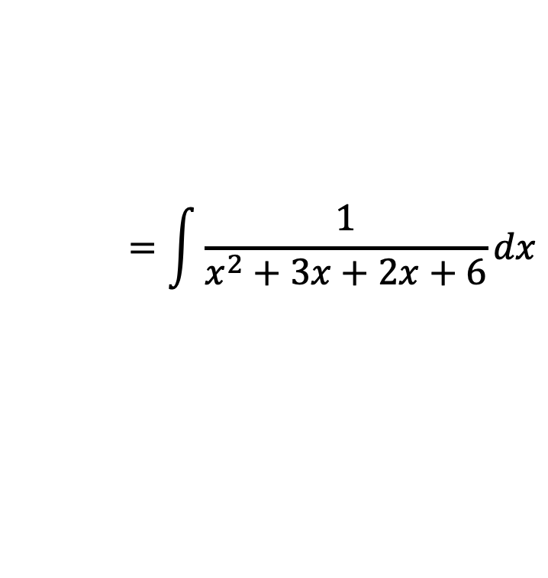
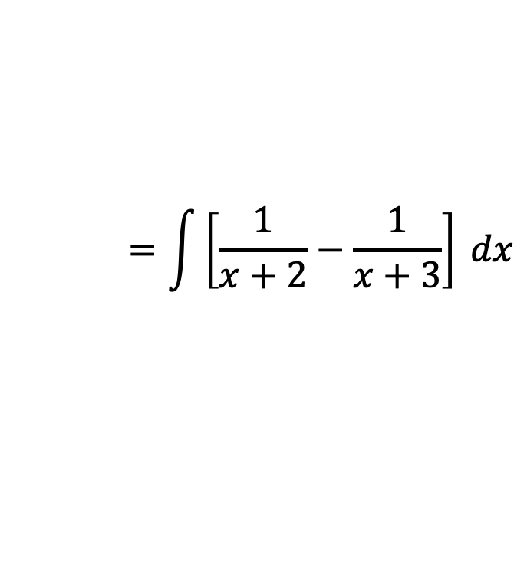







Evaluate$\int{\frac{dx}{x^{2}+5x+6}}$
$$\int{\frac{f^{′}\left(x\right)}{f\left(x\right)}}dx=ln \left|f\left(x\right)\right|+C$$
$$\int{\frac{dx}{x^{2}+5x+6}}$$
$$=\int{\frac{1}{x^{2}+3x+2x+6}}dx$$
Here,
$$⟹\int{\frac{dx}{x^{2}+5x+6}}=\int{\frac{1}{x+2}}dx−\int{\frac{1}{x+3}}dx$$
$$=\int{\frac{1}{x\left(x+3\right)+2(x+3)}}dx$$
$$=\int{\frac{1}{\left(x+2\right)(x+3)}}dx$$
$$=\ln\left|x+2\right|−\ln\left|x+3\right|+C$$
$$=\ln\left|\frac{x+2}{x+3}\right|+C$$
$$=\int{\left[\frac{1}{x+2}+\frac{−1}{x+3}\right] }dx$$
$$∴\int{\frac{dx}{x^{2}+5x+6}}=\ln\left|\frac{x+2}{x+3}\right|+C$$
$$=\int{\left[\frac{1}{x+2}−\frac{1}{x+3}\right] }dx$$
Exercise: (i) Evaluate$\int{\frac{x^{2}+1}{(x−1)(x−2)(x+2)}}dx$; (ii) Evaluate$\int{\frac{7x+4}{x^{3}−4x}}dx$

