Slide 1
Phillip Kevin Lane
Kotler • Keller
Marketing Management • 14e

Slide 2

Defining Marketing for the 21st Century
Chapter 1

Slide 3

Discussion Questions
Why is marketing important?
What is the scope of marketing?
What are some fundamental marketing concepts?
How has marketing management changed in recent years?
What are the task necessary for successful marketing management?

Slide 4
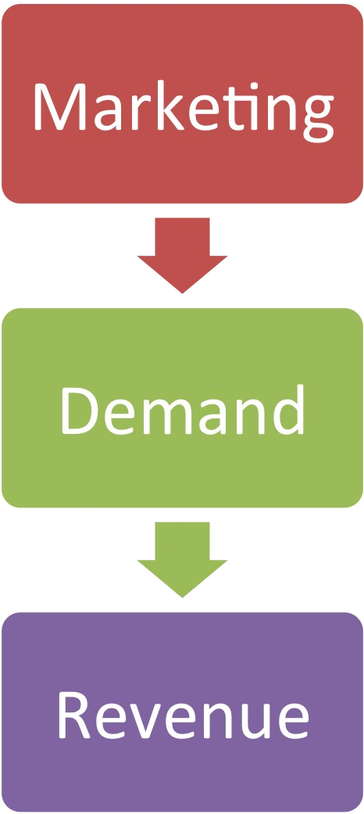
Jobs
Profits
Giving

Slide 5

Marketing is the activity, set of institutions, and processes for creating, communicating, delivering, and exchanging offers that have value for customers, clients, partners,
Defined
and society at large.

Slide 6

Defined
Marketing management is the art and science of choosing target markets and getting, keeping, and growing customers through creating, delivering, and communicating superior customer value.

Slide 7
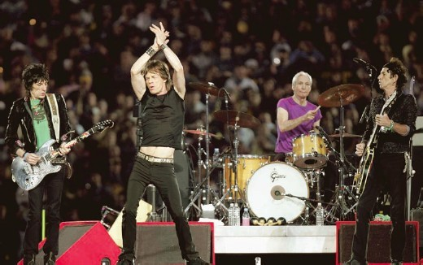

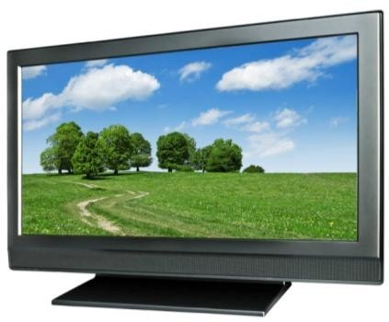
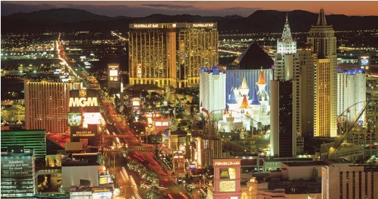
What is Marketed?
Persons
•
•
•
•
•
•
Experiences Events Properties Organizations Information Ideas
Goods
Places
Services

Slide 8


Who markets?
Response
Attention Purchase Donation Vote
Marketer
Prospect

Slide 9

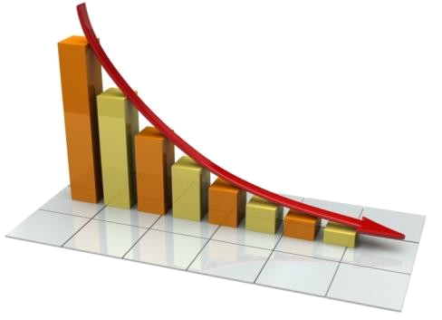

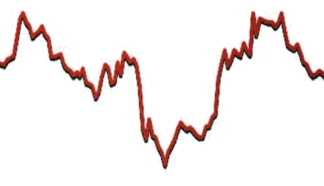
Types of Demand
Unwholesome
Declining
•
•
•
•
Nonexistent Latent
Full Overfull
Irregular
Negative

Slide 10
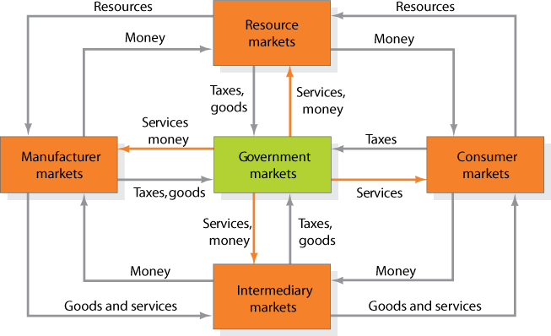
Markets
Figure 1.1

Slide 11
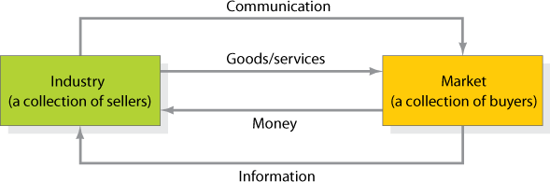
Simple Marketing System
Figure 1.2

Slide 12




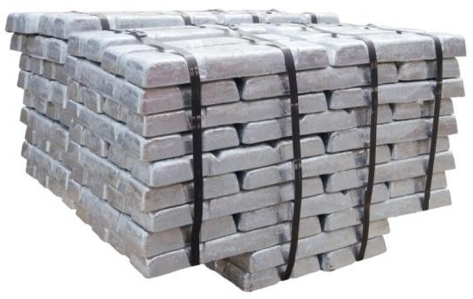
Key Customer Markets
Global Markets
Consumer Market
Business Markets
Government Market

Slide 13



Markets
Marketplaces
Marketspaces
Metamarkets

Slide 14



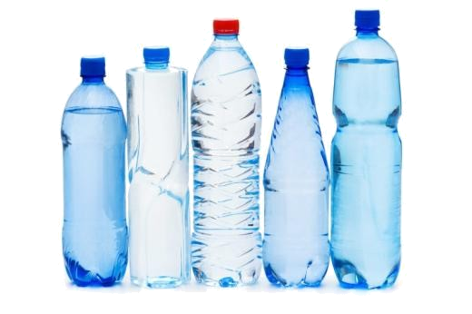
Core Marketing Concepts
Needs, Wants, and Demands
Target Markets, Positioning,
and Segmentation
Offerings and Brands
Value and Satisfaction

Slide 15
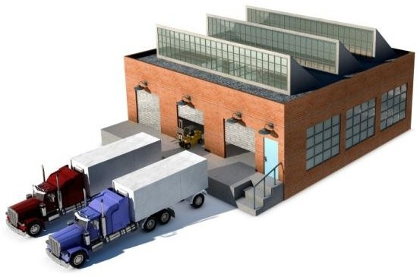

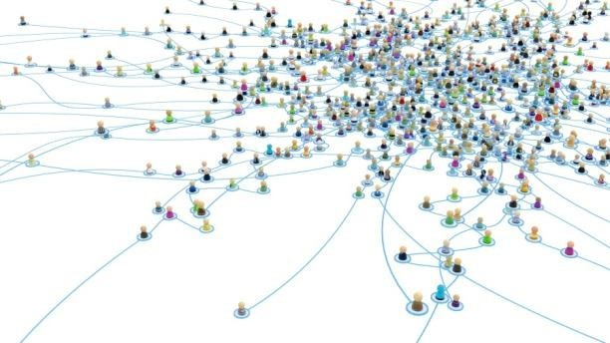

Core Marketing Concepts
Marketing Channels
Supply Chain
Marketing Environment
Competition

Slide 16


The New Marketing Realities
Globalization
Communicate
w/Customer
Information
Technology
Collect
Information
Consumer
Information
Increased
Competition
Differentiate
Goods

Slide 17

Who is Responsible for Marketing?
Entire Organization
Marketing Department
Chief Marketing Officer
(CMO)

Slide 18

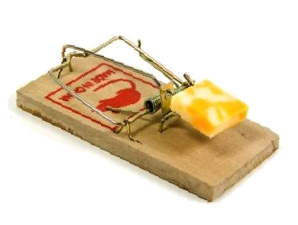
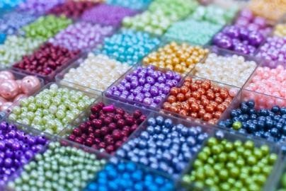

Marketing Concepts
Quality Innovation
Create, deliver, and communicate value
Production
Mass production Mass distribution
Product
Selling
Marketing
Holistic
Unsought goods Overcapacity

Slide 19
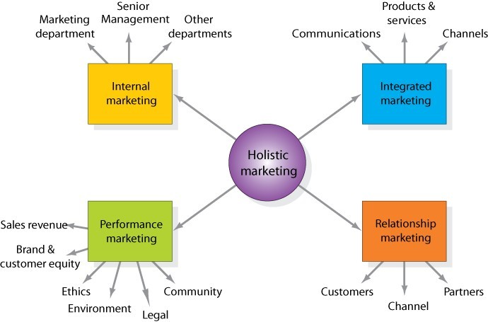
Holistic Marketing Dimensions
Figure 1.3

Slide 20


Relationship Marketing
Build long-term relationships
Develop marketing networks

Slide 21
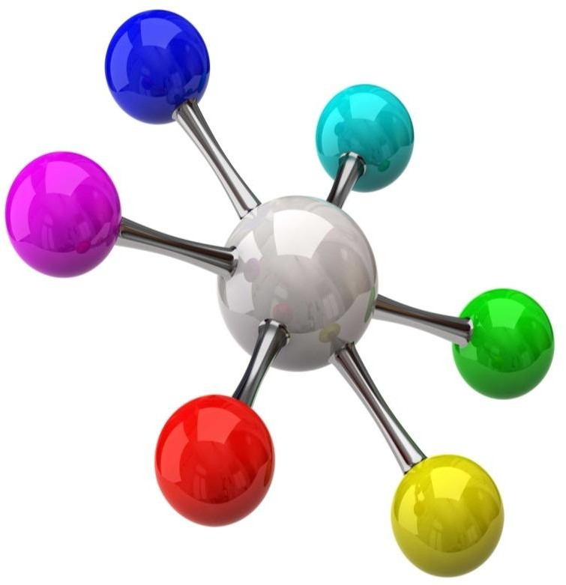
Integrated Marketing
Create, communicate, and deliver customer value

Slide 22

Internal Marketing

Slide 23



Performance Marketing
Social Responsibility
Financial Accountability

Slide 24
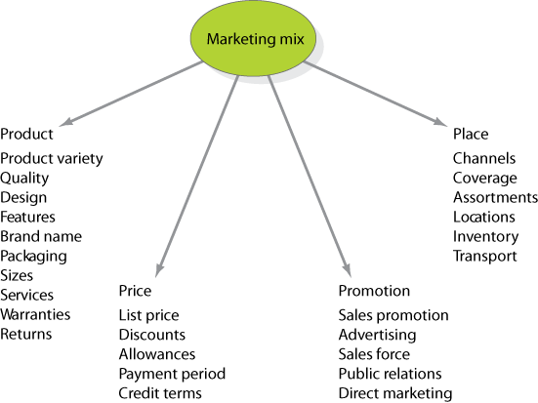
The Four P’s of the Marketing Mix
Figure 1.4

Slide 25
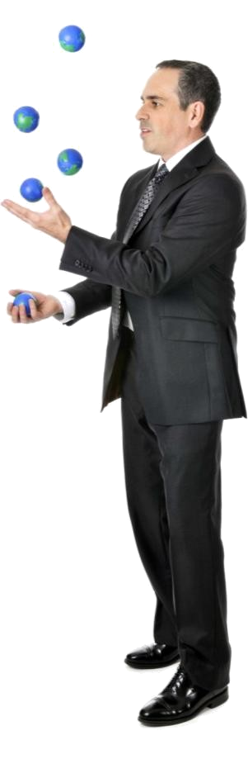
Marketing Management Tasks
Developing market strategies and plans
Capturing marketing insights
Connecting with customers
Building strong brands
Shaping market offerings
Delivering value
Communicating value
Creating long-term growth

