Slide 1
Neural Networks
182-15-11711
BEBE KHODEZATUL KOBRA

Slide 2
Artificial neuron networks
supervised learning
gradient descent

Slide 3
Connectionist Models

Slide 4
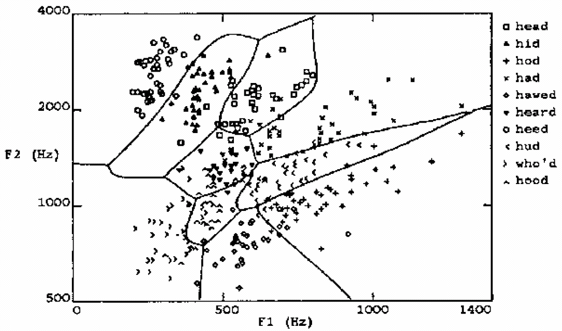
Learning highly non-linear functions

Slide 5
Learning highly non-linear functions
f: X → Y
f might be non-linear function
X (vector of) continuous and/or discrete vars
Y (vector of) continuous and/or discrete vars

Slide 6
Thank YOU

