Slide 1
Environmental Implications
of
Sectoral Development

Slide 2
What are the sectors of Environmental Implications?
Agricultural sector
Industrial sector
  Mining industry
  Textile
  Paper & Pulp
  Meat
  Food
  Tannery
  Cement
  Petrochemical
  Pharmaceuticals
Water Development, Flood Control & Irrigation
Energy sector
Transport & Communication
Infrastructure development
Tourism
Water supply & Sanitation sector
Electronic goods manufacturing industry
Fertilizer/pesticides
Construction industry
Automobile industry
Chemical industry

Slide 3
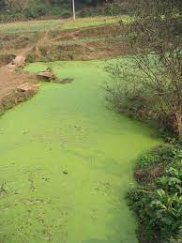
Describe the impacts of Agricultural sector on environment
Agriculture has a profound impact on the environment on the following:
Air pollution: drift of agricultural chemicals (pesticides, herbicides,
fungicides, fertilizers) pollen, dust
Water pollution: leaching of nutrients and eutrophication. Contamination of groundwater and surface water by pesticides, herbicides and fertilizers.

Slide 4
Describe the impacts of Agricultural sector on environment
Water quantity: High yielding needs huge amount of water for irrigation.
Soil degradation & pollution: irreversible losses of soil due to soil
sealing & erosion, contamination from increased use of pesticides,
fertilisers etc., acidification, salinisation and compaction. Loss of organic matter, soil biodiversity and fertility loss is due to unsustainable practices of agriculture.

Slide 5
Describe the impacts of Agricultural sector on environment
– Greenhouse gas emission: Agriculture is a significant
contributor of CH₄ and NO₂ gases.
– Biodiversity loss: Key factors causing the decline in biodiversity
include habitat disturbance and changes in the food chain. As the
agricultural production has intensified, all levels of biological diversity (genetic, species, and habitats) have declined in farming
environments.
– Human health: Toxicity of chemicals in food chain and
ultimately affect human health

Slide 6
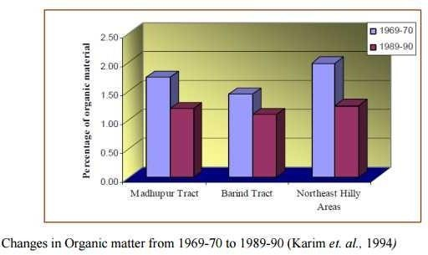
Agricultural Sector

Slide 7
What measures can be taken in Agricultural sector to protect the environment?
Some measures:
Developing measures that will encourage flexibility in land use. Crop management in relation to climate change is a present concern.
Increasing water management efficiency in order to sustain agricultural production under changing climatic condition
– Identification and preservation of plant and diversity as key natural resources sustaining
animal future
genetic agrifood,
aquaculture and bioenergy production.
– The application of agrochemicals which does not adversely affect the fertility as well as the organic properties of soil and which also produce adverse impact on man and animals should be regulated.

Slide 8
What measures can be taken in Agricultural sector?
Continued…………
– Production, import and use of the harmful chemicals should
be phased out gradually and should be prohibited as soon as
possible
– Integrated protection and
pest management should be used. Through
multiplication of snakes, frogs, lizards, turtles and
other wild animals, natural methods of pest control should be encouraged.
– Organic farming should be encouraged. Organic farming should promote and enhance agro ecosystem health, including biodiversity, biological cycles and soil biological activity . Organic
farming focuses
animal welfare by
on sustainability, environmental protection and
reducing or eliminating chemical inputs such
as fertilizers, pesticides.

Slide 9
Industrial sector
Industrialisation creates employment,
eradicates
poverty, promotes gender
equality, and greater
labour
standards, and enhances
access to
environmental
education and healthcare.
Industrial processes poses negative
impacts, causing climate change, loss of natural resources, air, soil and water pollution and extinction of species.
Pollution contributed is industry specific.

Slide 10

Raw materials
Plant processes or
Product
Water
By-product
Unit operations
Energy
Gaseous emissions
Chemicals
Wastewater
Air
Solid waste
In-plant recycle
Reusable waste in another operation

Slide 11
Pollutants from Different Industries
(http://www.eolss.net/sample-chapters/c09/e4-11-02- 00.pdf)
Industrial Sectors | Pollutant Forms
 | Gas | Solid Waste and Solids | Water | Other
Iron and Steel | SO_{x}, NO_{x}, HC, CO, H₂S, Toxic Chemicals | Slag, Wastes, Sludge from effluent treatment | BOD, COD, Oil, Metals, Acids, Phenol, Cyanide | Noise, Particulate
Textile and Leather | SO_{x}, HC | Sludge (chromium) from effluent treatment | BOD, Solids, Sulphates and Chromium, Dyes | Odour, Noise, Particulate
Pulp and Paper | SO_{x}, No_{x} | Sludge from effluent treatment | BOD, COD, Solids, Chlorinated organics compounds | Odour, Noise, Particulate
Petrochemicals , Refineries | SO_{x}, NO_{x}, HC, CO, H₂S, Toxic Chemicals | Spent catalysts, Tars, Sludge | BOD, COD, Oil, Phenols and Chromium | Odour, Noise, Particulate
Chemicals | Organic Chemicals | Sludge from pollution treatment and process waste | COD, Organic Chemicals, Heavy Metals, Solids and Cyanide | Odor, Toxic Chemicals

Slide 12
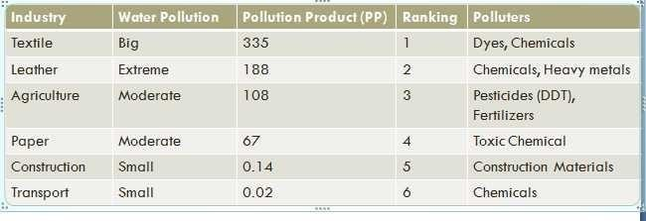
Water Pollution by Industries in Bangladesh
(http://reedconsultingbd.com/media/k2/attachments/Are_textile_industries_the_main_so urce_of_water_pollution_in_Bangladesh_March_Final_2011.pdf)

Slide 13
What are the effects of Mining Industry on the environment? Explain
Air: Mines produce dust from bursting operations and haul roads. Coal mines release CH4 and other GHGs. Smelter operations with insufficient safeguard have the potential to pollute the air with heavy metals, sulphur dioxide and other pollutants.
Water: mining industry uses large quantities of water. Mining releases sulphur oxides into the air which reacts with water and produces sulphuric acids. This, together with various trace elements affects surface water and groundwater and impacts the eco system.

Slide 14
What are the effects of Mining Industry on the environment? Explain
Land: The movement of rocks during mining activities and the overburden materials overlying the mineral deposits impacts land severely.
Health & Safety: Mining operation is very dangerous and hazardous. Underground mining is more hazardous than surface mining because of poor ventilation, visibility and danger of falling of rocks. The greatest health risk arise from dust which may lead respiratory diseases and from exposure to radiation depending upon the mine type.

Slide 15
What measures can be taken in Industrial sector to protect the environment?
Ensure EIA in all new industries both public and private
Encourage development of environmentally sound and appropriate technologies and initiative on research and foundation in the field of industry.
Prevent wastage of raw material and ensure their sustainable use in industry.
Promote cleaner production processes.
Industries that are potential polluters will make provision to introduce pollution control measures
4R policy should be encouraged

Slide 16
Tourism Industry
Resource use
  Energy
  Water
  land
Pollution and waste outputs
  Water quality
  Air quality
  Noise
  Solid waste generation
Transportation
Development & land use
Economy
Education
Eco-system alteration
  Impacts on wildlife
  Aesthetic & cultural impacts

Slide 17
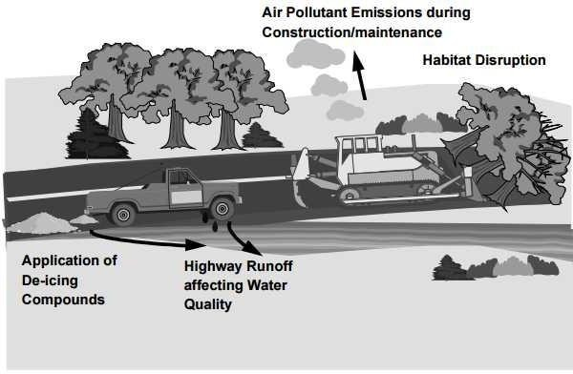
Impacts in Transport sector

Slide 18
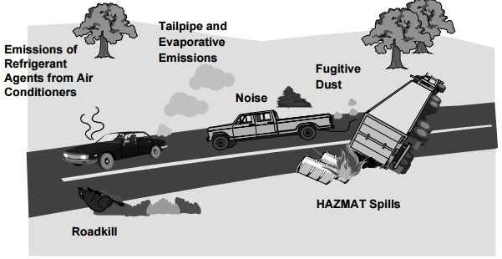

Slide 19
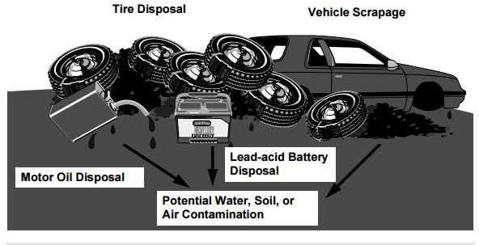

Slide 20
Impacts of Transportation sector on Environment How Transportation sector change the quality of air?
Emission of carbon-dioxide (CO₂) from the burning of fossil fuels is a major contributor. For the transport sector, the greenhouse gas emissions are dominated by the CO₂ emissions from burning fossil fuels. These are strongly related to transport energy use.
Release of Particulate matter (PM₁₀, PM_{2.5}), Nitrogen oxides (NOx), Sulphur oxide (SO₂ ). Ozone (O₃ ), Volatile organic compounds (VOC).
Health impacts such as aspiration diseases due to the fine particles (PM_{2.5}/PM₁₀, other air pollutants). Exhaust emission particles are hereby considered as the most important pollutant. In addition, Ozone (O₃ ) has impacts on human health.

Slide 21
Impacts of Transportation sector on Environment
How Transportation sector affects other sectors?
Building and material damages: Impacts on buildings and
materials from air soiling of building
pollutants. Mainly two effects are of importance: surfaces/facades primarily through particles and
dust. The second, more important impact on facades and materials is the degradation through corrosive processes, due to acid air pollutants like NOx and SO₂.
Crop losses in agriculture and impacts on the biosphere: crops as well as forests and other ecosystems are damaged by acid deposition, ozone exposition and SO₂
Impacts on biodiversity and ecosystems (soil and water/groundwater): the impacts on soil and groundwater are mainly caused by eutrophication and acidification due to the deposition of nitrogen oxides, as well as contamination with heavy metals (from tire wear and tear).

Slide 22
Impacts of Transportation sector on Environment
Noise
  Traffic noise has a variety of adverse impacts on human health.
The World Health Organization (WHO) has community noise, including traffic noise, as a health problem.
recognized
serious public
Traffic noise has various adverse effects. The most widespread effect is simply annoyance. In addition, there is substantial evidence for serious health problems caused by traffic noise. The main problem is disturbance of sleep patterns, which affects cognitive functioning (especially in children) and contributes to certain cardiovascular diseases. There is also increasing evidence for an impact of noise raising blood pressure (Den Boer & Schroten, 2007).

Slide 23
Impacts of Transportation sector on Environment
Land Use
  Transportation facilities have an impact on the urban landscape. The development of port and airport infrastructure is significant features of the urban and peri- urban built environment. Social and economic cohesion can be severed when new transport facilities such as elevated train and highway structures cut across an existing urban community. Arteries or transport terminals can define urban borders and produce segregation. Major transport facilities can affect the quality of urban life by creating physical barriers, increasing noise levels, generating odors, reducing urban aesthetic and affecting the built heritage

Slide 24
Impacts of Transportation sector on Environment
How Transportation sector change the quality of water?
Water quality
  Transport activities have an impact on hydrological conditions. Fuel, chemical and other hazardous particulates discarded from aircraft, cars, trucks and trains or from port and airport terminal operations, such as de-icing, can contaminate rivers, lakes, wetlands and oceans.
  The main effects of marine transport operations on water quality predominantly arise from dredging, waste, ballast waters and oil spills.
  Waste generated by the operations of vessels at sea or at ports cause serious environmental problems. Besides, various types of garbage containing metals and plastic can persist on the sea surface for long periods of time and can threaten the ecosystem.

Slide 25
Impacts of Transportation sector on Environment
How Transportation sector change the quality of soil?
Soil quality
  Soil erosion and contamination
  Shipping activities causes damage such as river banks
in confined channels
Highway construction, airport developments etc. lead loss of fertile land and productive soils.
Soil contamination can occur through the use of toxic materials by the transport industry.
Fuel and oil spills from motor vehicles are washed on road sides and enter the soil. Chemicals used for the preservation of railroad ties may enter into the soil. Hazardous materials and heavy metals have been found in areas contiguous to railroads, ports and airports.

Slide 26
Impacts of Transportation sector on Environment
Biodiversity changes
Transportation also influences natural vegetation.
The need for construction materials and the development of land based transportation has led to deforestation.
Transport routes reducing wetland species.
have required draining land,
thus areas and driving-out water plant
The need to maintain road and rail right-of way or to stabilize slope along transport facilities has resulted in restricting growth of certain plants or has produced changes in plants with the introduction of new species different from those which originally grew in the areas.
Many animal species are becoming extinct as a result of changes in their natural habitats and reduction of ranges

Slide 27
Impacts of Transportation sector on Environment
Resource use
  Large amounts of oil based resources used for transport
  Materials are extracted for infrastructure construction
Wastes production
Vehicles contain materials such as lead,
and
mercury,
other
cadmium, hexavalent chromium
environmentally harmful substances.
Existing cars by weight, about three-quarters of a car is steel and aluminium, which is recycled. The rest, which is mainly plastics, is disposed of by incineration or in landfills. Cars also contain dangerous liquid substances (anti-freeze, brake fluid, oil, etc.) that are harmful to the environment if not handled properly (EEA, 2003).
Vehicles, fluid, tyres, spent oil, scrap materials etc. are produced

Slide 28
Some measures in Transport Sector
Development of alternative fuels and ensure greater energy efficiency
Set demanding targets for the reduction of greenhouse gas emissions from transports
Behavioural change and adaptation polices are also needed which ensure that the transport system is more resilient to the effects of climate change.
Continued action is needed to make vehicles more recyclable and
to require the industry to recycle used vehicles.
development of more efficient engine and fuel technologies should be needed to reduce the emissions of air pollutants
Greater emphasis is needed on the design of vehicles and infrastructure which are fit for purpose, use recyclable and low density materials and help improve the life-cycle sustainability of the transport system.

Slide 29
Impacts in Energy Sector
Non renewable
  Coal
  Natural Gas
  Nuclear Power
  Oil
Renewable
  Wind
  Solar
  Biomass
  Hydropower
  Tidal
  Geothermal
  Biofuel
  Waste

Slide 30
Nuclear
Mining hazard of radioactive material
Accidental release of radioactive materials
Dose not emit SO_{X}, NO_{X}, CO_{X}
Nuclear waste disposal

Slide 31
EIA Methods
What is mean by EIA Methods?
Approached developed to identify, predict and value changes of an action
Mechanisms by which information is collected and organized , evaluated and presented
Concerned with predicting the future states of environmental parameters and may involve mathematical modeling

Slide 32
EIA Methods
Why do we need EIA methods?
- The administrative procedures of EIA Varies country to country
from
- Provides uniform standard
EIA methodologies ensure that the best possible information from EIA procedures is available to decision makers and the public i.e.
Identify the main environmental issues and aspects
Identify significant positive and negative impacts
Evaluate the overall environmental impact of
the scheme to enable comparison between alternative proposals

Slide 33
EIA methods
Write some Methods of EIA?
Some common methods
Checklists
EES
Matrices
Network
Cost Benefit Analysis
SMW
Overlays/GIS

Slide 34
Checklists
Write short note on checklist method of EIA?
Standard lists of the types of impacts associated with a particular type of project
Primarily organizing information or ensuring that no potential impact is overlooked.
Should enable identification of impacts on
  Soil
  Water
  Air
  Flora
  Fauna
  Resources
  Recreation
  cultural

Slide 35
Checklists
Types of checklists
  Simple checklists: a list of environmental parameters with no guidelines on how they are to be measured and interpreted
  Descriptive checklist: includes an identification of environmental parameters and guidelines on how to measure data on particular parameters.
  Scaling checklist: similar to a descriptive checklist, but with additional information on subjective scaling of the parameters
  Questionnaire: three types of answer, ‘ye’s, ‘no’, ‘may be’

Slide 36
Checklists
What are the advantages and disadvantages of checklist method of EIA?
Advantages
  can structure initial stages of assessment
  help to ensure that vital factors are not neglected
  are easy to apply, particularly by non-experts
Disadvantages
  They are too general or incomplete;
  They do not illustrate interactions between effects;
  The identification of effects is qualitative and subjective
  pose danger of “tunnel vision”

Slide 37
Matrices
Matrix methods identify interactions between various project actions and environmental parameters and components
Allow for the identification of cause-effect relationships
Can address impact severity and significance
Qualitative or quantitative estimates can be used
A matrix of potential interactions is produced by combining these two lists (placing one on the vertical axis and the other on the horizontal axis)

Slide 38
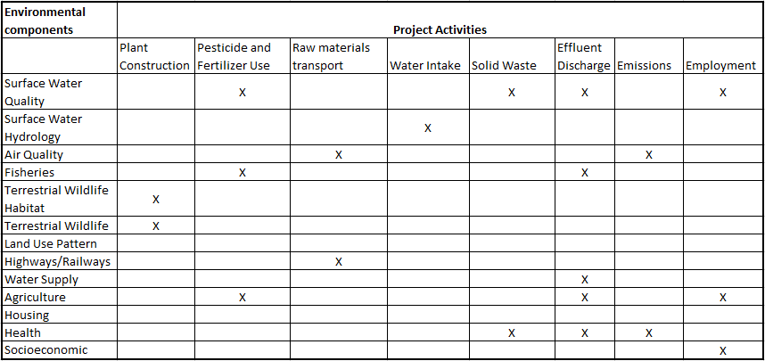

Slide 39
Networks/Flowcharts
Flowcharts and impacts trees, including network diagrams-
Enable the analysis of the inter-relationship between causes and effects
Enables the analysis of indirect and cumulative impacts.

Slide 40
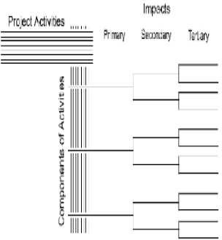
Networks
Network diagrams provide a means for displaying first, secondary, tertiary, and higher order impacts.
To develop a network, a series of questions related to each project activity (such as what are the primary impact areas, the primary impacts within these areas, the secondary impact areas, the secondary impacts within these areas, and so on) must be answered.

Slide 41
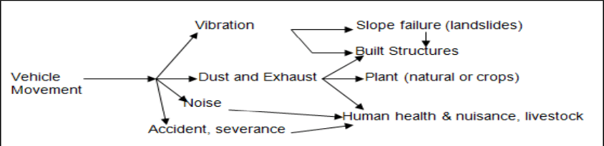

Slide 42
Networks/Flowcharts
What are the advantages and disadvantages of flowcharts method of EIA?
Advantages:
  integrated assessment, instead of discipline by discipline
  inter-relations between causes and effects, including indirect impacts
  cumulative impact assessment - communication (when simple).
Disadvantages:
  complexity (especially visually complex)
  difficult to distinguish and quantify magnitudes (and importance) of different impacts

Slide 43
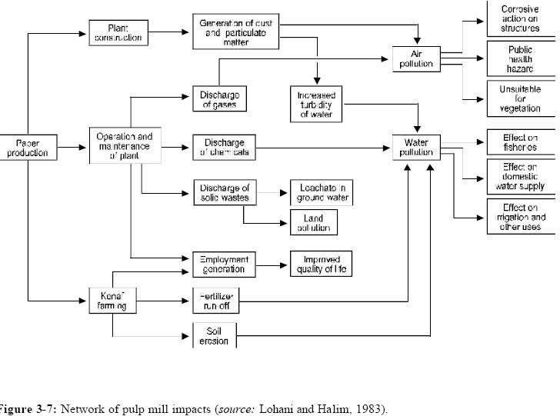

Slide 44
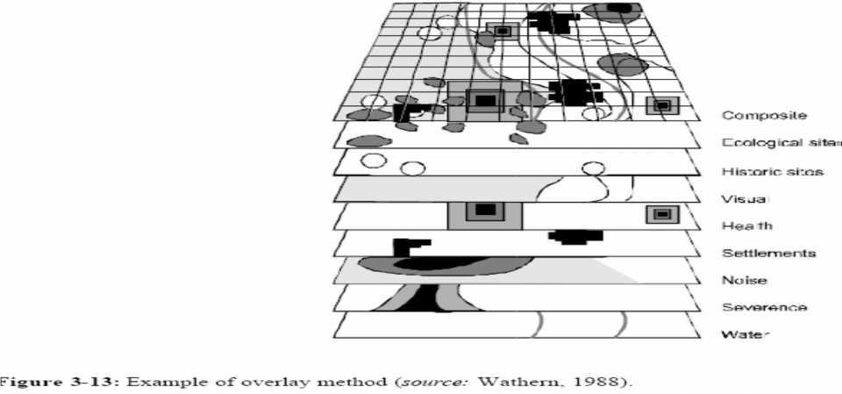
Overlays/GIS
Essentially, the overlay
method divides the study area into convenient
geographical units based on uniformly spaced grid points, topographic features,
or differing land uses. Field
surveys, topographical land inventory maps, aerial
photography, etc., are used to assemble information related to environmental and human factors within the geographical units. Factors are composed by assembling concerns that have a common basis, and regional maps are drawn for each factor. Through the use of overlays, land use possibilities and engineering feasibility are visually determined
(McHarg, 1968).

Slide 45
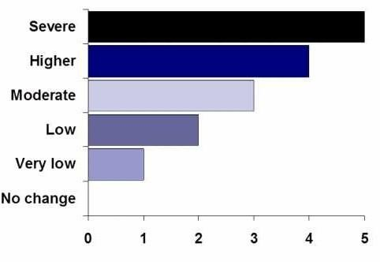
EES (Environmental Effect Study)
Changes of environmental parameters
  Severe (+5 or -5)
  Higher (+4 or -4)
  Moderate (+3 or -3)
– Low (+2 or -2)
  Very Low (+1 or -1)
  No change (0)

Slide 46
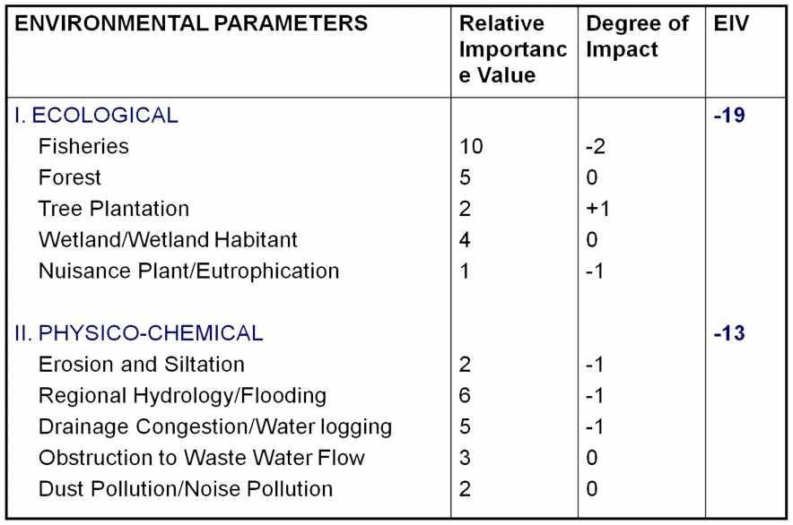
Impact Evaluation

Slide 47
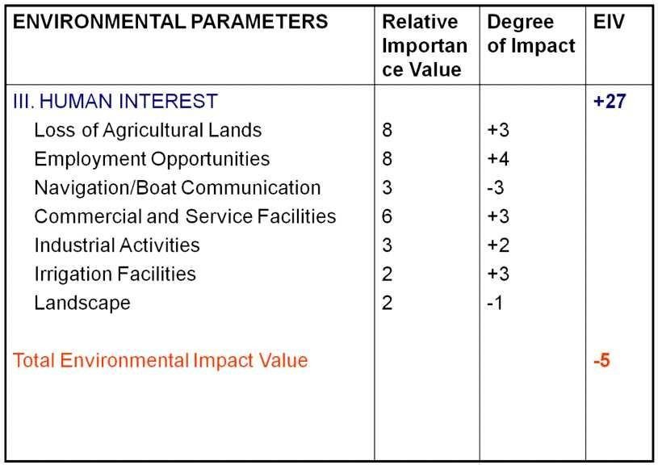
Impact Evaluation

