Slide 1

Industrial Sector in Bangladesh
Md. Fouad Hossain Sarker
Associate Professor & Head
Department of Development Studies
Daffodil International University

Slide 2
Objectives of this Class
Understanding of the concept and its root
Investigate the contribution of Industrial sector of Bangladesh.
Explore the common industrial scenario of BD.
Identify the weakness of the Industrial sectors of BD.
Suggest the measures to develop the Industrial sector of BD.

Slide 3
Concept of Industrialization
Industrialization is the process in which a society or country transforms itself from a primarily agricultural society into an industrial one based on the manufacturing of goods and services. Characteristics of industrialization include the use of technological innovation to solve problems as opposed to superstition or dependency upon conditions outside human control such as the weather, as well as more efficient division of labor and economic growth.
Industrialization is part of a process where people adopt easier and cheaper ways to make things. Using better technology, it becomes possible to produce more goods in a shorter amount of time.
Modernization and structural transformation of the economy and diversification of the economic base, increasing returns and economies of scale, technological progress and productivity increase, accelerated economic growth and employment creation, increase in incomes and standard of living of the people are the universally recognized dynamic benefits arising from industrial development. It was started from 1760.

Slide 4
Objectives of Industrialization
Macro objectives of industrialization are-
  Play a major role in economic development
  To increase GDP
  Provide a secure basis for a rapid of growth of income.
  Help in raising the standard of living
  Provide employment, meeting high income demands
  Brings in technological progress and change in the outlook of the people
  Decrease the dependency on foreign resources
Micro objectives of industrialization are-
To provide employment to working labor force
To supply consumer, capital and intermediary goods
To support agriculture and service sectors
To improve balance of payment positive by promoting export industry and import substitute industries

Slide 5
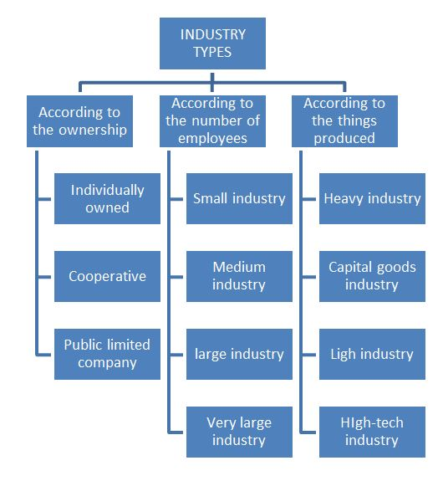
Classification of Industries in Bangladesh
Large Industry
Medium Industry
Small Industry
Micro Industry
Cottage Industry
Reserved Industry
Thrust Sector Industries
SME

Slide 6
Contribution of Industrial Sectors
Industrial Sector in GDP
Industrial Sector has given the opportunity of employment to millions of unemployed, especially innumerable uneducated women of the country. It is making significant contribution in the field of our export income.
The contribution of the industry sector to the economy of Bangladesh has been increasing day by day.
Contribution of Industrial sector in GDP is 24.21% (Fiscal ear 2019-2020)
Year | Contribution of Industrial sector in GDP (%)
1941-1950 | 4
1951-1960 | 5
1961-1970 | 10
1971-1980 | 11
1981-1990 | 12
1991-2000 | 15
2001-2011 | 30
2011-2012 | 31.26
Source: World Bank Report and
Ministry of Finance, Bangladesh

Slide 7
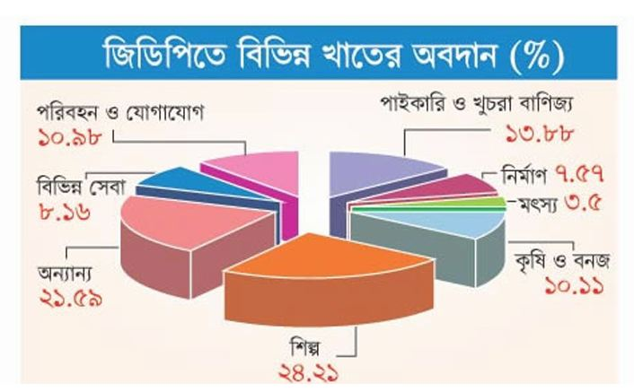
Fiscal Year-2019-20

Slide 8
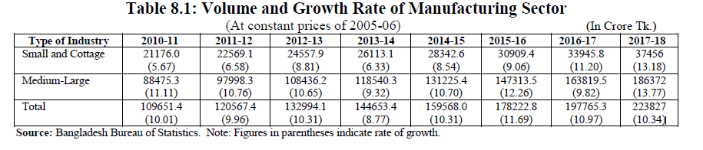
BER-2018, Chapter 8-Industry | 101

Slide 9
Common Industries in Bangladesh
Main Industrial Sectors:
RMG
ICT
Frozen Foods industry
Leather Industry
Jute Industry
Power sector
Pharmaceutical industry
Others:
Ceramics
Plastics
Ship building

Slide 10
RMG Industry
The industry employs 3.6 million workers dispersed among 5,400 factories. Currently the sector accounts for 78 percent of exports and contributes 16 percent to the gross domestic product (2013).
RMG export remains strong:
Readymade Garment (RMG) exports surged 14 percent to $24.49 (monthly export statistics, EPB) billion US dollar in 2013/14 fiscal year from a year earlier. But the total exports were 1 percent below the target of $30.5 billion, partly because of political violence leading up to an election in January that crippled the economy. Though the total export target was not met, garments still played the lead role in exports and retained a satisfactory growth.

Slide 11
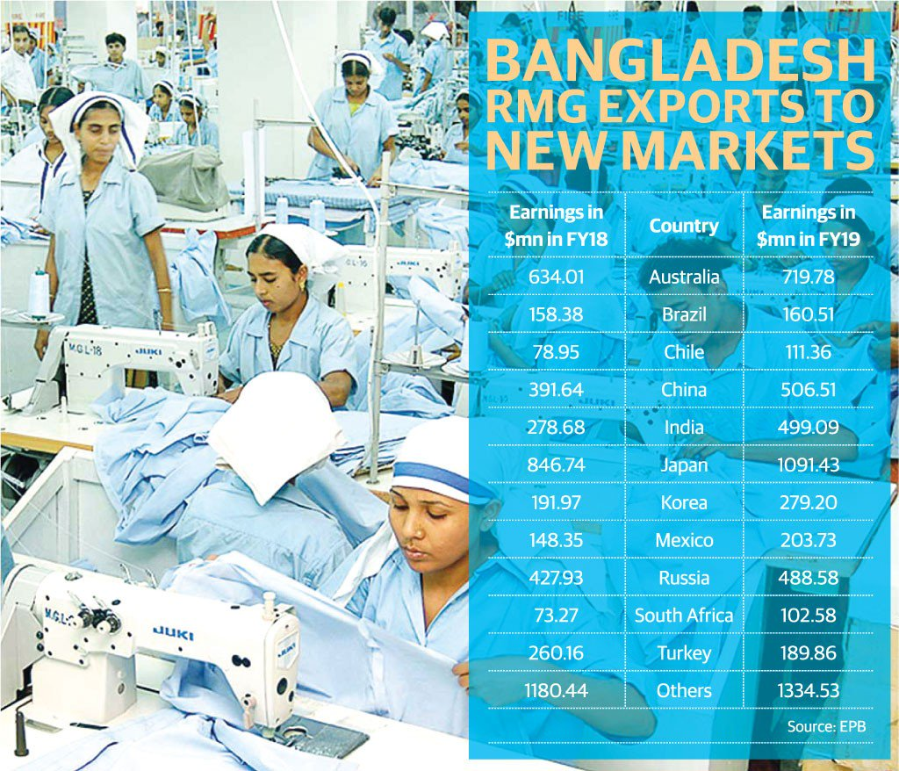
RMG Contribution in Export Arena-3

Slide 12
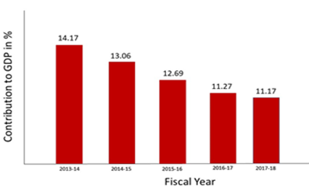
RMG Industry-1

Slide 13
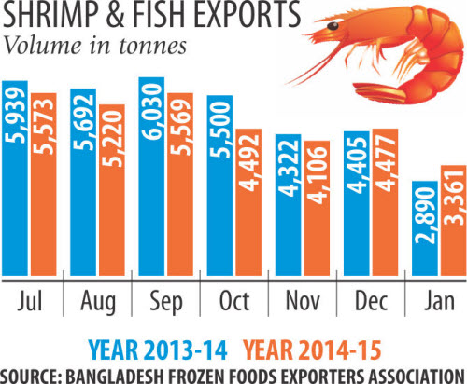
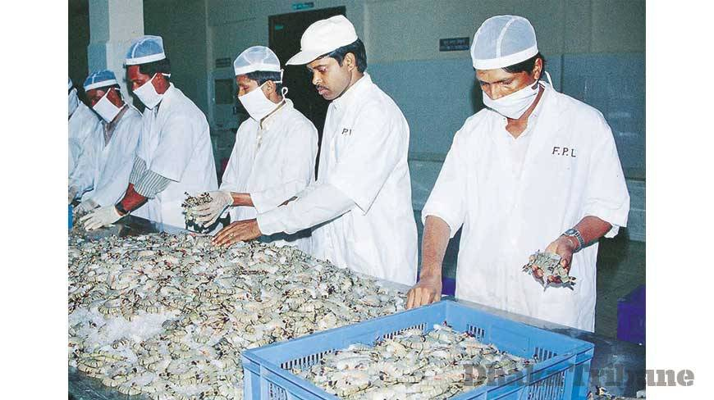
Frozen Foods Industry-1
Frozen foods is the second largest export sector of the economy. The massive natural resources available in Bangladesh make this sector particularly promising for investors looking to supply in international as well as in domestic markets.

Slide 14


Frozen Foods Industry-2
Following a period of strong investment in technology, processes and regulation the frozen foods sector has flourished and earned itself an excellent reputation with trading partners.
The demand for “ready to cook”
Frozen Foods: Frozen Ready to Cook Snacks, Frozen Ready to Cook Meat, Frozen Ready to Cook Vegetables, Frozen Ready to Cook Fishes

Slide 15
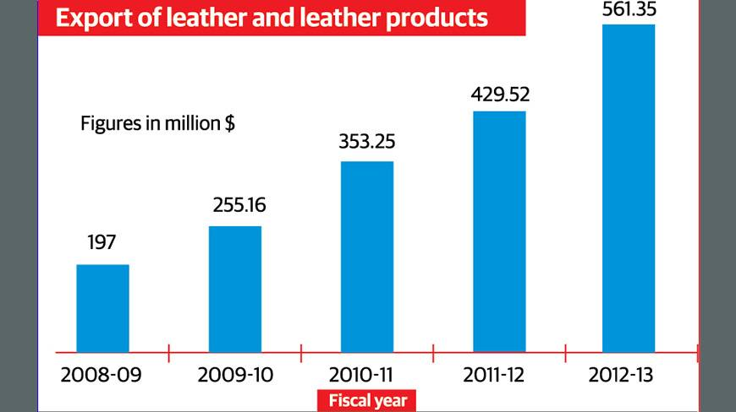
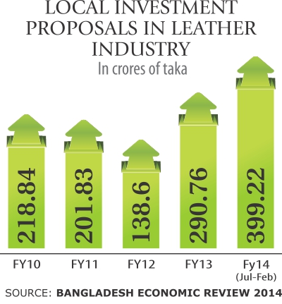
Leather Industry
Leather Industry developed in Bangladesh on a large-scale basis from the 1970s. About 95% of leather and leather products of Bangladesh are marketed abroad, mostly in the form of crushed leather, finished leather, leather garments, and footwear. Most leather and leather goods go to Germany, Italy, France, Netherlands, Spain, Russia, Brazil, Japan, China, Singapore and Taiwan
Bangladesh now exports leather, leather goods and footwear worth around $1 billion a year, which accounts for only 0.005 percent of the global market worth $230 billion, said Shaheen Ahmed, chairman of Bangladesh Tanners Association (BTA)

Slide 16
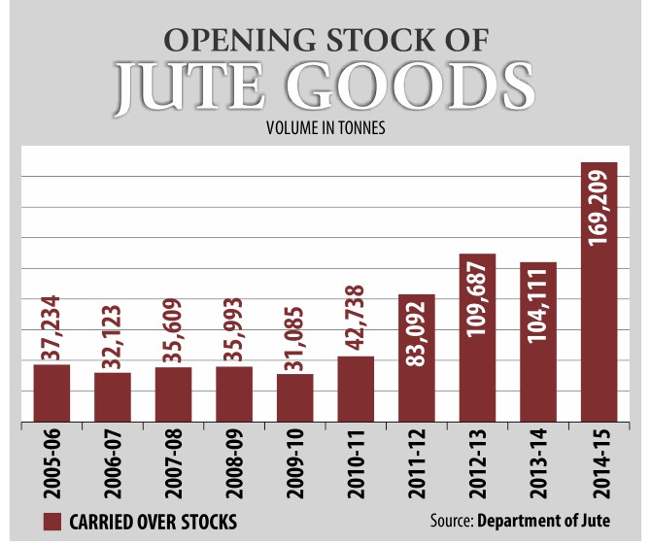
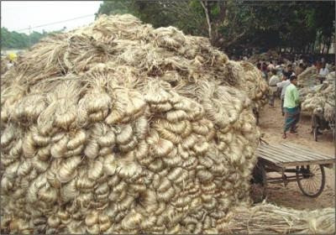
Jute Industry
Jute Industry played an important role in the economic development of Bengal. At the beginning of the twentieth century, Bengal could boast of only one manufacturing industry - jute.

Slide 17

Jute Industry
Bangladesh holds the 2nd position as a Jute producer in the world with the average production of Jute 1.08 m ton/Year.
About 40 million people are involved directly and indirectly in the jute industry.

Slide 18
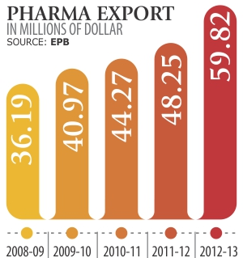
Pharmaceutical Industry
The pharmaceutical industry in Bangladesh is one of the most developed technology sectors within Bangladesh. Manufacturers produce insulin, hormones, and cancer drugs. This sector provides 97% of the total medicinal requirement of the local market. The industry also exports medicines to global markets, including Europe. Pharmaceutical companies are expanding their business with the aim to expand the export market.

Slide 19
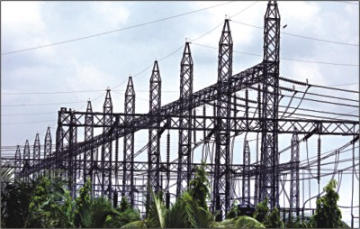
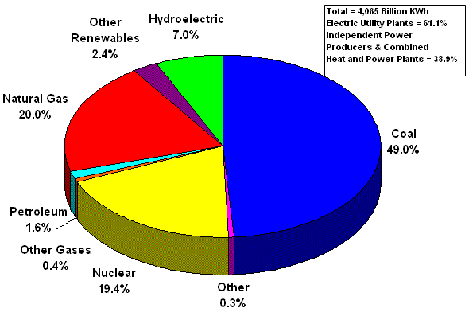
Power Sector
Bangladesh’s power sector is one of the fastest growing in South Asia. The growth in terms of capacity addition has been remarkable -- increasing from 5% to 28% from 2012 to 2018 according to the World Bank and the Bangladesh Power Development Board.
In June 2018 about 90 percent people of the country are covered by electricity facilities including renewable energy ( BER-2018)
https://www.dhakatribune.com/opinion/op-ed/2019/06/21/transforming-the-power-sector-of-bangladesh

Slide 20
ICT Industry
ICT is regarded as a thrust sector and the present government has pledged to build a digital Bangladesh within 2021. By 2030, ICT will be first exported field in global market. ICT ministry was established in 2011
No. of Registered Software & ITES Companies | 1000+
No. of BASIS Member Companies | 705 (February 2014)
Approx. Revenue of Local Industry (incl. Export) | US $ 400 million
Approx. Revenue from Software | Tk. 790 crore
Approx. Revenue from ITES | Tk. 1050 crore
Export (2012 -2013) | US $ 101.63 Million
No. of Exporting Companies | 160 +
No. of Export Destination Countries | 60+
Approx. No. of Human Resource Employed in the Industry | 70,000

Slide 21
Development of ICT Industry
First Computer: Bangladesh has about six decades of experience in using computers. In its early days, the ICT sector in Bangladesh was mainly focused on hardware operations. The first ‘second generation" mainframe computer was installed in 1964 at Dhaka University. Soon after this, several banks and industrial concerns started using computers, mainly for accounting.
First Computer Center: In 1982, a computer center was established at the Bangladesh University of Engineering and Technology. This center, later renamed the Department of Computer Science and Engineering, has played a pivotal role in Bangladeshi IT education since its inception.
The Innovation of Bangla Writing: The innovation of software concerning "Bangla writing" on computers materialized in 1987. Mainul Islam managed to write Bangla on an Apple Macintosh computer. With the ability to use Bangla on computers, the value of computers in offices quickly rose.
Introduction of the Internet: After the introduction of the internet in 1996, the development of exportable software and multimedia systems commenced.

Slide 22
Development of ICT Sector
Journey of BCS: The Bangladesh Computer Society (BCS), an association of the IT professionals, for instance, was formed in 1979. BCC, the Bangladesh Computer Council, is the consequence of the evolution of the National Computer Committee constituted in 1983.
Journey of many Organizations: In 1997 It is recognized that the ICT industry is a potential sector and it has an impact on the economy. After that in collaboration with industry associations (BCS, BCC, BASIS, and BACCO) and international trade support institutions the government has taken both short and long term measures to support and enhance the development of the domestic sector and increase the export of ICT products. BASIS, established in 1997, promotes the ICT sector through awareness building, practical education for new graduates and paid internships, and training programs for mid-career employees.
Connected with Submarine Cable: Bangladesh got connected with its first undersea cable, SEA-ME-WE 4, in 2006.

Slide 23

Development: ICT Policy 2009
In order to translate the vision for digital Bangladesh into a reality, it is necessary to have an appropriate ICT policy. ICT Policy 2009 has been framed to meet this need. The objectives, as set out in the policy to ensure the role of ICT in national development, are to:
    maintain social equity,
    increase productivity,
    ensure data integrity,
    assist education and research,
    generate employment,
    increase export,
    enhance the quality of health services,
    ensure access to information for all,
    protect the environment and strengthen disaster management,
    support expansion of ICT.

Slide 24
Development of ICT Sector
Software Park: Software Technology Park (STP) at Janata Tower was established in Dhaka in 2015.
High Tech Park: Bangladesh Hi-tech Park Authority is a government agency in Bangladesh dedicated to establish, manage and operate technology business parks throughout the country. Formed in 2010, BHTPA is now implementing the projects including the Kaliakoir Hi-Tech Park in Gazipur District and Jessore Software Technology Park. Planned projects include Mohakhali IT Village in Dhaka, Barendra Silicon City in Paba Upazila of Rajshahi District, and Sylhet Electronic City in Companiganj Upazila, Sylhet. BHTPA is also approving private hi-tech park to implemented by private companies. Thus far, 39 hi-tech parks have been under constructions and approved for construction by BHTPA in different regions in Bangladesh.
A2I Project: Aspire to Innovate (a2i) of the ICT Division supported by UNDP, a special program of the government’s Digital Bangladesh agenda, is a key driver of the nation’s goal of becoming a developed country by 2041 and in achieving the 2030 Sustainable Development Goals.

Slide 25
Telecommunication Industry
The total number of Mobile Phone subscribers has reached 161.772 Million at the end of June, 2019. The Mobile Phone subscribers are shown below:
OPERATOR | SUBSCRIBER (IN MILLIONS)
Grameen Phone Ltd. (GP) | 75.330
Robi Axiata Limited (Robi) | 47.939
Banglalink Digital Communications Limited | 34.667
Teletalk Bangladesh Ltd. (Teletalk) | 3.836
Total | 161.772
http://www.btrc.gov.bd/content/mobile-phone-subscribers-bangladesh-june-2019

Slide 26
Telecommunication Industry
The total number of Internet Subscribers has reached 96.199 Million at the end of June, 2019. The Internet subscribers are shown below:
OPERATOR | SUBSCRIBER (Million)
Mobile Internet | 90.409
WiMAX | 0.055
ISP + PSTN | 5.734
Total | 96.199
http://www.btrc.gov.bd/content/internet-subscribers-bangladesh-june-2019

Slide 27
Problems of Industrial Sector
High Competition and impact of free market economy
Malpractices in providing industrial loan
Highly dependency on jobs in place of entrepreneur mind
Lack of FDI and capital for investment and reinvestment mind
Workers do not receive their right benefits
Labor unrest due to some needs
Poor presence of labor rights advocacy
Instable political situation
High rate of corporate tax
Lack of raw materials in various industries

Slide 28
Problems of Industrial Sector
Uncertainly of power and fuels
Lack of well trained up manpower
Lack of technological knowledge and skills
Lack of disruptive thinking
Red tapism (Bureaucrative behavior)
Absences of compliances
Inadequate port facilities
Withdrawn quota advantage
Lack of research and innovation
Imbalance trade and business

Slide 29
Thing to do for development
Role of policy-makers
Capacity-building of the workforce
Imparting training to make skilled workers.
Reducing of VAT and taxes.
Stabling the Political Situation.
Private sectors development
Developing ICT Capacity.
Reducing High Rate of Corporate Tax.
ICT access opportunity for the citizen
Reducing tax on technologies, hand sets and other equipments related to the telecommunication
Conducting more research works for developing telecom sector
Use of cost reduction strategy of internet

Slide 30
Thing to do for development
Removals of export problems etc.
Removing infrastructural bottlenecks
Building additional supply capacity,
Use of cost reduction strategy, and
Increase in value-addition through backward integration
Production of sufficient raw materials in the country.
Assurance of safety, salary and other facilities of the workers
More advanced of EPZ
Technology and efficiency
Friendship to all, business to all…………………………..

Slide 31
References
Information Technology in Bangladesh, Sustainable Development Networking Programme By Dr. Jamilur Reza Choudhury, 2013.
Bangladesh Computer Council By Mahbubul Alam, 2013.
Information technology to contribute 7.28 percent to GDP by 2021, in Bangladesh Sangbad Sangstha. 20 July 2013.
The Bangladesh Telecoms Sector: Challenges And Opportunities By Ifty Islam, Asian Tiger Capital Partners.
Problems and Prospects of Telecommunication Sector of Bangladesh: A Critical Review By Ms. Farhana Zamil and Md. Miraj Hossen
Banglapedia, The National Encyclopedia of Bangladesh

