Slide 1
Today’s Topic: spoilage of Storage foods

Slide 2
Concept on Food spoilage
Food spoilage is defined as damage or injury to food rendering in unsuitable for human consumption.
Food spoilage means the original nutritional value, texture, flavor of the food are damaged, the food become harmful to people and unsuitable to eat.
Food must be considered spoiled if it is contaminated with pathogenic microorganisms or various poisonous agents, such as pesticides, heavy metals etc.
Spoiled food considered unsafe ---- food borne pathogen may be present
Any changes in the visual ,smell and texture of food that makes it unacceptable for consumption.

Slide 3
Causes of food spoilage
The major causes of food spoilage include
Growth and activity of Microorganisms
Action of native enzymes
Chemical reactions of the constituents of food
Vermin
Mechanical damage and
Storage conditions

Slide 4
Causes of food spoilage(Cont.)
Growth and activity of microorganisms
Bacteria, yeasts and molds are microorganisms that cause food spoilage. They produce various enzymes that decompose the various constituents of food.
Bacteria, yeasts and molds.

Slide 6
Mold
Bacteria
Yeast

Slide 7
Causes of food spoilage(Cont.)
Growth and activity of microorganisms
Bacteria: Bacteria (singular bacterium) are prokaryotic microscopic organism that lacks a nuclear membrane around their single circular chromosome. Reproduction is done by simple fission.
Mold: Mold is the multicellular filamentous fungi whose growth on foods usually is recognized by its fuzzy or cottony appearance. Reproduction is done by asexual & sexual reproduction.
Yeast: A microscopic fungus consisting of single oval cells that reproduce by budding, and capable of converting sugar into alcohol and carbon dioxide.

Slide 8
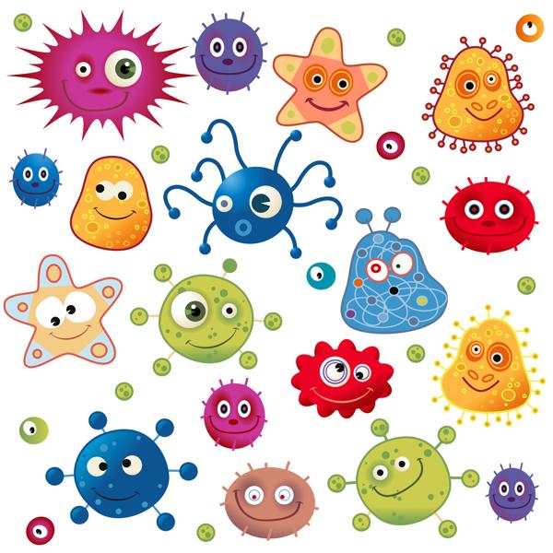
Tips:
Half a million microbes can dwell in 1 sq. inch of your skin.
Pathogenic bacteria cause diseases, but it is surprising that almost 99% bacteria are helpful ones.
Of the total bacteria in our bodies, a healthy balance is 85% good bacteria and 15% bad bacteria.
Remarkably, scientists estimate that only 1-10% of total bacteria have even been discovered.

Slide 9
Examples of each group microorganism
Bacteria | Mold | Yeast
Escherichia coli | Penicillium roqueforti | Saccharomyces cerevisiae
Lactobacillus acidophilus | Aspergillus oryzae, | Cryptococcus neoformans
Lactobacillus bulgaricus | Rhizopus oryzae | Saccharomyces pastorianus
Lactobacillus fermentum | Penicillium chrysogenum | Candida stellata
Clostridium botulinum | Penicillium notatum | Candida albicans

Slide 10
(b). Enzyme activity:
Causes of food spoilage(Cont.)
Action of enzymes found inherently in plant or animal tissues start the decomposition of various food components after death of plant or animal.
Browning:
When you cut or bruise food such as apple or yam, the exposed surface will discolor and turn brownish due to the activity of enzymes (phenolase, peroxidase and polyphenol oxidase).
Ripening:
Enzymes are involved in the process that causes ripening in certain foods such as fruits and vegetables. For example, unripe bananas contain starch which is gradually converted to sugars.

Slide 11
(c). Chemical reactions:
Causes of food spoilage(Cont.)
These are reactions that are not catalysed by enzymes.,e.g. oxidation of fat.
The qualities of foods deteriorate due to chemical reactions of the constituents of food.
The unsaturated fatty acid components undergo oxidation due to exposure to atmospheric air.(Rancidity)
Free fatty acids released due to hydrolytic reactions causing odor as well as undesirable changes in the texture of food.
Chemical reactions also include losses of vitamins due to oxidation or light.
Chemical reactions can be prevented by using antioxidants and proper packaging.

Slide 12
(d). Vermin:
Causes of food spoilage(Cont.)
Vermin includes ants, rats, cockroaches, mice, birds, larval stages of some insects.
Vermins are particularly destructive to fruits and vegetables.
The loss of food due to vermins varies from 5 to 30% depending upon the care taken during storage.
Insects cause greater damage by brusing and cutting, thus exposing them to microbial atatck.
On the otherhand, rodent consuming considerable quantity of food also contaminate the food through their droppings, urine and filth. Rodents are also carries of pathogenic bacteria.
Insect infestations in grains, dry fruits, spices are generally controlled by fumigation with methyl bromide, ethylene oxide or propylene oxide.

Slide 13
(e)Mechanical damage
Causes of food spoilage(Cont.)
Mechanical damage of fruits and vegetables may be resulted during harvesting.
Mechanical damage also caused during post harvest handling, mainly transportation.
Proper packaging and post-harvest handling with care are recommended to reduce post-harvest loss due to mechanical damage.

Slide 14
(f) Storage conditions
Causes of food spoilage(Cont.)
Temperature
Temperature of storage chamber plays important role in deteriorating quality of foods. The rate of a chemical reaction doubles for every 10ºC rise in temperature.
Mesophilic microbes that grow at optimal temperatures in the range 20ºC to 40ºC.
Thermophilic microbes that have a minimum temperature of growth at or above 20 degrees C and a maximum temperature of growth extending up to 60 to 62 degrees C
Psychrophilic microbes that can grow at or below 0 °C.

Slide 15
Causes of food spoilage(Cont.)
Oxygen
Atmospheric oxygen has detrimental effects on vitamin A, C, food color, flavor and other constituents.
Foods store best when oxygen free. Removing oxygen will prevent oxidation of compounds in foods. Ways to remove oxygen:
Displacing oxygen
-Purge air from product with an inert gas(nitrogen).
-Dry ice is often used giving off carbon dioxide gas which displaces oxygen.
Oxygen absorber – Air contains about 78% nitrogen and 21% oxygen, leaving about 1% for the other gasses. If the oxygen is absorbed, what remains is 99% pure nitrogen in a partial vacuum.

Slide 16
Causes of food spoilage(Cont.)
Light
Light destroys riboflavin, vitamin A, Vitamin C and also promotes light induced oxidation reactions affecting flavor and color of food
Duration
Deterioration of food is time-dependent. The longer the storage time the greater the deterioration

Slide 18
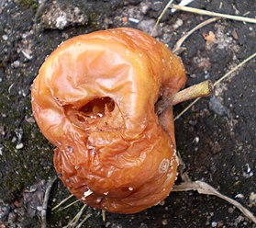
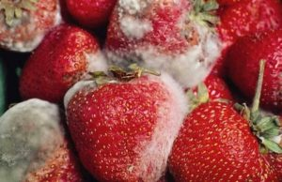
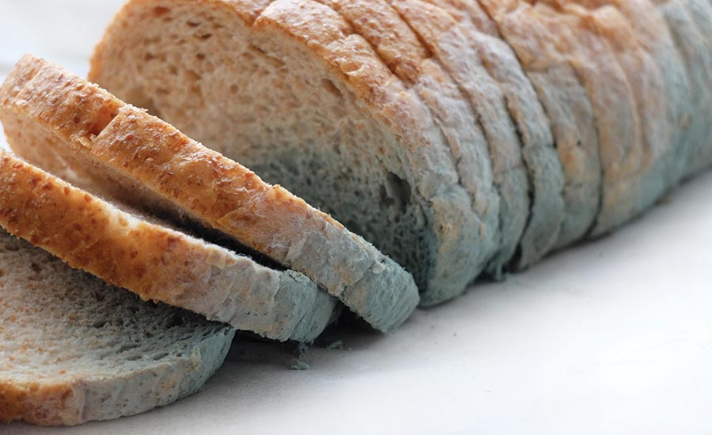
When food spoils, the following may change:
appearance
taste
texture
odour
Food may become unsafe to eat.

Slide 19
when a food “looks bad,” what is this referring to?
1. Appearance
Microbial growth
mycelia or colonies visible on surface (vegetative part of a fungus/fungus-like bacterial colony)
development of cloudiness in liquids
Changes in food color due to heme or chlorophyll breakdown
2. Textural changes
Slime formation
due primarily to surface accumulation of microbial cells
also be a manifestation of tissue degradation
Tissue softening due to enzymatic degradation (e.g. soft rot in veggies)
3. Changes in taste and odor
Development of:
nitrogenous compounds (ammonia, amines, etc.)
sulfides
organic acids

Slide 20
Do you know which is responsible for meat color?
Hemoglobin
(Not)
Correct Answer:
Myoglobin

Slide 21
Information for Previous Slide.
Heme (from the Greek for blood) is the basic chemical structure (Fig. 1) responsible for the red color of two important animal pigments:
hemoglobin, the red pigment of blood, and myoglobin, the red pigment of muscles.
Practically all the red color of red meat is due to myoglobin,
since the hemoglobin is removed with the bleeding of the slaughtered animal.
Other colored muscle compounds (cytochromes, vitamin B ₁₂, flavoproteins) do not contribute significantly to the color of red meat.

Slide 22
Intrinsic Factors :
These are inherent in the food. They include:
Hydrogen ion concentration (pH)
water activity
Nutrient content
antimicrobial substances
Biological structure

Slide 23
Hydrogen ion concentration (PH)
• Most bacteria grow best at neutral or weakly alkaline pH usually between 6.8 and 7.5.
• Some bacteria can grow within a narrow pH range of 4.5 and 9.0, e.g. salmonella
• Other microorganisms especially yeasts and molds and some bacteria grow within a wide pH range, e.g. molds grow between 1.5 to 11.0, while yeasts grow between 1.5 and 8.5.
Microorganisms that are able to grow in acid environment are called acidophilic microorganisms.
• These microorganisms are able to grow at pH of around 2.0.
• Yeasts and molds grow under acid conditions.
• Other microorganisms such as vibrio cholerae are sensitive to acids and prefer alkaline conditions.
• Most bacteria are killed in strong acid or strong alkaline environment except Mycobacteria.

Slide 24
Classify Food On the basis of pH

Slide 26
Water activity
The effect of moisture is in terms of water activity:
the amount of free water in a food medium.
The amount of free water is important for growth of microorganisms.
If there is lack of this free water microorganisms will not grow.
Water activity is defined as the vapor pressure of water in food substance to vapor pressure of pure water at the same temperature. (Aw = Vp of Water in Food/Vp of Pure Water)
The water activity is therefore equal to 1.0.
Food products have a water activity of less than 1.0.
A saturated salt solution has a water activity of 0.75.
Salting and drying reduces the water activity of a food product.

Slide 27
Classify Microorganism On the basis of Water Activity Level

Slide 28
Water activity

Slide 30
Nutrients content of the food
Microorganisms require proteins, carbohydrates, lipids, water, energy, nitrogen, Sulphur, phosphorus, vitamins, and minerals for growth.
Various foods have specific nutrients that help in microbial growth.
Foods such as milk, meat and eggs contain a number of nutrients that are required by microorganisms.
These foods are hence susceptible to microbial spoilage.

Slide 31
Antimicrobial substances and Biological structure
Antimicrobial substances
• Antimicrobial substances in food inhibit microbial growth.
• Various foods have inherent antimicrobial substances that prevent (inhibit) microbial attack.
• Such inhibitors are like lactinin and anti- coliform factors in milk and lysozyme in eggs.
Biological structures
• Some foods have biological structures that prevent microbial entry.
• For example, meat has fascia, skin and other membranes that prevent microbial entry.
• Eggs have shell and inner membranes that prevent yolk and egg white from infection.

Slide 33
Antimicrobial substances
Coumarins – fruits and vegetables
lysozyme – cow’s milk and eggs
Aldehydic and phenolic compounds – herbs and spices
Allicin – garlic
Polyphenols – green and black teas

Slide 34
Extrinsic factors
Extrinsic factors : Are factors external to the food that affect microbial growth. They include:
1. Temperature of storage,
2. Presence and concentration of gases in the environment
3. Relative humidity of food storage environment
Temperature
• The growth of microorganisms is affected by the environmental temperatures.
• Various microorganisms are able to grow at certain temperatures and not others.
• Bacteria can therefore be divided into the following groups depending upon their optimum temperature of growth.

Slide 35
Classification of M.O on the Basis of Temperature
.
(i) Psychrophilic microorganisms :
• These grow best at about 20o C but also down to -10o C in unfrozen media.
Psychrophilic bacteria can cause food spoilage at low temperatures.
• Several of the microorganisms found in the soil and water belong to this group.
(ii) Mesophilic bacteria:
• These organisms grow between 25o C and 40o C, with an optimum growth temperature close to 37o C
• Some such as Pseudomonas aeroginosa may grow at even lower temperatures between 5- 43o C
• None of the mesophilic bacteria are able to grow below 5o C or above 45o C.
• Most pathogenic bacteria belong to this group.
(iii) Thermophilic bacteria:
• These grow at temperatures above 45o C. Often their optimum growth temperatures is between 50o C and 70o C.
• Growth of some bacteria occur at 80o C.
• Bacteria in this group are mainly spore formers and are of importance in the food industry especially in processed foods.

Slide 36
Note that:
The effect of temperature on microbial growth also depends upon other environmental conditions such as:
o Growth factors in the nutrient medium,
o pH of the food, and
o Water activity

Slide 37
Extrinsic factors
2.Concentration of gases in the environment
• This relates to the presence and concentration of gases in the food environment.
• Various microorganisms require for growth, either
high oxygen tension (aerobic),
low oxygen tension(micro aerobic) or
absence of oxygen (anaerobic).
• Some microorganisms may grow either in high oxygen tension, or in the absence of oxygen (facultative anaerobes).
Foods affected by various groups
• Anaerobic or facultative anaerobic spore formers are most likely to grow in canned foods .
• Micro aerophilic bacteria are most likely to grow in vacuum packed foods since they have low oxygen tension, while
• Aerobic bacteria are likely to grow on the surface of raw meat.
• Aerobic molds will grow in insufficiently dried or salted products.

Slide 38
Extrinsic factors
3. Relative humidity
• Relative humidity is the amount of moisture in the atmosphere or food environment.
• Foods with low water activity placed at high humidity environment take up water, increase their water activity and get spoiled easily.
• For example, dry grains stored in a environment with high humidity will take up water and undergo mold spoilage.

Slide 39
Prevention of Spoilage
Store food in the right place
Check labels for where they should be stored.
Check date marks on food labels.
Do not leave foods out – they could get warm or be contaminated with microbes from an insect or pest.
Prepare and cook food hygienically
Get ready to cook – hands, aprons …
Prepare raw foods away from cooked foods – do not mix up.
Cook foods thoroughly, e.g. no raw areas in roast chicken.
Clean up and be tidy all the time

Slide 40
Question??

Slide 41
Additional Information
A xerophile (from Greek xēros, meaning 'dry', and philos, meaning 'loving')^{[1]} is an extremophilic organism that can grow and reproduce in conditions with a low availability of water, also known as water activity.
Osmophilic organisms are microorganisms adapted to environments with high osmotic pressures, such as high sugar concentrations.
Halophilic (salt-loving) organisms
Facultative Anaerobe Definition
A facultative anaerobe is an organism which can survive in the presence of oxygen, can use oxygen in aerobic respiration, but can also survive without oxygen via fermentation or anaerobic respiration.

Slide 42
N
K
T
H
A
S

Slide 43
Why aren't bacteria called parasites?
Why aren't bacteria, viruses and fungi called parasites?

Slide 44
Bacteria cannot be called parasites. Why?
Microorganisms are present in food, water, and air. They can also travel from one person to another. They cannot be called parasites in human body because the human body functions well with their help. There are both helpful and harmful types of bacteria.

Slide 45
Why aren't bacteria, viruses and fungi called parasites even though they have to depend on their hosts for survival?
A parasite is an organism that lives on or in an organism and derives nutrition at the host's expense. Most bacteria and fungi don't require a live host nor do they necessarily receive their nutrition at the expense of the host. Most bacteria of the gut are commensal (gaining a benefit, but causing no harm) or symbiotic (benefiting themselves and their host). Viruses do not have their own metabolism. They don't have nutritional requirements, and some don't cause harm to the host cell.
Depending on the biologist, whether or not a virus is itself a living thing is also open to debate (sort of like asking if a wrench is a machine).

