Slide 1
DESIGN AND CONSIDERATION FOR FOOD AID STORAGE:
Humyra Nowshin
Lecturer
Dept. of Nutrition & Food Engineering
Daffodil International University

Slide 2
FOOD AID STORAGE
The main function of most food aid stores is to provide transit facilities.
The storage period frequently cannot be determined in advance, but is usually less than 12 months and frequently less than 3 months.

Slide 3
FUNCTIONS OF FOOD AID STORES
o Security from theft
protection of stocks from rain, flash floods, rising damp, solar heating and pests,
especially rodents and birds
easy intake and dispatch of goods, including good access to the store
good in-store handling arrangements and access to all stocks for inspection,
physical stock-taking and insect pest control where necessary
easy maintenance of the store structure

Slide 4


CONSIDERATION

Slide 5
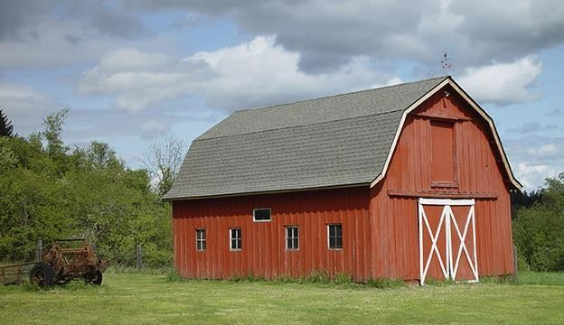

WHICH THINGS SHOULD YOU CONSIDER?
Security
Site
Roof
Floor
Walls
Hygiene

Slide 6
SURVEY OF STORES
A survey of all existing available stores should be carried out before an informed decision can be made on warehousing/food aid storage.
It will also help identify and quantify stores that can be used during emergencies, and possibly clarify additional warehousing requirements.

Slide 7
THE SURVEY SHOULD INCLUDE INFORMATION ON:
location of the storage facility
number of stores and their dimensions
capacities, both nominal and actual
construction materials
state of repair
road access

Slide 8
THE SURVEY SHOULD INCLUDE INFORMATION ON: (CONT.)
time and distance for delivery from a supply centre
sustainability for routine or emergency food storage
ownership
source of data
additional comments.
This information can be obtained from local records,
  surveys by field staff and
  data from government, non-governmental organizations
  and the private sector.
  The information should be stored on a computer database to facilitate updating.

Slide 9
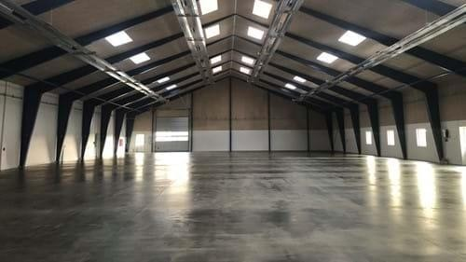
EXISTING BUILDINGS
Security Site Roof Floor Walls Hygiene

Slide 10
Security
The buildings must be secure against theft, with strong locks on all doors and all other openings secure.
In some situations, guards must be employed and a security fence with
adequate lighting may be needed around the site.
Site
The area should be assessed for any risk of contamination from industrial pollution and rodent infestation.
There should be no large trees near the store and the vegetation should be cleared.
The site should be free from risk of flooding and drainage should be adequate.
It should have good access by rail, road or water to facilitate intake and distribution of foodstuffs.

Slide 11
3) Roof
The roof should be inspected for leaks. This is most easily achieved during or just after rain.
Corrugated galvanized roof sheets, if holed, should be replaced or mended with bituminous adhesive and hessian patches.
A tar-soaked tarpaulin will serve as a temporary patch.
A good roof is essential for food aid storage.
4) Floors
Concrete floors are preferable, but an earth or sand floor will suffice in emergencies.
If there are rodent entry points the floor should be covered with 100 mm of concrete.
Dunnage (Wooden plates) must be used on floors where ground moisture can penetrate

Slide 12
Walls
These should be rodent-proof, with all known entry points well sealed.
Any windows should be covered with at least 12-mm thick wooden planks or welded metal for security.
Hygiene
There will need to be sanitary facilities for staff, and provisions for the disposal of waste materials from the store.
Existing buildings should be thoroughly cleaned before use as food stores;
dirty buildings need only be rejected if they cannot be cleaned.
In field situations, buildings that are far from ideal for food aid storage may have to be accepted, but any building that cannot be made secure, that is poorly sited or has a badly leaking roof which cannot be repaired, should be rejected.

Slide 13
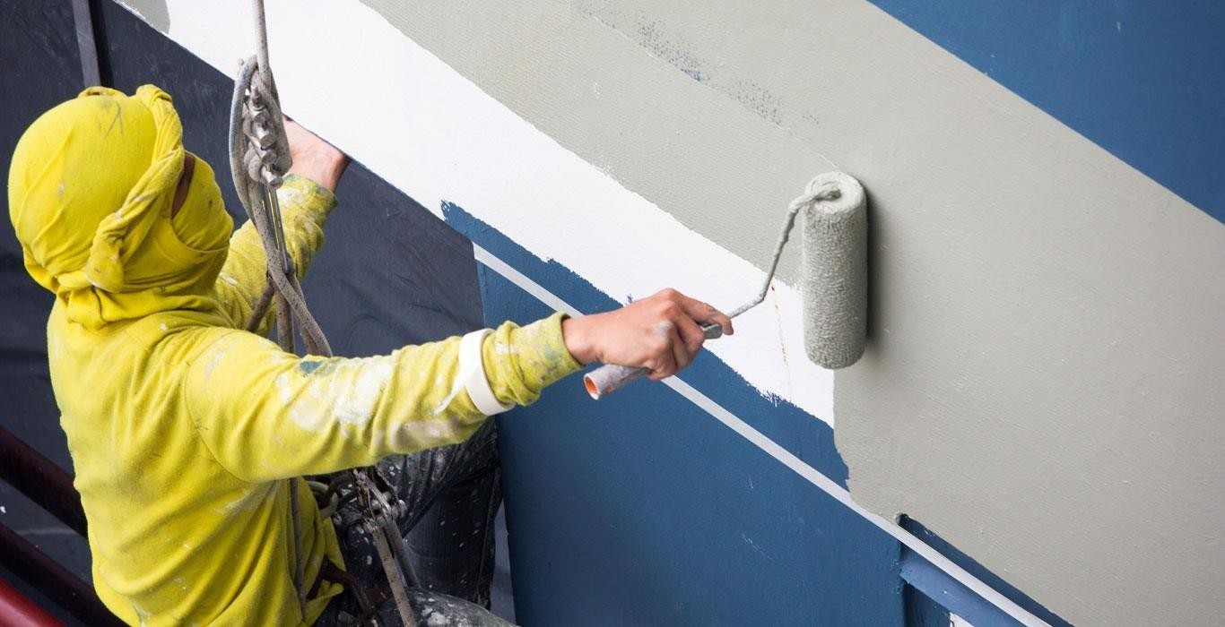
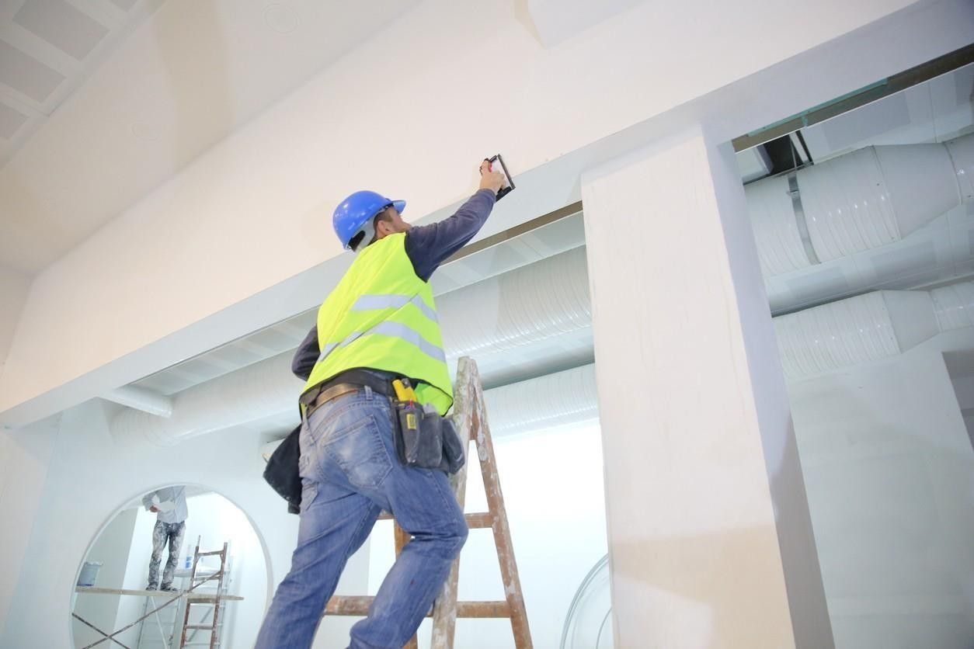
MODIFICATION TO EXISTING BUILDINGS

Slide 14
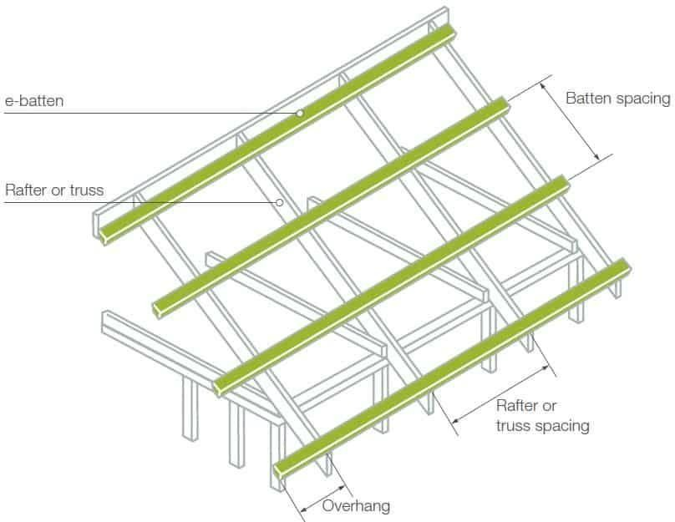

Slide 15
MODIFICATION TO EXISTING BUILDINGS
Professional guidance is needed before specifications can be prepared, materials quantified and budgets drawn up. Where such assistance is not available, the following notes may be helpful.
Re-roofing
Tile roofs should be replaced if the battens supporting the tiles have decayed or if the nails or pegs that hold them in position have rusted or rotted away.
The whole roof covering should be stripped, battens replaced and re- nailed, and the tiles relaid.
The possibilities for replacement by sheeting with galvanized steel or aluminium alloy should be considered.
There is no need to renew battens when replacing tiles with sheeting, but additional purlins on top of the rafters will be needed for firm anchorage of the sheeting.

Slide 16
MODIFICATION TO EXISTING BUILDINGS
Re-flooring
Whenever possible, decayed wooden floors should be replaced with concrete floors; preferably with a damp-proof course, although in very dry situations this may be an unnecessary complication.
Doors
Badly worn hinged doors are best replaced by metal sliding doors, hung from the top, installed to run outside the building.

Slide 17
MODIFICATION TO EXISTING BUILDINGS
Ventilation
If increased ventilation is needed, the simplest method of achieving this in a single storey framed building is by installing (or enlarging) eaves ventilation.
In each bay, the top 0.6 m of cladding can be removed if there is sufficient roof
overhang to prevent the entry of wind-blown rain.
Welded steel mesh should be installed in the space for security, and wire netting fitted to prevent entry of birds. In some climates it might be desirable to control this ventilation with adjustable covers.
Security
The most likely alteration or improvement for an existing building is the erection of a security fence.
The fence should be at least 3 m high, constructed of chain-link fencing on steel posts. The fence should be clear of all buildings by 3 m and should be well illuminated at night.

Slide 18
MODIFICATION TO EXISTING BUILDINGS
Management
Old buildings often need more careful management than new buildings.
It is very important that at least one trained person is clearly responsible for the store.
Single-storey buildings are usually the easiest to manage, but multi-storey buildings should not necessarily be ruled out.
Schools, prisons and offices have all been used successfully as food aid
stores in the past.
However, long-term successful storage depends on both suitable structures and good management.
Good quality drainage must be available.

Slide 19
SITE SELECTION:
The soil load-bearing capacity is all-important. Weak soils can substantially increase building costs. Some soils, such as black cotton soils, should be avoided if possible.
Excessively wet areas, and dry areas that suffer from flash floods, are also difficult sites. Areas that remain dry all year are preferable.
The long axis of stores should be oriented at right angles to the prevailing wind, with the principal doors located on the long sides.
This is expensive, and requires one or more drainage channels to be made across the slopes uphill from the store, to lead drainage water around and away from the environs of the store without causing soil erosion.
Drains that cross the building site need to be sunk deep, covered with 150 mm of concrete all round the pipe, and the trench filled with hardcore.
Store floors need to be above ground level, with surrounding ground and road surfaces sloping away from the walls and doors.

Slide 20
SITE SELECTION:
Access by vehicles both to the site, and around the store to doors or ramps, is important and needs to be carefully considered in relation to the site. Local authorities may have planning requirements for roadways or recommendations on their construction. Widths of roadways suitable for today’s trucks may be inadequate for the large trucks of the future (think 5–10 years ahead). Road turning circles and concrete aprons in front of doors need to be generously proportioned. The installation of a weighbridge to avoid delays in loading and unloading will be needed at large installations.
A well ventilated store for pest control chemicals and a separate store for other equipment are advisable. These are best sited where they will not obstruct traffic and movement around the store.
Water, electricity, sewage disposal and general drainage may influence the choice of site. Any future expansion or development of the site should also be considered, and there should be adequate space for this. The building layout should be planned so that it can be efficiently incorporated into any expansion.

Slide 21
SPECIFICATIONS: DIMENSIONS OF BASIC STORE BUILDING
When first inviting manufacturers to tender for the design, fabrication and supply of
the structure, they should be asked to state if minor modifications to
dimensions
would result in significant cost savings.
Typical dimensions for a 1000 tons capacity
store are:
  Span: 19 m
  Length: 28 m; five bays each 5.6 m long
  Height: 5.5 m from floor level to eaves
  Roof pitch: 17–20° (approximately)
Eaves overhang: 1 m along length, except over door where overhang is 3
m
Roof overhang: 1 m at gables.

Slide 22
THANK YOU

