Slide 1
Air property or PSYCHROMETRY
HUMYRA NOWSHIN
Lecturer
Department of Nutrition and Food Engineering
Daffodil International University

Slide 2
OJECTIVE OF LECTURE
To Understand Psychrometric Properties.
To Understand Psychrometry Chart.
To Understand Psychrometry Processes.
To Understand Working Principle Of Airwasher

Slide 3
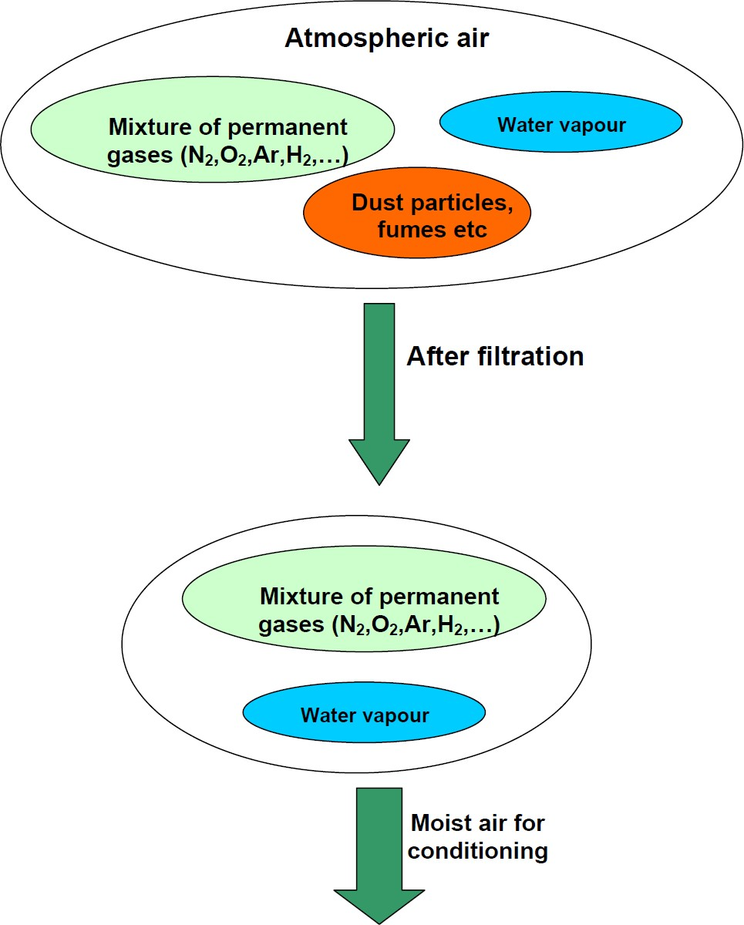
Atmosphere

Slide 4
What is Psychrometry
Psychrometry is the study of the properties of mixtures of dry air and water vapor
Example: how wet is the air ?
Why study psychrometry?
To be able to analyze various processes involving moist air.
Example: if the air is warm and wet, what will be the air-conditioning design required

Slide 5
Important Psychrometric Properties
Dry Bulb Temperature (ºF or ºC)
Wet Bulb Temperature (ºF or ºC)
Humidity ratio (g / kg or Grains / lb)
Relative humidity (%)
Dew-point Temperature (ºF or ºC)
Specific volume (m³/kg, Cu. Ft/lb)
Enthalpy (KJ/Kg or Btu/lb)

Slide 6
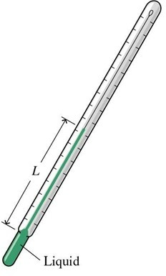

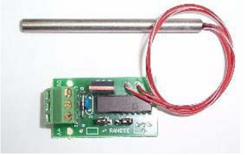
Dry Bulb Temperature (DBT)
⬥ Dry bulb temperature (DBT) is the temperature of the moist air as measured by a standard thermometer or other temperature measuring instruments

Slide 7
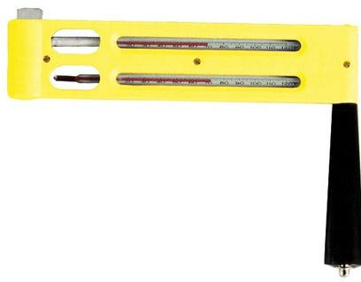
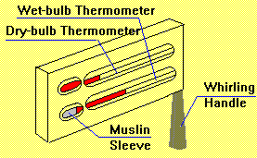
Wet Bulb Temperature
⬥ Wet bulb temperature is the lowest temperature that can be reached by the evaporation of water only. It is the temperature one feels when one's skin is wet and is exposed to moving air.
The device has 2 thermometers.
One with a cotton wick saturated with water.

Slide 8
Absolute humidity
The mass of water vapor per unit volume of air containing the water vapor. This quantity is also known as the water vapor density.

Slide 9
Humidity Ratio / Specific Humidity
⬥ The humidity ratio (or specific humidity) W is the mass of water associated with each kilogram of dry air. Assuming both water vapour and dry air to be perfect gases, the humidity ratio is given by:
m_{v} – Mass of vapour
ω = ^{mv}
m
m – Mass of dry air
a
a
Units – g / kg or Grains / lb

Slide 10
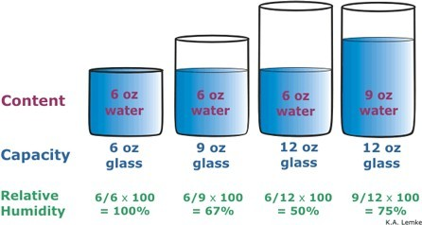
Relative Humidity
⬥ The amount of moisture that air holds (m_{v}) relative to the maximum amount of moisture the air can hold (m_{s}) at the same temperature.
Relative humidity is normally expressed as a percentage. When Φ is 100 percent, the air is saturated.
φ = ^{mv}
m_{s}

Slide 11
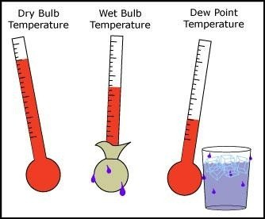
Dew-Point Temperature
The temperature of saturated moist air at the same pressure and humidity ratio of a given air mixture.
This is the temperature at which condensation begins when the air is cooled at constant pressure
Example

Slide 12

Specific Volume
The specific volume is defined as the number of cubic meters of moist air per kilogram of dry air.
Unit – m³/kg of dry air
Used to calculate mass flow rate of air

Slide 13
Enthalpy
The enthalpy of moist air is the sum of the enthalpy of the dry air (Sensible heat) and the enthalpy of the water vapour(Latent Heat) .
Total Enthalpy = Sensible heat + Latent Heat
Sensible heat = Enthalpy due to change in temp.
Latent heat = Enthalpy due to change in humidity

Slide 14
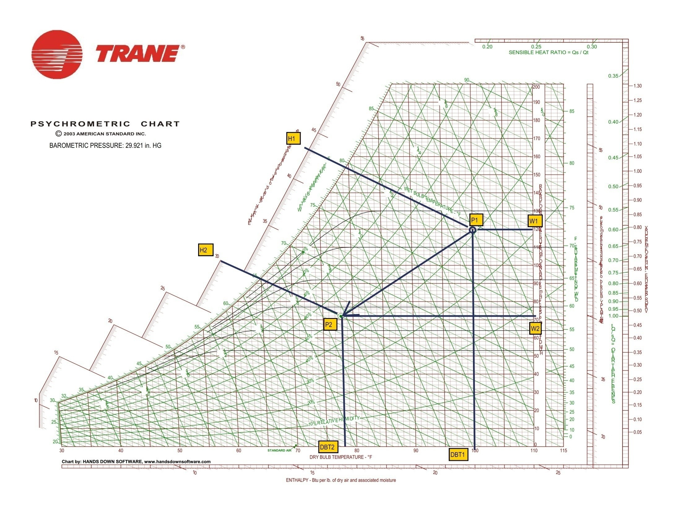

Slide 15
Psychrometry Chart
A Psychrometric chart is graphical representation of the thermodynamic properties of moist air.
Need two quantities for a state point
  Can get all other quantities from a state point
Can do all calculations without a chart
  Often require iteration
  Many “digital” psychrometric charts available

Slide 16
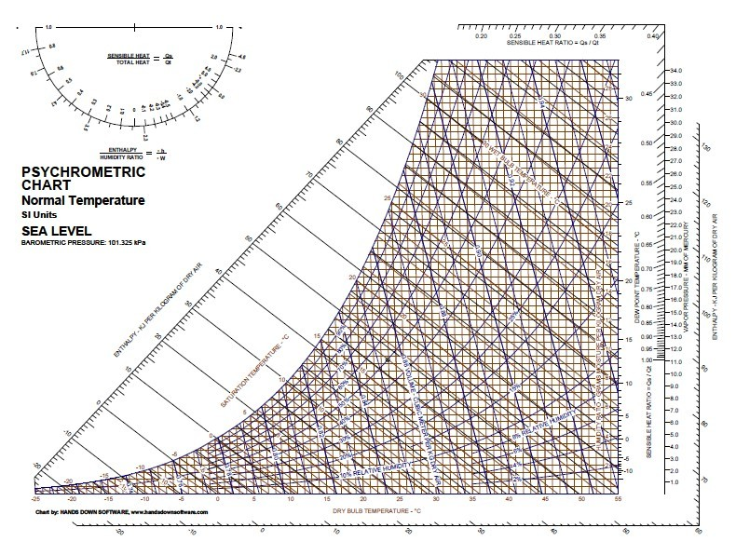
Psychrometry Chart – Continue..

Slide 17
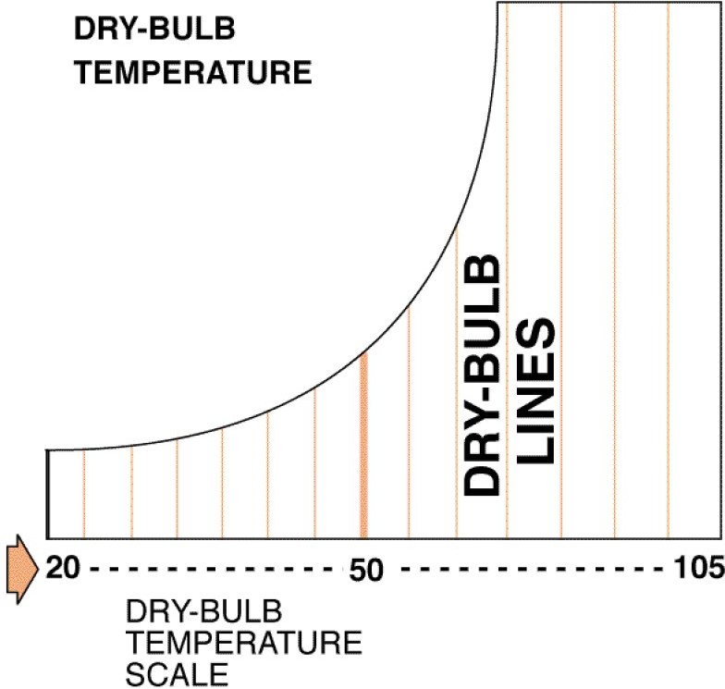
Dry Bulb Temperature(DBT) Line

Slide 18
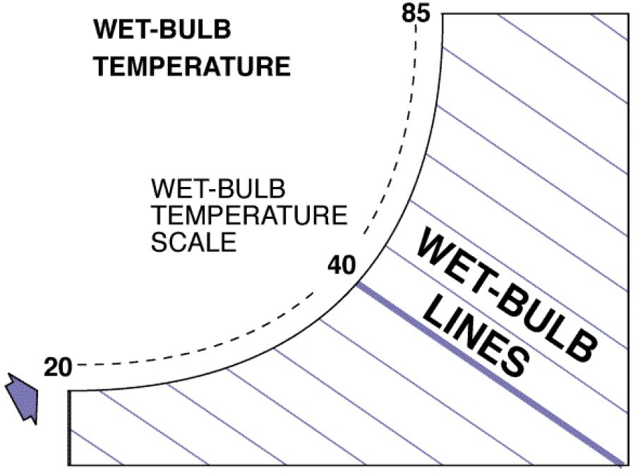
Wet Bulb Temperature(WBT) Line

Slide 19
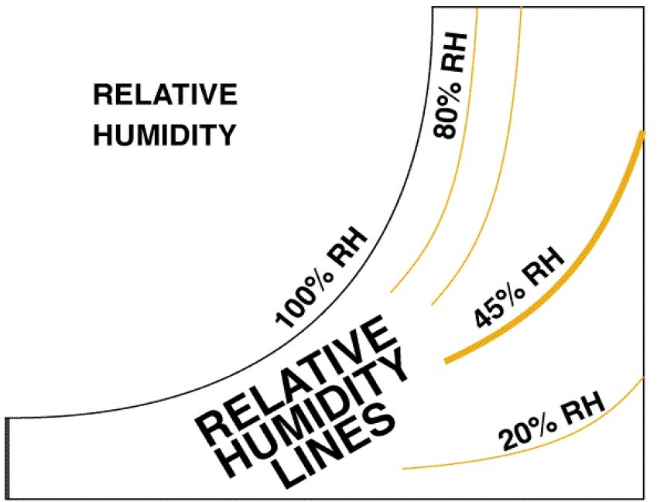
Relative Humidity Lines

Slide 20
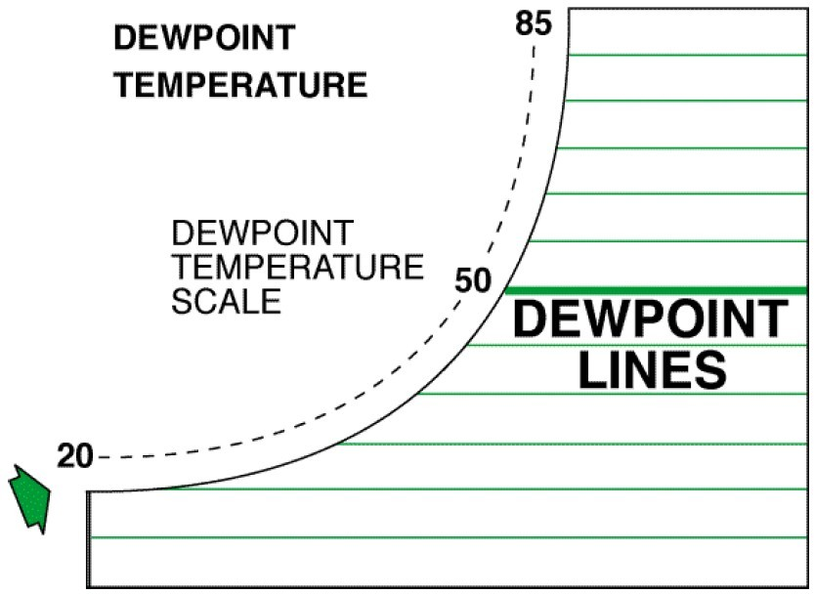
Dew-Point Temperature Lines

Slide 21
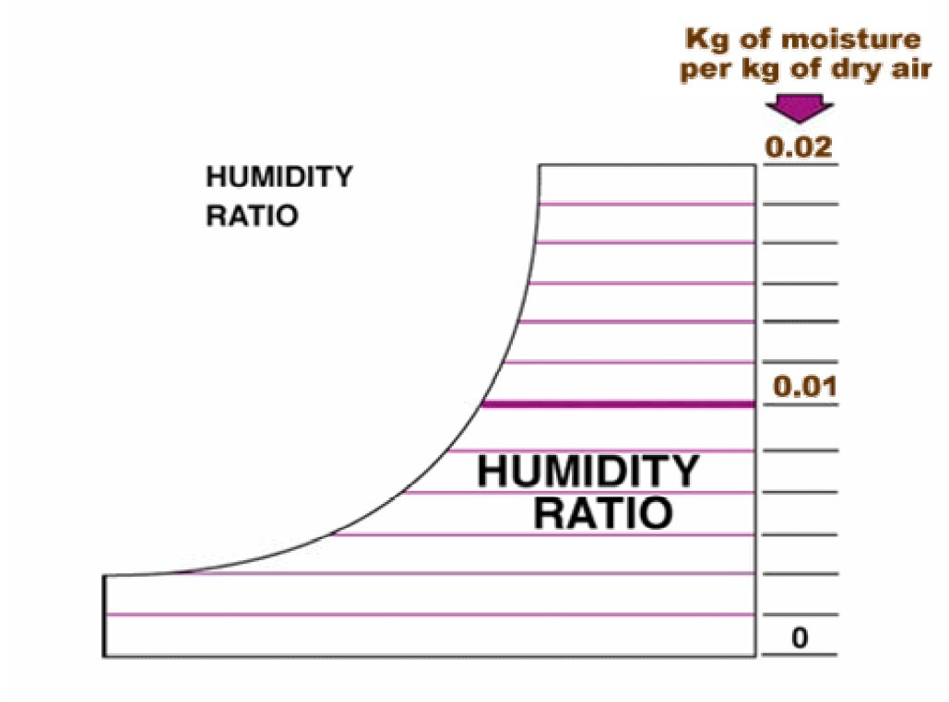
Humidity Ratio / Specific Humidity Lines

Slide 22
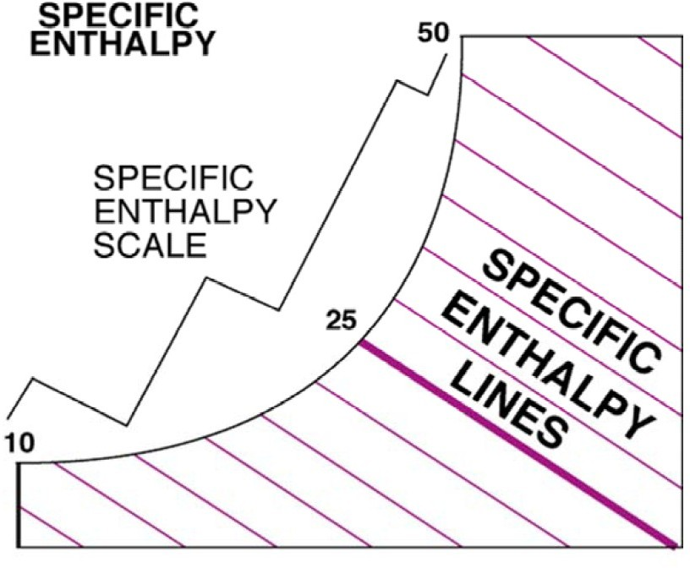
Specific Enthalpy Lines

Slide 23
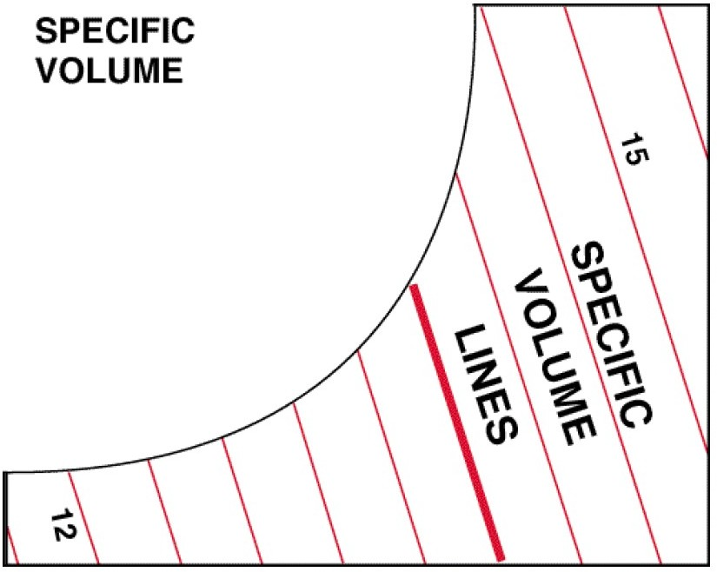
Specific Volume Lines

Slide 24
Psychrometric Processes
Sensible Heating
Sensible Cooling
Humidification
Dehumidification
Heating and Humidification
Cooling and Dehumidification
Cooling and Humidification
Heating and Dehumidification

Slide 25
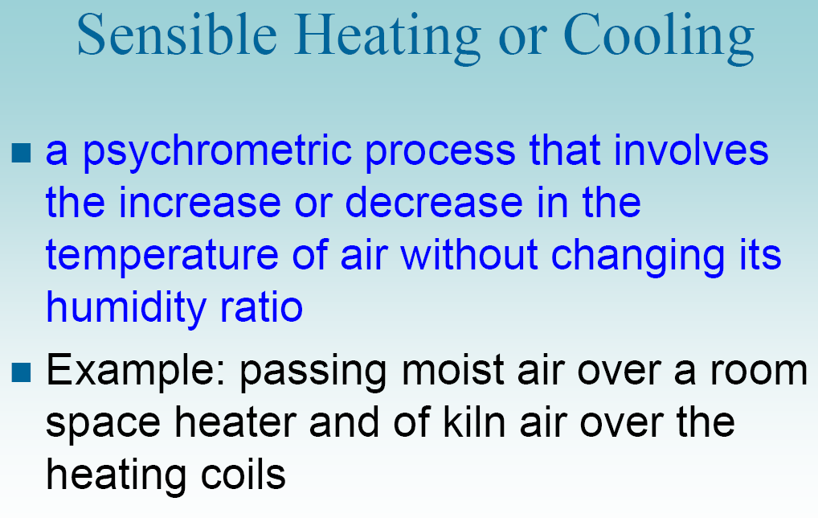

Slide 26

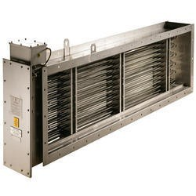
Absolutehumidity (kg/kg)
Sensible Heating
Relative humidity (%) 100 90 80 70
60 50 40
0.0450
160
30
0.0400
150
Air at 44 ºF
140
0.0350
130
Air at 65 ºF
0.0300
120
110
20
0.0250
Duct Heater
100
90
0.0200
80
70
0.0150
10
60
50
0.0100
40
30
0.0050
20
P1
P2
Enthalpy (kJ/kg) 0
-40 -35 -30 -25 -20 -15 -10 -5 0
Dry bulb temperature (°F)
10
0.0000
5 10 15 20 25 30 35 40 45 50 55 60 65 70 75 80 85 90 95 100 105 110 115 120 125 130 135

Slide 27
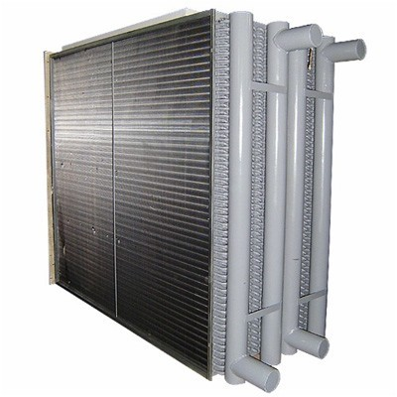
Sensible Cooling Air at
65 ºF
Absolutehumidity (kg/kg)
Relative humidity (%) 100 90 80 70
60 50 40
0.0450
CHW in
Air at 44 ºF
160
30
0.0400
150
140
0.0350
130
0.0300
120
110
20
0.0250
100
Cooling Coil
90
0.0200
CHW out
80
70
0.0150
10
60
50
0.0100
40
30
0.0050
20
P1
P2
Enthalpy (kJ/kg)
0
10
0.0000
-40 -35 -30 -25 -20 -15 -10
Dry bulb temperature (°F)
-5 0 5 10 15 20 25 30 35 40 45 50 55 60 65 70 75 80 85 90 95 100 105 110 115 120 125 130 135

Slide 28
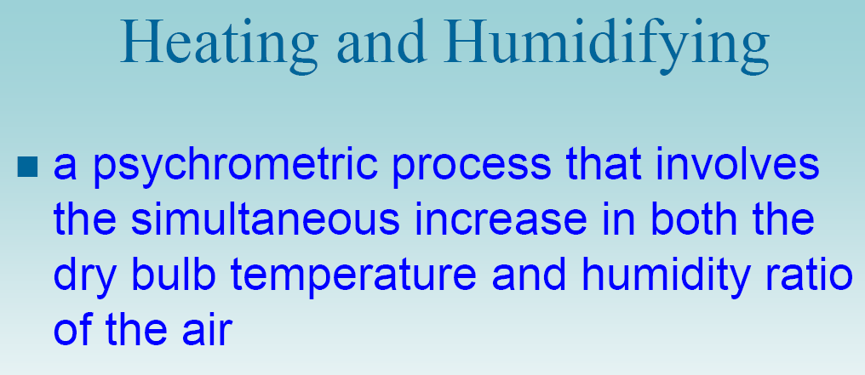
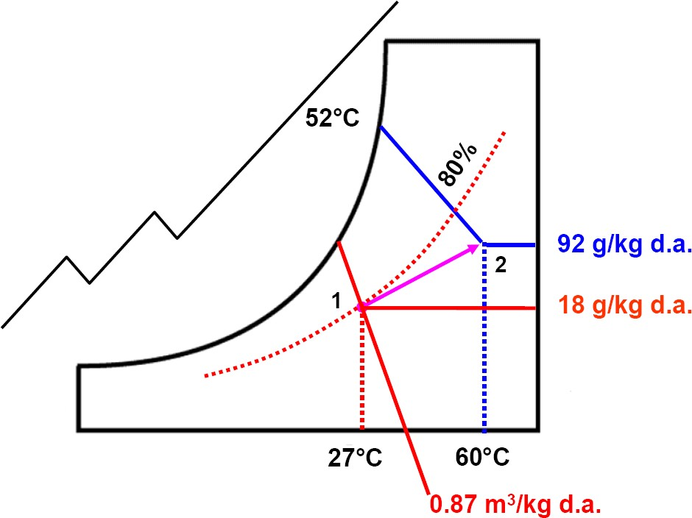

Slide 29
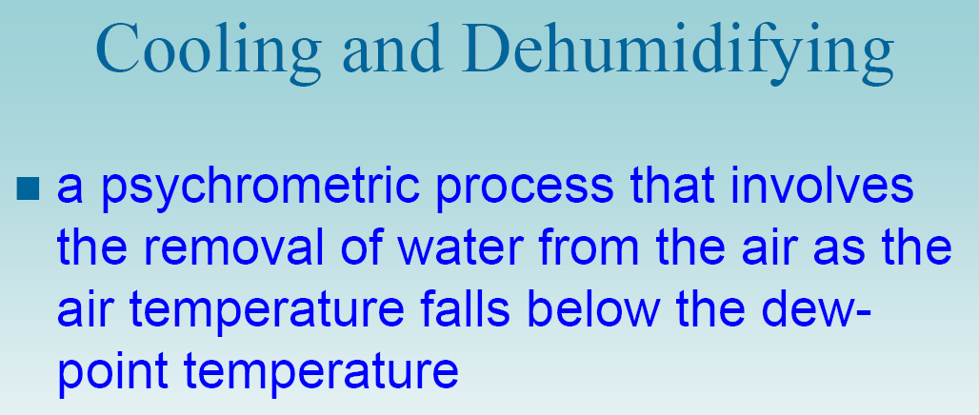

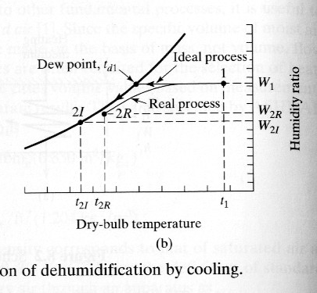



Air at 75 ºF
CHW
in
Air at 57 ºF
Cooling Coil
CHW
out

Slide 30
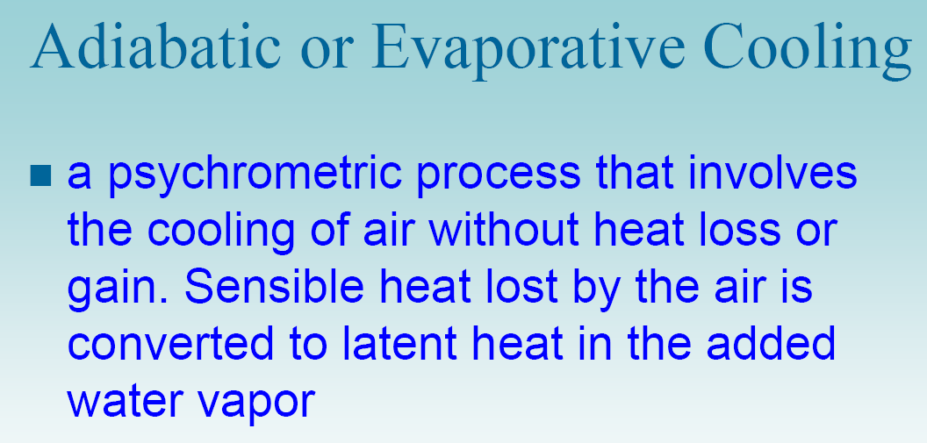
Cooling and Humidification

Slide 31
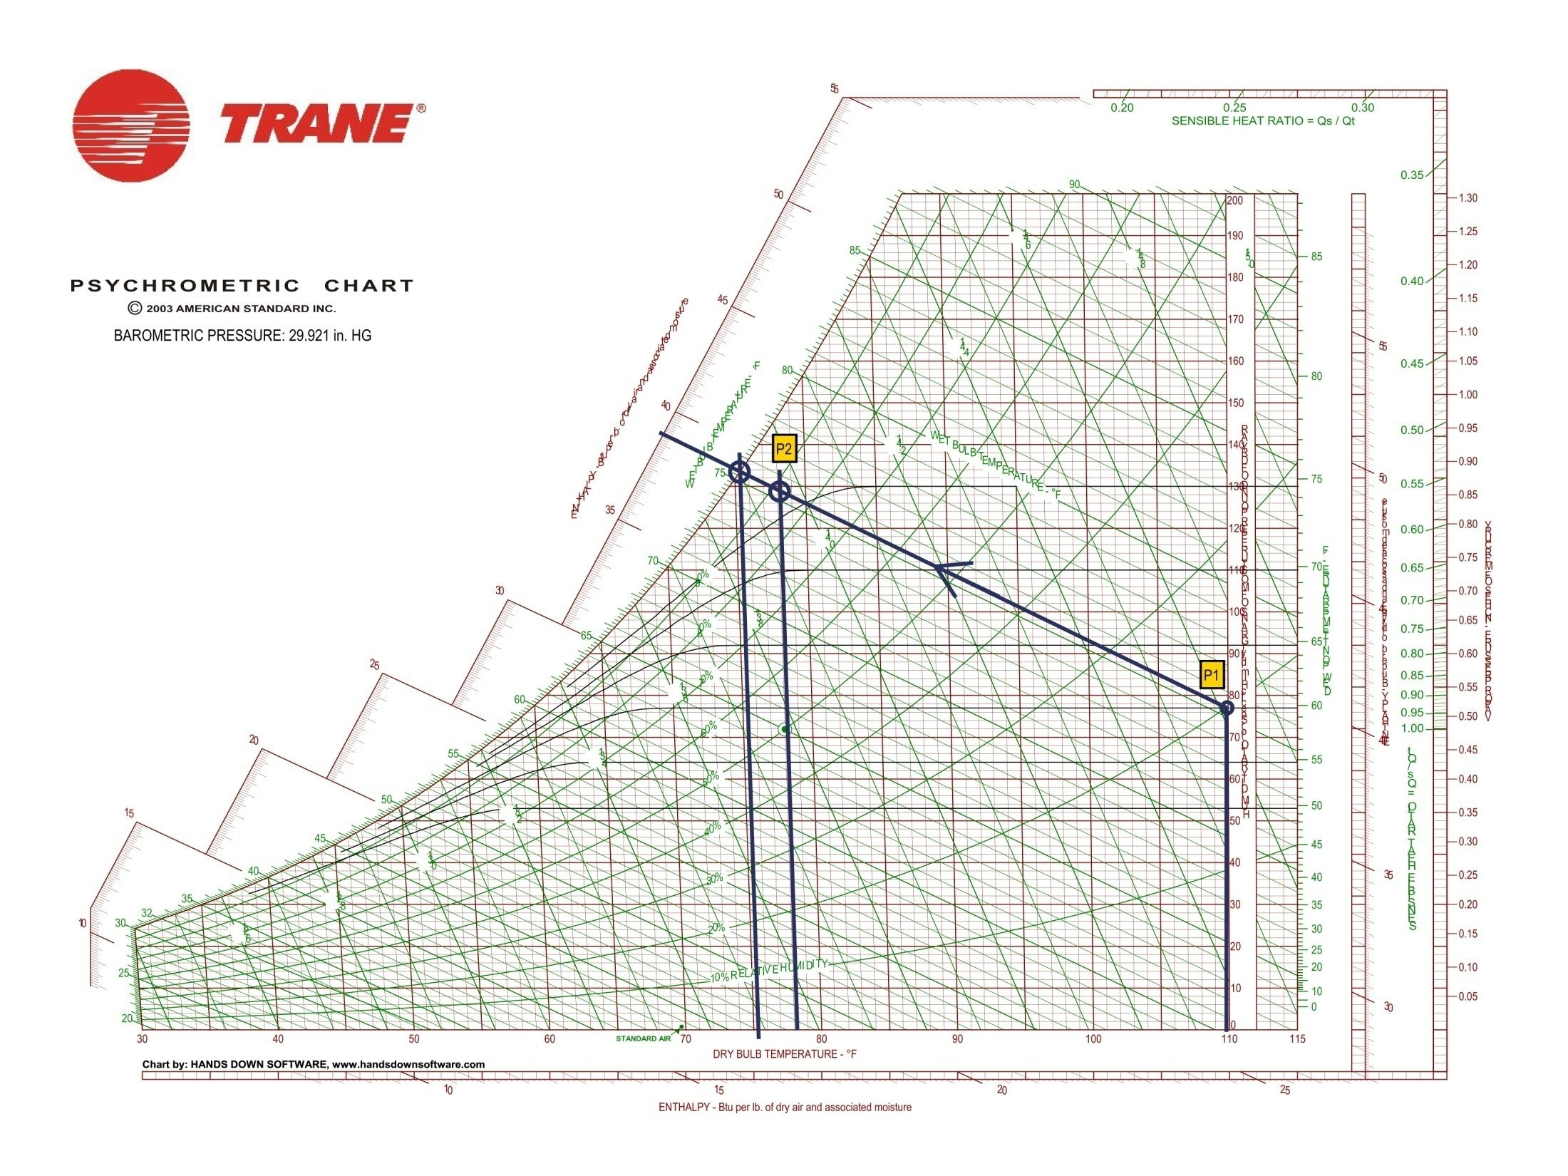

Slide 32
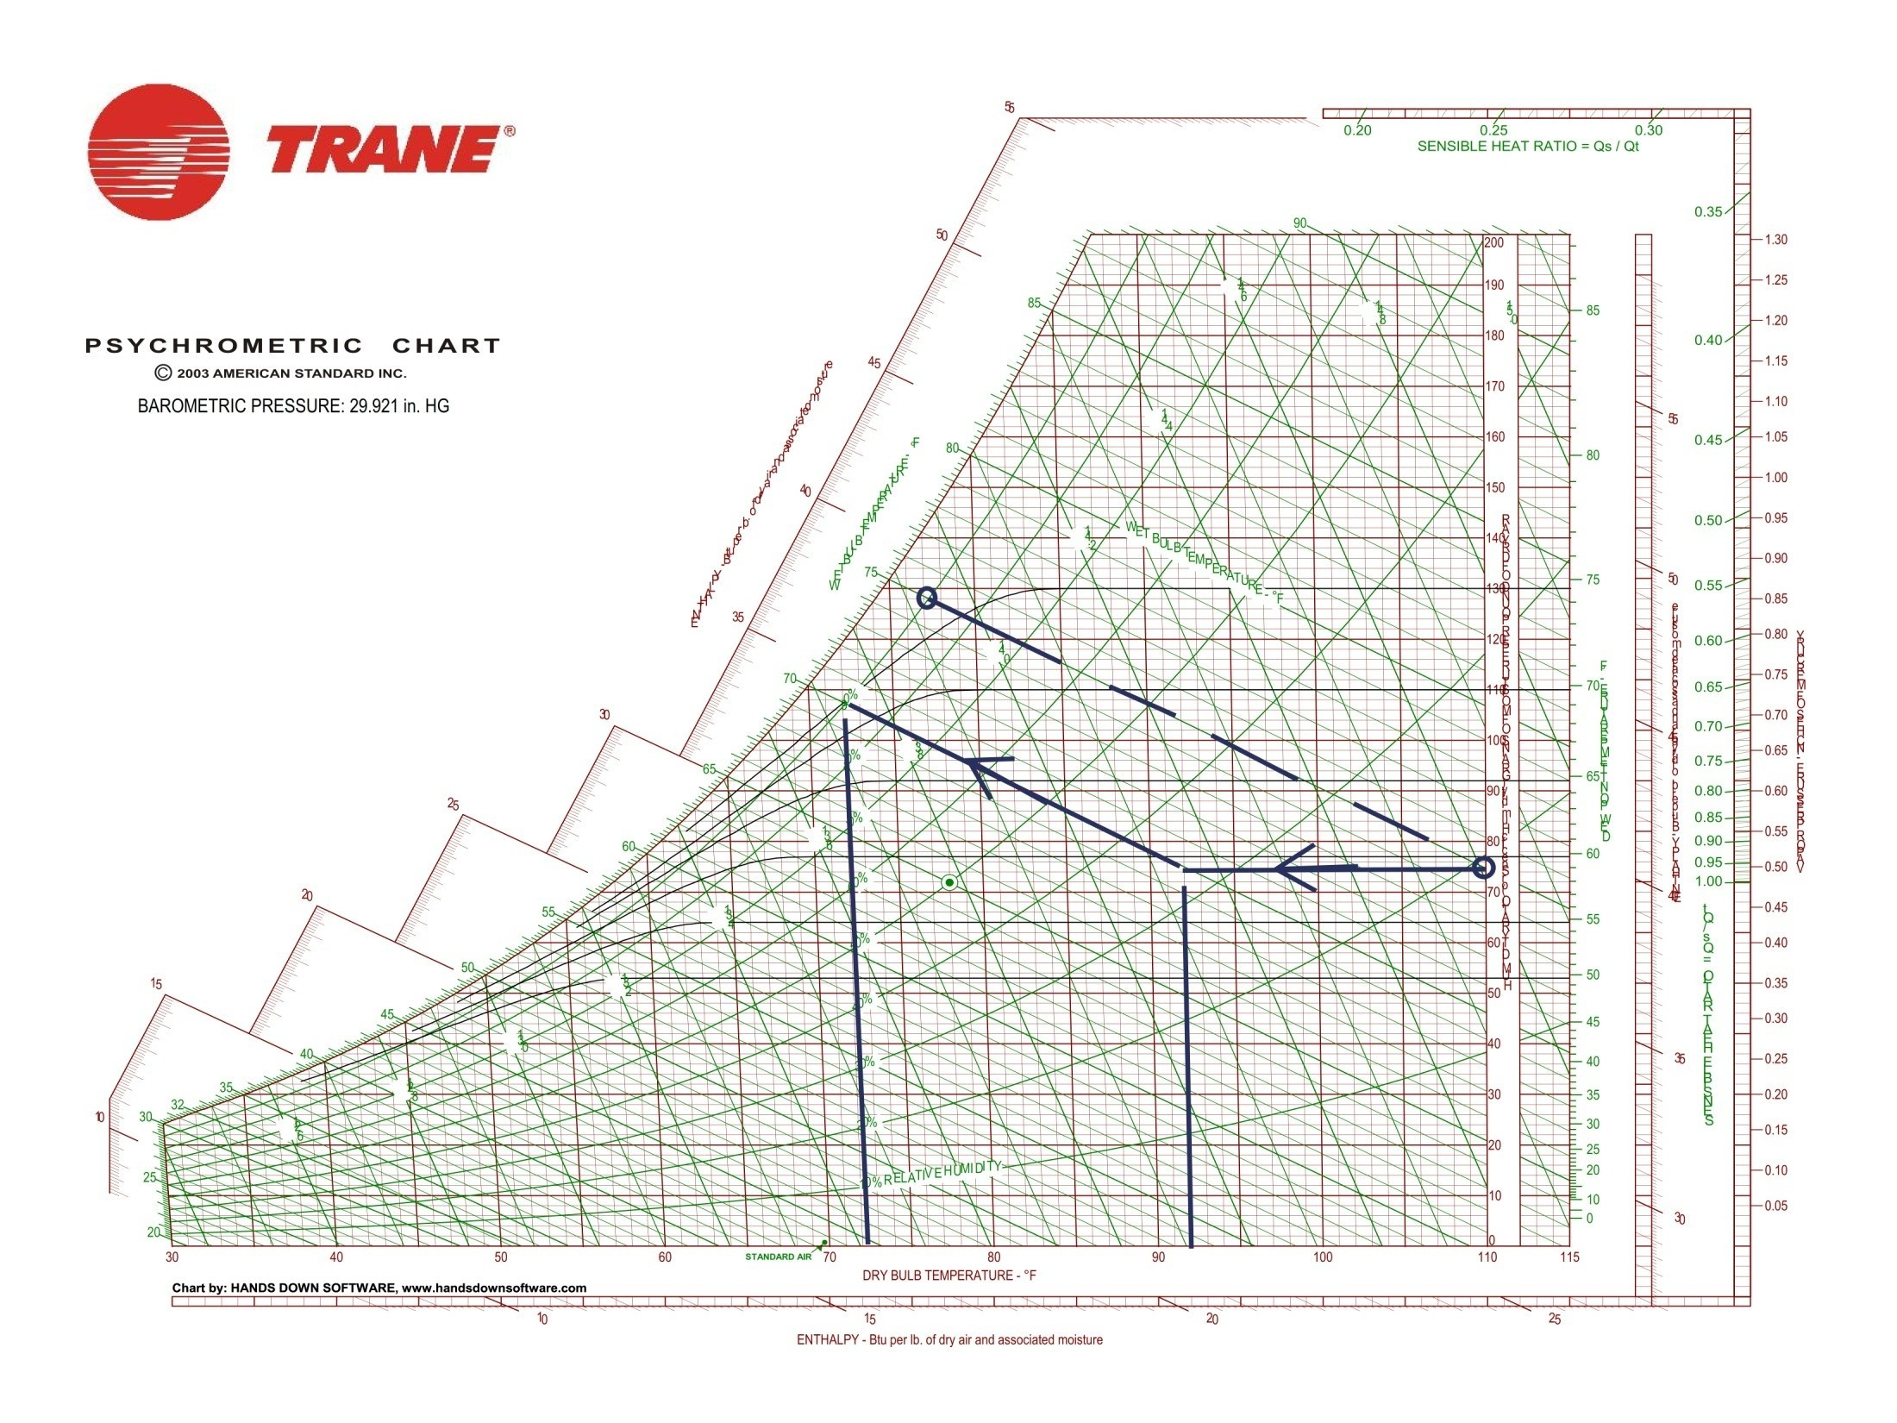

Slide 33
Airwasher
An air washer is a device for conditioning air. In an air washer air comes in direct contact with a spray of water and there will be an exchange of heat and mass (water vapour) between air and water
The outlet condition of air depends upon the temperature of water sprayed in the air washer.
Hence, by controlling the water temperature externally, it is possible to control the outlet conditions of air, which then can be used for air conditioning purposes.

Slide 34
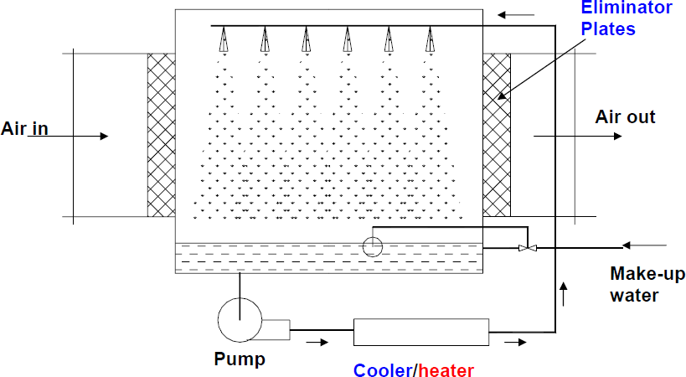

Slide 35
QUESTIONS
???

Slide 36
THANK YOU

