Slide 1
Ventilation
Humyra Nowshin
Lecturer
Dept. of Nutrition & Food Engineering
Daffodil International University

Slide 2

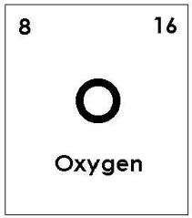
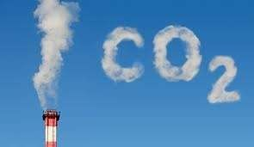

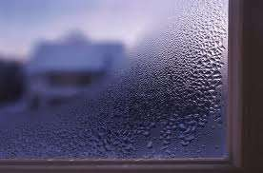


 Definition - a means of changing the air in an enclosed space to :
Control Carbon Dioxide
Keep fresh air for respiratory system
Preserve correct level Of Oxygen in the air
Remove dust and odors
Lowering the heat level
Control the moisture level
VENTILATION REQUIREMENTS

Slide 3











 Air changes per hour or ventilation rate is the preferred
 Requirements for an acceptable amount of fresh air supply in buildings will vary depending on the nature of occupation and activity.
criteria for system design.
 This is calculated by dividing the quantity of air by the room volume and multiplying by the occupancy.
Air changes per hour
= quantity of air x occupancy
room volume
VENTILATION REQUIREMENTS

Slide 4
Natural Ventilation
Mechanical Ventilation
SYSTEM OF VENTILATION

Slide 5











 Definition - the process of supplying and removing air through an indoor space without using mechanical systems. It refers to the flow of external air to an indoor space as a result of pressure or temperature differences
 The benefits of natural ventilation include:-
Improved Indoor air quality (IAQ)
Energy savings
Reduction of greenhouse gas emissions
Occupant control
Reduction in occupant illness associated with Sick Building Syndrome
Increased worker productivity
SYSTEM OF VENTILATION –Natural

Slide 6
















 Definition - mechanical ventilation systems circulate fresh air using ducts and fans rather than relying on airflow
through small holes or crack’s in a home’s wall, roof or windows. Homeowners can breath easier knowing their home has a good ventilation.
 Benefits of using mechanical ventilation:-
Better indoor air quality –can remove
pollutants, allergens, and moisture that can cause mold problems
More control – provide proper fresh air flow along with
appropriate locations for intake and exhaust
Improved comfort – allow a constant flow of outside air into the home and can also provide
filtration, dehumidification, and conditioning of the incoming outside air.
SYSTEM OF VENTILATION -Mechanical

Slide 7




 These systems employ an electrically driven fan or fans to provide the necessary air movement;
 They also ensure a specified air change and the air under fan pressure can be forced through filters. There are three types of mechanical ventilation systems:
Natural inlet and mechanical extract (exhaust system).
Mechanical inlet and natural extract
Mechanical inlet and extract
SYSTEM OF VENTILATION -Mechanical

Slide 8


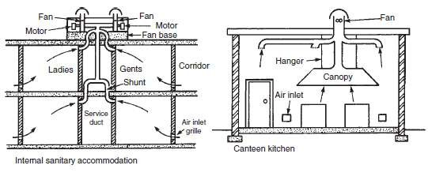



NATURAL INLET & MECHANICAL EXTRACT
 This is the most common type of system and is used for kitchens, workshops, laboratories, internal sanitary apartments, garages and assembly halls.
 The fan creates negative pressure on its inlet side, and this causes the air inside the room to move towards the fan, and the room air is displaced by the fresh air from outside the room.
SYSTEM OF VENTILATION -Mechanical

Slide 9


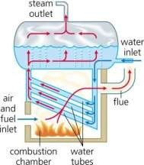
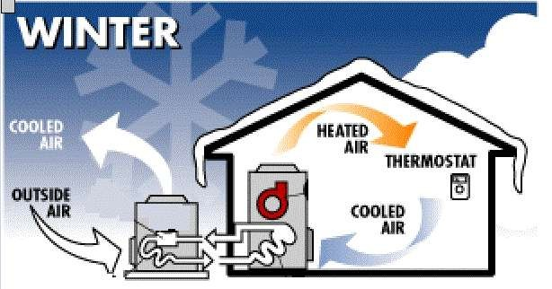



MECHANICAL INLET & NATURAL EXTRACT
 It is essential with this system that the air is heated before it
is forced into the building.
 The system may be used for boiler rooms, offices and certain types of factories.
 The air may be heated in a central plant and ducted to the various rooms, or a unit fan convector may be used.
SYSTEM OF VENTILATION -Mechanical

Slide 10







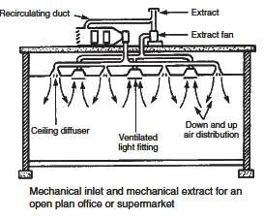
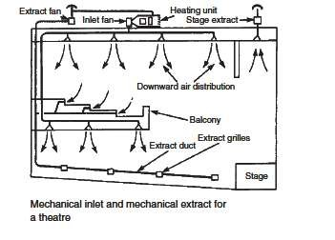



MECHANICAL INLET & EXTRACT
 This provides the best possible system of ventilation, but it I also the most expensive and is used for many types of buildings including cinemas, theatres, offices, lecture theatres, dance halls, restaurants, departmental stores and sports centers. The system is essential for operating theatres and sterilizing rooms.
SYSTEM OF VENTILATION -Mechanical

Slide 11


