Slide 1
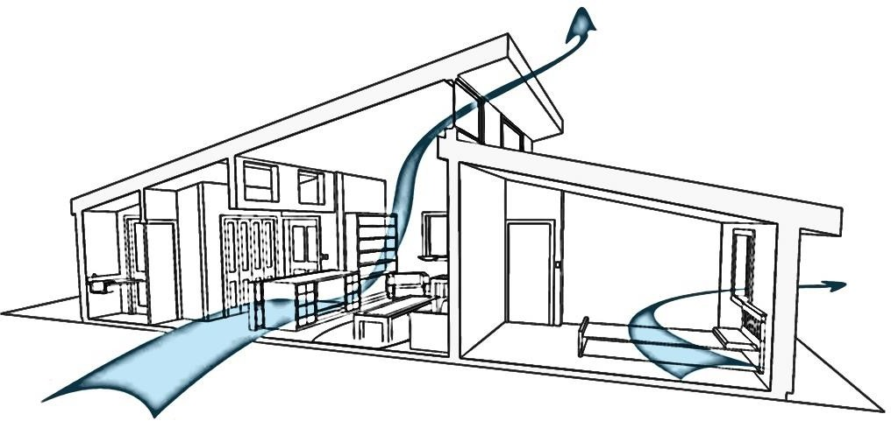
NATURAL VENTILATIO₁N
HUMYRA NOWSHIN
Lecturer
Department of Nutrition and Food Engineering
Daffodil International University

Slide 2
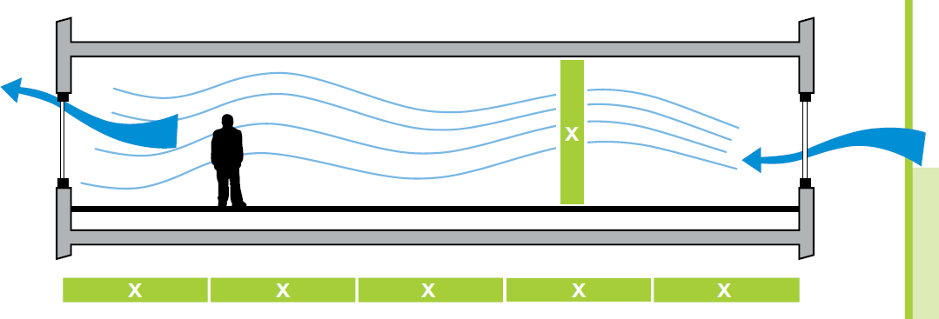
WHAT IS NATURAL VENTILATION ?
Natural ventilation is the process of supplying and removing air through a space by natural means it can be achieved with openable windows or vents.
Natural ventilation and air movement can be simply achieved by ‘structural controls’ as it does not depends on any form of external energy supply or mechanical installation.
2

Slide 3
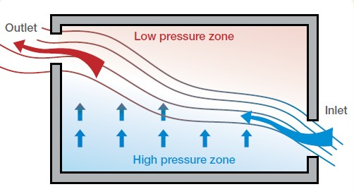
WHY NATURAL VENTILATION ?
The purpose of providing natural ventilation is to achieve maximum human comfort in indoor by utilizing maximum natural energy and resources.
3

Slide 4
DIFFERENT TECHNIQUES TO ACHIEVE NATURAL VENTILATION:-
STACK EFFECT
WIND TOWER
COURTYARD EFFECT
4

Slide 5
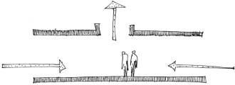
STACK EFFECT :-
Stack effect depends on thermal forces and difference in temperature .
Reason of stack effect :-
Pressure difference between the outside air and the air inside the building caused by difference in temperature
Outdoor air
Outdoor air
Section
5

Slide 6
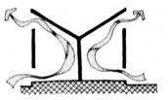
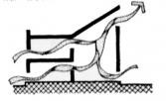

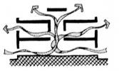
STACK VENTILATION SECTIONS :-
TALL ROOMS
TALL ROOMS AT EDGE
TALL ROOMS WITHIN
STAIRS AS STACK
6

Slide 7
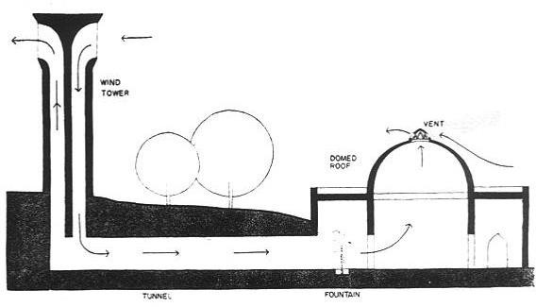
WIND TOWER
Air enters in wind tower through openings- cooled down- becomes heavier and sinks down ( presence of air movement)
After whole day air exchange – tower becomes warm in the evening .
Tower walls absorbs heat during daytime and releases at night
A typical wind Tower section
7

Slide 8
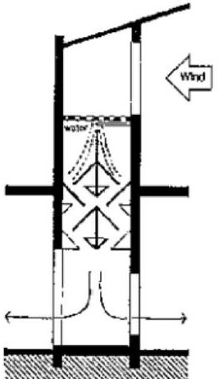
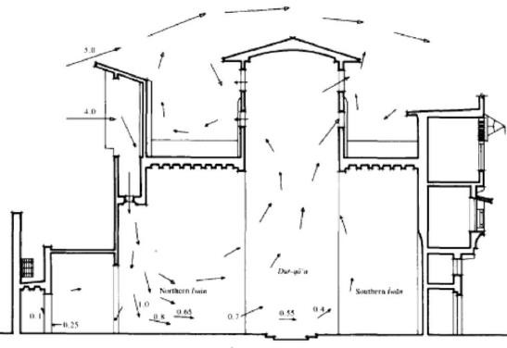
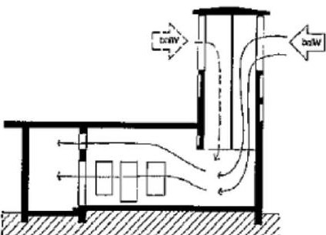
DIFFERENT TYPES OF WIND TOWERS :-
•
WATER SUPPLY
EVAPORATIVE COOLING
MULTI DIRECTIONAL WIND CATCHER
8

Slide 9
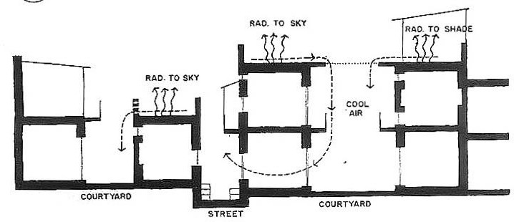
COURTYARD EFFECT:-
Due to incident solar radiation in a courtyard, air gets warmer and rises , cool air from ground level flows through the lower openings
RADIATION TO SKY
LANDSCAPE OR WATER BODY
SECTION SHOWING COURTYARD EFFECT
9

Slide 10
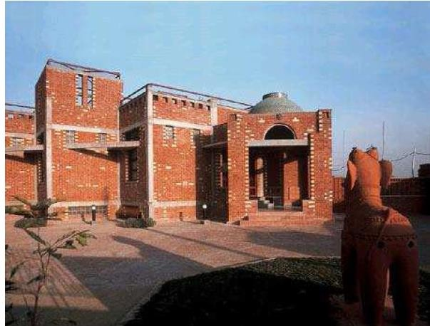
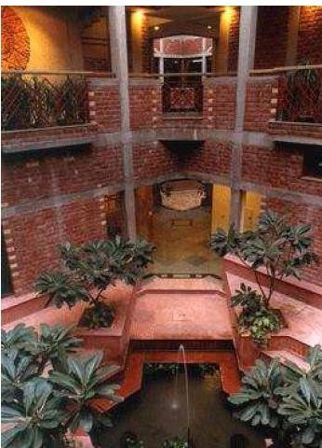
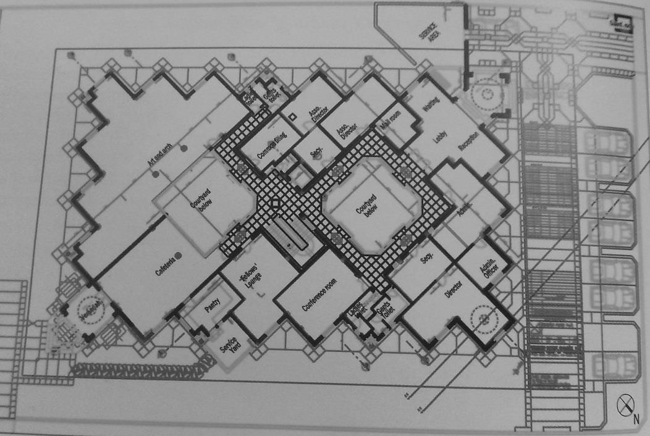
COURTYARDS IN MODERN BUILDINGS :-
VIEW
Sunken courtyard inside the building with water body and landscape
PLAN
American institute of indian studies

Slide 11
NATURAL VENTILATION EXTERNAL FEATURES:-
  Orientation of buildings
  Position of openings
  Cross ventilation
  Size of openings
  Opening types
Presentation By- Ar. Roopa Chikkalgi
11

Slide 12
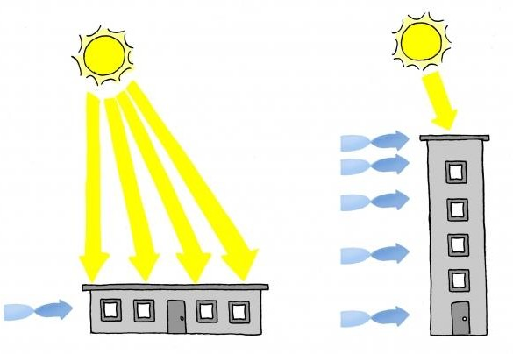
MASSING AND ORIENTATION OF BUILDING:-
As a general rule, thin tall buildings will encourage natural ventilation and utilize prevailing winds, cross ventilation, and stack effect.
Tall buildings also increase the effectiveness of natural ventilation, because wind speeds are faster at greater heights
Tall buildings improve natural ventilation, and in lower latitudes reduce sun exposure.
12
Presentation By- Ar. Roopa Chikkalgi

Slide 13
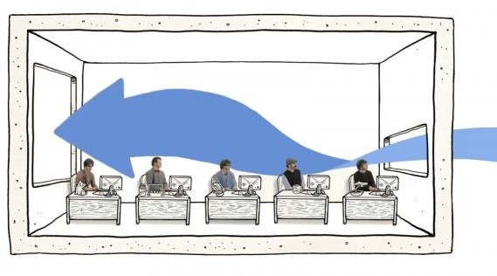
OPENING SIZE:-
SMALL INLET
LARGE OUTLET
Pairing a large outlet with a small inlet increases incoming wind speed.
Presentation By- Ar. Roopa Chikkalgi
13

Slide 14
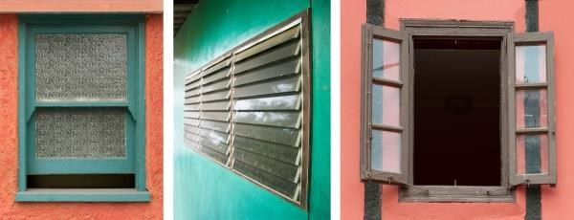
OPENING TYPE:-
OPENING CAN BE ANY TYPE ACCORDING TO THE BUILDING TYPE AND CLIMATIC CONDITION
Presentation By- Ar. Roopa Chikkalgi
14

Slide 15
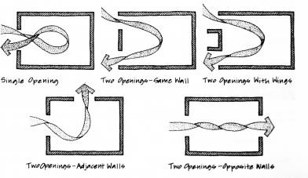
CROSS VENTILATION:-
Windows or vents placed on opposite sides of the building give natural breezes a pathway through the structure
15

Slide 16
SCOPE –
To minimize the external energy or mechanical system.
Implementation of natural ventilation system- natural daylighting can be provided.
Thermal comfort can be acquired with less economical budget
Presentation By- Ar. Roopa Chikkalgi
16

Slide 17


Slide 18


