Slide 1
NFE 415
FOOD STORAGE ENGINEERING
Humyra Nowshin
Lecturer
Dept. of Nutrition & Food Engineering
Daffodil International University

Slide 2
Lecture 9: Topic
Problems based on fan laws
  Volume of Air Example
  Pressure Example
  Power Example

Slide 3
Volume of Air Example
A Factory of 37500m³ space currently requires five air changes an hour to remove waste heat generated by industrial process machinery.
Later additional machines are added to the factory and the required number of air changes per hour increases to 6 to maintain the desired maximum air temperature within the factory.
At a pressure loss of 40 Pa due to ductwork, louvers and other ancillary items. 20 number external rotor motor fans were used.
From the manufacturer’s data sheet we know that to deliver this performance, the RPM of the fan is 865 u/min. So what is the RPM of the fan required to be to deliver this flow rate increase?

Slide 4
Hint
The original air flow rate, V₁ is 187500 m³/hr to achieve this.
V₂, calculated by multiplying the space by the new air change requirements, is simply 37500m³ x 6 which give a new requirement of 225000 m³/hr.

Slide 5
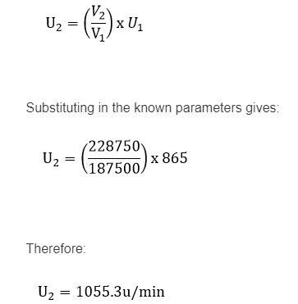

Slide 6
Pressure Example
Continuing with our first situation of the industrial process factory which has added machinery and now requires additional air flow to maintain working conditions, what will the pressure of the fans now be?

Slide 7
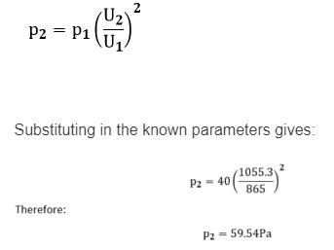

Slide 8
Power Example
From the original duty point, it is given that the power consumption was 2120 W at 187500 m³/hr @ 40Pa.
So what will the total additional power consumption be for all 20 fans?

Slide 9
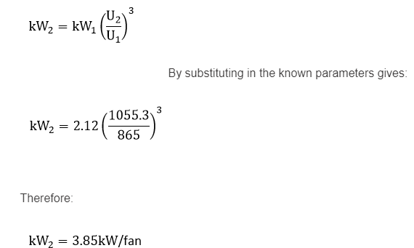
Over 20 fans the total power increase is 34.6kW

Slide 10
Problem
A fan provides 12000 CFM of air at 500 RPM. A 5 horsepower motor is attached which produces 1″ of static pressure.
New equipment is being added to the system which will require 1.5″ of static pressure. To accommodate the change in static pressure, what size motor is needed.

Slide 11
Given
Initial Pressure (N₁) = 1 in wg
Initial Motor Speed (RPM₁) = 500
Initial Motor (hp₁) = 5 hp
Final Pressure (N₂)= 1.5 in wg
p1/p2=(rpm1/rpm2)2
hp1/hp2=(rpm1/rpm2)3

Slide 12


To solve this problem you need to first solve for the new RPM
N₂ = 490 RPM
Now to solve for the new horsepower
Horsepower required is now 9.2
Use 10 hp motor

Slide 13
THANK YOU

