Slide 1
NFE 415
FOOD STORAGE ENGINEERING
Humyra Nowshin
Lecturer
Dept. of Nutrition & Food Engineering
Daffodil International University

Slide 2
Topics
Air handling in the food
industry
  Objective
  Basic Considerations
  Role of air handling systems
  Factors affecting air handling systems
  Illustration Practices

Slide 3
Introduction & Objective
The quality of air within factory buildings is controlled by many food manufacturers.
Environmental air of a speciﬁc quality (temperature, humidity and particle concentration) and quantity (fresh air volume) is required for the comfort and safety of employees.
Objective of Air Handling
“To assist food producers and storage managers in the design, selection, installation, and operation of air handling systems.”

Slide 4
Basic Considerations
For the manufacture of some products, it is necessary to impose additional controls on environmental air quality to reduce the possibility of contamination.
Also, process air that comes in contact with food must be controlled.
The controlled properties of air, especially temperature and humidity, may be used to prevent or reduce the growth rate of some micro-organisms in manufacturing and storage areas.
The particle content—dust and micro-organisms— can also be controlled to limit the risk of product contamination and hence contribute to safe food manufacture.

Slide 5
Role of air handling systems
Properly designed air handling systems control airborne particulates and odors and minimize the risks of products being contaminated by airborne contaminations such as:
Infectious pathogens (e.g. Salmonella, Listeria, E. coli) and
Toxigenic pathogens (e.g. Staphylococcus aureus and clostridia) and
Spoilage microorganisms (e.g. yeast, molds, pseudomonads and lactic acid bacteria).

Slide 6
Variables regarding air handling systems
In addition to control of airborne contamination, the following variables are important to the speciﬁcation of the air handling system:
Temperature: temperatures below 13°C should only be used when higher temperatures would be harmful to food safety.
Air distribution: to remove the heat imposed by the processes and people, to provide sufﬁcient fresh air, prevent the ingress of airborne contamination and avoid regions of static air.

Slide 7
Factors affecting air handling systems
Factors that affect the choice of air management are as follows:
Volume of the space;
Cooling capacity (removal of heat);
Number of people (fresh air requirement);
Temperature differences with adjoining work areas;
Humidity and odor control;
Over pressure required;
Air quality required.

Slide 8
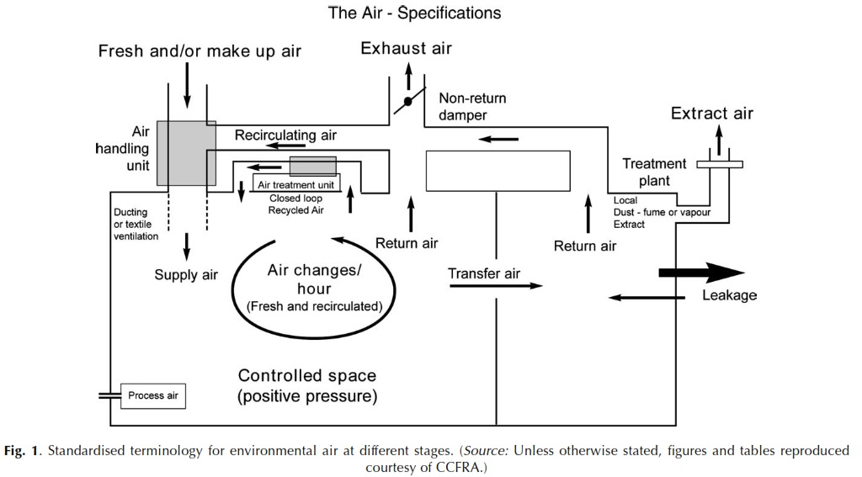
Schematic Diagram Showing the Air Flow Pattern in a Common Plant/Storage

Slide 9
THANK YOU

