Slide 1
Food storage and plant layout design

Slide 2
Topics
1. Layout diagrams/design
2. Plant location consideration
3. Food Storage location consideration
4. Safety issues/measures
5. Hazard/accident management

Slide 3
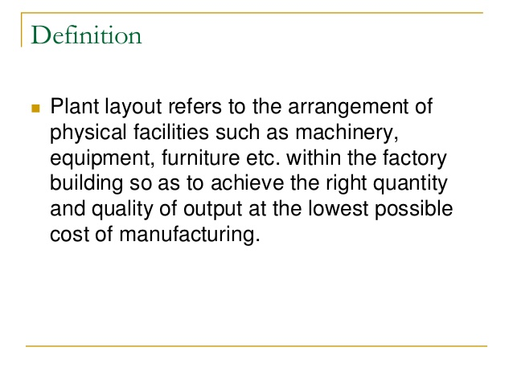
What is a Plant Layout?

Slide 4
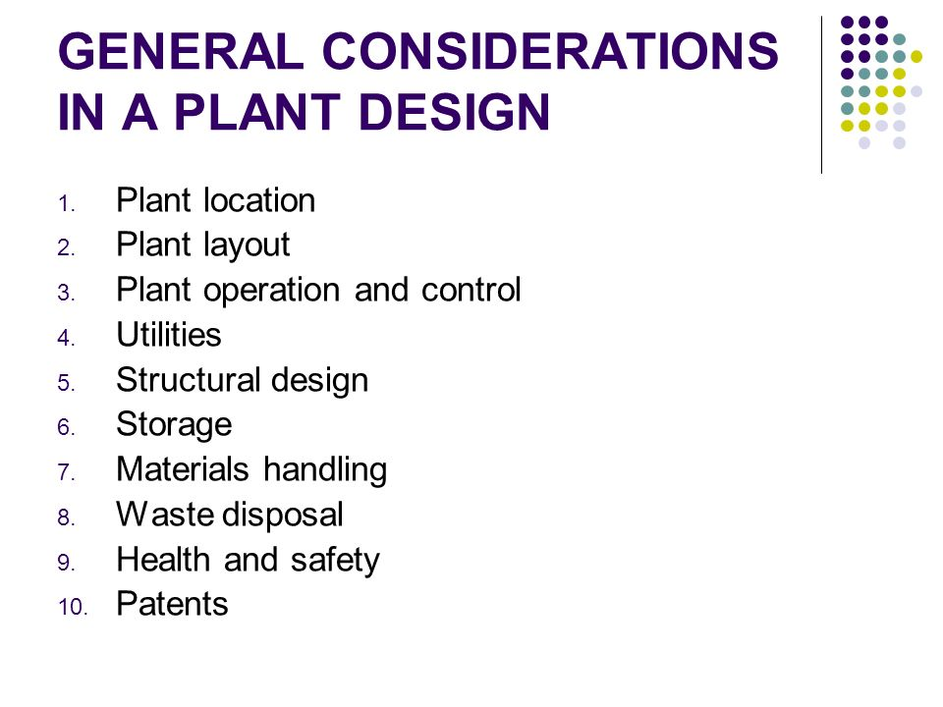

Slide 5
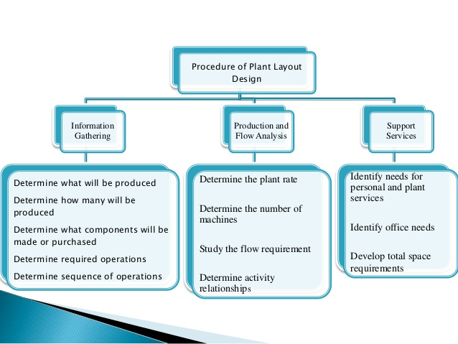

Slide 6
Objectives of plant layout
1. Minimizing handling of materials.
2. Maintaining flexibility of operations.
3. Ensuring optimum utilization of men, materials, equipment and available space.
4. Achieving good work flow and avoiding accumulation of work.
5. Minimizing delays and bottlenecks in the production system.
6. Ensuring safety of workmen by minimizing and eliminating the chances of accidents.

Slide 7
Continue
7. Providing for effective supervision and production control.
8. Minimizing work-in-process inventory.
9. Providing sufficient and conveniently located service centers.
10. Flexibility in design to adapt to the changing future requirements.

Slide 8
Steps involved in designing a plant layout
1. Collection of required data
2. Preparation of blueprint for the floor plan
3. Preparation of process chart and flow diagram
4. Preparation of draft layout
5. Test run

Slide 9
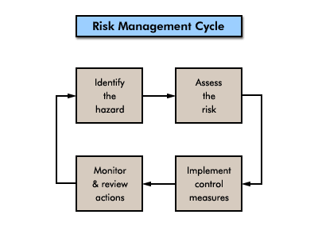
Managing risks and hazards
Identify workplace hazards
Assess risks
Manage risks
Monitor control methods

Slide 10
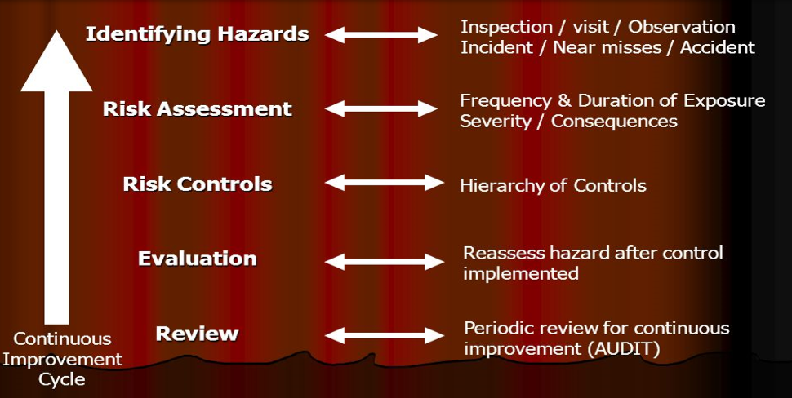
Hazard Management

Slide 11
Thank you for patience hearing

