Slide 1
Chapter - 2 History of film
Prepared by
Sadia Mustafa Sraboni

Slide 2
Early Years
17th -18th century: Lantern slides
19th century saw vast proliferation of visual forms of popular culture
Industrial Era
Books of photographs, illustrated fiction

Slide 3
Early Years
Middle/working class:
Visit circuses, amusement parks, music halls, theater troupes, dioramas, stereoscopes

Slide 4
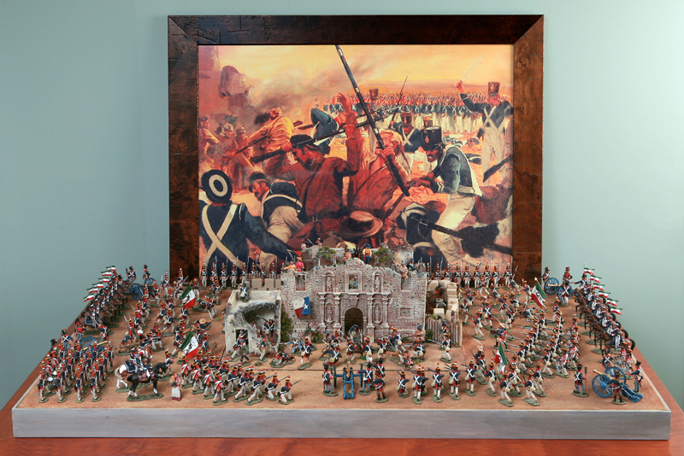
Diorama
Painted backdrops featuring 3-D figures depicting historical events

Slide 5
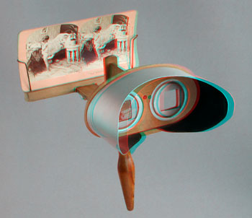
Stereoscopes
Hand-held viewers that created three dimensional effects by using oblong cards with two photographs printed side by side

Slide 6
Pre-conditions for Motion Pictures
1st: Scientists had to realize, the human eye will perceive motion if a series of slightly different images is placed before it in rapid succession-minimally around 16 per second.

Slide 7
Phenakistoscope (1832)
Deceiving scope
http://www.youtube.com/watch?v=dAoa0mv2id4

Slide 8
Zoetrope (1833)
Life + turn
http://www.youtube.com/watch?v=-3yarT_h2ws

Slide 9
Pre-conditions for Motion Pictures
2nd: these fast-moving images needed to be projected on a surface
17th Century “magic lanterns” projecting glass lantern slides (paintings illuminated by glass), but couldn’t flash large numbers of images fast enough to create illusion of motion.

Slide 10
Pre-conditions for Motion Pictures
3rd: Ability to use photography to make successive pictures on clear surface
Speed up exposure time

Slide 11
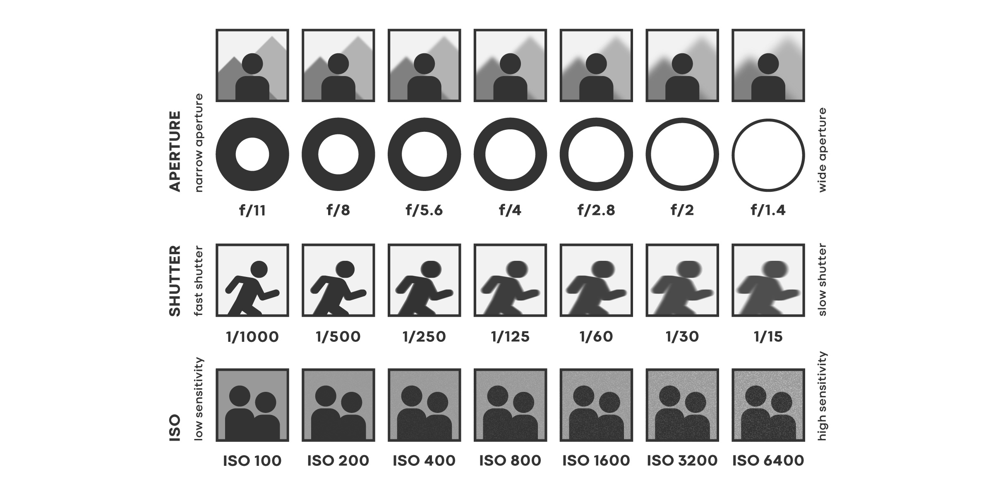
Exposure
the act of presenting rays of light to a photosensitive surface.
First photograph/frame had exposure time of 8 hours (1839)
Motion pictures=split-second exposure
This became feasible in 1878

Slide 12
Pre-conditions for Motion Pictures
4th: Photographs needed to be printed on a base flexible enough to be passed through a camera rapidly.
1888: George Eastman devised a camera that made photographs on rolls of thin paper. Kodak!
The next year, he introduced transparent roll of film creating a breakthrough in the move toward cinema.

Slide 13
Pre-conditions of Motion Picture
5th: Needed to find a suitable mechanism for cameras and projectors.
The camera: the film strip had to stop briefly while light entered through the lens and exposed each frame; a shutter then covered the film as another frame moved into place.

Slide 14
Shutter & Aperture
a mechanical device for opening and closing the aperture of a camera lens to expose film or the like.
an opening, usually circular, that limits the quantity of light that can enter an optical instrument.
https://www.shutterstock.com/blog/exposure-what-is-shutter-speed

Slide 15
Invention of the Motion Picture
Thomas Edison developed Kinetoscope in 1891 the first motion picture system (peep show in a box)
Scottish-English immigrant William Dixson joined Edison’s team to help develop the technology that would combine pictures and sound
Looped in :30 vignettes, no story connecting them.

Slide 16
Kinetoscope
A phonograph inside the cabinet. The viewer would look into the peep-holes of the Kinetoscope to watch the motion picture while listening to the accompanying phonograph through two rubber ear tubes connected to the machine. The picture and sound were made somewhat synchronous by connecting the two with a belt
46 frames per second

Slide 17
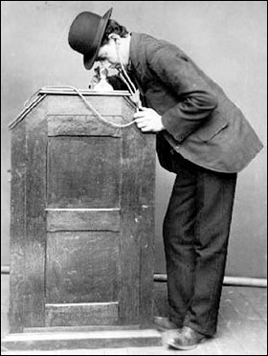
Kinetoscope

Slide 18
The Bioscop
Invented by Skladanowsky brothers
Held two strips of 3 ½” film running side by side-frames projected alternately
15 minute programs
Too cumbersome

Slide 19
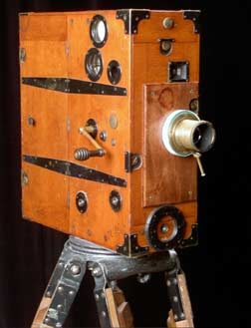
The Bioscop

Slide 20
The Lumiere Brothers
Invented a projection system that helped make cinema a commercially viable enterprise internationally!!
Designed the “cinematographe”
35 mm film
16 frames per second

Slide 21
Lumiere Brothers
Workers Leaving the Factory, 1895

Slide 22
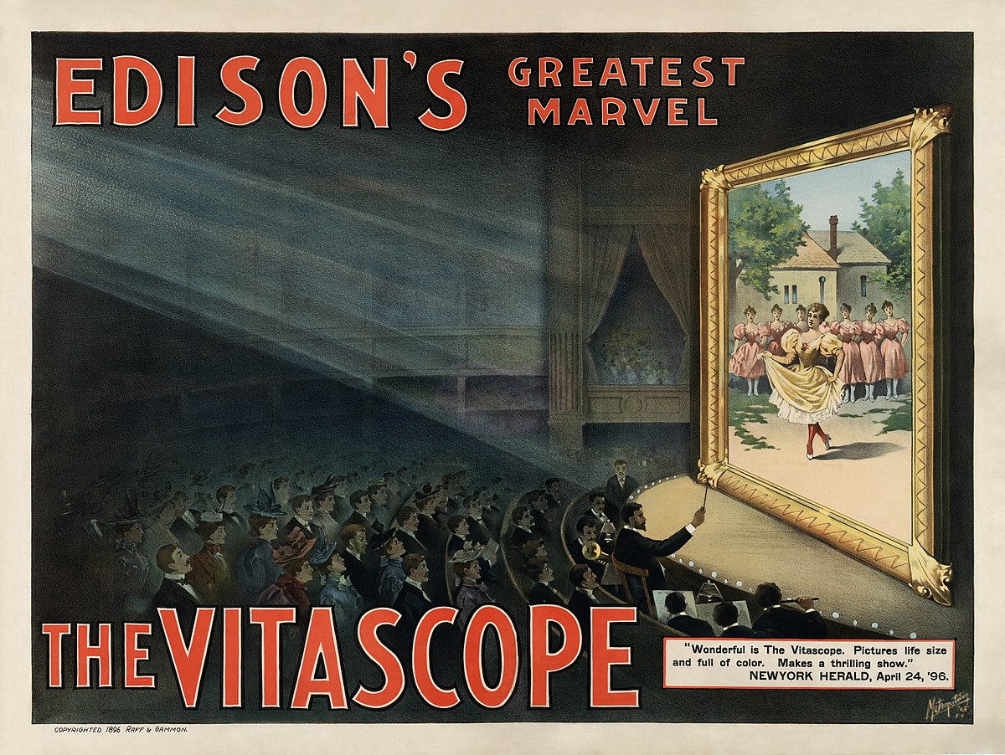
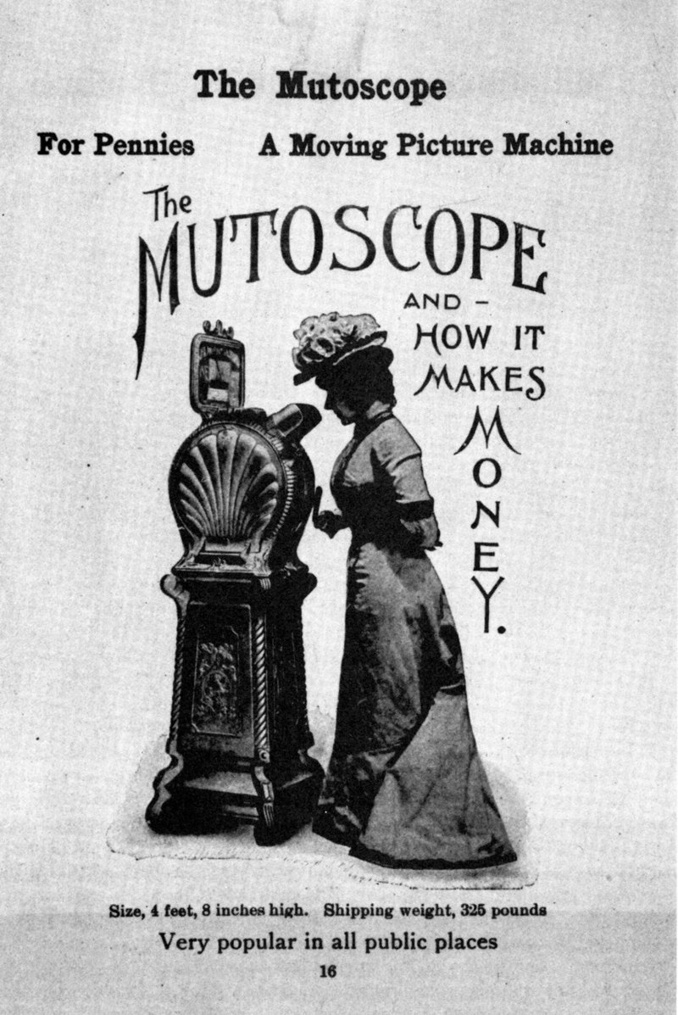
American Developments
Edison’s Kinetoscope evolved into Vitascope (life scope) October 1895
Rough Sea at Dover
Inventor, Thomas Armat created Vitascope and Edison manufactured it.
1894: American Mutoscope Company
70 mm film that yielded larger, sharper images

Slide 23
American Developments
1897: 2 means of film exhibition
Peep show devices for individual viewing
Projection systems for audiences
https://www.youtube.com/watch?v=iZc4C7SgtJI&t=156s
Types of cinema:
Scenics, topicals and fiction films

Slide 24
Scenics
Short travelogues offering views of distant lands

Slide 25
Topicals
News events, recreations of key occurrences in studio
Sinking of battleship Maine during Spanish-American War (1898)
https://www.loc.gov/item/98500970

Slide 26
Fiction Films
Brief staged scenes telling a story
Some shot outdoors, but most shot in front of painted backdrops
1904-became the industry’s main product
Camera set up in one position and action unfolded in one continuous take.
No credits, music
Provided live
by the “exhibitor”

Slide 27
American Developments
1905- Admission to Nickelodeon (movie theater) = $.05-$.10 for a 15-60 minute production
Audiences sat on benches, wooden seats
Front display=hand painted signs
Actors stood behind screen and spoke dialogue in synchronization with the action on the screen
Sound effects were made with noisemakers behind the screen
Warner Bros., Universal, Paramount, MGM got there start as Nickelodeon exhibitors

Slide 28
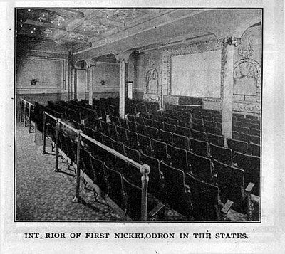
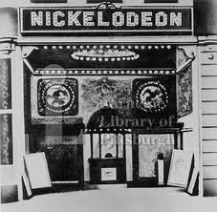
Nickelodeon

Slide 29
American Cinema: Pre WWI
Industry professionals focused on swiftly expanding the demand for film in America
Nickelodeon theaters were clustered in business districts and working-class neighborhoods
1908 Nickelodeons were the main form of exhibition
Most films came from abroad
Studio System born from the Nickelodeon boom

Slide 30
American Cinema: Pre-WWI
Edison company vs. American Mutoscope and Biograph
Conflicts over camera patents and equipment licensing distracted the two companies from the distribution aspect.
Two companies decided to cooperate-created Motion Pictures Patent Company that owned and charged licensing fees on key existing patents.
Production companies had to pay MPPC licensing fees in order to exist.

Slide 31
Patent
An invention or process protected by this right
The Vitascope

Slide 32
American Cinema: Pre-WWI
MPPC limited number of foreign companies
MPPC’s goal was to control all three aspects of the industry: production, distribution and exhibition.
Only licensed companies could produce, distribute and exhibit films=oligopoly
Eastman Kodak only sold films to MPPC licensed companies, etc.

Slide 33
Production
The whole creative process involved in the making of a film (shooting footage, set design, costume, directing, editing, etc)

Slide 34
Distribution
The process of selling and marketing the film

Slide 35
Exhibition
The process of showing the film in theaters
Exhibitors were those who owned and operated theaters and were involved in the buying/renting process of films.

Slide 36
Oligopoly
When a small number of firms cooperate to control the market.
In the film industry, when any other unlicensed firmed attempted to shoot, distribute, or exhibit a film, MPPC would threatened to sue for patent infringement.
Monopoly: when one firm controls the market

Slide 37
American Cinema: Pre-WWI
The independents fought back!!
6000 theaters agreed to pay the fees to MPPC
2000 refused
A market for unlicensed producers and distributors was created by these 2000
This portion of the industry was identified as the independents.

Slide 38
Independents
A group of professionals in the film industry who were not licensed through the MPPC to create, distribute, and exhibit films.

Slide 39
American Cinema: Pre WWI
The Independent Movement
Independent Motion Picture Company, New York Motion Picture Company
These companies could rent films from European companies that MPPC had shut out.
To avoid patent infringement suits they claimed to be using cameras that employed different mechanisms than Edison’s.

Slide 40
American Cinema: Pre-WWI
The MPPC retaliated and created the General Film Company in 1910 in an attempt to monopolize the distribution aspect of filmmaking.
GFC released ALL films made by MPPC producers.
MPPC also hired detectives to investigate the Independents claims in regards to mechanisms.
MPPC lost a key suit where IMP claimed to be using a different mechanism and after investigations, the court ruled that this particular mechanism had been anticipated in earlier patents, so therefore was not a violation
This freed all independents from the fear of infringement law suits!!!

Slide 41
American Cinema: Pre-WWI
After key loss, MPCC suffered, and many independents began banding together.
It was during this time that the feature film length was established AND it was the birth of the Hollywood Studio System.

Slide 42
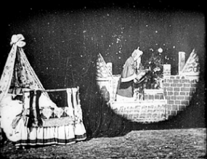
Advancement of film language
Development of editing techniques and special effects, along with the capacity for increased runtimes provided by the Latham loop, allowed for the advancement of narratives to flourish as audiences grew more familiar to the novelty of seeing motion captured on screen and competing inventors sought newer material.

Slide 43
Maturation and film business
The first successful permanent theatre showing only films was "The Nickelodeon", which was opened in Pittsburgh in 1905. By then, there were enough films several minutes long available to fill a programme running for at least half an hour, and which could be changed weekly when the local audience became bored with it. Other exhibitors in the United States quickly followed suit, and within two years, there were 8,000 of these nickelodeons in operation across the United States. The American experience led to a worldwide boom in the production and exhibition of films from 1906 onwards.
Movie theaters became popular entertainment venues and social hubs in the early 20th century, much like cabarets and other theaters.

Slide 44
Early animation
https://www.youtube.com/watch?v=-sa1MblIgE0

Slide 45
Cinema of Bangladesh
The cinema of Bangladesh, better known as Dhallywood (Bengali: ঢালিউড), is the Bengali-language film industry based in Dhaka, Bangladesh. It has often been a significant film industry since the early 1970s. The dominant style of Bangladeshi cinema is melodramatic cinema, which developed from 1947 to 1990 and characterizes most films to this day. Cinema was introduced in Bangladesh in 1898 by the Bradford Bioscope Company, credited to have arranged the first film release in Bangladesh. Between 1913 and 1914, the first production company, Picture House, was opened. A 1928 short silent film titled Sukumari (The Good Girl) was the first Bengali-produced film in the region. The first full-length film, The Last Kiss, was released in 1931. Following the separation of Bangladesh from Pakistan, Dhaka became the center of the Bangladeshi film industry, and has generated the majority share of revenue, production and audiences for Dhallywood films. The Face and the Mask, the first Bengali-language full-length feature film was produced in 1956. During the 1970s, many Dhallywood films were inspired by Indian films, with some of the films being unofficial remakes of those films. The industry continued to grow, and many successful Bangladeshi films were produced throughout the 1970s, 1980s and the first half of the 1990s.

Slide 46
Origin
On 28 December 1895, the Lumière brothers began commercial bioscope shows in Paris, with the first bioscope shows of the Indian subcontinent occurring the following year, including one in Calcutta and another at the Crown Theatre in Dhaka. The Bradford Bioscope Company of Calcutta arranged the show, which featured very short news items and other short features including footage of the jubilee of Queen Victoria, battles between Greek and Turkish forces, and the French underground railway. The price of a ticket to the show was an expensive eight anas to three taka. Bioscope shows continued to be shown throughout the region, including in Bhola, Manikganj, Gazipur, Rajbari, and Faridpur. These became the first films ever to be released in Bangladesh. The first seeds of Bengali cinema were sown by Hiralal Sen, a native of Bogjuri who is considered a stalwart of Victorian era cinema. Sen founded a company named The Royal Bioscope Company in 1898, producing scenes from the stage productions of a number of popular shows at the Star Theater, Minerva Theater, and Classic Theater in Kolkata. He pioneered film-making in the Calcutta in 1901, and shot footage in his home region. This was the first filming of what is now the nation of Bangladesh.
At the time when Calcutta-based film production houses were forming, East Bengal cinema halls were showing films produced in Calcutta, Bombay, Madras, Hollywood, and Paris. Sequential bioscope shows were started in Dhaka in 1913–14 in a jute store. It was named Picture House, becoming the first theater to be built in present-day Bangladesh.

Slide 47
Silent era
The Madan Theatre started making films in Calcutta in 1916. The first Bengali feature film, Billwamangal, was produced and released in 1919 under the banner of the Madan Theatre. The movie was directed by Rustomji Dhotiwala and produced by Priyonath Ganguli, the son of a nawab estate of Dhaka. A Bengali film organization named the Indo British Film Co was soon formed in Calcutta under the ownership of Dhirendra Nath Ganguly, a relative of Rabindranath Tagore. Ganguly directed and wrote Bilat Ferat in 1921. The film was the first production of the Indo British Film Co. The Madan Theatre production of Jamai Shashthi(1931) was the first Bengali talkie directed by Amar Choudhury.

Slide 48
Early development: Pakistan era
By 1947, there were around 80 cinemas in Bangladesh. After the partition of India in 1947, there were efforts to turn Dhaka into East Bengal's cultural center, with various individuals like Abbasuddin Ahmed creating short-lived film production companies in the city. In March 1948, when the Governor-General of Pakistan Mohammad Ali Jinnah came to visit East Pakistan, the radio broadcaster and filmmaker Nazir Ahmed was commissioned to create the informational film In Our Midst with the help of Calcutta-based film technicians. It was the first informational film of Bangladesh.

Slide 49
International recognition of Bangladeshi cinema
Internationally acclaimed Bangladeshi films include, Zahir Raihan's Stop Genocide (1971); Ritwik Ghatak's A river called Titas (1973); Sheikh Niamat Ali and Moshiuddin Shaker's Surjo Dighal Bari (1979); Tanvir Mokammel's Hooliya (1984), Nadir Naam Modhumati (1995) Quiet Flows the River Chitra (1999), Lalsalu (2001) and Lalon (2004); Morshedul Islam's Agami (1984), Chaka (1993), Dipu Number Two (1996), Dukhai (1997), Duratta (2004) and Amar Bondhu Rashed (2011); Tareque Masud's The Inner Strength (1989), Song of Freedom (1995), Story of Freedom (1999) and The Clay Bird (2002); Humayun Ahmed's Aguner Poroshmoni (1994) and Shyamol Chhaya (2004); Abu Sayeed's kittonkhola (2000), Shankhonad (2004), Rupantor (2008); Enamul Karim Nirjhar's Aha! (2007); Golam Rabbany Biplob's On the Wings of Dreams (2007); Mostofa Sarwar Farooki's Bachelor (2003), Third Person Singular Number (2009), Television (2013) and No Bed of Roses; Tauquir Ahmed's Joyjatra (2004) and Oggyatonama (2016); Rubaiyat Hossain's Meherjaan (2011) and Under Construction (2016); Kamar Ahmad Simon's Shunte Ki Pao! (Are You Listening!) (2012); Zahidur Rahim Anjan's Meghmallar (2014); Aung Rakhine's My Bicycle (2015); Bijon Imtiaz's Matir Projar Deshe-Kingdom of Clay Subjects (2016), Amitabh Reza Chowdhury's Aynabaji (2016) etc. These films won many international acclaims introducing Bangladeshi films to a wide international audiences. The late Tareque Masud is regarded as one of Bangladesh's outstanding directors due to his numerous productions on historical and social issues. Masud was honored by FIPRESCI at the Cannes Film Festival in 2002 for his film The Clay Bird (2002).

Slide 50
Film production and distribution house
There are more than 100 production houses in the Bangladeshi film industry, but few have managed to be successful in the market. Such production houses and distribution houses have helped Bangladeshi movies to reach a national and international platform, releasing films and distributing them to audiences overseas. Some well-known production houses in the Bangladeshi cinema include, Impress Telefilm, Khona Talkies, SK Films, Monsoon Films, Jaaz Multimedia, Tiger Media Limited, The Abhi Pictures, Fatman Films, Bongo BD.

Slide 51
Notable films: Classics
Sukumari-The good girl (1927–28)
The Last Kiss (1931)
The Face and the Mask (1956)
The Day Shall Dawn (1959)
The Sky and The Earth (1959)
The Clay Hill (1959)
Asiya (1960)
Kokhono Asheni (1961)
Shonar Kajol (1962)
Kancher Deyal-The Glass Wall (1963)
Shangam (1964)
Bahana (1965)

Slide 52
Cult films
Alor Michil (1974)
Megher Onek Rong (1976)
Shimana Periye (1977)
Chhutir Ghonta (Holiday Hours) (1980)
Emiler Goenda Bahini-Emil and the Detectives (1980)
Devdas (1982)
Boro Bhalo Lok Chhilo (1982)
Hooliya (Wanted) (1984)
The Gypsy Girl (1989)

Slide 53
Modern era films
Jaago(2010)
Meherjaan (2011)
Quicksand (2012)
Lal Tip (2012)
Shunte Ki Pao! (Are You Listening!) (2012)
Television (2013)
Ant Story (2014)
Faand: The Trap (2014)
Agnee (2014)
Taarkata (2014)
Checkmate (2014)
Desha: The Leader (2014)
Glow of the Firefly (2014)
Brihonnola (2014)

Slide 54
Commercial successes
Surjo Dighal Bari (1979)
Chhutir Ghonta (Holiday Hours) (1980)
Emiler Goenda Bahini (1980)
Devdas (1982)
The Gypsy Girl (1989)
Chakor(1992)
Aguner Poroshmoni (1994)
Dipu Number Two (1996)
Coolie (1997)
Kukkhato Khuni (2000)
Monpura (2009)
Most Welcome (2012)

Slide 55
Festivals
Dhaka International Film Festival
Bangladesh Short Film Forum
International Short and Independent Film Festival
International Children's Film Festival

Slide 56
Awards
Bachsas Film Awards – since 1972
National Film Awards – since 1975
Meril Prothom Alo Awards – since 1998
Babisas Award – since 2004
Ifad Film Club Award – since 2012
Lux Channel I Performance Award
Green Bangla Binodon Bichitra Performance Award

Slide 57
Film education
Bangladesh Film And Television Institute
International Academy of Film and Media (IAFM), partner of the event International Student Award organised by UniFrance
Department of Film and Television (Under Jagannath University)
Television and Film Studies (Under University of Dhaka)
Graphics Design & Multimedia, BA(Hons.) (Shanto-Mariam University of Creative Technology (SMUCT)
Film and Media Studies, BA(Hons.), Film and Media Studies, MA (Under Stamford University Bangladesh)
Multimedia & Creative Technology (Under Daffodil International University)
Department of Film, Television and Digital Media (FTDM) (Under Green University of Bangladesh)
Department of Media and Communication (Under Independent University, Bangladesh)
Bangladesh Film Institute (Past) and Bangladesh Film Institute (Present)
Moviyana Film Society
Bangladesh Film and Television Academy
Pathshala Cinema Department
Bangladesh Film School

