Slide 1
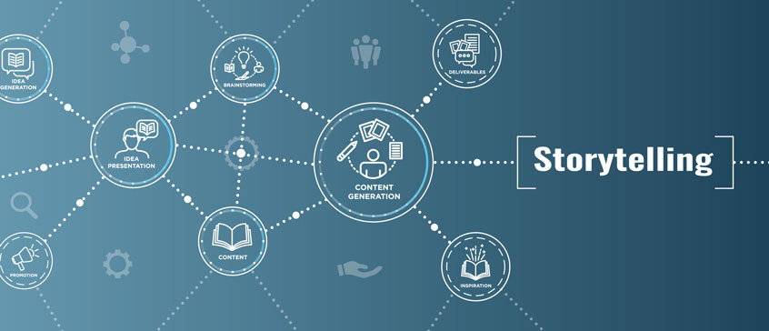
Chapter – 6
Fundamentals of Story Narrative
Prepared by
Sadia Mustafa Sraboni

Slide 2
How to Structure a Story: The Fundamentals of Narrative
As children, we learned stories begin with "once upon a time" and end with "happily ever after." While this may be the most simplistic view of a story, it offers storytellers advice on a narrative structure that stands the test of time.
A good book has a beginning, middle, and end—but a good storyteller knows it’s not always that simple. Getting from beginning to end requires you to follow a certain structure in order to create an engaging and exciting experience for the reader.

Slide 3
What is Narrative Structure?
Narrative structure, also referred to as a storyline or plotline, describes the framework of how one tells a story. It's how a book is organized and how the plot is unveiled to the reader.
Most stories revolve around a single question that represent the core of the story. Will Harry potter defeat Voldemort? Will Romeo and Juliet end up together? Will Frodo destroy the Ring?
The series of events that follow in an attempt to answer this defining question is what creates your narrative structure.
Various components work together to build a narrative structure, but it’s mostly centered around the development of your plot and your main character(s).

Slide 4
Types of Narrative Structure
Linear/Chronological: When the author tells a story in chronological order. This structure can include flashbacks, but the majority of the narrative is told in the order that it occurs. Most books tend to fall under this narrative structure.
Nonlinear/Fractured: A nonlinear structure tells the story out of chronological order, jumping disjointedly through the timeline. David Mitchell’s Cloud Atlas is an example of this narrative structure, as it switches between multiple characters at different points in time.
Circular: In a circular narrative, the story ends where it began. Although the starting and ending points are the same, the character(s) undergo a transformation, affected by the story's events. S.E. Hinton’s The Outsiders is an example of circular narrative structure.

Slide 5
Parallel: In parallel structure, the story follows multiple storylines, which are tied together through an event, character, or theme. F. Scott Fitzgerald’s The Great Gatsby or the movie Finding Nemo are both examples of this structure.
Interactive: The reader makes choices throughout the interactive narrative, leading to new options and alternate endings. These stories are most prominent as "choose your own adventure" books.

Slide 6
Types of Narrative Arcs for Plot Development
Regardless which narrative structure you choose, one of the biggest components to creating a great storyline or narrative structure is developing your plot. These are all the actions that will take place in the book, culminating in an interesting and satisfying ending.
These structures are often considered “arcs” because of the way a story rises and falls, creating an arc shape. The most fundamental narrative arc includes the following five plot stages:
Exposition: This is your introduction, where you introduce the characters, establish the setting, and present the primary conflict.
Rising action: This second stage is where you introduce the primary conflict and set the story in motion. Each succeeding event should be more complicated than the previous, creating tension and excitement as the story builds.

Slide 7
Climax: This is the turning point in the story—the point of the highest tension and conflict. This is the moment that should leave the reader wondering what’s next.
Falling action: In this stage, the story begins to calm down and work toward a satisfying ending. Loose ends are tied up, explanations are revealed, and the reader learns more about how the conflict is resolved.
Resolution: The main conflict gets resolved and the story ends.
This narrative arc is the most basic framework for developing a book’s plot. Although you can vary it slightly, your story should follow this basic structure.
However, more comprehensive frameworks exist if you need extra help developing a plot.
The 3 Act, 8 Sequence structure is used by both authors and screenwriters alike to develop an engaging storyline.

Slide 8
Act 1 – The Beginning
Sequence 1 – Status Quo and Inciting Incident: Established the main character in his/her normal life, ending with a point that sets the story into motion.
Sequence 2 – Predicament and Lock-In: Sets up the central conflict of the story and the main character accepts the call to action.

Slide 9
Act 2 – The Middle
Sequence 3 – First Obstacle: The character faces the first obstacles toward reaching their goal, building the tension and putting them at a point of no return.
Sequence 4 – Midpoint: A decisive moment where the main character faces the central conflict in some way, usually realizing something that changes him/her.
Sequence 5 – Rising Action: Continue to raise the stakes for your main character, usually with a subplot of some sort that builds up to the main conflict.
Sequence 6 –Biggest Obstacle: The main conflict or the highest point of tension in your story. This should be the most difficult moment for your character, so make it count.

Slide 10
Act 3 – The End
Sequence 7 – Twist: Here, your character deals with the remnants of the main conflict or realized a new goal they have to achieve.
Sequence 8 – Resolution: Where you’ll give the answer to your story’s main question, thus resolving the conflict and bringing your story to a satisfying close (or a cliffhanger, if you’re writing a series).
As you can see, this narrative structure follows a very similar pattern as the basic five-element framework, but it can provide you with a little more information and guidance as you work to build out your plot.

Slide 11
Elements of Storytelling

Slide 12
1. Plot
The plot is the most important part of any story. It defines what story is all about. What the audience will experience. It sets up the motivations, challenges, the Goal, and the road people are taking to fulfill it.
It helps the audience to empathize with the protagonist(User), connect and understand the underlying characteristics and details involved with it. A simple plot is all that is required to build a good story.

Slide 13
2. Character
Characters are the elements who are living in the story. The people who are being affected by the Plot, who has motivations, traits, personalities, weakness, fear, who takes actions based on their psychological traits. These are the element whose actions determine the flow of the plot.
To build a strong story, the characters have to be well-defined and consistent across the entire story because the audience can only believe, empathize with the characters if they can deduce their traits and can relate to them and able to see the justification behind character’s action. That is how the Audience will be able to build their trust in the character.
He is the most popular character spread across all mediums. And almost everyone knows what type of character he is, what is his background, what are his motivations, why he does what he does and how he is able to afford everything that he does.

Slide 14
3. Theme
The Importance of Theme cannot be understated. It has a great influence on way the plot is being perceived, Surrounding of a Story gives direct support to the character traits and gives an opportunity for the Audience to understand the underlying motivations and fear.
And it also enables us to reuse the plot and characters in different stories. Many stories have a somewhat identical plot, characters, motivations and such, but what really makes a difference in those sort-of similar stories is the Theme of the story.
This is one of the main things that Disney used in their earlier animated movies to differentiate between One Disney princess from another. They changed the Theme of the Story

Slide 15
4. Dialogue
It is the way how characters connect with each other and to you, The Audience. The choice of words used in the story. The tone used, the words being used and how it caters to the Audience it has been designed for. Because this element enables the story to resonate with the intended audience. The factors that affect the Dialogue of a story ranges from:
The Audience
The Message
The Platform used for Distribution of Story
And the Brand story is under.

Slide 16
5. Melody
By hearing the word Melody, almost everyone thinks of — the Music, the Tune or some Audio. True to the point, they are in fact correct. Melody provides familiarity with the audience about the story and what they are about to perceive. It also helps to trigger certain emotions into audience psych and the audience can recognize or get an idea of what they are about to perceive and what they can expect.
For example, A beat of John Williams’s Star Wars theme is enough to let the audience know that “They can expect a Space Adventure, or see, Darth Vader, choking someone while telling them not to choke on their aspirations.”

Slide 17
6. Decor
The Decor translates to the Visual aesthetics of the Theme. The graphics that are being used to support the Theme, that has a certain look and feel.
Humans are visual learners, we see things, and that’s how we learn and remember stuff. So the graphic in storytelling plays a really important part in establishing the world in which our Plot and Character take place.
Mind you, Decor can also be painted using the words as well. A Skillful story-teller knows how to establish the decor from their words and paint the picture clearly inside Humans' brains.

Slide 18
Conclusion
And there you have it, the Ancient Greek wisdom by Aristotle himself, condensed into this small article.
The story is great, everyone has one, and everyone wants to listen. But it takes special skills to Tell the Story. It takes effort to engage your audience, even if the size of the audience is one.
If you want to be a good Designer, Be a good storyteller.
Specify your target audience, Make your plot as simple as it gets and compelling. With the characters well-defined traits, motivation, and goals. Think of your theme and the decor that goes with it to make it authentic and believable. Use the Dialogue which fits perfectly with your audience. The melody that makes your Story familiar and recognizable with the brand. And when the audience feels like everything is getting recognizable and familiar in the story, surprise them with a spectacle.

