Slide 1
WELCOME
Course Title: Basic Functional English
Course Code: ENG101

Slide 2

Nahida Akter Poly
Lecturer,
Department of English,
Daffodil International University

Slide 3

What do you think of this statement?

Slide 4
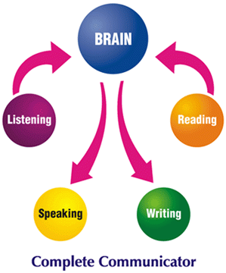

Slide 5

What is Functional English?

Slide 6
Functional English
Functional English is about the usage of English in our day-to-day life. It is often offered as a foundation course, as a good command of English is often required for academic studies and career progression. Functional English equips students with the necessary knowledge, skills and understanding to use and apply English in everyday life.

Slide 7

Thank You

