Slide 1
Use of
Articles

Slide 2
The definite article - the
We use the definite article in front of a noun when we believe the listener/reader knows exactly what we are referring to.
              The sun
              The moon
              The holy Quran
              The Bible

Slide 3
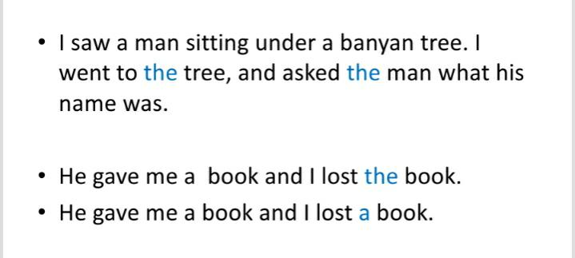

Slide 4
Geographical use of definite article
Typically, the article the is not used before the names of countries and territories.
            The Bangladesh is a riverine country.
            Bangladesh is a riverine country.

Slide 5
However, the is used before countries whose names are plural in form:
    Have you ever been to Netherlands ?
    Have you ever been to the Netherlands ?

Slide 6
The is also used with countries whose names include the words states, kingdom, or republic:
    My sister lives in United States.
    My sister lives in the United States .

Slide 7
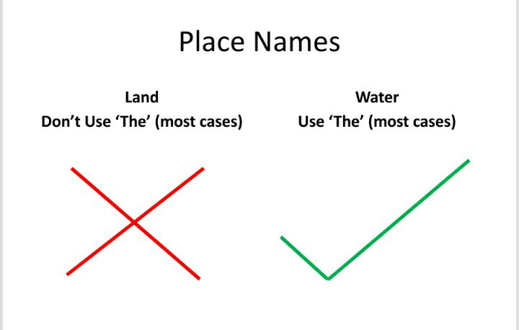

Slide 8
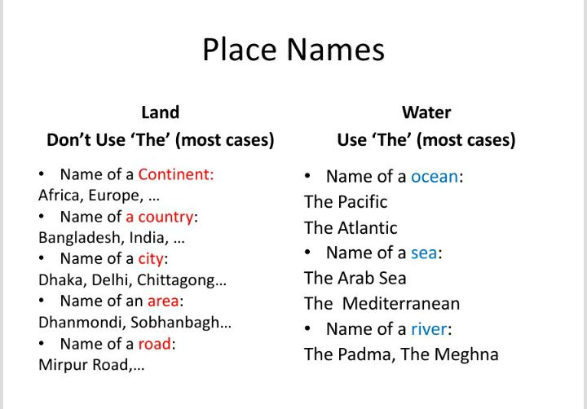

Slide 9
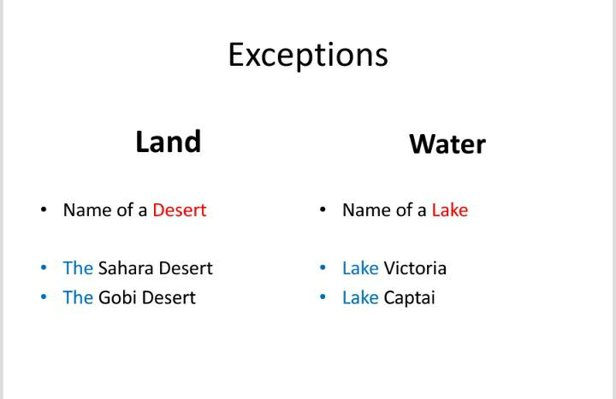

Slide 10
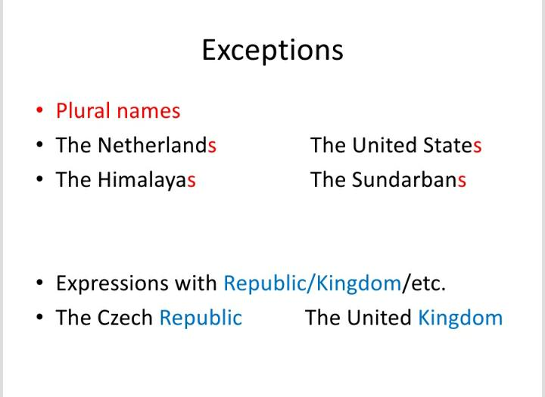

Slide 11
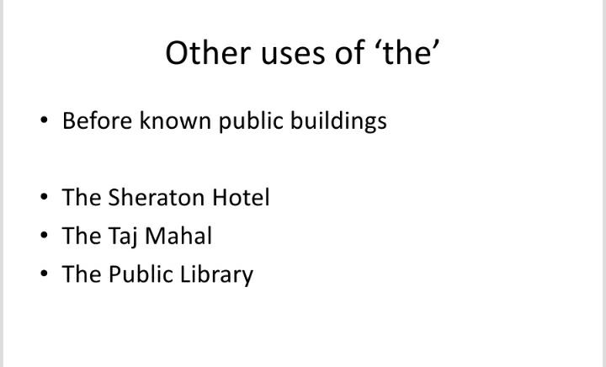

Slide 12
Before superlatives
He is the richest man of this country.
She is one of the most beautiful girls I have ever seen.
He used to be the best singer of their class.

Slide 13
Before ordinal numbers
The last chapter is very important.
This is the 21st century.

Slide 14
With collective nouns

