Slide 1
ASRH situation: global, developed and developing country’s perspective
Dostogir Harun
Email: dostogirharun@gmail.com
Cell: 01556 636 545

Slide 2
Adolescent health-Global situation
Young people
  Big numbers
  Big challenges
  Big possibilities

Slide 3
Adolescence
Adolescence is variously defined as a period of transition from childhood to adulthood. It involves a rapid change in many aspects including the biological, psychological and socio-cultural. The World Health Organization (WHO) has defined adolescence as progression from the onset of secondary sex characteristics to sexual and reproductive maturity; development of adult mental processes and adult identity and transition from socio-economic dependence to relative independence (WHO, 1975 cited in Population Reports, 1995:3).

Slide 4
Adolescent health-Global situation
At present there are more young people between the ages of 10 and 24 today than at any other time in human history
Today’s generation of young people numbers slightly less than 1.8 billion in a world population of 7.3 billion
It’s up from 721 million people aged 10 to 24 in 1950 when the world’s population totaled 2.5 billion (UN Department of Economic and Social Affairs, 2014)
UNDESA estimated the number of 10 to 24-year-olds will reach two billion by the middle of this century

Slide 5
Adolescent health-Global situation
In the world’s 48 least developed countries, most people are children (under age 18) or adolescents (ages 10 to 19)
In Afghanistan and 15 countries in sub-Saharan Africa, half the population is under 18. In Chad, Niger & Uganda, half are under 16
Fully 89 percent of the world’s 10 to 24-year olds, almost nine out of 10, live in less developed countries
India has the world’s highest no of 10 to 24-year-olds, with 356 million

Slide 6
Adolescent health-Global situation
Research has found correlations between a high proportion of 15-29-year in a population and a greater incidence of civil conflict
Complications during pregnancy & childbirth are a common cause of death among girls and young women in developing countries
The complications of pregnancy and childbirth are still the 2nd leading killer of females aged 15 to 19
Worldwide, suicide is one of the big causes of death for adolescent girls aged 15 to 19

Slide 7
Adolescent health-Global situation
HIV is today the 2nd leading cause of death for adolescents, and in contrast to the case with maternal mortality
Every day, 39,000 girls become child brides (about 140 million) in a decade linked to early pregnancy and deaths from complications
Gender inequality closely tracks the proportion of youth populations
Unwanted pregnancy is common among the poor and valuable
Adolescents have less access to contraception because of social pressures to have a baby as soon as possible (Mouli and colleagues, 2014).

Slide 8
Adolescent health-Global situation
Access to quality comprehensive sexuality education remains elusive for most adolescents (UN Commission on Population and Development, 2014; UNESCO, 2014a).
Adolescents and young women seeking abortion or post-abortion care face access problems in many countries
Younger women are more likely to wait to seek an abortion, use an unskilled abortion provider or use dangerous methods to self-abort, and delay seeking care for complications (Rosen, 09)
Many young women who do get pregnant do not use or have no access to prenatal care services (UNFPA, 2013a, Reynolds et al., 2006)
Millions of adolescents and young people lack access to sexual and reproductive health information and services

Slide 9
Adolescent health-Global situation
Millions of adolescents and young people lack access to sexual and reproductive health information and services
Adolescents also have significantly lower access to and use of HIV testing & counseling compared to older people (10 % young men and 15% of young women know their HIV status -WHO-2013)
Adolescents also have less access to HIV treatment and care relative to older people (United Nations, 2014a; Kim et al.2014)
Adolescents, particularly unmarried adolescents, often face hostile and judgmental health care workers. (Some may refuse to provide services, and others may berate adolescents who they believe should not be having sexual relations-Chandra-Mouli et al., 2014).

Slide 10
Adolescent health-Global situation
33 million women between the ages of 15 and 24 would use contraceptives if they had access to them (MacQuarrie, 2014).
Adolescents are more likely to take risky behavior
Inequalities in young people’s access to and use of sexual and reproductive services
Adolescent girls are the most vulnerable to health education and other social support in the LIMCs
Improving adolescent girls in those mentioned areas can reduce the health burden

Slide 11
Discussion Article
Adolescent Health 2
Global perspectives on the sexual and reproductive health of adolescents: patterns, prevention, and potential
Linda H Bearinger, Renee E Sieving, Jane Ferguson, Vinit Sharma

Slide 12
Summary
Worldwide, societal shifts and behavioral patterns exacerbated by unique developmental vulnerabilities create a confluence of factors that place today’s adolescents at heightened risks for poor health outcomes
Country-level data show that continued investment in effective prevention and treatment strategies is essential to protect adolescents’ sexual and reproductive health.
Whereas strategies must be tailored to the developmental needs of this age group and their social contexts, effective approaches are multifaceted.
All adolescents need access to quality youth-friendly services provided by clinicians trained to work with this population. Sex education programs should offer accurate, comprehensive information while building skills for negotiating sexual behaviors.

Slide 13
Summary
Girls and boys also need equal access to youth development programs that connect them with supportive adults and with educational and economic opportunities.
Although progress has been made since the 1994 International Conference on Population and Development, adolescents continue to be disproportionately burdened by threats to their sexual and reproductive health.

Slide 14
The Health Status of Young Adults in the USA
The health issues of young adulthood have received relatively little attention compared with those of adolescence, although the critical issues in young adulthood parallel those of adolescence.
Young adults often fare worse than adolescents on health indicators, with many measures of negative outcomes—including rates of injury, homicide, and substance use—peaking during the young adult years.
The contextual factors shaping health status and access to care in young adulthood differ significantly from the context of adolescence.
This article synthesizes national data to present a health profile of young adults, reviewing social indicators that describe the context of young adulthood and presenting measures of health status.

Slide 15
The Health Status of Young Adults in the USA
We examine mortality, morbidity, risky behaviors, and health care access and utilization, identifying the most significant gender and racial/ethnic disparities.
The article also identifies limitations of existing data and offers suggestions for future research and health monitoring in this area.
We conclude with a discussion of current efforts to address the health and well-being of young adults and argue for creating a national health agenda for young adults that includes research, programs, and policies to address health issues during this period of the lifespan.

Slide 16
Adolescents in Bangladesh: at a glance
About 23 percent of the total population is adolescent (10-19)
About 32 percent are in the age range of 10-24 years
About 45 percent of the total is very young (below 15 years)
About 48% of (15 to 19-year-old) adolescent girls are married and about 60% of them are becoming mothers before reaching the age of 19.
39% of married adolescent girls have never used contraception.
The ratio of urban and rural adolescent girls is 1:5.

Slide 17
Adolescents in Bangladesh: at a glance
The ratio of urban and rural adolescent girls is 1:5.
Mean age at marriage is 16.9 years.
Most of the adolescents are illiterate (27%), unemployed (89%), and with no access to health facilities (77%)
80.6 births per 1,000 women 15 through 19 years of age, more than twice the average in the Asia region
Teenage pregnancy & motherhood is a key social & health concern
Early teenage pregnancy can cause serious health problems for both the mother and the child

Slide 18
Adolescents in Bangladesh: at a glance
The other key causes of mortality in young mothers are toxemia, abortion,
and violence
Early childbearing has an adverse health effect on a young mother
Early childbearing among teenagers is more common in rural than in urban areas (32 and 27 % respectively)
Domestic violence remains the biggest threat to the security of adolescent health in Bangladesh
Adolescence is a profound and complex stage of life that influences future health outcomes, attitudes, and behaviors

Slide 19
Adolescents in Bangladesh
Adolescents appear to be poorly informed with regard to their own sexuality, physical well-being, health and bodies
Lack of knowledge on reproductive and sexual health that causes young people to engage in risky sexual behavior
The reproductive health needs of young women are quite different from those of young men
According to WHO, worldwide, girls younger than 18 are up to five times more likely to die in childbirth than are women in their 20s

Slide 20
Adolescents reproductive health in Bangladesh
Misunderstanding of issues related to puberty, fertile period, and risky sexual behavior such as abortion, STDs, and HIV/AIDS
Due to lack of access to information and services and societal pressure to perform as adults apart from the physical, mental, and emotional changes they are undergoing
The existing information and services that are available are not specific to adolescents and the materials are not youth-friendly

Slide 21
Adolescents reproductive health in Bangladesh
Many young engage in sexual activities without protection from many partners, and are likely to experience STDs and HIV/AIDS
In BD adolescent represent about ¼ of the total population so their health issues is a major fact of the overall country’s health status
Adolescents in BD face a number of preventable diseases including early pregnancy, violence, nutrition deficiency, and chronic illness

Slide 22
Adolescents health in Bangladesh
Empowering adolescent girls is recognized as a key to improving overall RCH outcomes and accelerating social and economic development
Discrimination against girls has been identified as one of the prime ARH issues in Bangladesh
The discrimination exists in most spheres of life (health, education, empowerment, etc)
There are also wide disparities in opportunities available to rural Vs Urban, Poor vs rich in all aspects of life

Slide 23
Marriage pregnancy and contraception among adolescents
Inspire of legal age of marriage (18 and 21) early marriage among female is prevalent in Bangladesh (11% age 10-14 & 46% age 15-19)
Early marriage is common in rural areas (around 80% girls married before 18)
Married girls are under pressure for child, result early pregnancy
Some social issues pressure parents to marry girls early (dowry, safety)
Lack of awareness and experience, contraceptive use is also low among adolescent in Bangladesh (42% and 58%)
LBW is more common for adolescent girls than adult women
Unwanted pregnancy and unsafe abortion rate is also higher among adolescent girls

Slide 24
Nutrition among adolescent
The nutritional status of adolescent in Bangladesh is deplorable
Lack of proper knowledge, incorrect food habits, inability of additional dietary needs during pregnancy cause health hazards
Many studies in Bangladesh girls have higher nutrition deficiency than boys
Some misconception in rural and remote areas still have practicing not to give more food to pregnant women for difficulty in delivery
Poor people have nutrition deficiency and rich have obesity in BD
Lack sufficient nutritionist is another challenges for proper dieting

Slide 25
Violence, exploitation and abuse
Violence against adolescent is common in many forms (Physical, sexual, mental)
Dowry related violence, marital rape, sexual harassment, acid thronging, force prostitution, trafficking also cause of vulnerability
Low paid, long hours work, adverse work situation higher health risk for adolescents
Most rape causes among young girls (UNICEF & AOSK) that have greater consequences in physical and mental health
300000 young Bangladeshi girls work in the brothel of India 20000 women trafficked to Pakistan over last ten years

Slide 26
Violence, exploitation and abuse con..
MMS is not also happen a lot and often boys are forced to participate such unproductive sexual act, resulted STIs
A study ( unpublished) found high proportions of adolescent male are suffering from STIs
Adolescents in Bangladesh also involved a lot in risky behavior and activities widely

Slide 27
Adolescent Sexual and Reproductive Health Programs in Humanitarian Settings
Globally, 16 million adolescent girls aged 15-19 years and two million girls under age 15 give birth every year
In the poorest regions of the world, this translates to roughly one in three girls bearing children by the age of 18
Adolescent girls are at the highest risk of maternal mortality: the risk of pregnancy-related death is twice as high for girls aged 15-19 and five times higher for girls aged 10- 14 compared to women in their twenties
Further, pregnant adolescents are more likely than adults to pursue unsafe abortions; an estimated three million unsafe abortions occur every year among girls aged 15-19

Slide 28
Adolescent Sexual and Reproductive Health Programs in Humanitarian Settings
In humanitarian settings, child-bearing risks are compounded for adolescents, due to increased exposure to forced sex, increased risk taking and reduced availability of and sensitivity to ASRH services
During conflict or a natural disaster, family and social structures are often disrupted, and educational and social services are discontinued
Adolescents can become sexually active when few protective services are available, and girls especially are vulnerable to sexual assault and exploitation
Such risks increase their vulnerability to sexually transmitted infections, unwanted pregnancies and unsafe abortion
Investing in ASRH may delay first pregnancy, reduce maternal mortality, improve health outcomes, contribute to broad development goals and reduce poverty

Slide 29
What is the youth experience in Somalia
Unemployment is high among youth, although many do some sort of informal work
Most youths want to work in an office, although most lack the skills to do so and opportunities are limited
Major barriers to employment are lack of skills and experience; tribalism/nepotism and corruption; insecurity (lack of freedom of movement and access to land and businesses); and gender discrimination

Slide 30
What is the youth experience in Somalia
What is the youth experience? In Somalia, youth experience is largely driven by poverty, food insecurity, and lack of access to education and other services
Urban youth have access to more services. Overwhelmingly, education is the number one aspiration of younger youth, while employment is the number one aspiration of older youth, especially if they already have some education
Younger youth believe that education is the way to a better life, while older youth (25-30 years-old) are dissatisfied with the education they received as it has generally not resulted in employment
Unemployment is high among youth, although many do some sort of informal work
While the production sector (agriculture, livestock, fisheries) has been the primary employer, youth are interested in modern or mechanized production rather than manual labor

Slide 31
What is the youth experience in Somalia
Youth lack access to money and assets to start their own businesses, in addition to having low education and skills
When not at school or work, female youth are most likely to be at home, and, regardless of gender, youth are engaged in social media and texting.
Many communities experience treatable illnesses such as TB, diarrhea, and malnutrition
Teen pregnancy, rape in some areas, and substance abuse appear to be on the rise and are big concerns among youth who see these issues as affecting physical and mental health.

Slide 32
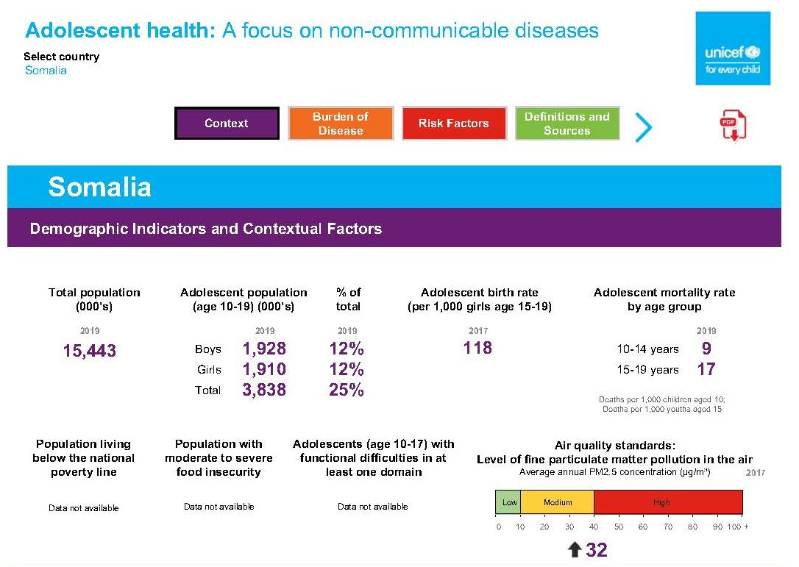

Slide 33
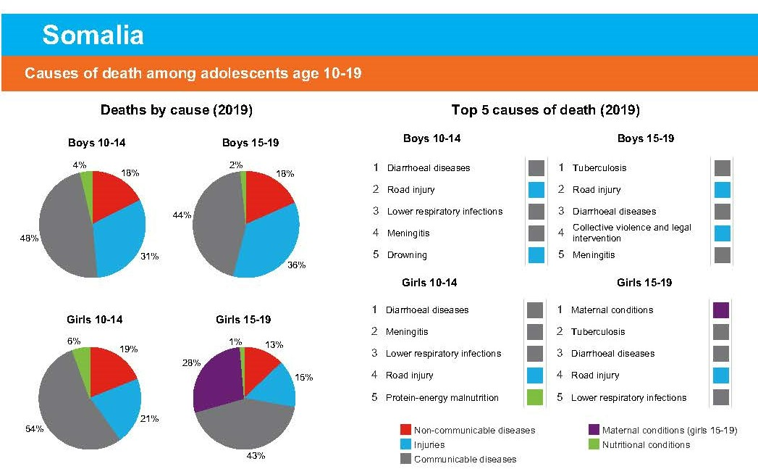

Slide 34
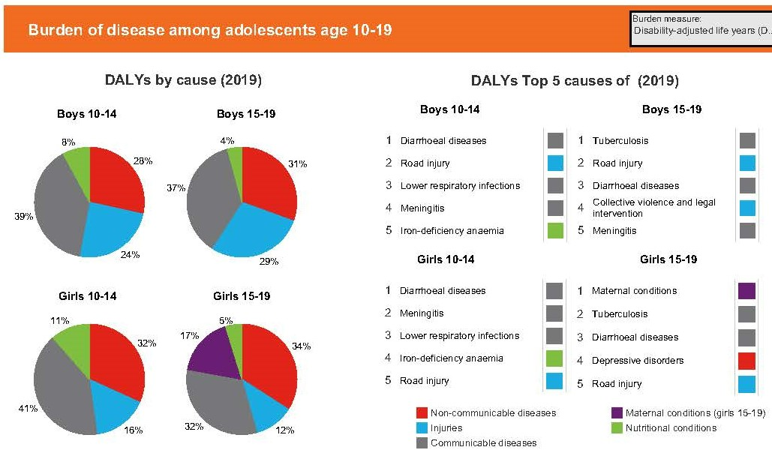

Slide 35
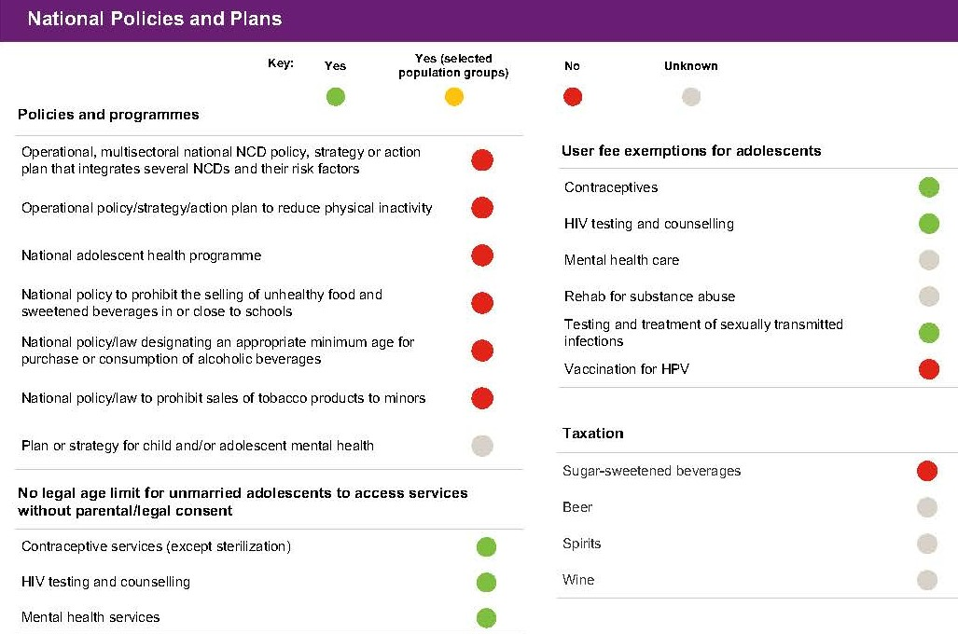

Slide 36
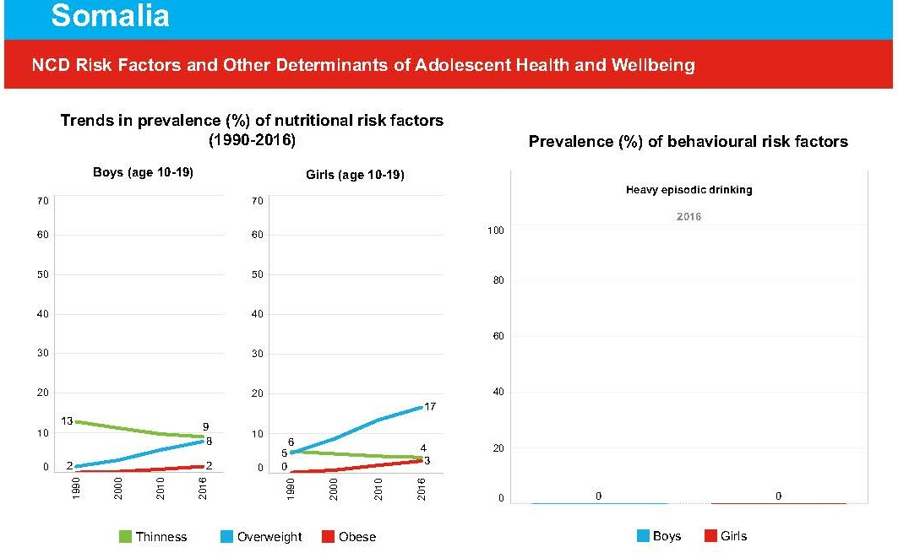

Slide 37
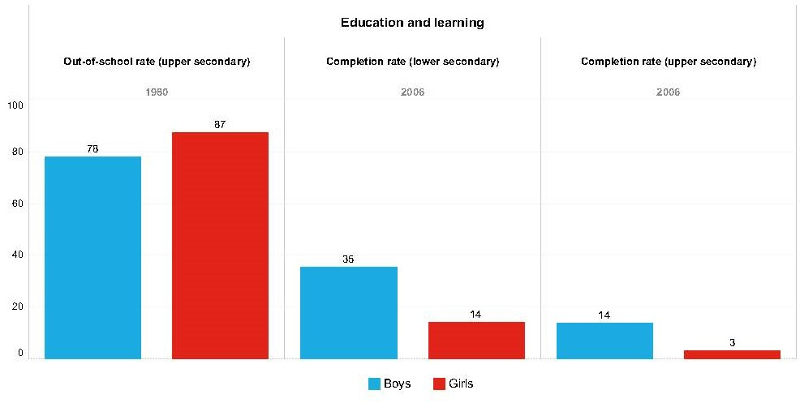

Slide 38
Discussion Article
Association Between Child Marriage and Reproductive Health Outcomes and Service Utilization: A Multi-Country Study From South Asia
  Deepali Godha, M.B.B.S., Ph.D. a,*, David R. Hotchkiss, Ph.D. b, and Anastasia J. Gage, Ph.D. b
  Received July 19, 2012; Accepted January 25, 2013

Slide 39
Association Between Child marriage and RH outcomes
Child marriage is significantly associated with poor fertility outcomes, lower contraceptive use early in the marriage, and inadequate maternal health care use
The vulnerable position of young women who married at age 17 is corroborated by our findings that child marriage is significantly associated with unwanted pregnancies
Women who married in early adolescence have a higher tendency toward most of the negative outcomes, compared with women who married in middle adolescence
Maternal child marriage has been found to be significantly associated with an increased likelihood of stunting & underweight
Child marriage adds a layer of vulnerability to women that leads to poor fertility control and fertility-related outcomes, and low maternal health care use
Notes:
Association Between Child Marriage and Reproductive Health Outcomes
and Service Utilization: A Multi-Country Study From South Asia
Deepali Godha, M.B.B.S., Ph.D. a,*, David R. Hotchkiss, Ph.D. b, and Anastasia J. Gage, Ph.D. b
a Independent Consultant, Indore, India
b Department of Global Health Systems and Development, Tulane University School of Public Health and Tropical Medicine, New Orleans, Louisiana
Article history: Received July 19, 2012; Accepted January 25, 2013
Keywords: Child marriage; South Asia; Fertility; Contraceptive use; Maternal health care utilization

