Slide 1
Bangladesh:
Sociological and Anthropological Perspectives

Slide 2
Chapter Objectives
Explore socio-anthropological perspectives of Bangladesh
Make your understanding about the social structure, stratification, and it’s relevance to Bangladesh
Deliberate the cultural evaluation, various cultural elements, and practices of Bangladesh
Discuss the indigenous community of Bangladesh
Explore the impact of globalization on Bengali culture and society

Slide 3
SOCIOLOGICAL AND ANTHROPOLOGICAL PERSPECTIVE
Sociology and anthropology involve the systematic study of social life and culture in order to understand the causes and consequences of human action.
They examine how culture, social structures (groups, organizations and communities) and social institutions (family, education, religion, etc.) affect human attitudes, actions and life-chances.
Sociology and anthropology combine scientific and humanistic perspectives in the study of society. Drawing upon various theoretical perspectives, sociologists and anthropologists study areas such as culture, socialization, deviance, inequality, health and illness, family patterns, social change and race and ethnic relations.
This combination also helps students to understand everyday social life as a blend of both stable patterns of interaction and ubiquitous sources of social change

Slide 4
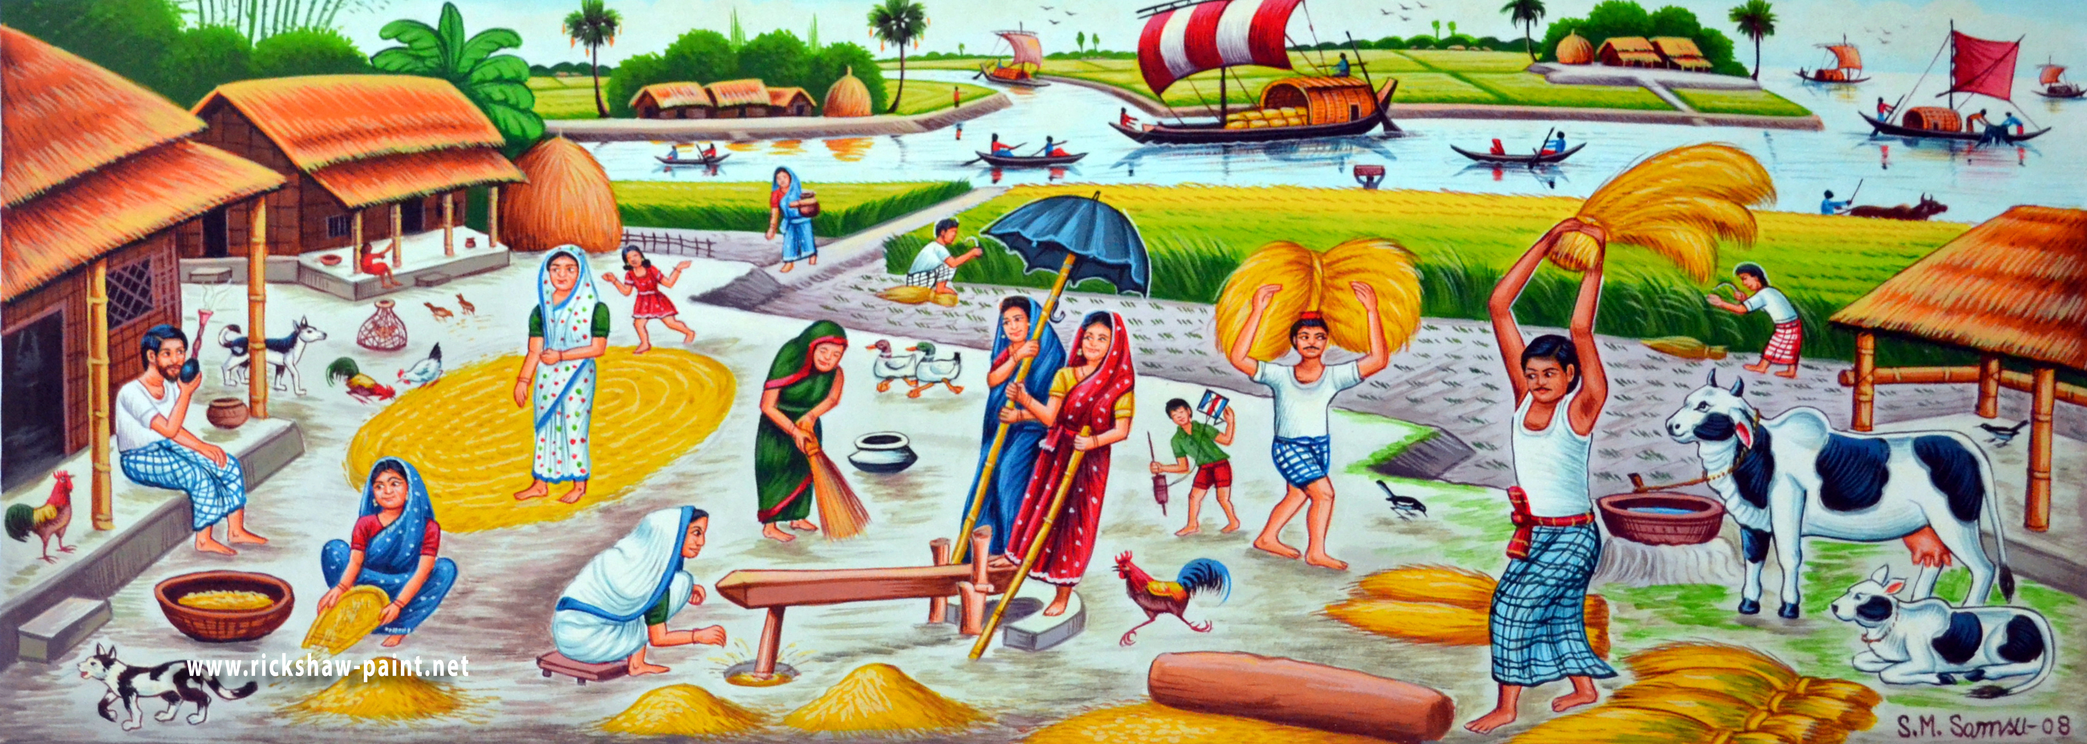
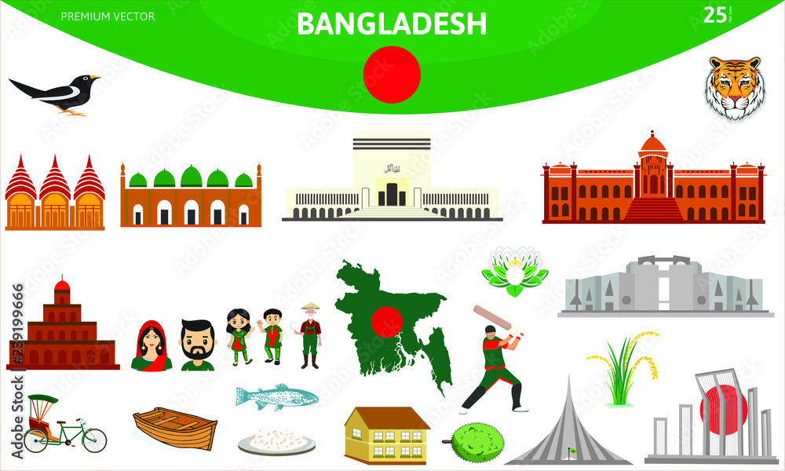
ANTHROPOLOGY DEALS WITH CULTURE & SOCIOLOGY DEALS WITH SOCIETY
There can be no culture without society
and there can be no society without culture

Slide 5
SOCIETY AND ITS TYPES
Societies are social groups that differ according to subsistence strategies, the ways that humans use technology to provide needs for themselves. Anthropologists tend to classify different societies according to the degree to which different groups within a society have access to advantages such as resources, prestige, or power.
Sociologists place societies in three broad categories:
      Pre-industrial;
      Industrial and
      Postindustrial.

Slide 6
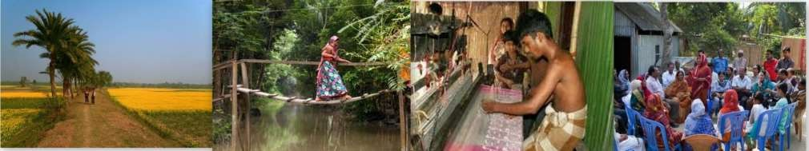
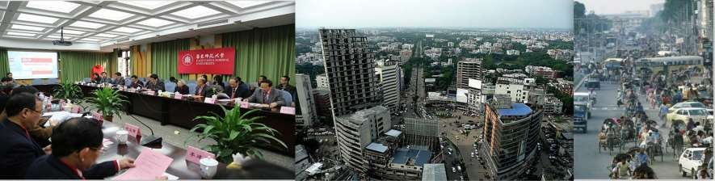
SOCIAL STRUCTURE OF BANGLADESH
Social structure is the organized pattern of social relationships and social institutions that together compose society
Urban Society
Rural Society
Bangladesh did not exist as a distinct geographic and ethnic unity until independence. It had been a part of Indian Empires
Establishment of Pakistan in 1947
Establishment of Bangladesh in 1971

Slide 7




SOCIAL STRUCTURE OF BANGLADESH (CONT.)
The rural economy in Bangladesh has been a powerful source of economic growth
.
.
.
Generates
6% increase
in non farm income
10% increase
in farm income
4.65%
Agriculture growth high between 2010-2018
87%
Rural household receive income from agriculture
65%
Household rely on both farm and non farm incomes
2%
Rural non farm relative to urban employment
Agriculture growth stimulates non farm income

Slide 8
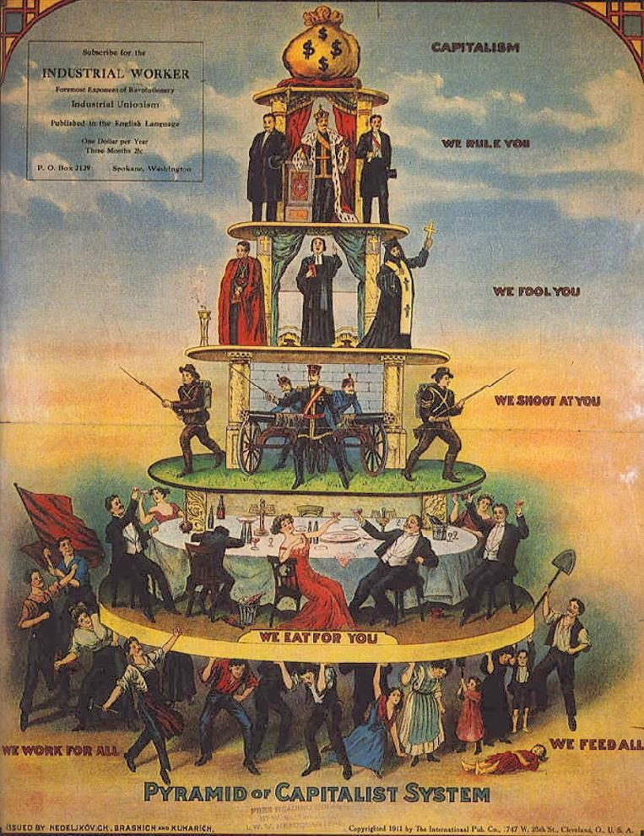
SOCIAL STRATIFICATION
Social Stratification is the ranking of people or groups according to their unequal access to scarce resources. Bases of social stratification include:
Power is the ability to control the behaviors of others, with or without their consent. It can be based on force, particular social status, personal characteristics, or customs and traditions.
Prestige is the respect, honor, recognition or courtesy an individual receive. Occupation, property, education, family background, area of residence are common determinants of prestige in Bangladesh
Socio economic status is a rating that combines both social factors such as educational level, occupational prestige and economic factors such as income.

Slide 9
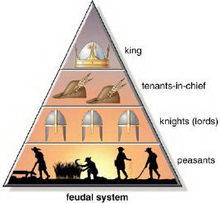
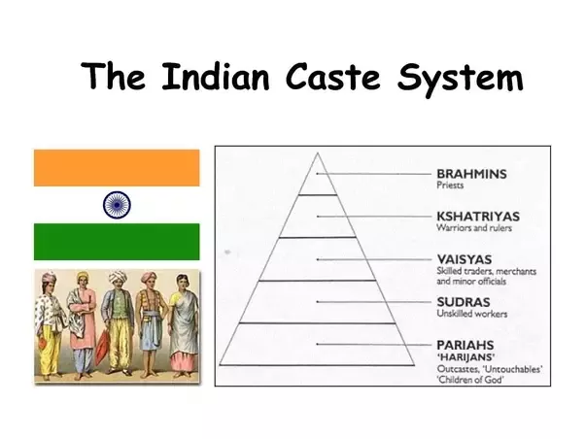
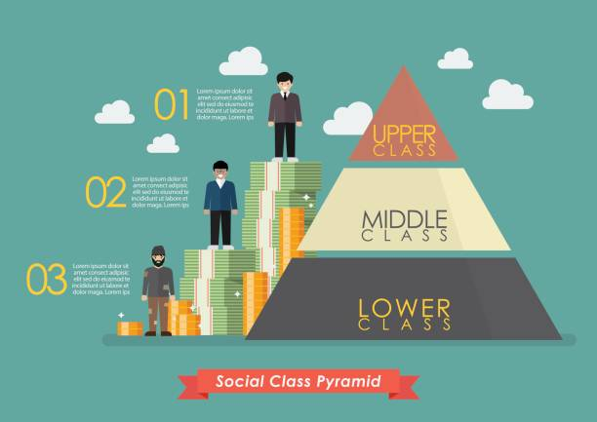
FORMS OF STRATIFICATION
Estate system is a politically based system of stratification characterized by limited social mobility that is best exemplified in European Feudal society.
Caste System is a system of stratification characterized by hereditary notions of religious and theological purity and generally offers no prospects for social mobility. The “Varna” system in India is the best example.
Class System is an economically based stratification characterized by somewhat loose social mobility and categories based on roles in production process rather than individual characteristics. Example: Capitalist class system

Slide 10
SOCIAL STRATIFICATION IN BANGLADESH
Social Stratification
in Present Society
On the basis of income and wealth we can divide the society of Bangladesh into three broad categories though there are different sub groups.
UPPER CLASS
Industrialist, Businessman and Top Professionals etc.
MIDDLE CLASS
Professionals, Bureaucrats and Skilled Workers etc
LOWER CLASS
Rickshaw puller, Labor, Poor farmer and Fisher man etc.
Social Stratification
In Hindu Society
In the Hindu society in Bengal we got two caste division which are:
Brahmans
Upper class people
Non-Brahmans
Kayastha Baidya, Tanti, Swarnakar and
Chamar etc.
Social stratification
In Colonial Period
We noticed another different type of social stratification in the colonial period which was centered ownership of land. Like as:
Zamindars
The most powerful class in the agrarian structure.
Rich Peasant Class
During the colonial time we witnessed the emergence of a rich peasant class who occupied an important position.
Poor peasants
working class coming from the landless and marginal peasants.

Slide 11
Different Concepts: Culture, Traditions, Norms and Values
Culture is “the expression of our nature in our modes of living and our thinking, intercourse, in our literature, in religion, in recreation and enjoyment.”
Tradition is a belief or behavior passed down within a group or society with symbolic meaning or special significance with origins in the past.
Social norms are informal understandings that govern the behavior of members of a society.
Values are assumption, largely unconscious, of what is right and important.
Civilizations are large human societies that typically consist of many cities and share common cultural and technological traits. MacIver remarks, “Civilization is what we have, culture is what we are.”

Slide 12
Major Cultural Shift of Changes in Bangladesh
Period | Food Habit | Religion | Dress | Language | Education & Literature
Mughal Bengal | ‘Kabab’ ‘Rezala’, ‘Korma’ and other Mughal foods took their places beside the usual fish, rice and vegetables of the Bengalis. | The concept of Islam in the worship of Allah, equality and brotherhood greatly influenced the people of the country The influence of ‘Vaishnava’ Movement of Sree Chaitnya reflected in the social and religious life of the Hindus | Ornamented and pearl-studded glittering, dress, ‘salwar’ and ‘kamiz’ adorned the Hindus and the Muslims alike The poor wore normal dresses and wooden sandals. The rich and middle-class women wore attractive dresses with muslin They used to go out sometimes in Palaanquins | Persian was the dominant and “official” language of the empire Urdu Mughal-Pathan kings nourished the Bangla language | remarkable Development in education and literature Gazals and Sufi literature The Vaishmava Padabali

Slide 13
Major Cultural Shift of Changes in Bangladesh
Period | Food Habit | Religion | Dress | Language | Education & Literature
British period | The British adapted several of the food choices to their taste and developed the “curry”. Emergence of certain “Raj” traditions like that of “tea” | Main religions were Hinduism, Islam, Christian British tried to cast Christianity in the light of a better religion and with economic inducements convinced the poor Indians into Christianity | British Raj brought with itself changing trend in draping the sari. Earlier way of draping sari without blouse was seen as inappropriate, so Bengali women started wearing sari with a blouse or an undershirt (Jama) and petticoat (Shaya) Men wore pant shirt Dhoti Panjabi | English was made the official language People of British Bengal talked in Bangla and other local languages. | British established the Christian missionary School to increase the Christianity in India.

Slide 14
Major Cultural Shift of Changes in Bangladesh
Period | Food Habit | Religion | Dress | Language | Education & Literature
Pakistan period | Rice, pulses, fish, meat and vegetables | Main religions were Islam but other religion including Hindu, Christian, Buddhism existed | ‘Lungi’, sharee, salwar- kamiz, dhuti, Panjabi, Fotua etc. | “Without one state language, no nation can remain solidly together and function."- Jinnah Urdu was the state language. After 1952, Bangla was established as state language of East Pakistan. | Before independence in 1971, there were only 6 universities

Slide 15
Major Cultural Shift of Changes in Bangladesh
Period | Food Habit | Religion | Dress | Language | Education & Literature
Independent Bangladesh | Panta Ilish Mache vathe Bangali | Main religions were Hinduism, Islam, Christian Religious harmony | Bangladeshi women habitually wear Sarees made with Jamdani A common hairstyle is Beni (twisted bun) Traditionally males wear Panjabis, Fatuas and Pajamas Hindus wear Dhuty for religious purposes. Now-a-days common dresses of males are shirts and pants | 98% of the population can speak Bengali Bangla is the state language of Bangladesh Ethnic people speak in their mother tongue | After independence in 1971, First Education commission was formulated.

Slide 16
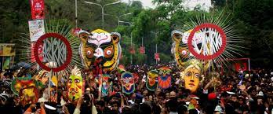
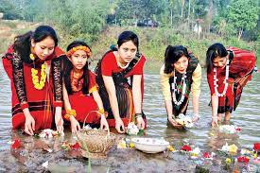
Culture of Bangladesh
The cultural background of Bangladesh is diverse. The original inhabitants of this area were pre-Aryan. After words, they were influenced by Aryan thoughts. Again this culture is influenced by the ingredients of Muslim culture of Turkey, Arab, Iran and Middle-Asia. Lastly, with the arrival of the Europeans especially the British, A different cultural trend was set. In this way, in course of time, our culture gradually developed with the essence of different cultures

Slide 17
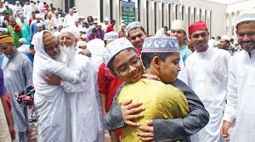
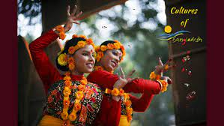
Cultural Diversity in Bangladesh
Bangladesh has a rich, diverse culture. Its deeply rooted heritage is thoroughly reflected in its architecture, dance, literature, music, painting and clothing. The three primary religions of Bangladesh (Islam, Hinduism and Buddhism) have had a great influence on its culture and history.
Our culture is manifested in various forms, including music, dance, and drama; art and craft; folklore ; languages and literature; philosophy and religion; festivals and celebrations; as well as in a distinct cuisine and culinary tradition.

Slide 18
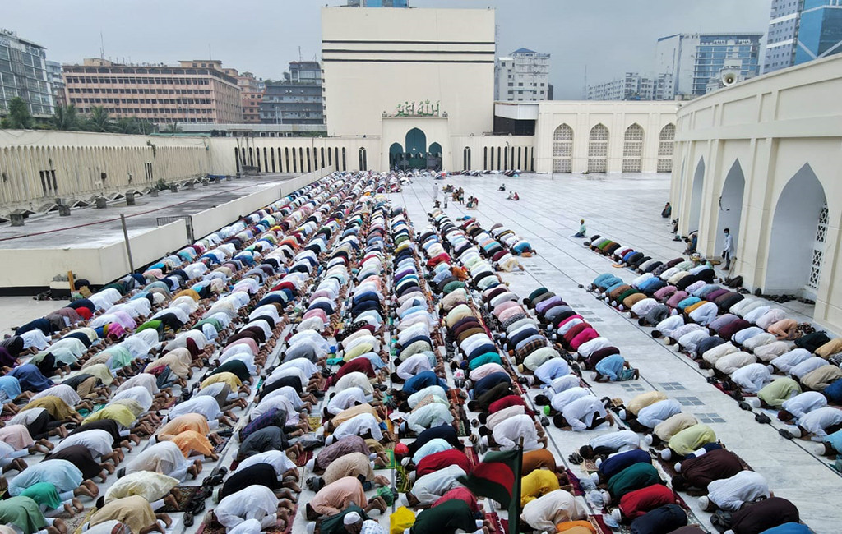
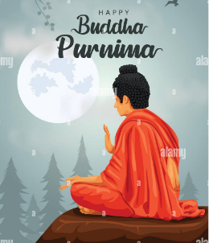

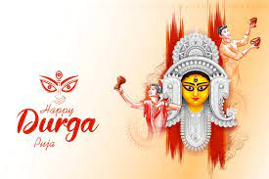
Festivals of Bangladesh
Cultural Festivals
Festivals and celebrations are an integral part of the culture of Bangladesh. Festivals have always played a significant role in the life of the people of Bangladesh. Muslim peoples are observed Eid-e-Miladunnabi, Eid-ul-Fitr, Eid-ul-Azha, Muharram etc. Hindus observe Durga Puja, Saraswati Puja, Kali Puja etc. Christmas is observed by Christians. Buddha’s Purnima is a festival celebrated by the Buddists.

Slide 19
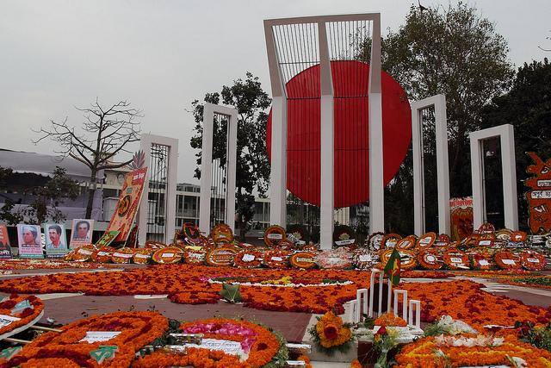
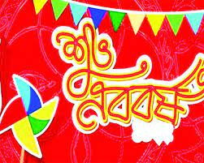
Secular/Common Cultural Festivals of Bangladesh
International Mother Language Day (21st February)
Pahela Baisakh (the first day of Bangla year)
Independence Day (26th March)
Victory Day (16th December)
Rabindra Jayanti
Nazrul Jayanti
Pahela Falgun
Nobanno Utshob
Shakrain Festival

Slide 20
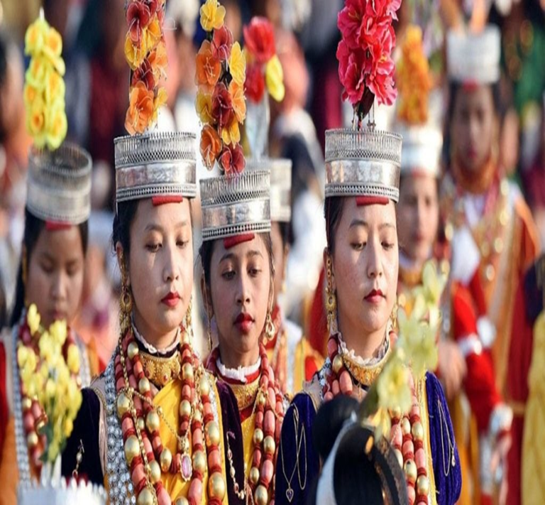
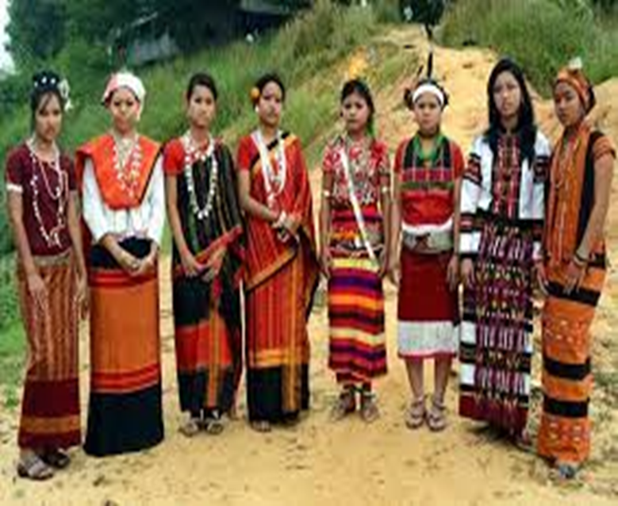
Indigenous Community of Bangladesh
The Indigenous People of Bangladesh are living mostly in the Chittagong Hilly areas. The communities are defined as distinct people socially, economically, and politically. They are also known as Tribal People or Ethnic Group or Minorities in Bangladesh.
Bangladesh is a country of cultural and ethnic diversity, with over 54 indigenous peoples speaking at least 35 languages, along with the majority Bengali population.
Most of the tribal groups are formed consisting of tribal kings, village headmen, and a self-sustaining natural lifestyle. The situation in the lifestyle is not satisfactory at all. They are very simple, honest, hospitable, and follow the tribal kings.

Slide 21
Indigenous (Tribal/Ethnic) People of Bangladesh
Bangladesh is a country of cultural and ethnic diversity, with over 54 Indigenous Peoples speaking at least 35 languages, along with the majority Bengali population. The most populous indigenous peoples in Bangladesh are the Santal, Chakma, Marma and Mandi.
Of these the first and last are considered plains-dwelling Adivasis, with the Mandi living in north-central Bangladesh and the Santal in the north-west. They have a strong relationship with the land and there is a deep interrelationship between their religious beliefs and their social structure.

Slide 22

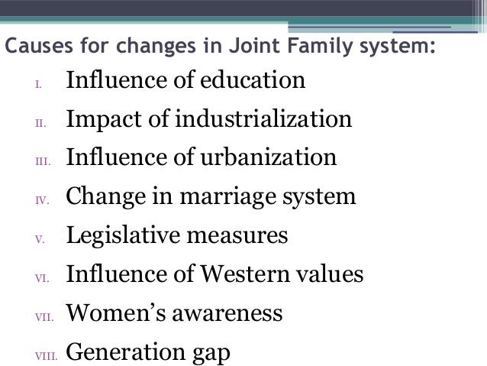
IMPACT OF GLOBALIZATION ON BENGALI SOCIETY

Slide 23
GLOBALIZATION’s IMPACT ON BENGALI CULTURE
Wider and easier access to internet
Advancement of satellite channels
Lack of knowledge/ respect to own culture
Tendency to imitate foreign culture
Identity crisis
Degrading value structure
Irregular arrangement of cultural program
Lack of cultural organization
Cultural conflicts
Music: Western, Indian, Korean pop/rock songs.
Dance: Hiphop, Bollywood dances are getting more popular.
Movies: new movies have Bollywood, Hollywood touch. Theatre dramas are getting rare.
Festivals: Valentines' day, friendship day, father’s day etc western festivals are being celebrated.
Dresses: western dresses become more popular.

Slide 24
References
Van Schendel, W. (2020). A history of Bangladesh. Cambridge University Press.
Economic Review Report-2021, Government of Bangladesh.
Bangladesh Population census, BBS 2022 Report
BBS. 2011. Statistical Pocket Book - 2010. Dhaka: BBS, Government of Bangladesh.

Slide 25
THANK YOU

