Slide 1

Industrial Sector in Bangladesh
Md. Fouad Hossain Sarker
Assistant Professor & Head
Department of Development Studies
Daffodil International University

Slide 2
Objectives of this Class
Investigate the contribution of Industrial sector of Bangladesh.
Explore the common industrial scenario of BD.
Identify the weakness of the Industrial sectors of BD.
Suggest the measures to develop the Industrial sector of BD.

Slide 3
Contribution of Industrial Sectors
Industrial Sector in GDP
Industrial Sector has given the opportunity of employment to millions of unemployed, especially innumerable uneducated women of the country. It is making significant contribution in the field of our export income.
The contribution of the industry sector to the economy of Bangladesh has been increasing day by day.
Contribution of Industrial sector in GDP is 24.21% (Fiscal ear 2019-2020)
Year | Contribution of Industrial sector in GDP (%)
1941-1950 | 4
1951-1960 | 5
1961-1970 | 10
1971-1980 | 11
1981-1990 | 12
1991-2000 | 15
2001-2011 | 30
2011-2012 | 31.26
Source: World Bank Report and
Ministry of Finance, Bangladesh

Slide 4
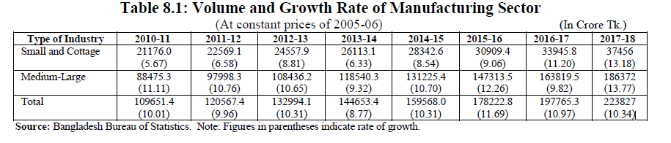
BER-2018, Chapter 8-Industry | 101

Slide 5
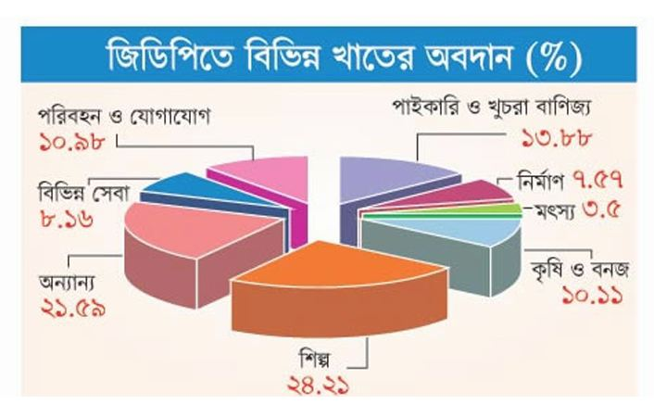
Fiscal Year-2019-20

Slide 6
Common Industries in Bangladesh
Main Industrial Sectors:
RMG
ICT
Frozen Foods industry
Leather Industry
Jute Industry
Power sector
Pharmaceutical industry
Others:
Ceramics
Plastics
Ship building

Slide 7
RMG Industry
The industry employs 3.6 million workers dispersed among 5,400 factories. Currently the sector accounts for 78 percent of exports and contributes 16 percent to the gross domestic product (2013).
RMG export remains strong:
Readymade Garment (RMG) exports surged 14 percent to $24.49 (monthly export statistics, EPB) billion US dollar in 2013/14 fiscal year from a year earlier. But the total exports were 1 percent below the target of $30.5 billion, partly because of political violence leading up to an election in January that crippled the economy. Though the total export target was not met, garments still played the lead role in exports and retained a satisfactory growth.

Slide 8
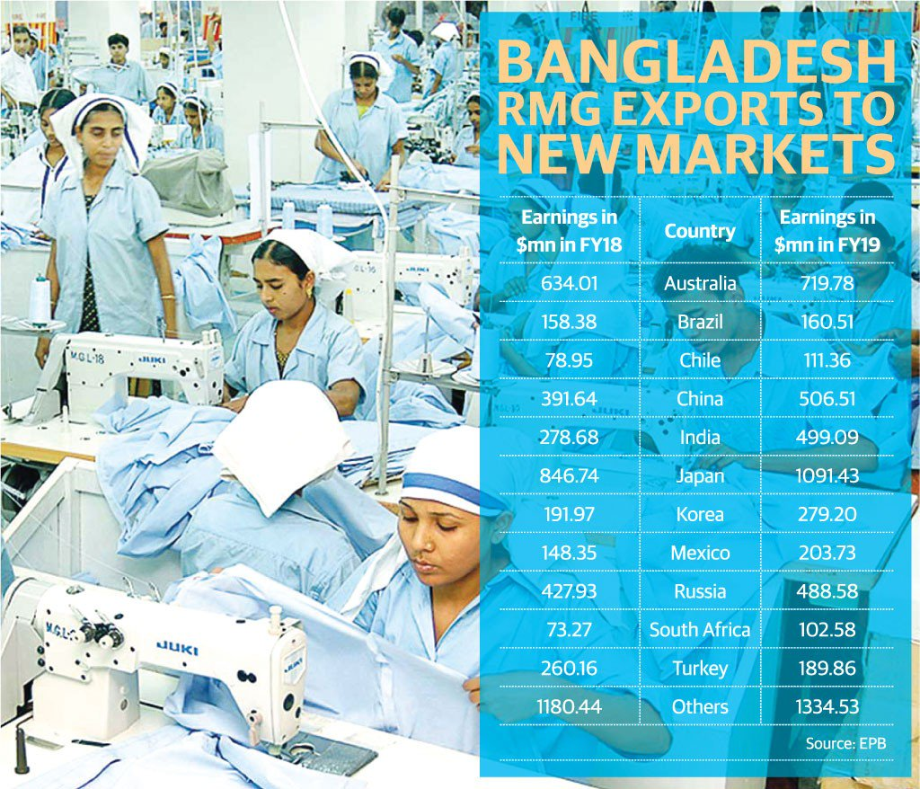
RMG Contribution in Export Arena-3

Slide 9
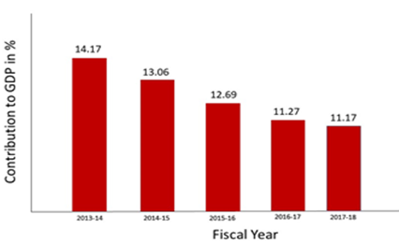
RMG Industry-1

Slide 10
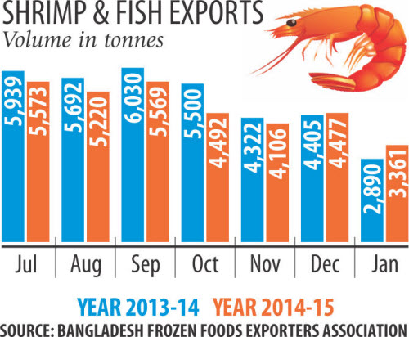
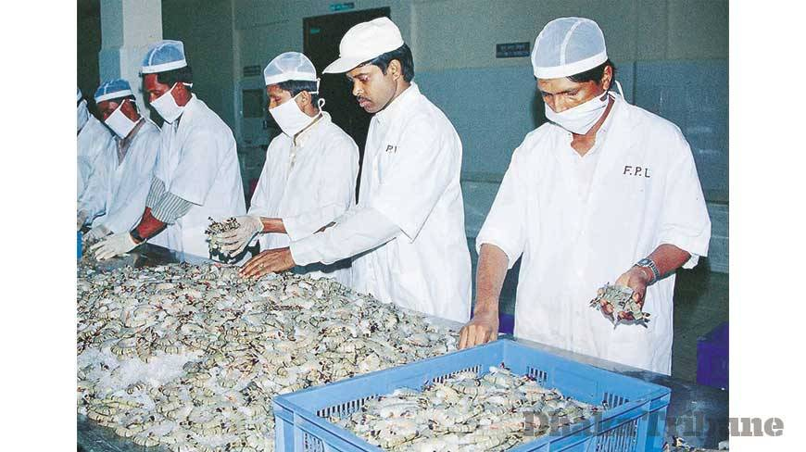
Frozen Foods Industry-1
Frozen foods is the second largest export sector of the economy. The massive natural resources available in Bangladesh make this sector particularly promising for investors looking to supply in international as well as in domestic markets.

Slide 11


Frozen Foods Industry-2
Following a period of strong investment in technology, processes and regulation the frozen foods sector has flourished and earned itself an excellent reputation with trading partners.
The demand for “ready to cook”
Frozen Foods: Frozen Ready to Cook Snacks, Frozen Ready to Cook Meat, Frozen Ready to Cook Vegetables, Frozen Ready to Cook Fishes

Slide 12
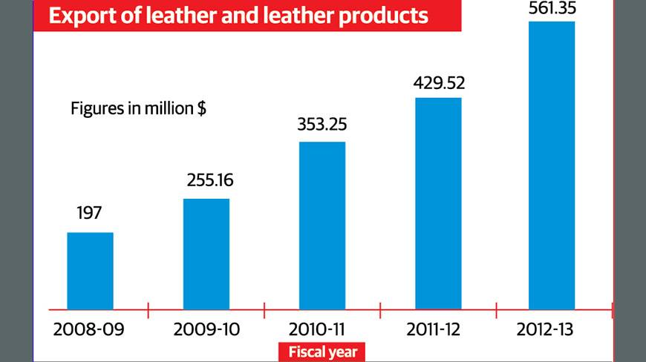
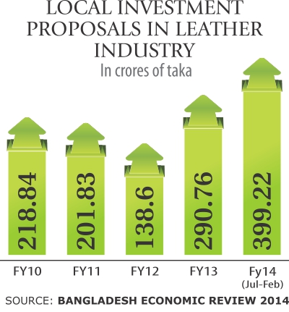
Leather Industry
Leather Industry developed in Bangladesh on a large-scale basis from the 1970s. About 95% of leather and leather products of Bangladesh are marketed abroad, mostly in the form of crushed leather, finished leather, leather garments, and footwear. Most leather and leather goods go to Germany, Italy, France, Netherlands, Spain, Russia, Brazil, Japan, China, Singapore and Taiwan
Bangladesh now exports leather, leather goods and footwear worth around $1 billion a year, which accounts for only 0.005 percent of the global market worth $230 billion, said Shaheen Ahmed, chairman of Bangladesh Tanners Association (BTA)

Slide 13
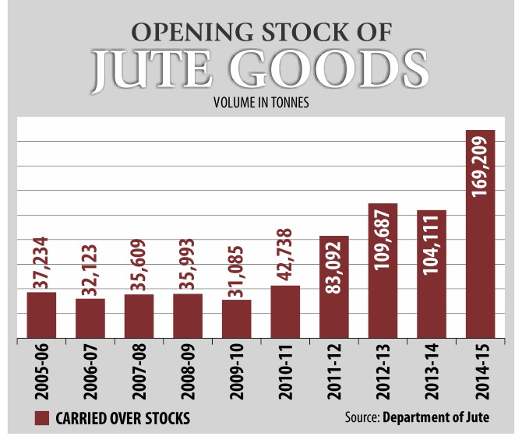
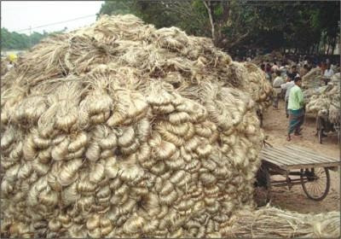
Jute Industry
Jute Industry played an important role in the economic development of Bengal. At the beginning of the twentieth century, Bengal could boast of only one manufacturing industry - jute.

Slide 14

Jute Industry
Bangladesh holds the 2nd position as a Jute producer in the world with the average production of Jute 1.08 m ton/Year.
About 40 million people are involved directly and indirectly in the jute industry.

Slide 15
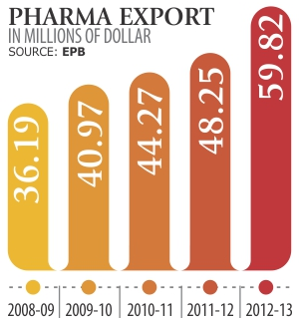
Pharmaceutical Industry
The pharmaceutical industry in Bangladesh is one of the most developed technology sectors within Bangladesh. Manufacturers produce insulin, hormones, and cancer drugs. This sector provides 97% of the total medicinal requirement of the local market. The industry also exports medicines to global markets, including Europe. Pharmaceutical companies are expanding their business with the aim to expand the export market.

Slide 16
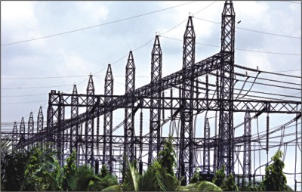
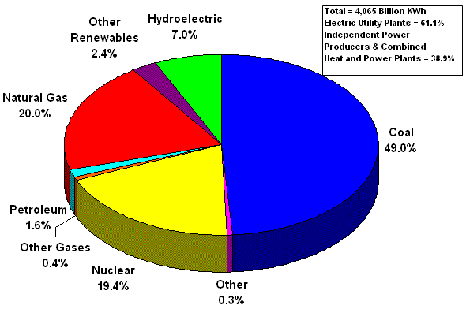
Power Sector
Bangladesh’s power sector is one of the fastest growing in South Asia. The growth in terms of capacity addition has been remarkable -- increasing from 5% to 28% from 2012 to 2018 according to the World Bank and the Bangladesh Power Development Board.
In June 2018 about 90 percent people of the country are covered by electricity facilities including renewable energy ( BER-2018)
https://www.dhakatribune.com/opinion/op-ed/2019/06/21/transforming-the-power-sector-of-bangladesh

Slide 17
ICT Industry
ICT is regarded as a thrust sector and the present government has pledged to build a digital Bangladesh within 2021. By 2030, ICT will be first exported field in global market. ICT ministry was established in 2011
No. of Registered Software & ITES Companies | 1000+
No. of BASIS Member Companies | 705 (February 2014)
Approx. Revenue of Local Industry (incl. Export) | US $ 400 million
Approx. Revenue from Software | Tk. 790 crore
Approx. Revenue from ITES | Tk. 1050 crore
Export (2012 -2013) | US $ 101.63 Million
No. of Exporting Companies | 160 +
No. of Export Destination Countries | 60+
Approx. No. of Human Resource Employed in the Industry | 70,000

Slide 18
Telecommunication Industry
The total number of Mobile Phone subscribers has reached 161.772 Million at the end of June, 2019. The Mobile Phone subscribers are shown below:
OPERATOR | SUBSCRIBER (IN MILLIONS)
Grameen Phone Ltd. (GP) | 75.330
Robi Axiata Limited (Robi) | 47.939
Banglalink Digital Communications Limited | 34.667
Teletalk Bangladesh Ltd. (Teletalk) | 3.836
Total | 161.772
http://www.btrc.gov.bd/content/mobile-phone-subscribers-bangladesh-june-2019

Slide 19
Telecommunication Industry
The total number of Internet Subscribers has reached 96.199 Million at the end of June, 2019. The Internet subscribers are shown below:
OPERATOR | SUBSCRIBER (Million)
Mobile Internet | 90.409
WiMAX | 0.055
ISP + PSTN | 5.734
Total | 96.199
http://www.btrc.gov.bd/content/internet-subscribers-bangladesh-june-2019

Slide 20
Problems of Industrial Sector
High Competition and impact of free market economy
Malpractices in providing industrial loan
Highly dependency on jobs in place of entrepreneur mind
Lack of FDI and capital for investment and reinvestment mind
Workers do not receive their right benefits
Labor unrest due to some needs
Poor presence of labor rights advocacy
Instable political situation
High rate of corporate tax
Lack of raw materials in various industries

Slide 21
Problems of Industrial Sector
Uncertainly of power and fuels
Lack of well trained up manpower
Lack of technological knowledge and skills
Lack of disruptive thinking
Red tapism (Bureaucrative behavior)
Absences of compliances
Inadequate port facilities
Withdrawn quota advantage
Lack of research and innovation
Imbalance trade and business

Slide 22
Thing to do for development
Role of policy-makers
Capacity-building of the workforce
Imparting training to make skilled workers.
Reducing of VAT and taxes.
Stabling the Political Situation.
Private sectors development
Developing ICT Capacity.
Reducing High Rate of Corporate Tax.
ICT access opportunity for the citizen
Reducing tax on technologies, hand sets and other equipments related to the telecommunication
Conducting more research works for developing telecom sector
Use of cost reduction strategy of internet

Slide 23
Thing to do for development
Removals of export problems etc.
Removing infrastructural bottlenecks
Building additional supply capacity,
Use of cost reduction strategy, and
Increase in value-addition through backward integration
Production of sufficient raw materials in the country.
Assurance of safety, salary and other facilities of the workers
More advanced of EPZ
Technology and efficiency
Friendship to all, business to all…………………………..

Slide 24
References
Information Technology in Bangladesh, Sustainable Development Networking Programme By Dr. Jamilur Reza Choudhury, 2013.
Bangladesh Computer Council By Mahbubul Alam, 2013.
Information technology to contribute 7.28 percent to GDP by 2021, in Bangladesh Sangbad Sangstha. 20 July 2013.
The Bangladesh Telecoms Sector: Challenges And Opportunities By Ifty Islam, Asian Tiger Capital Partners.
Problems and Prospects of Telecommunication Sector of Bangladesh: A Critical Review By Ms. Farhana Zamil and Md. Miraj Hossen
Banglapedia, The National Encyclopedia of Bangladesh

