Slide 1
CE 447
Lesson 1
Climate Change and Sustainable Development
Course Teacher
Abu Hasan
Senior Lecturer
Department of Civil Engineering

Slide 2
Climate
What is Climate?
Climate means the usual condition of the temperature, humidity, atmospheric pressure, wind, rainfall, and other meteorological elements in an area of the Earth's surface for a long time. In simple terms climate is the average condition for about thirty years.
Differentiate between Climate and weather?
Climate is the over all conditions of these variables in a given region over long periods of time. Weather only describes the short-term conditions of these variables in a given region or day to day conditions in the atmosphere.

Slide 3
Climate system
Define climate system?
The climate system is defined as the five components in the geophysical system, the atmosphere and four others which directly interact with the atmosphere and which jointly determine the climate of the atmosphere.
The five components are listed below:
Atmosphere;
(b) Ocean;
(c) Land surface;
(d) Ice and snow surfaces (both land and ocean areas); and,
(e) Biosphere (both terrestrial and marine).

Slide 4
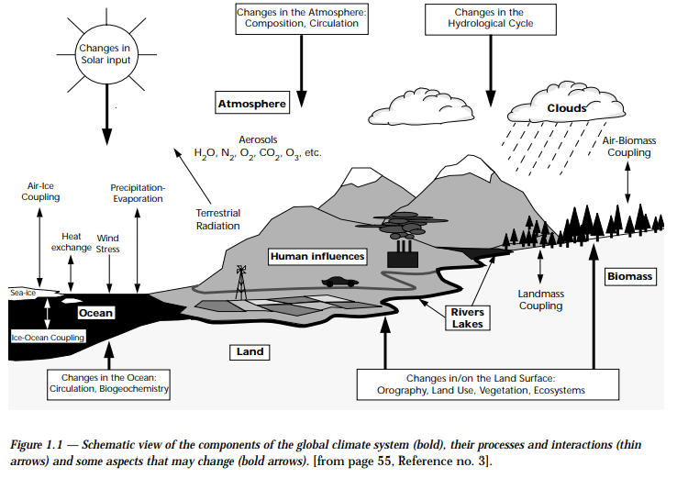

Slide 5
Climate Change
What is climate change?
Climate change is any significant long-term change in the expected patterns of average weather of a region (or the whole Earth) over a significant period of time. Climate change is about abnormal variations to the climate, and the effects of these variations on other parts of the Earth.
How does climate change affect us?
As the climate warms, it changes the nature of global rainfall, evaporation, snow, stream flow and other factors that affect water supply and quality. Specific impacts include: Warmer water temperatures affect water quality and accelerate water pollution.

Slide 6
Development
What is Development?
The act or process of growing, progressing
Development is what we do in attempting to improve our lot within the abode
The process of economic and social transformation that is based on complex cultural and environmental factors and their interactions
Economic growth is the indicator of Development

Slide 7
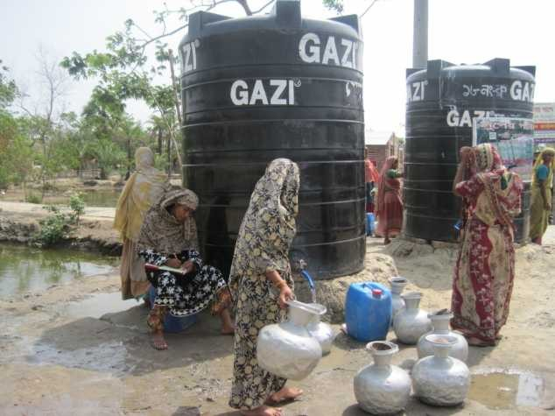
Is this Sustainable Development?
What is the difference between Development & Sustainable Development?

Slide 8
Sustainable Development
According to Brundtland Report (Our Common Future, WCED (1987) Sustainable Development is
– The development which meets the needs of present without compromising the ability of future generations to meet their own needs.
Sustainable Development implies economic growth together with the protection of environmental quality, each reinforcing the other.
Sustainable Development, thus, is maintaining a balance between the human need to improve lifestyles and feeling of well-being on one hand, and preserving natural resources and ecosystems, on which we and future generations depend.

Slide 9
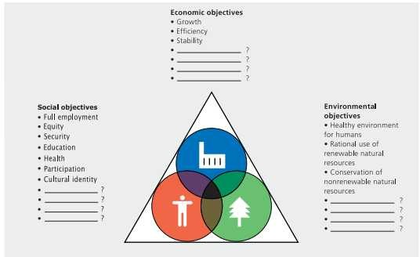
Objectives of Sustainable Development

Slide 10
Main Features of SD
A desirable human condition : a society that people want to sustain because it meets their needs.
An enduring ecosystem condition: an ecosystem that maintains its capacity to support human life and others.
A balance between present and future generations; and within the present generation.
Economic: An economically sustainable system must be able to produce goods and services on a continuing basis, to maintain manageable levels of government and external debt, and to avoid extreme sectoral imbalances which damage agricultural or industrial production.

Slide 11
Main Features of SD
Environmental: An environmentally sustainable system must maintain a stable resource base, avoiding over- exploitation of renewable resource systems or environmental sink functions, and depleting non- renewable resources only to the extent that investment is made in adequate substitutes. This includes maintenance of biodiversity, atmospheric stability, and other ecosystem functions not ordinarily classed as economic resources.
Social: A socially sustainable system must achieve distributional equity, adequate provision of social services including health and education, gender equity, and political accountability and participation.

Slide 12
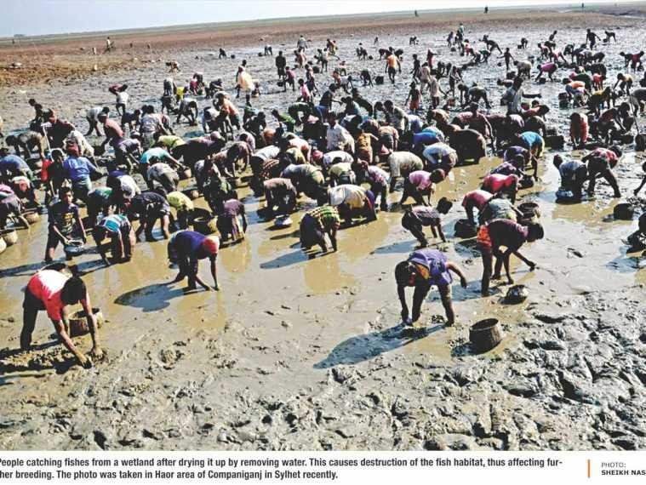
The Daily Star, 17 March 2015
Is it the way we conserve the eco system?

Slide 13
Rules of Sustainable Development
The implication of the concept of sustainable development is that:
  The next generation should inherit such a stock of wealth, comprising man made assets and environmental assets which stresses on all capital assets
  The next generation should inherit a stock of environmental assets no less than inherited by the previous generation which stresses on natural capital only
  The components of the inherited stock should be man made assets and human assets which includes human capital besides man made and natural capital

Slide 14
Rules of sustainable development
Aggregate capital stock (man made + natural + human)
  Man made capital (K_{M}) consisting of machines, buildings, roads etc.
  Natural capital (K_{N}) includes all renewable and non-renewable resources or any natural assets yielding a flow of ecological services with economic values over time
  Human capital (K_{H}) comprises the stock of knowledge and skills

Slide 15
Indicators of Sustainability
Pearce and Atkinson has developed a sustainability index or indicator of the form:
Z = S/Y – d_{M}K_{M}/Y – d_{N}K_{N}/Y
Where,
S → gross saving
Y → income
d_{M} → depreciation of man made capital
d_{M} → depreciation of natural capital
K_{M} → Man made capital
K_{N} → Natural capital
To ensure sustainability, Z ≥ 0.

Slide 16
Indicators of Sustainability
GNH: The four pillars of Gross National Happiness (GNH) are the promotion of equitable and sustainable socio-economic development, preservation and promotion of cultural values, conservation of the natural environment, and establishment of good governance.
HDI: The Human Development Index (HDI) (1990) is the measure of life expectancy, literacy, education, and standard of living for countries worldwide. It is a standard means of measuring well- being, especially child welfare. It is used to determine and indicate whether a country is a developed, developing, or underdeveloped country and also to measure the impact of economic policies on quality of life.
EF: Ecological Footprint (EF) compares human consumption of natural resources with Earth’s ecological capacity to regenerate them.
HPI: Happy Planet Index is an innovative measure (2006) that shows the ecological efficiency with which human well-being is delivered. It is the first ever index to combine environmental impact with human well-being. Each country’s HPI value is a function of its average life satisfaction, life expectancy at birth, and ecological footprint per capita.

Slide 17
Tools to Achieve Sustainability
What are the Tools to Achieve Sustainability?
By-product synergy and industrial ecology
Cleaner production
Design for environment
Eco-efficiency
Energy efficiency
Environmentally conscious manufacturing
Pollution prevention
Zero-emission processes
The four Rs (reduce, recycle, reuse, recovery)
Green procurement
Performance contracting

Slide 18
Tools to Achieve Sustainability
Describe the Tools to Achieve Sustainability?
By-product synergy
A holistic view of industry in which organisations exchange energy and material between one another, rather than operating as isolated units
Cleaner Production
Continuous application of an integrated preventive environmental strategy applied to processes, products and services to increase eco-efficiency and reduce risks to humans and the environment

Slide 19
Tools to Achieve Sustainability
Design for environment
Techniques used to incorporate an environmental component into products and services before they enter the production phase
  Eco-efficiency
A vision for producing economically valuable goods and services while reducing the ecological impact of their production

Slide 20
Tools to Achieve Sustainability
Pollution prevention
Reduces the amount of hazardous substance, pollutant or contaminant entering any waste stream or otherwise released into the environment. It can be achieved by good housekeeping, material substitution, manufacturing modification, resource recovery, technology etc.
  Zero-emission process
Improving technologies and processes to the point of maximum resource productivity and virtually no waste

Slide 21
Tools to Achieve Sustainability
Energy efficiency
Energy efficiency makes sense both environmentally and economically. It produces a good return on investment while at the same time reducing carbon di oxide emissions
The four R’s (reduce, recycle, reuse, recovery)
    Lower disposal cost, lower treatment cost, lower energy cost, savings of materials and supply, lower storage cost, a reduction in regulatory compliance costs

Slide 22


