Slide 1

CE 447
Lesson 2
Goals of Development
Course Teacher
Md. Abu Hasan
Senior Lecturer
Department of Civil Engineering

Slide 2
Millennium Development Goals (MDGs)
The Millennium Development Goals (MDGs) are eight goals with measurable targets and clear deadlines for improving the lives of the world's poorest people.
It consists of eight general goals and twenty one specific targets.
The Millennium Declaration was signed in the September 2000 global summit held at the UN headquarters in New York by the 189 UN member and agreed to be achieved by the year 2015.

Slide 3
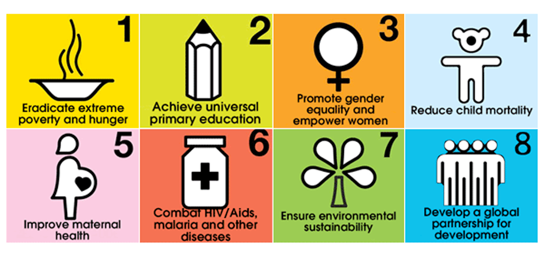
Millennium Development Goals (MDGs)

Slide 4
Millennium Development Goals (MDGs)
To eradicate extreme poverty and hunger
To achieve universal primary education
To promote gender equality and empower women
To reduce child mortality
To improve maternal health
To combat HIV/AIDS, malaria, and other diseases
To ensure environmental sustainability
To develop a global partnership for development

Slide 5
Reference: http://en.wikipedia.org/wiki/Millennium_Development_Goals
Millennium Development Goals (MDGs)
Goal 1: Eradicate extreme poverty and hunger
  Target 1A: Halve, between 1990 and 2015, the proportion of people living on less than $1.25 a day
  Target 1B: Achieve Decent Employment for Women, Men, and YoungPeople
  Target 1C: Halve, between 1990 and 2015, the proportion of people who suffer from hunger

Slide 6
Millennium Development Goals (MDGs)
Goal 2: Achieve universal primary education
– Target 2A: By 2015, all children can complete a full course of primary schooling, girls andboys
Goal 3: Promote gender equality and empower women
– Target 3A: Eliminate gender disparity in primary and secondary education preferably by 2005, and levels by 2015
Goal 4: Reduce child mortality rates
– Target 4A: Reduce by two-thirds, between 1990 and 2015, the under-five mortality rate

Slide 7
Millennium Development Goals (MDGs)
Goal 5: Improve maternal health
  Target 5A: Reduce by three quarters, between 1990 and 2015, the maternal mortality ratio
  Target 5B: Achieve, by 2015, universal access to reproductive health
Goal 6: Combat HIV/AIDS, malaria, and other diseases
  Target 6A: Have halted by 2015 and begun to reverse the spread of HIV/AIDS
  Target 6B: Achieve, by 2010, universal access to treatment for HIV/AIDS for all those who need it
  Target 6C: Have halted by 2015 and begun to reverse the incidence of malaria and other major diseases

Slide 8
Millennium Development Goals (MDGs)
Goal 7: Ensure environmental sustainability
  Target 7A: Integrate the principles of sustainable development into country policies and programs; reverse loss of environmental resources
  Target 7B: Reduce biodiversity loss, achieving, by 2010, a significant reduction in the rate of loss
  Target 7C: Halve, by 2015, the proportion of the population without sustainable access to safe drinking water and basic sanitation
  Target 7D: By 2020, to have achieved a significant improvement in the lives of at least 100 million slum-dwellers

Slide 9
Millennium Development Goals (MDGs)
Goal 8: Develop a global partnership for development
  Target 8A: Develop further an open, rule-based, predictable, non-discriminatory trading and financial system
  Target 8B: Address the Special Needs of the Least Developed Countries (LDCs)
  Target 8C: Address the special needs of landlocked developing countries and small island developing States
  Target 8D: Deal comprehensively with the debt problems of developing countries through national and international measures in order to make debt sustainable in the long term
  Target 8E: In co-operation with pharmaceutical companies, provide access to affordable, essential drugs in developing countries
  Target 8F: In co-operation with the private sector, make available the benefits of new technologies, especially information and communications

Slide 10
Millennium Development Goals (MDGs)
Where is Bangladesh now?
  Achievements
    Reducing extreme poverty
    Curbing prevalence of underweight children under 5 yrs
    Bringing down under 5 child mortality
    Raising enrolment in primary schools
    Increased ratio of girls to boys in primary and secondary education
    Improved maternal health
Lagging behind
  Creating jobs
  Preserving ecology
  Ensuring nutrition
  Income inequality

Slide 11

What is after MDG?

Slide 12
Sustainable Development Goals (SDGs)
The Sustainable Development Goals (SDGs) or Global Goals are a collection of 17 interlinked global goals designed to achieve a better and more sustainable future for all.
The SDGs were set up in 2015 by the United Nations General Assembly (UN-GA) and are intended to be achieved by the year 2030.
They are included in a UN-GA Resolution called the 2030 Agenda or what is colloquially known as Agenda 2030.
The SDGs were developed in the Post-2015 Development Agenda as the future global development framework to succeed the Millennium Development Goals which ended in 2015.
SDG aims ending poverty and hunger, improving health and education, making cities more sustainable, combating climate change, and protecting oceans and forests.

Slide 13
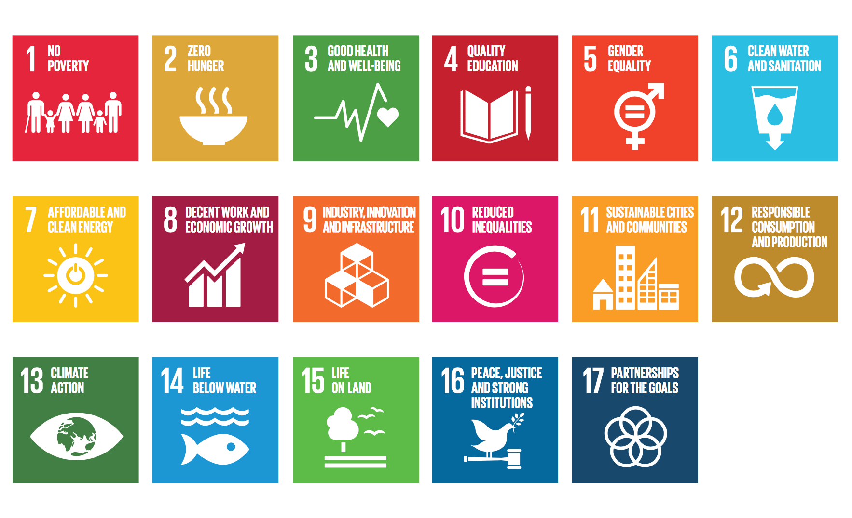
Sustainable Development Goals (SDGs)

Slide 14
Sustainable Development Goals (SDGs)
Goal 1: No poverty in all its forms everywhere
Goal 2: Zero hunger (no hunger), achieve food security and improvednutrition, and promote sustainable agriculture
Goal 3: Good health and well-being to Ensure healthy lives and promote well-being for all at all ages
Goal 4: Quality education to Ensure inclusive and equitable quality education and promote life-long learning opportunities for all

Slide 15
Sustainable Development Goals (SDGs)
Goal 5: Gender equality and empower all women and girls
Goal 6: Clean water and sanitation to Ensure availability and sustainable management of waterand sanitation for all
Goal 7: Affordable and clean energy to Ensure access to affordable, reliable, sustainable, and modern energy for all
Goal 8: Decent work and economic growth to Promote sustained, inclusive and sustainable economic growth, full and productive employment and decent work for all

Slide 16
Sustainable Development Goals (SDGs)
Goal 9: Industry, Innovation and Infrastructure to Build resilient infrastructure, promote inclusive and sustainable industrialization and foster innovation
Goal 10: Reduce inequality within and among countries
Goal 11: Sustainable cities and communities to Make cities and human settlements inclusive, safe, resilient and sustainable
Goal 12: Responsible consumption and production to Ensure sustainable consumption and production patterns
Goal 13: Climate action Taking urgent action to combat climate change and its impacts

Slide 17
Sustainable Development Goals (SDGs)
Goal 14: Life below water to Conserve and sustainably use the oceans, seas and marine resources for sustainable development
Goal 15: Life on land to Protect, restore and promote sustainable use of terrestrial ecosystems, sustainably manage forests, combat desertification, and halt and reverse land degradation and halt biodiversity loss
Goal 16: Peace, justice and strong institutions to Promote peaceful and inclusive societies for sustainable development, provide access to justice for all and build effective, accountable and inclusive institutions at all levels
Goal 17: Partnership for the goals to Strengthen the means of implementation and revitalize the global partnership for sustainable development

Slide 18
Sustainable Development Goals (SDGs)
The first 16 goals address priority areas that:
  Increase the ambition/ improving and sustaining current achievements on existing MDG goals (poverty, health education, gender)
  Economic sustainability (inclusive growth, jobs, infrastructure, industrialization)
Environmental sustainability (climate change, oceans and land based ecosystems, sustainable consumption and production)
All held together by the glue of ‘peaceful and inclusive societies for sustainable development’ (governance agenda, rule of law, violence).
The 17th goal covers means of implementation (finance, trade, technology, capacity building, partnerships, and data)

Slide 19
Sustainable Development Goals (SDGs)
Environmental issues are strongly represented- climate change, marine and land base ecosystems, and sustainable consumption and production
Governance - for the first time – incorporating a goal and targets on governance and peaceful societies (legal identity, tackling corruption and bribery etc)
Participatory/Inclusiveness Process in formulation of the SDGs- The participation and buy in of a wide range of stakeholders including member states and non governmental organizations
The broad nature of the SDG is also a reflection of the nature of challenges facing the world today

Slide 20


