Slide 1
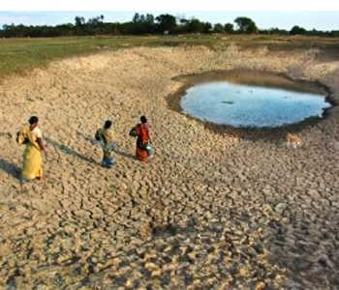
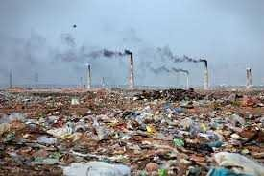
Lesson 3
Environmental Issues and Priorities
Course Teacher
Md. Abu Hasan
Senior Lecturer
Department of Civil Engineering

Slide 2
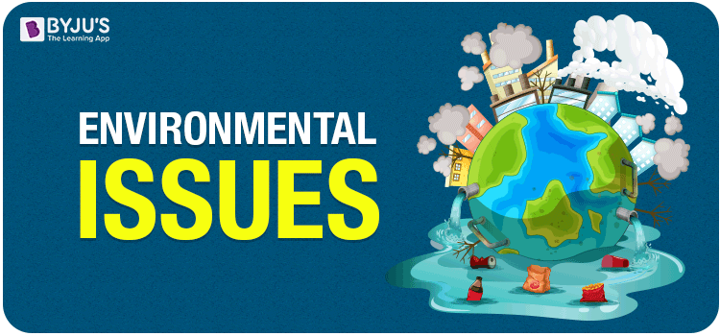

Slide 3
Environmental Issues
  Environmental issues are effects of human activity on the biophysical environment, most often of which are harmful effects that cause environmental degradation.
  Environmental degradation is the deterioration of the environment through depletion of resources such as quality of air, water and soil; the destruction of ecosystems; habitat destruction; the extinction of wildlife; and pollution. It is defined as any change or disturbance to the environment perceived to be deleterious or undesirable.

Slide 4
Environmental Issues
Emissions to air
  Acid rain
  Movement of pollution
  Ozone depletion
  Global warming
  Air pollution
Discharges to water
  Effluent discharges
  Groundwater pollution
  Contaminated marine life
  Destruction of reefs
Natural environment
  Deforestation
  Sustainable environment
  Damage to ecosystem
  Desertification
  Loss of Bio-diversity
  Soil pollution

Slide 5
Environmental Issues
Solid waste
  Landfill
  Waste management
  Recycling
  Packaging
  Incineration (Incineration is the process of burning hazardous materials at temperatures high enough to destroy contaminants.
Quality of life
  Noise
  Dust
  Litter (rubbish such as paper, cans, and bottles left lying in an open or public place.)
  Polluted beaches

Slide 6
Priority Areas
Land degradation
Hill cutting and cultivation in the slopes
Improper use of agrochemicals
Use of arsenic contaminated water in agriculture
Water pollution from industrial effluents, human waste
Air pollution from industries, different mode of transports
Management of clinical and hazardous waste

Slide 7
Priority Areas
Choice of technology and raw materials in industries
Land use planning for urban development
Vehicular air pollution and noise pollution
Safe water access and sanitation facility
Conservation of biodiversity
Energy security
Proper environmental management of ecologically critical areas

Slide 8
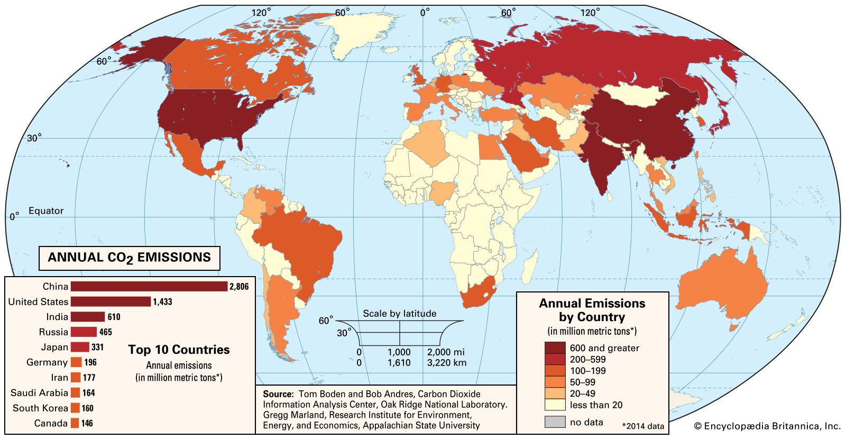
Environmental Issues & Priorities
Global 2. Regional 3. Local

Slide 9
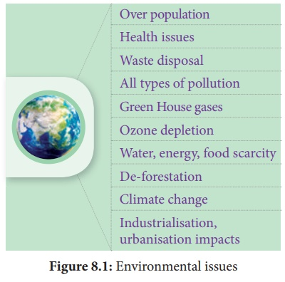
Environmental Issues with Highest Priorities

Slide 10
Global Warming
Global warming, the phenomenon of increasing average air temperatures near Earth’s surface over the past one to two centuries, happens mostly in the troposphere. Troposphere is the lowest level of the atmosphere, which extends from Earth’s surface up to a height of 10 miles. This layer contains most of Earth’s clouds and is where living things and their habitats and weather primarily occur.
According to a report by the Intergovernmental Panel on Climate Change (IPCC) global surface temperature increased 0.74 ± 0.18 °C (1.33 ± 0.32 °F) between the start and the end of the 20th century.

Slide 11
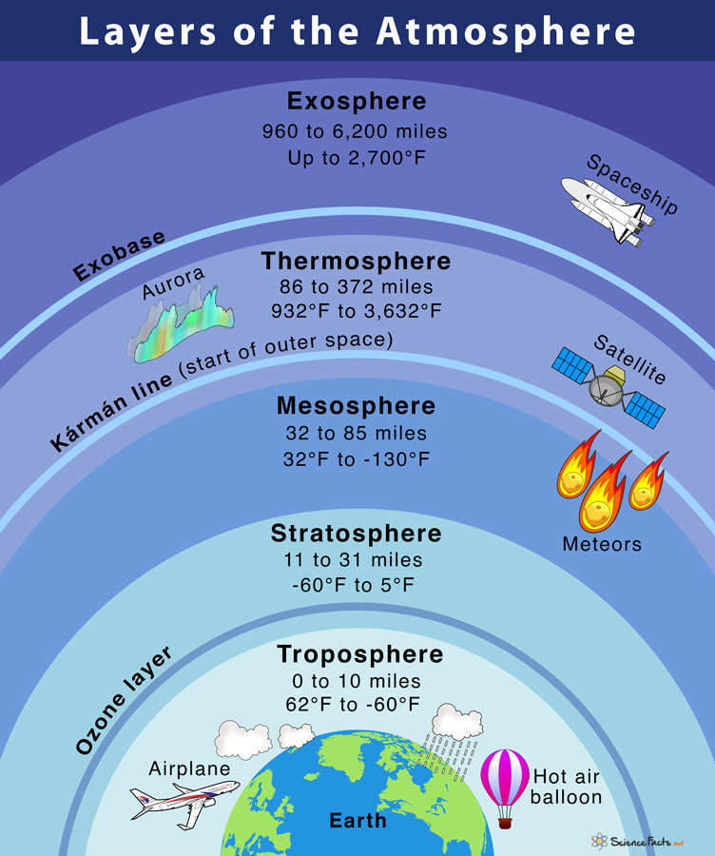
Global Warming

Slide 12
Causes of Global Warming
Human activity affects global surface temperatures by changing Earth’s radiative balance—the “give and take” between what comes in during the day and what Earth emits at night.
Increases in greenhouse gases—i.e., trace gases such as carbon dioxide and methane that absorb heat energy emitted from Earth’s surface and reradiate it back—generated by industry and transportation cause the atmosphere to retain more heat, which increases temperatures and alters precipitation patterns.

Slide 13
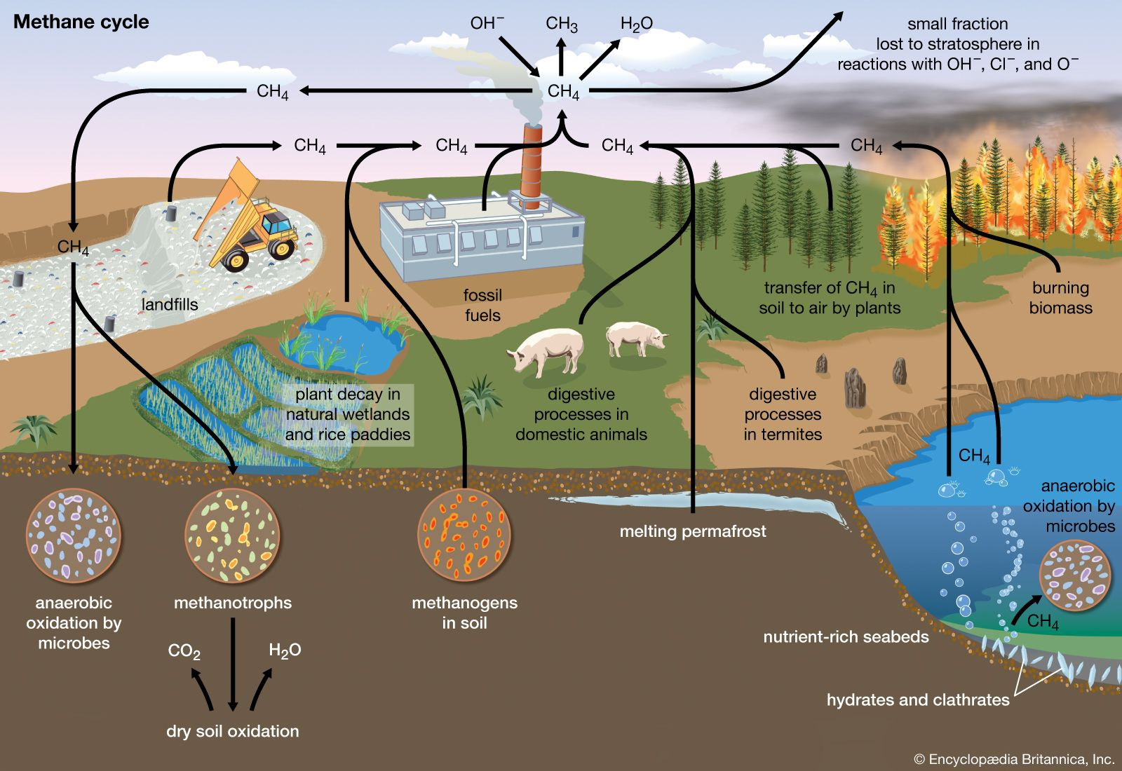
Causes of Global Warming

Slide 14
Effects of Global Warming
What are the Effects of Global Warming?
  Earth’s average temperature will increase by 1.4 – 5.8 °C by the year 2100 (IPCC)
  Sea level will rise, caused by the melting of glaciers and polar ice , with increased temperature
  Increased flooding in coastal wetlands
  Worst impact on agriculture, ecosystem
  Worldwide average rainfall will increase, but the rainfall pattern will be disrupted
  Impact on bio-diversity
  Threats to human health
  15-17% of Bangladesh could be under water for a one metre sea level rise

Slide 15
Responses on Global Warming
What responses are taken to control global warming?
Response (International):
  Kyoto Protocol, 1997 (in December 1997 in Kyoto, Japan) is an international agreement is adopted in 1997 that aimed to reduce carbon dioxide emissions and the presence of greenhouse gases.
    Switch over to non fossil fuel energy sources such as solar, nuclear, wind, hydro etc. from fossil fuel energy source
    Increase afforestation and decrease deforestation
    Carbon emission limit set and
    Carbon Trading
  Copenhagen summit, 2009 attempted to make legally binding to the developed nations to reduce greenhouse gas emission without any legal accord

Slide 16
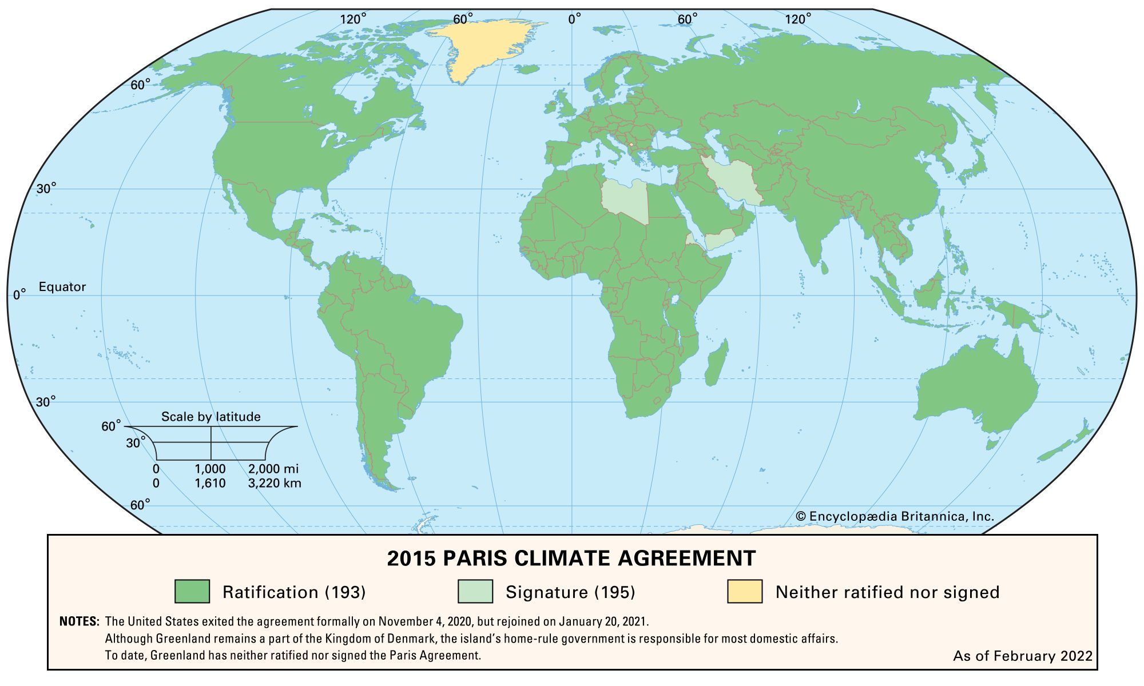
Responses on Global Warming

Slide 17
Responses on Global Warming
What responses are taken to control global warming?
Response (International):
  Giving voice to a growing conviction of most of the scientific community, the Intergovernmental Panel on Climate Change (IPCC) was formed in 1988 by the World Meteorological Organization (WMO) and the United Nations Environment Program (UNEP).
  Paris Agreement, 2015 sets out a global framework to avoid dangerous climate change by limiting global warming to well below 2°C and pursuing efforts to limit it to 1.5°C (2.7 °F). It also aims to strengthen countries' ability to deal with the impacts of climate change and support them in their efforts.

Slide 18
Responses on Global Warming
What responses are taken in Bangladesh to control global warming?
Responses (Bangladesh: Adaptation and Mitigation measures for Bangladesh
  BD Govt. has formulated the National Adaptation Program of Action (NAPA) in 2005 and Bangladesh Climate Change Strategy and Action Plan (BCCSAP) in 2008
  BCCSAP, 2009 has identified six priority areas: (i) food security, social protection and health; (ii) disaster management; (iii) infrastructure; (iv) research and knowledge management; (v) mitigation and low carbon development; (vi) capacity building and institutional strengthening

Slide 19
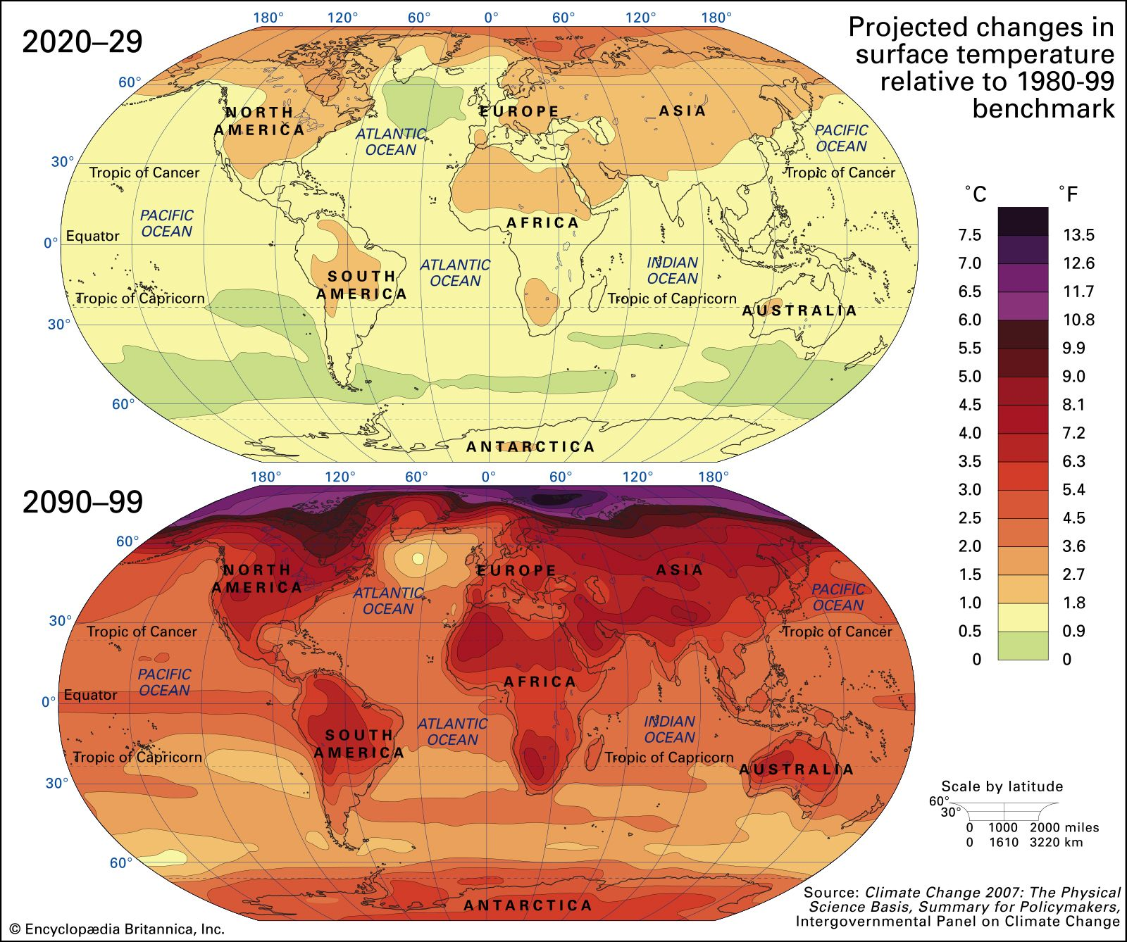
Global Warming

Slide 20

Break for refreshment

Slide 21
Greenhouse Gas
A greenhouse gas is a gas that absorbs and emits radiant energy within the thermal infrared range, causing the greenhouse effect. So-called greenhouse gases are, mainly
Carbon dioxide (CO₂)
Methane (CH₄)
Nitrous oxide (N₂O)
Industrial gases:
  Hydrofluorocarbons (HFCs)
  Perfluorocarbons (PFCs)
  Sulfur hexafluoride (SF₆)
  Nitrogen trifluoride (NF₃)

Slide 22
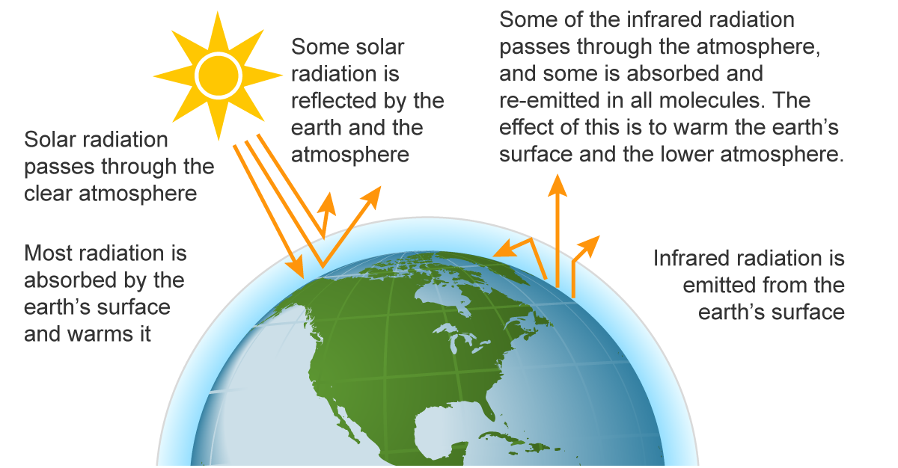
Greenhouse Effect on Earth
Source: Adapted from U.S. Environmental Protection Agency (public domain)

Slide 23
Greenhouse Effect on Earth
Solar radiation passes through the atmosphere to the earth.
Some incoming sunlight is reflected by Earth's atmosphere and surface, but most is absorbed by the surface, which is warmed.
Some Infrared (IR) radiation escapes to space, but some is absorbed by the atmosphere's greenhouse gases (especially carbon dioxide, water vapour, and methane) and reradiated in all directions, some to space and some back toward the surface, where it further warms the surface and the lower atmosphere.

Slide 24
Adaptation Policies
Climate change adaptation is the process of adjusting to current or expected climate change and its effects. It is one of the ways to respond to climate change, along with mitigation.
For humans, adaptation aims to moderate or avoid harm, and exploit opportunities; for natural systems, humans may intervene to help adjustment.
Adaptation actions can be either incremental (actions where the central aim is to maintain the essence and integrity of a system) or transformative (actions that change the fundamental attributes of a system in response to climate change and its impacts).

Slide 25
Adaptation Policies
Importance
The need for adaptation varies from place to place, depending on the sensitivity and vulnerability to environmental impacts.
Adaptation is especially important in developing countries since those countries are most vulnerable to climate change and are bearing the brunt of the effects of global warming. Human adaptive capacity is unevenly distributed across different regions and populations, and developing countries generally have less capacity to adapt.
Adaptive capacity is closely linked to social and economic development.
In general higher levels of development mean higher adaptive capacity, but some development locks people in to certain patterns or behaviors. And the most developed areas may have low adaptation capacity to new hazards, not previously experienced, relative to more familiar hazards.
The economic costs of adaptation to climate change are likely to cost billions of dollars annually for the next several decades.

Slide 26
Adaptation Policies
Write the name of areas where Adaptation policies and measures are required?
Adaptation policies and measures are required in the following areas:
  Agriculture, forestry and fisheries
  Water supplies
  Extreme events
  Capacity building including research
  Coastal zones
  Infrastructure
  Human health
  National policies

Slide 27
Biodiversity
Biodiversity or Biological Diversity is the variety and variability of life on Earth.
Biodiversity refers to the variety of living organisms or species both flora and fauna present in an area.
The variety of living organisms means variety of animals, plants, fungi, and even microorganisms like bacteria that make up our natural world. Each of these species and organisms work together in ecosystems, like an intricate web, to maintain balance and support life.

Slide 28
Biodiversity
It can be classified into following three types:
Genetic diversity: Genetic diversity is all the different genes contained in all individual plants, animals, fungi, and microorganisms. It is the diversity within species.
Species Diversity: Species diversity refers to the variety of organisms in the environment. It is the diversity between species.
Ecosystem diversity: It is the diversity between ecosystems. From one region or country to another, there are different ecosystems or biomes with examples such as alpine meadows, taigas, wetlands, grasslands, mangroves, and deserts, among others.

Slide 29
Advantages of Biodiversity
Biodiversity provides resources for food, construction and raw materials for industry. It also provides
  the basis for improvement for domesticated species,
  maintains functions of ecosystem,
  stores and cycles nutrients essential for life,
  absorbs and breakdowns pollutants,
  recharge groundwater,
  protects catchment basins, protect soil from excessive erosion etc.
Natural and Anthropogenic activities are responsible for the loss of Biodiversity

Slide 30
Loss of Biodiversity
Natural and Anthropogenic activities are responsible for the loss of Biodiversity
How loss of habitat occurs for biodiversity loss?
Habitat degradation/loss is one of the major causes of biodiversity loss. Habitat loss occurs in three ways:
whole ecosystem is destroyed or converted into farmlands, exotic forests and settlements
ecosystem is partially removed, creating islands surrounded by farmlands,
ecosystems are degraded by the loss of species and disruption of their ecological processes. The habitat degradation can occur in many ways, like in patches, in waves or as linear.

Slide 31
Biodiversity
What are the Consequences of Biodiversity Loss?
Consequences of Biodiversity Loss
Losses of existing species
Accelerating soil erosion
Loss of genetic diversity
Changes in water cycle
Climate change
Loss of ecosystem services
Disruption of livelihoods
Social instabilities and economic losses
Increasing environmental refugees

Slide 32
Measures to conserve biodiversity
Biodiversity
What measures can be taken to conserve biodiversity?
National policy planning authority should recognize the necessity for conservation of biodiversity and ensure multisectoral coordination for it
Government agencies should be strengthened for this purpose and new agencies should be created whenever necessary
A digitized database on biodiversity
Awareness of conservation of biodiversity among all sections of society
Conservation regulation should be updated and enforced strictly

Slide 33
Measures to conserve biodiversity (Cont.)
Biodiversity
Studies and research of environmentally sound biotechnology and evaluation of possible impact on biodiversity
Improving land use pattern and protecting forest land
Reducing social and economic imbalances
Emphasizing on community based conservation
Bringing endangered species in captivity for breeding

Slide 34
Ecological Foot Print
Ecological footprint of a population is an area of land and water that would be required to sustainably provide all of a particular population’s resources and assimilate all of its wastes
Ecological Footprint is a measure of the impacts human have on environment
Unit is Global Hectare (Gha)

Slide 35
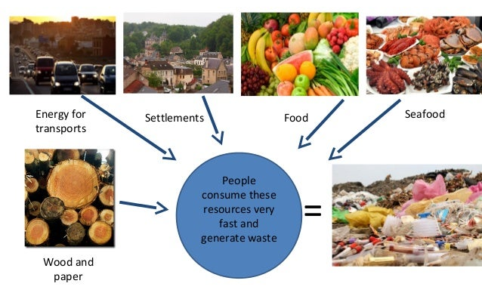
Ecological Foot Print

Slide 36
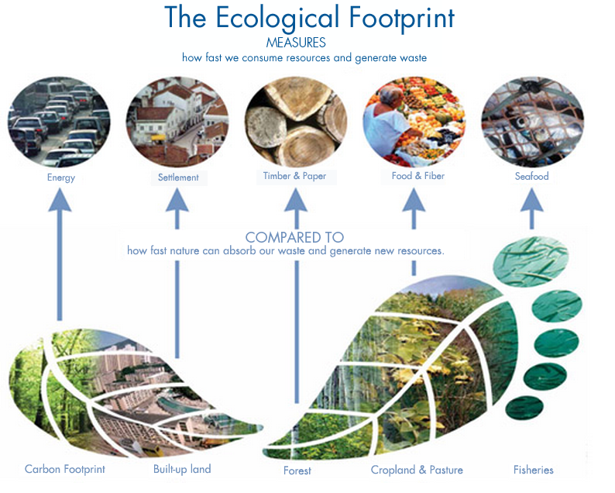

Slide 37
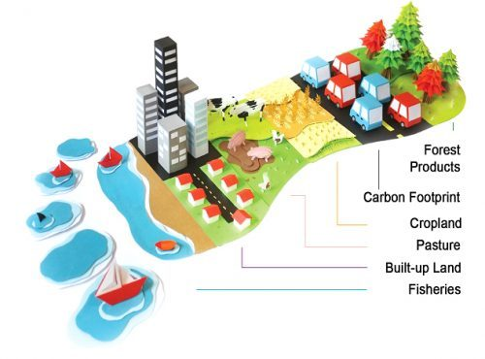
Ecological Foot Print

Slide 38
Ecological Foot Print
Factors affecting Ecological Foot Print
  Population
  Land size
  Per capita consumption
  Crop land and any other land that grow food, grow biofuel, graze animals, produce meat, produce wood, dig up minerals and the area of land needed to absorb wastes (solid, liquid, gaseous)

Slide 39


