Slide 1
Lesson 4
Course Teacher
Abu Hasan
Senior Lecturer
Department of Civil Engineering

Slide 2
Environmental Impact Assessment
Environmental impact assessment (EIA) is an environmental decision support tool, which provides information on the likely impacts of development projects to those who take the decision as to whether the project should be authorised.
It is a tool used to assess the significant effects of a project or development proposal on the environment.
EIAs make sure that project decision makers think about the likely effects on the environment at the earliest possible time and aim to avoid, reduce or offset those effects. This ensures that proposals are understood properly before decisions are made.

Slide 3
EIA Methods
What is mean by EIA Methods?
Approached developed to identify, predict and value changes of an action
Mechanisms by which information is collected and organized , evaluated and presented
Concerned with predicting the future states of environmental parameters and may involve mathematical modeling

Slide 4
EIA Methods
Why do we need EIA?
Provides uniform standard
EIA methodologies ensure that the best possible information from EIA procedures is available to decision makers and the public
Identify the main environmental issues and aspects
Identify significant positive and negative impacts
Evaluate the overall environmental impact of the scheme to enable comparison between alternative proposals
The administrative procedures of EIA Varies from country to country

Slide 5
EIA methods
Write some Methods of EIA?
Some common methods are
- Adhoc
- Checklists
Matrices
Network
Overlays/GIS
EES (Environmental Effect Study)
Cost Benefit Analysis

Slide 6
Adhoc
Adhoc methods indicate broad areas of possible impacts by listing composite environmental parameters (Ex: flora and fauna) likely to be affected by the proposed activity.
These methods involve assembling a team of specialists who identify impacts in their area of expertise. Here, each parameter is considered separately and the nature of impacts (long term or short term, reversible or irreversible) are considered.
These methods give a rough assessment of total impact while giving the broad areas and the general nature of possible impacts. In this method, the assessor relies on an intuitive approach and makes a broad-based qualitative assessment.

Slide 7
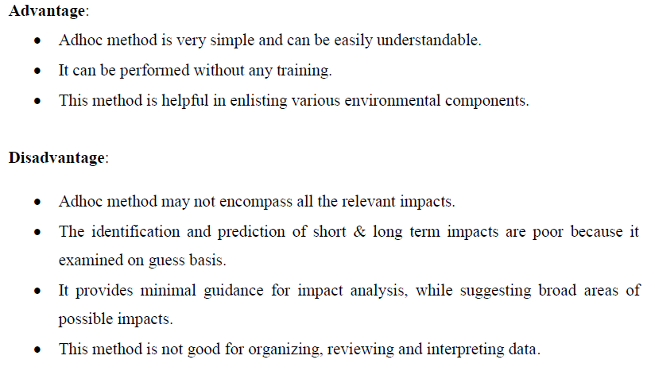
Adhoc

Slide 8
Checklists
Write short note on checklist method of EIA?
Standard lists of the types of impacts associated with a particular type of project
Primarily organizing information or ensuring that no potential impact is overlooked.
Should enable identification of impacts on
Soil
Water
Air
Flora
Fauna
Resources
Recreation
cultural

Slide 9
Checklists
Types of checklists
Simple checklists: a list of environmental parameters with no guidelines on how they are to be measured and interpreted
Descriptive checklist: includes an identification of environmental parameters and guidelines on how to measure data on particular parameters.
Scaling checklist: similar to a descriptive checklist, but with additional information on subjective scaling of the parameters
Questionnaire: three types of answer, ‘ye’s, ‘no’, ‘may be’

Slide 10
Checklists
What are the advantages and disadvantages of checklist method of EIA?
Advantages
can structure initial stages of assessment
help to ensure that vital factors are not neglected
are easy to apply, particularly by non-experts
Disadvantages
They are too general or incomplete;
They do not illustrate interactions between effects;
The identification of effects is qualitative and subjective
pose danger of “tunnel vision”

Slide 11
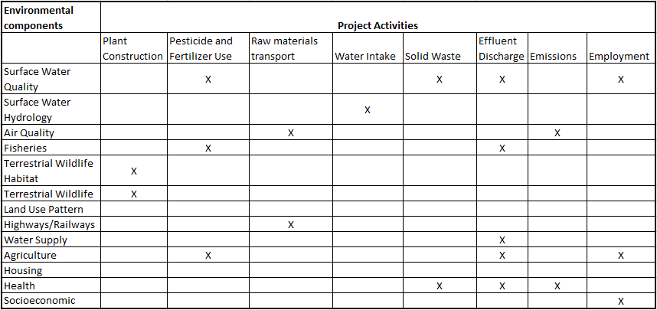
Checklists

Slide 12
Matrices
Matrix methods identify interactions between various project actions and environmental parameters and components
Allow for the identification of cause-effect relationships
Can address impact severity and significance
Qualitative or quantitative estimates can be used
A matrix of potential interactions is produced by combining these two lists (placing one on the vertical axis and the other on the horizontal axis)

Slide 13
Matrices

Slide 14
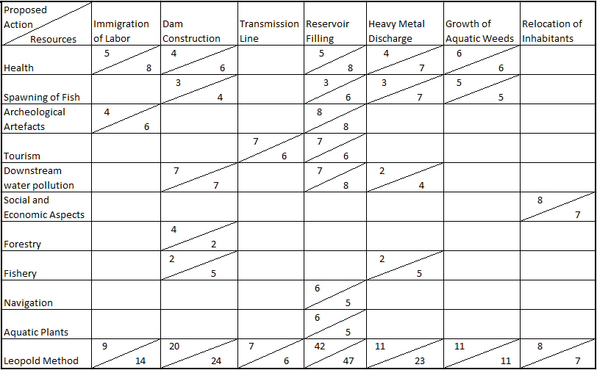
Matrices

Slide 15
Networks/Flowcharts
Flowcharts and impacts trees, including network diagrams-
Enable the analysis of the inter-relationship between causes and effects
Enables the analysis of indirect and cumulative impacts.
Network diagrams provide a means for displaying first, secondary, tertiary, and higher order impacts.
To develop a network, a series of questions related to each project activity (such as what are the primary impact areas, the primary impacts within these areas, the secondary impact areas, the secondary impacts within these areas, and so on) must be answered.

Slide 16
Networks/Flowcharts

Slide 17
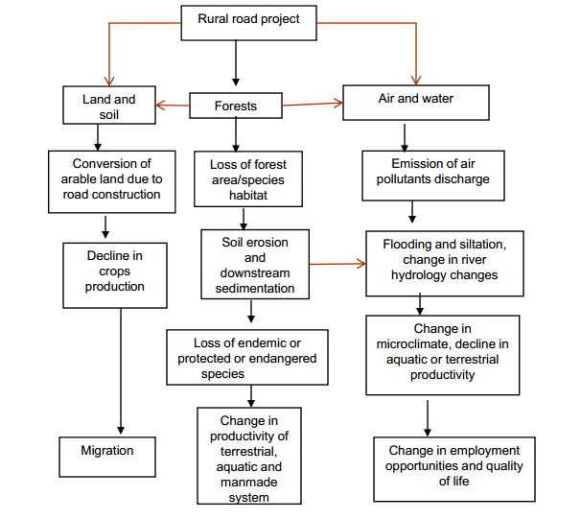
Networks/Flowcharts

Slide 18
Networks/Flowcharts
What are the advantages and disadvantages of flowcharts method of EIA?
Advantages:
integrated assessment, instead of discipline by discipline
inter-relations between causes and effects, including indirect impacts
cumulative impact assessment - communication (when simple).
Disadvantages:
complexity (especially visually complex)
difficult to distinguish and quantify magnitudes (and importance) of different impacts

Slide 19
GIS (Geographic Information System
A geographic information system (GIS) is a system that creates, manages, analyzes, and maps all types of data.
Importance of GIS
GIS is an essential component of the Environmental Impact Assessment (EIA) process, as environmental resources are directly affected by changes in the shape and extent of the proposed disturbance. GIS connects data to a map, integrating location data (where things are) with all types of descriptive information (what things are like there). This provides a foundation for mapping and analysis that is used in science and almost every industry. GIS helps users understand patterns, relationships, and geographic context. The benefits include improved communication and efficiency as well as better management and decision making.

Slide 20
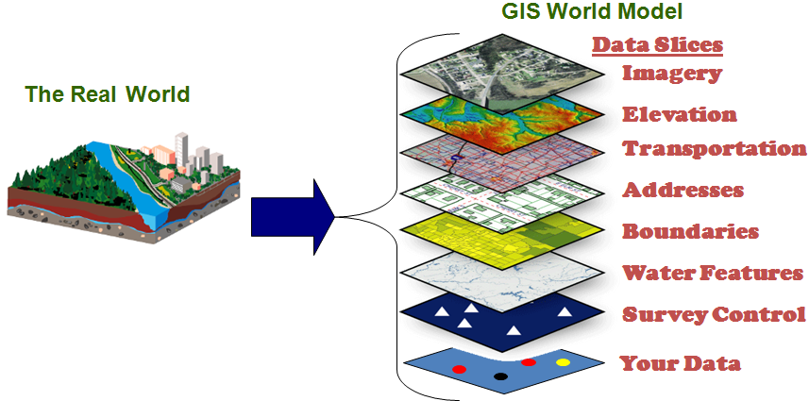
GIS (Geographic Information System

Slide 21
Overlays/GIS
Essentially, the overlay
method divides the study area into convenient
geographical units based on uniformly spaced grid points, topographic features,
or differing land uses. Field
surveys, topographical land inventory maps, aerial
photography, etc., are used to assemble information related to environmental and human factors within the geographical units. Factors are composed by assembling concerns that have a common basis, and regional maps are drawn for each factor. Through the use of overlays, land use possibilities and engineering feasibility are visually determined
(McHarg, 1968).

Slide 22
EES (Environmental Effect Study)
Changes of environmental parameters
Severe (+5 or -5)
Higher (+4 or -4)
Moderate (+3 or -3)
– Low (+2 or -2)
Very Low (+1 or -1)
No change (0)

Slide 23
Impact Evaluation

Slide 24
Impact Evaluation

Slide 25
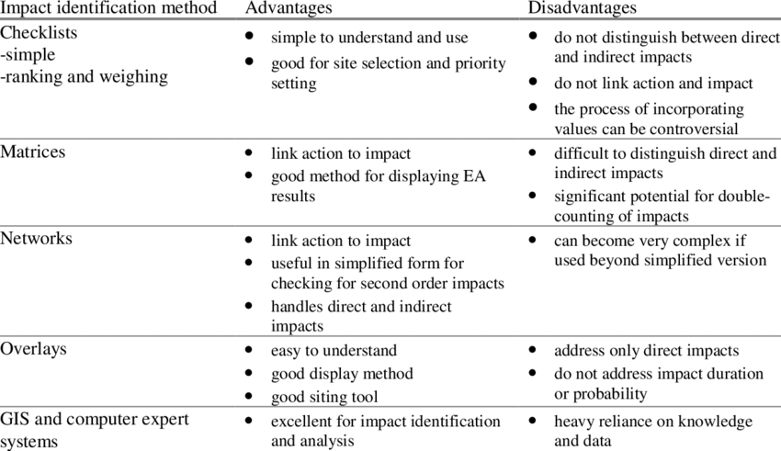
Advantages & Disadvantages for all

Slide 26
Environmental Impact Assessment
Stages of EIA

