Slide 1

Lesson 4
Environmental Management Plan
Course Teacher
Abu Hasan
Senior Lecturer
Department of Civil Engineering

Slide 2
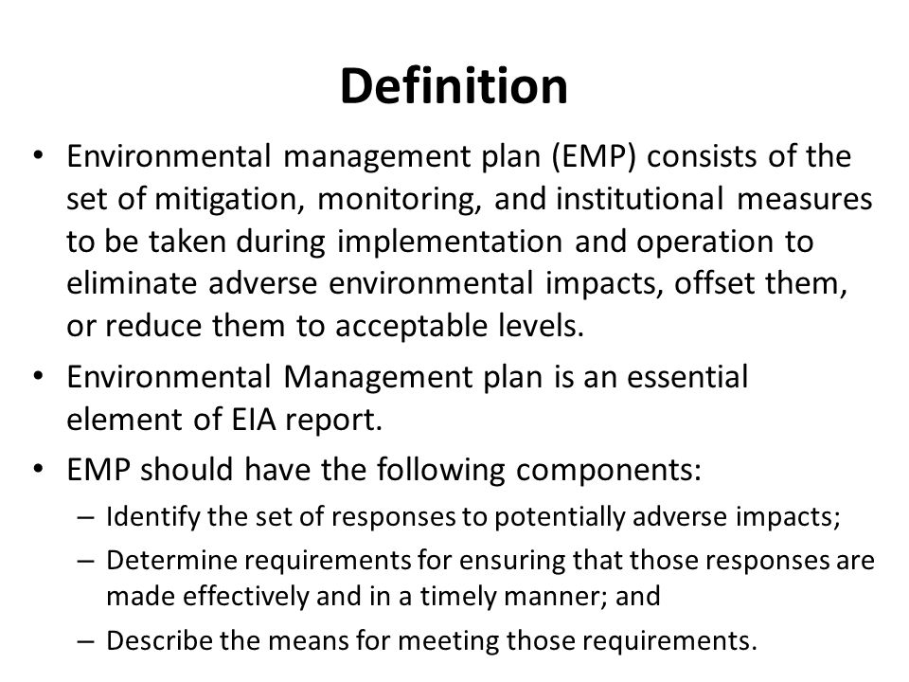
Environmental Management Plan (EMP)
An EMP is a site-specific plan developed to ensure that all necessary measures are identified and implemented in order to protect the environment and comply with environmental legislation.

Slide 3
Environmental Management Plan (EMP)
( EIA = Environmental Impact Assessment )

Slide 4
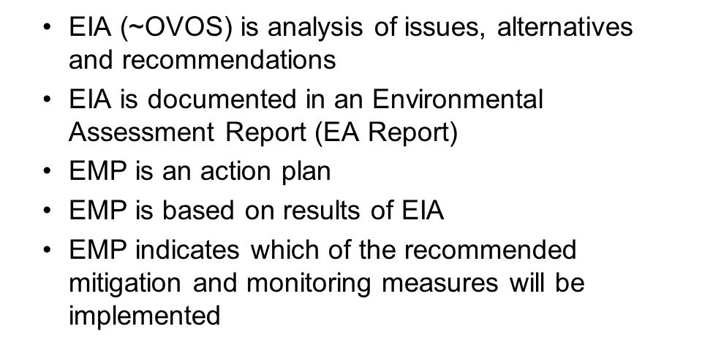
How is EMP related to EIA?
Maybe a standalone report or part of an EA report.

Slide 5
Role of an EMP
Summarize environmental impacts identified in the EA report
Identify impacts that must be mitigated
Describe mitigation measures
Describe monitoring and reporting arrangements
Describe assignment of responsibilities and schedules
Provide costs estimates for mitigation and monitoring measures

Slide 6
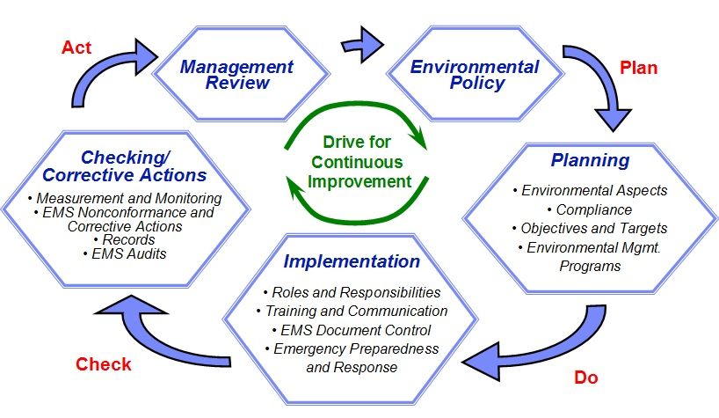
Steps Of EMP

Slide 7
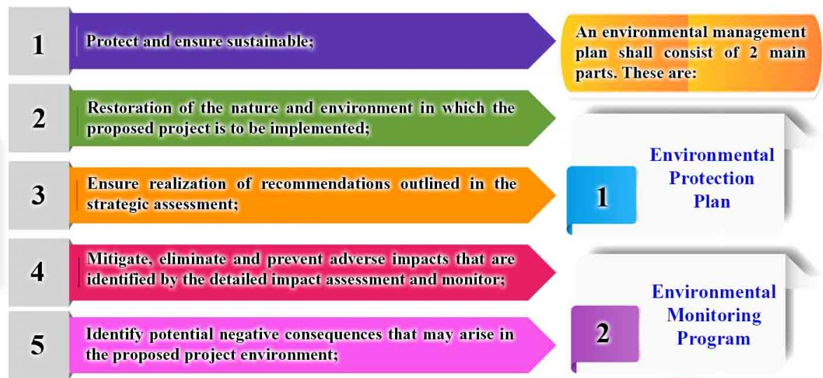
Purpose Of EMP

Slide 8
Features of an EMP
An instrument for implementing environmental management commitments, conditions, and requirements of project.
Promotes self-regulation & integration of environmental issues in planning and operations.
Addresses relevant environmental management issues,
Can be drafted in a consultative manner.
Facilitates environmentally sustainable development and decision-making process. It is:
  Able to forms the basis for consultation and negotiation of outcomes;
  Flexible;
  Comprehensive;
  Updatable; and
  A tool for promoting accountability

Slide 9
Environmental Management Strategies
Mitigation measures to Reduce or Eliminate Adverse Impacts
  Adoption of Protective Measures
  Selection of Alternatives
  Modification of Activities
  Changes in Construction Procedure/Materials
  Adoption of Supplementary program
Compensation or Off-set measures for Irreversible and Residual Impacts
  Resettlement of Affected People
  Development of Alternative Resources
  Replacement of Lost Resources
  Replacement of Lost Production

Slide 10
Environmental Management Strategies
Enhancement Measures to Maximize Positive Impacts
  Specific Environmental Enhancement Measures
  Replacement or Upgrading of Affected Resources
  Technical Support to Increase Production
  Training for Effective Management of Resources
  Introducing Community Management Practices
Environmental Monitoring
Disaster Management
Institutional Strengthening

Slide 11
Typical Contents of an EMP Report
Brief introduction of project design
Major findings of EIA/screening
Environmental impacts overview
Regulatory/statutory requirements
Environmental management proposed
Implementation arrangements
Institutional arrangements
Monitoring mechanism
Reporting system
Environmental training and management budget

Slide 12
EMP and the Project Cycle
PROJECT IDENTIFICATION
Preliminary Environmental Review
PRE-FEASIBILITY
IEE
FEASIBILITY STUDY
EIA
PROJECT DESIGN AND IMPLEMENTATION
EMP
(mitigation measures)
PROJECT OPERATION
EMP
(env. monitoring)
MONITORING
EVALUATION

Slide 13
One EMP or Multiple EMPs?
Some projects require several EMPs:
Site-specific EMPs
Typical for projects with several components or subprojects on different sites
Impact-specific EMPs, when particular impacts require special attention, e.g.:
EMP for hazardous waste management EMP for oil spill prevention and response
Recipient-specific EMPs targeted to particular ecosystems or their elements, e.g.:
EMP for protecting fish population from impact of hydro power development
To guide preparation of multiple EMPs, Generic or “Framework” EMP is developed first

Slide 14
Who prepares EMPs?
EMP is part of the EA done by the project implementing agency
The project implementation agency hires consultants to prepare EMPs
For construction projects, EMP may be developed by:
Design engineering consultant
Construction or EPC contractor
Who oversees implementation of EMPs?
The construction supervising engineer oversees the compliance of contractors with the EMPs.

Slide 15
Integration of EMP into project design?
Preliminary EIA
Prefeasibility study
Generic Environmental Management Plan
Feasibility study
Detailed EMPs:
Site-specific / Impact- specific
Detailed Design / Engineering
Tasks often
assigned to Design Engineering Consultant
Core tasks of the Design Engineering Consultant
Bidding Documents

Slide 16
Typical EMP format : Mitigation measures
 | Project Activity | Potential Environm ental Impacts | Proposed Mitigation Measures(s) (incl. Legislation & regulations) | Institutional Responsibilities (incl. Enforcement and coordination) | Cost Estimates
Pre- Construction Phase | 1) 2) 3)
 | …
Construction | 1)
Phase | 2)
 | 3)
 | …
Operation and | 1)
Maintenance | 2)
Phase | 3)
 | …

Slide 17
Example of EMP: Impact Mitigation (Construction)
Activity/Issues | Potentially Significant Impacts | Proposed Mitigation and Enhancement Measures | Responsible Parties
Influx of workers | Generation of sewage and solid waste | Construction of sanitary latrine and septic tank system (one latrine for 20 persons) Erecting “no litter” sign, provision of waste bins/cans, where appropriate Waste minimization, recycle and reuse Proper disposal of solid waste (in designated waste bins) | Contractor (Monitoring by EGCB)
 | Possible spread of disease from workers | Clean bill of health a condition for employment Regular medical monitoring of workers
Source: EIA of World Bank funded 335MW Combined Cycle Power Plant at Siddhirganj,
Narayanganj
Full report available at: http://www.egcb.com.bd/Publications/Final%20report_Siddhirganj335MW_EIA.pdf

Slide 18
Example of EMP: Impact Mitigation (Operation)
Activity/ Issues | Potentially Significant Impacts | Proposed Mitigation and Enhancement Measures | Responsibl e Parties
Power Generation | Emission from the power plant | Using stack as specified in the bid document Using low nitrogen oxide burners, as specified in the bid document Installation of stack emission monitoring equipment for major pollutants (monitoring requiring and cost estimate provided) Planting of trees around the project site, especially along the northern boundary of the school and residential areas located close to the project site (number and cost estimate provided) Restrictions may also be imposed on installation of industries in the area that emit significant amount of particulate matter. | EGCB
Source: EIA of World Bank funded 335MW Combined Cycle Power Plant at Siddhirganj,
Narayanganj
Full report available at: http://www.egcb.com.bd/Publications/Final%20report_Siddhirganj335MW_EIA.pdf

Slide 19
Typical EMP format: Monitoring
Proposed Mitigation Measure | Parameters to be Monitored | Location | Measurements (incl. Methods & equipment) | Frequency of Measurement | Responsibilities (incl. review and reporting) | Cost (equipment & individuals)
Pre- Construction Phase
Construction Phase
Operation and Maintenance Phase
Total Cost for all Phases

Slide 20
Example of EMP: Monitoring during construction
 | What | Where | How | When
Potential Environmental Impacts | parameter is to be monitored? | is the parameter to be monitored? | is the parameter to be monitored? | is the parameter to be monitored?
Damage to vegetation | Clearing techniques and relocation procedures utilized; record of fees to environmental fund | Power plant site, pipeline and transmission line routes | Visual and by comparison with pre- construction photo survey | Monthly throughout construction period
Loss of fertile topsoil and soil erosion | Soil storage procedures and location | Soil storage sites | Visual | Weekly during site preparation and construction period
Air pollution by dust | Dust level | All active construction sites | Visual | During construction
Noise from construction works | Noise level, dB[A] | All active construction sites | Measurements by a licensed organization using certified measurement devices | During construction

Slide 21
Example of EMP: Monitoring during operation
 | What | Where | How | When
Potential Environmental Impacts | parameter is to be monitored? | is the parameter to be monitored? | is the parameter to be monitored? | is the parameter to be monitored?
Air emissions of | Emissions of air pollutants: (1) NOx calculated as | At the stack of | By continuous | Initial test at
NOx, SO2, CO, | NO2; (2) SO2; (3) CO; (4) PM. The applicable | the power plant | monitoring | commissioning
and particulate | standards are: (1) NO2 ≤ 400 mg/m3; (2) SO2 ≤ 850 |  | equipment | and annual
matter (PM) | mg/m3; (3) CO ≤ 150 mg/m3; (4) PM ≤ 100 mg/m3 |  | supplied with the | subsequently.
 |  |  | power plant | Continuous for
 |  |  |  | NOx and CO.
Air emissions of | Ground level concentrations: (1) NOx; (2) SO2; (3) | In adjacent | By buying data | Once before
NOx, SO2, CO, | PM. The applicable environmental standards are: (1) | residential areas | from the local air | commissioning
and particulate | NOx: Annual average ≤ 40 μg/m3; Max 24-hour | and/or nearest air | quality | of the plant and
matter (PM) | average ≤ 150 μg/m3; Max 30-min average ≤ 500 | quality | monitoring | annually when
 | μg/m3 (2) SO2 Annual average ≤ 40 μg/m3; Max 24- | monitoring | station | the plant is in
 | hour average ≤ 150 μg/m3; Max 30-min average ≤ 500 | stations |  | operation
 | μg/m3 (3) PM Annual average ≤ 50 μg/m3; Max 24-
 | hour average ≤ 125 μg/m3; Max 30-min average ≤ 280
 | μg/m3
Noise from | Noise level, dB[A]. Applicable limits are 80 dB[A] on- | At 1 meter from | Measurements by | Once before
construction works | site and 65 dB[A] off-site. | operating turbines | a licensed | commissioning
 |  | and in nearest | organization | of the plant and
 |  | residential areas | using certified | annually when
 |  |  | measurement | the plant is in
 |  |  | devices | operation

Slide 22
EMP needs follow-up and supervision
EMPs should be periodically reviewed, especially when:
Environmental impacts are associated with the operational rather than construction phase (Example: power plant or mining operations);
Revisions to EMP may be necessary when:
Final EIA produced after project appraisal renders the original EMP obsolete or irrelevant;
Site-specific EMPs produced after project appraisal need to be checked during project supervision

