Slide 1
Capital Budgeting Processes & Techniques

Slide 2
Capital budgeting is the process of evaluating and selecting long term investments consistent with the firm’s goal of owner wealth maximization.

Slide 3
Motives for Capital Expenditure
Capital expenditure increases the productivity as well as profit for long term

Slide 4
Importance of Capital Budgeting:
Long term implication/ loss of flexibility
Lock of fund for long term
Strategic direction
Serious consequences, if erroneous forecast
Substantial expenditure
Risky

Slide 5
Steps in Capital Budgeting Decision:
1. Proposal generation/ Identification of investment projects
2. Estimating cash flows
3. Review and analysis/ Evaluation of the alternative investment
4. Decision making/ Selection of the investment projects
5. Implementation of the project
6. Follow up/ Continuous evaluation of the selected projects.

Slide 6
Applications of capital budgeting decisions:
Absolutely new investment proposal:
Expansion of existing products and markets
Expansion into new products or markets
Replacement decision
Maintenance of business
Cost reduction

Slide 7
Capital Budgeting Techniques:
Traditional approach:
Pay back period method
Accounting/ average rate of return (ARR)
Discounted payback period method
B. Modern approach (Discounted cash flow method):
Net present value method (NPV)
Internal rate of return (IRR) method
Profitability index (PI) method.
Modified IRR method

Slide 8
Capital Budgeting Decision Techniques
Payback Period: most commonly used
(it is defined as the number of years required to recover the original cash outlay invested in a project)
Accounting Rate of Return (ARR): focuses on project’s impact on accounting profits
(to measure the profit abilities of the investment proposals.)
Net Present Value (NPV): best technique theoretically
(NPV method is a process of calculating the present value of cash flows (inflows and outflows) of an investment proposal)
Internal Rate of Return (IRR): widely used with strong intuitive appeal
Is the discount rate at which net present value of the project becomes zero. Higher IRR should be preferred.
(IRR) equates the present value cash inflows with the present value of cash outflows of an investment.
Profitability Index (PI): related to NPV
Is the ratio of present value of future cash flows of a project to initial investment required for the project.

Slide 10
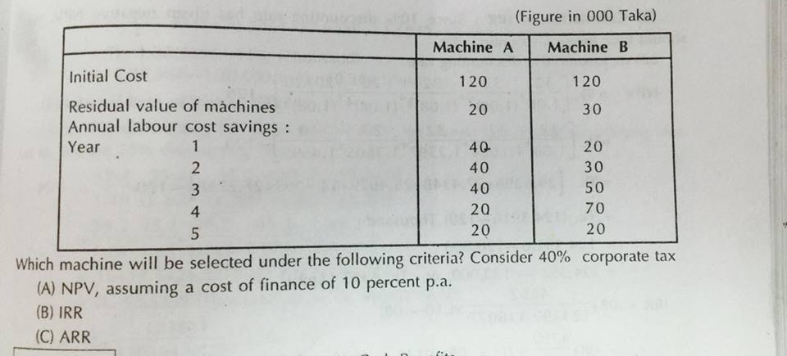

Slide 11
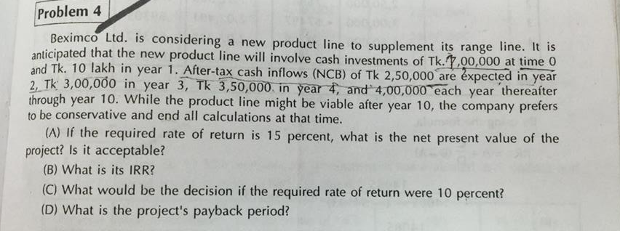

Slide 12
Payback Period
The payback period is the amount of time required for the firm to recover its initial investment
If the project’s payback period is less than the maximum acceptable payback period, accept the project
If the project’s payback period is greater than the maximum acceptable payback period, reject the project
Management determines maximum acceptable payback period

Slide 13
Pros And Cons Of Payback Method
Advantages of payback method:
Computational simplicity
Easy to understand
Focus on cash flow
Disadvantages of payback method:
Does not account properly for time value of money
Does not account properly for risk
Cutoff period is arbitrary
Does not lead to value-maximizing decisions

Slide 14
Discounted Payback Period
Discounted payback accounts for time value
Apply discount rate to cash flows during payback period
Still ignores cash flows after payback period

Slide 15
Accounting Rate Of Return (ARR)
Can be computed from available accounting data
Need only profits after taxes and depreciation
Accounting ROR = Average profits after taxes ÷ Average investment
Average profits after taxes are estimated by subtracting average annual depreciation from the average annual operating cash inflows
ARR uses accounting numbers, not cash flows; no time value of money
=
Average annual operating cash inflows
Average annual
depreciation
Average profits
after taxes
-

Slide 16
Net Present Value
The present value of a project’s cash inflows and outflows
Discounting cash flows accounts for the time value of money
Choosing the appropriate discount rate accounts for risk
Accept projects if NPV > 0

Slide 17
Net Present Value
A key input in NPV analysis is the discount rate
r represents the minimum return that the project must earn to satisfy investors
r varies with the risk of the firm and/or the risk of the project

Slide 18
Internal Rate of Return
Internal rate of return (IRR) is the discount rate that results in a zero NPV for the project
IRR found by computer/calculator or manually by trial and error
The IRR decision rule is:
If IRR is greater than the cost of capital, accept the project
If IRR is less than the cost of capital, reject the project

Slide 19
Advantages and Disadvantages of IRR
Advantages
Properly adjusts for time value of money
Uses cash flows rather than earnings
Accounts for all cash flows
Project IRR is a number with intuitive appeal
Three key problems encountered in using IRR:
Lending versus borrowing?
Multiple IRRs
No real solutions
IRR and NPV rankings do not always agree

Slide 20
Profitability Index
Calculated by dividing the PV of a project’s cash inflows by the PV of its outflows
Decision rule: Accept projects with PI > 1.0, equal to NPV > 0

Slide 21
Basic Terminologies:
Independent investments/ projects:
Dependent investments/ projects:
Complementary investment decision/ projects:
Substitute projects:
Mutually exclusive investment decisions /projects:
Conventional projects Vs Non-conventional projects
Unlimited Funds vs. Capital Rationing

Slide 22
Independent versus Mutually Exclusive Projects
Independent projects – accepting/rejecting one project has no impact on the accept/reject decision for the other project
Mutually exclusive projects – accepting one project implies rejecting another
If demand is high enough, projects may be independent
If demand warrants only one investment, projects are mutually exclusive
When ranking mutually exclusive projects, choose the project with highest NPV

Slide 23
Capital Rationing
The profitability index (PI) is a close cousin of the NPV approach, but it suffers from the same scale problem as the IRR approach.
The PI approach is most useful in capital rationing situations.

Slide 24
Costs: include or exclude?
A sunk cost is a cost that has already occurred, so it cannot be part of the incremental cash flows of a capital budgeting analysis.
An opportunity cost is what would be earned on the next-best use of the assets.
An incremental cash flow is the difference in a company’s cash flows with and without the project.
An externality is an effect that the investment project has on something else, whether inside or outside of the company.
Cannibalization is an externality in which the investment reduces cash flows elsewhere in the company (e.g., takes sales from an existing company project).

