Slide 1
Capital Budgeting
Analysis of A Single Project

Slide 2
Problem 01
An engineering company is considering an investment proposal to install new equipment facility. The project will cost Tk. 50,000. The facility has a life expectancy of 5 years and no salvage value. The company’s tax rate is 40%. The firm uses straight line method of depreciation. The estimated cash inflow from the proposed investment proposal are follows:
You are to decide whether to accept the project under:
1. Payback period 2. Average Rate of Return (ARR), 3. NPV at 10% discount 4. Internal rate of return 5. Profitability Index at 10% discount rate
Period( Year) | Cash Inflow (Tk.)
1 | 10,000
2 | 15,000
3 | 20,000
4 | 30,000
5 | 35,000

Slide 3
Solution:
Payback Period = $A+(NCO−C)/D$
Where, A= The year in which cumulative cash flow is nearer or closer to NCO
NCO= Net Cash Outlay or Investment
C= Cumulative cash inflow of the year A
D = Cash inflow of the year following the year A
Year | Net Cash Inflow | Cumulative Cash Inflow
1 | 10,000 | 10,000
2 | 15,000 | 25,000
3 | 20,000 | 45,000
4 | 30,000 | 75,000
5 | 35,000 | 1,10,000
So, Payback Period = $3+(50,000−45,000)/30,000$
= 3.17 years
Decision:
If the payback period is less than the maximum acceptance payback period ----accept the project.
If the payback period is greater than the maximum acceptance payback period ----reject the project.

Slide 4
2. Accounting Rate of Return (ARR) = $\left(Average Cash inflow after Tax/Average Capital\right)∗100$
ARR= 22000/25000 = 88%
Average Cash inflow After Tax = $\left(Cash inflow after Tax /No of years\right)$
= $\frac{10000+15000+20000+30000+35000}{5}$
= 22,000
Average Capital = $(Initial Capital+Additional Capital or Salvage Value)/2$
= (50000+0)/2 = 25000
Decision:
If ARR is greater than minimum expected rate of return --- accept the project.
If ARR is less than minimum expected rate of return --- reject the project.

Slide 5
Where, A = Cash inflow of different years
R = Discount rate or cost of capital
C = Cash outflow or investment
=$\left\{\frac{10000}{(1+.10)}+\frac{15000}{{\left(1+.10\right)}^{2}}+\frac{20000}{{\left(1+.10\right)}^{3}}+\frac{30000}{(1+{.10)}^{4}}+\frac{35000}{(1+{.10)}^{5}}\right\}−50,000$
= (9,091 + 12,397 + 15,027 + 20,490 + 21,732) - 50,000
= 78,737 - 50,000
= 28,737 (As NPV is positive, so the company should invest in this project)
Decision:
If NPV is Positive --- accept the project.
If NPV is Negative --- reject the project.

Slide 6
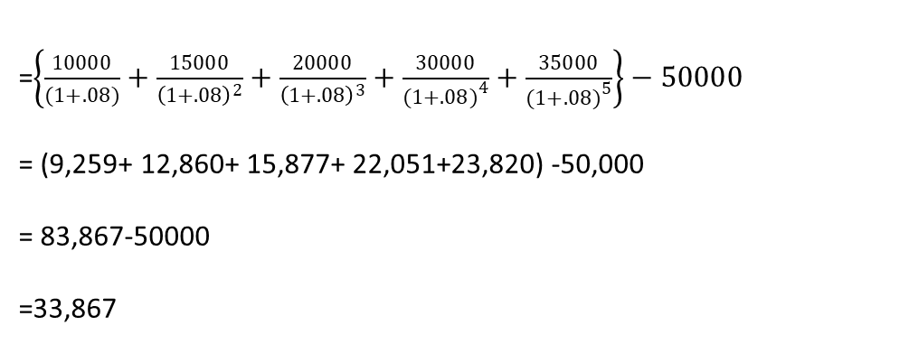
4. Internal Rate of Return (IRR) = $A+\{C/D\}(B−A)$
Where, A = Lower Discount Rate
B = Higher Discount Rate
C = NPV of Lower Discount Rate
D = Difference between the NPVs of Higher and Lower Discount Rate
Let another discount rate is 8%,
=$\left\{\frac{10000}{(1+.08)}+\frac{15000}{{\left(1+.08\right)}^{2}}+\frac{20000}{{\left(1+.08\right)}^{3}}+\frac{30000}{(1+{.08)}^{4}}+\frac{35000}{(1+{.08)}^{5}}\right\}−50000$
= (9,259+ 12,860+ 15,877+ 22,051+23,820) -50,000
= 83,867-50000
=33,867
IRR = $A+\{C/D\}(B−A)$
= $.08+\frac{33,867}{(33,867−28,737)} (.10−.08)$
= 0.2120
=21.20% (As IRR is greater than cost of capital, so the company should accept the project)
Decision:
If IRR is greater than the cost of capital ----accept the project.
If IRR is less than the cost of capital ----reject the project

Slide 7
5. Profitability Index (PI): Present Value of Cash inflow
Present Value of Cash outflow
= 78,737
50,000
= 1.57 (As PI is greater than 1 so we should accept the project)
Decision:
If profitability index is more than 1 (PI>1) ---- accept the project.
If profitability index is less than 1 (PI<1) ---- reject the project.

Slide 8
If there is more than one project than the decision will be
ST10-1
As NPV is highest for Project ….. So the company should invest in Project …….
 | Project M | Project N
PBP | 2.85 | 2.67
ARR | 70.18% | 70.37%
NPV | 637.13 | 1,153.18
IRR | 15.03% | 14.62%
PI | 1.57 | 1.04

