Slide 1
The Essential Elements of Contract.

Slide 2
Topic Name : The Essential Elements Of Contract

Slide 3
Offer And Acceptance
The meaning of offer and acceptance is the basis of a contract. To form a contract, there must be an offer made by one party which is, in turn, accepted by another party, and then, in most cases goods and services must be exchanged between the two.
An offer needs to be clear, definite, complete and final.
It should be communicated to the offeree.
Example: A offers to buy B's car for rupees two lacs and B accepts such an offer. An offer does not create any legal obligations, but after the offer is accepted it becomes a promise.

Slide 4
Intention to create legal Relationship
Intention to create legal relations is defined as an intention to enter a legally binding agreement or contract.
Intention to create legal relations is one of the necessary elements in formation of a contract. If there is no agreement by both of the parties, it may make the contact being a void agreement.
Example : you may have an agreement to meet a friend at a park.

Slide 5
Capacity to Contract
Capacity to contract means a party has the legal ability to enter into a contract.
Capacity also means a person has to be competent as defined by law.
capacity is determined by whether or not they have reached the age of majority and if they are mentally capable of understanding the applicable contract terms.

Slide 6
Free Consent
Free consent refers to two parties both agreeing to a contract, including all of its terms and conditions, at their own will. This means that neither party was coerced, cheated, or forced into the contract.

Slide 7
Lawful Object
It is necessary that agreement is made for a lawful object. The object of contract must not be illegal, immoral, opposed to public.
Every agreement with unlawful object is illegal and therefore contract is void.
Example : A hires a house to use for gambling. The object of agreement is illegal and void.

Slide 8
Lawful Consideration

Slide 9
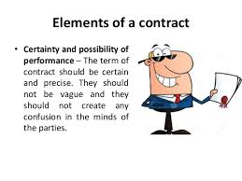
Certainty and possibility of performance
Certainty and Possibility of Performance. The agreements, in which the meaning is uncertain or if the agreement is not capable of being made certain, it is deemed void.

Slide 10
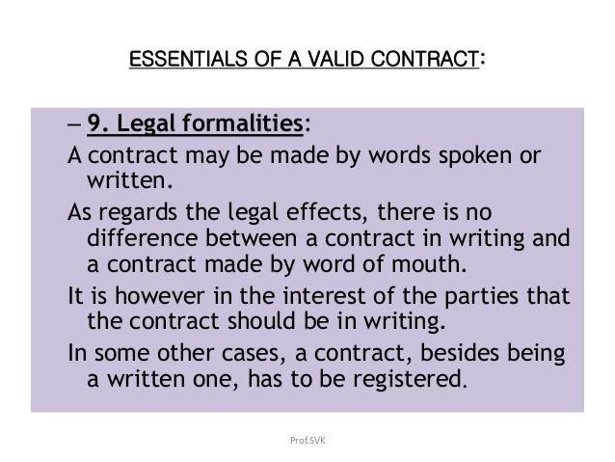
Legal Formalities

Slide 11
Classification of contracts
Contracts can be classified into five broad divisions namely
The method of formation of a contract
The time of performance of contract
The parties of the contract
The method of formalities of the contract
The method of legality of the contract

Slide 12
Classification of contracts
Under the method of formation of a contract may be three kinds,
Express contract: Express contract is one which expressed in words spoken or written. When such a contract is formal, there is no difficulty in understanding the rights and obligations of the parties.
Implied contract: The condition of an implied contract is to be understood form the acts, the contract of the parties or the course of dealing between them

