Slide 1
Ozymandias
Another name for Rameses II – the King of Egypt in 13th Century BCE – over three thousand years ago

Slide 2
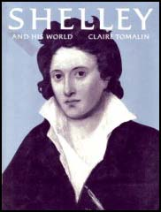
Ozymandias/Percy Bysshe Shelley (1792-1822)
A British Romantic poet.
Like other romantic poets, he wrote about the return to nature, freedom, democracy and human rights.
Many of the poems often use ancient stories as sources of inspiration.
Ozymandias is his most famous poem.

Slide 3
The Poem: Ozymandias
The name: a combination of two Greek words: ozium= breath, air; mandate= to rule
A sonnet- little song (Italian)
Sonnets usually contain 14 lines.
the octave- the first 8 lines: the question/the problem
the sestet- answers the question/ resolves the problem

Slide 4
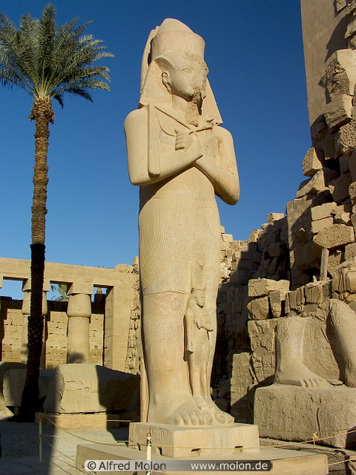
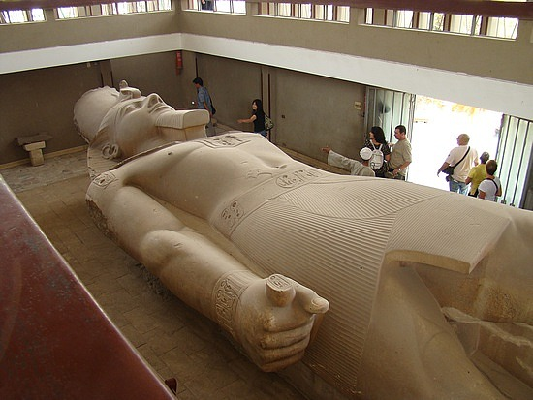
Rameses II
Rameses paid for a sculptor to carve a statue of him with the inscription ‘Look on my works, ye might, and despair’
Look on my works, ye might, and despair

Slide 5
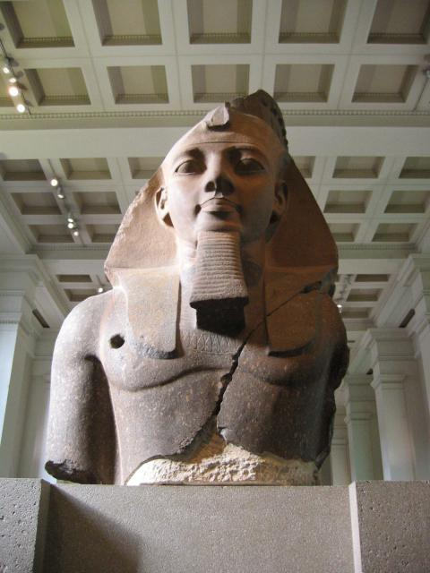
Who is this statue of?

Slide 6
Ramses II, Pharaoh, Ozymandias

Slide 7
What happened to the statue?

Slide 8
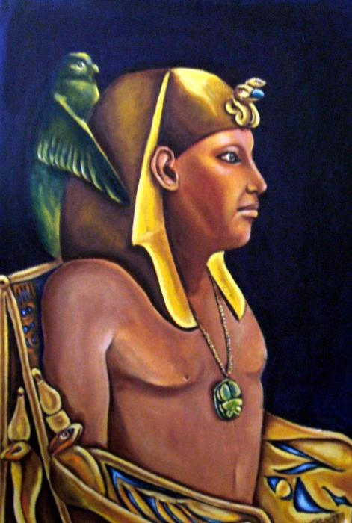
What Kind of a leader was Ramses the Great?
Distinguishing different perspectives:
From our perspective, he
was probably very charismatic.
took every possible advantage of
reign.
exercised total control.
was megalomaniac.
was ruthless in wars.
was cruel to his subjects and to strangers.

Slide 9
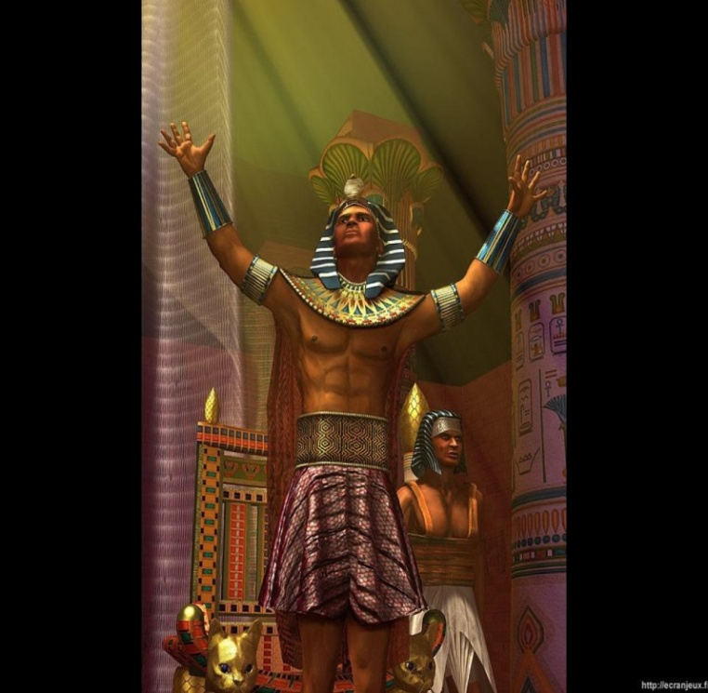
What kind of a leader was Ramses the Great?-Continuation
Distinguishing different perspectives:
In ancient times, he was probably considered
neither better nor worse than any other Egyptian king.
did what Egyptian pharaohs were suppose to do.

Slide 10
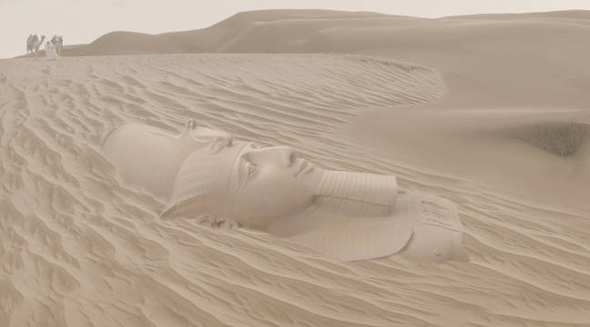
Let’s finish this presentation together:
If YOU could, what would YOU say to Ozymandias?

Slide 11
Why would he pay for a statue of himself?
So that his powerful rule would be remembered forever!

Slide 12
Specifics
Literary time period: Romantic
Purpose of the poem: Win a sonnet writing contest
Style: Sonnet, Iambic Pentameter
Tone: Mocking
Themes:
Art withstands time (or at least it lasts much longer than any other manmade creation)
Everything diminishes with time regardless of its grandure

Slide 13
Ozymandias
The narrator/speaker tells a story about what he saw in a desert/Egypt
Ancient/old
The trunk is the main part of the body – only the legs show
 | I met a traveller from an antique land Who said: `Two vast and trunkless legs of stone Stand in the desert. Near them, on the sand, Half sunk, a shattered visage lies, whose frown, And wrinkled lip, and sneer of cold command, Tell that its sculptor well those passions read Which yet survive, stamped on these lifeless things, The hand that mocked them and the heart that fed. And on the pedestal these words appear -- "My name is Ozymandias, king of kings: Look on my works, ye Mighty, and despair!" Nothing beside remains. Round the decay Of that colossal wreck, boundless and bare The lone and level sands stretch far away.'
face
The base of the statue
Be afraid
Big ruin of the statue

Slide 14
Ozymandias
The ‘frown’, ‘sneer’ and ‘cold command’ suggest that the king was cruel and bossy
Speech marks to show that the narrator is telling us what the traveller said
 | I met a traveller from an antique land Who said: `Two vast and trunkless legs of stone Stand in the desert. Near them, on the sand, Half sunk, a shattered visage lies, whose frown, And wrinkled lip, and sneer of cold command, Tell that its sculptor well those passions read Which yet survive, stamped on these lifeless things, The hand that mocked them and the heart that fed. And on the pedestal these words appear -- "My name is Ozymandias, king of kings: Look on my works, ye Mighty, and despair!" Nothing beside remains. Round the decay Of that colossal wreck, boundless and bare The lone and level sands stretch far away.'
Nearby, lies the face of the statue – half covered
The sculptor clearly knew what his ruler was like – vain, proud, evil and unpleasant
This plosive word suggests to us that the sculptor didn’t like the king

Slide 15
Ozymandias
In the first sestet (first 6 lines) the poet Shelley explores the result (fate) of such vanity and pride
 | I met a traveller from an antique land Who said: `Two vast and trunkless legs of stone Stand in the desert. Near them, on the sand, Half sunk, a shattered visage lies, whose frown, And wrinkled lip, and sneer of cold command, Tell that its sculptor well those passions read Which yet survive, stamped on these lifeless things, The hand that mocked them and the heart that fed. And on the pedestal these words appear -- "My name is Ozymandias, king of kings: Look on my works, ye Mighty, and despair!" Nothing beside remains. Round the decay Of that colossal wreck, boundless and bare The lone and level sands stretch far away.'

Slide 16
Ozymandias
Even though the quotation the king wanted still remains – his statue’s body does not. This is ironic. Neither the sculptor or the king (Ozymandias) or the statue remain to boast of power and authority – the very reason the statue was made for.
 | I met a traveller from an antique land Who said: `Two vast and trunkless legs of stone Stand in the desert. Near them, on the sand, Half sunk, a shattered visage lies, whose frown, And wrinkled lip, and sneer of cold command, Tell that its sculptor well those passions read Which yet survive, stamped on these lifeless things, The hand that mocked them and the heart that fed. And on the pedestal these words appear -- "My name is Ozymandias, king of kings: Look on my works, ye Mighty, and despair!" Nothing beside remains. Round the decay Of that colossal wreck, boundless and bare The lone and level sands stretch far away.'
What is also important to note is that the speaker in the poem is telling us about something someone else saw – this suggests that the king’s power was lost long ago as not many people have even seen his statue – this is the point of the second hand story.

Slide 17
Ozymandias
14 lines = a sonnet
 | I met a traveller from an antique land Who said: `Two vast and trunkless legs of stone Stand in the desert. Near them, on the sand, Half sunk, a shattered visage lies, whose frown, And wrinkled lip, and sneer of cold command, Tell that its sculptor well those passions read Which yet survive, stamped on these lifeless things, The hand that mocked them and the heart that fed. And on the pedestal these words appear -- "My name is Ozymandias, king of kings: Look on my works, ye Mighty, and despair!" Nothing beside remains. Round the decay Of that colossal wreck, boundless and bare The lone and level sands stretch far away.'
The highlighted words show the decay and loneliness of the statue
Time has destroyed the statue and Ozymandias’s memory that he tried hard to preserve – we end up mocking him for his efforts; his self-centredness and self-obsession

Slide 18
Ozymandias
Note the use of the alliteration in the octave (first eight lines)
 | I met a traveller from an antique land Who said: `Two vast and trunkless legs of stone Stand in the desert. Near them, on the sand, Half sunk, a shattered visage lies, whose frown, And wrinkled lip, and sneer of cold command, Tell that its sculptor well those passions read Which yet survive, stamped on these lifeless things, The hand that mocked them and the heart that fed. And on the pedestal these words appear -- "My name is Ozymandias, king of kings: Look on my works, ye Mighty, and despair!" Nothing beside remains. Round the decay Of that colossal wreck, boundless and bare The lone and level sands stretch far away.'
Note the use of parallelism (the balancing of two phrases)
The use of caesura (midline fullstop) makes the reader pause for effect – to think/to show the isolation of the statue
Alliteration to emphasise the emptiness around the statue

Slide 19
Why write the poem?
In Shelley’s time he disagreed with the government’s policies and uses this poem as a way of speaking his mind
However, it is also a poem that has a timeless quality to show that all civilisations fall and crumble with time
Why have the words on the statue survived? – this could be a message from Shelley to imply that the words of poets with outlive the words of dictators

Slide 20
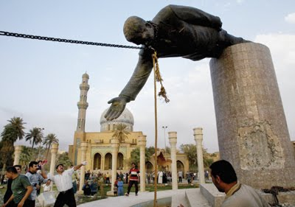
How the mighty have fallen
This image of Saddam Hussein’s statue being pulled down shows how a once powerful and frightening figure’s reign ultimately is forgotten

Slide 21
Writing for an AP prompt
Main sections to talk about:
The contrast between the survival of the artist's sculpture and the destruciton of Ozymandias' kingdom. Irony of the King's claim that he has the most powerful kingdom when he only has a desert to show for his work. The scultptor's skill is still evident despite the statue(especially its face) being in ruins.
Possible Thesis:
Shelley utilizes a variety of literary features to assert that despite the decay of time, art will live on far beyond the world around it.
Possible Topic sentences:
Mocking the king, Shelley emphasizes the vastness of Ozymandias' great kingdom in the past and compares it to the present where only his statue remains.
Shelley also highlights the artist's ability in the creation of the statue.

