Slide 1

Evaluating and Building HR Strategy
Dr. AKM Mohsin | Daffodil International University, Bangladesh

Slide 2
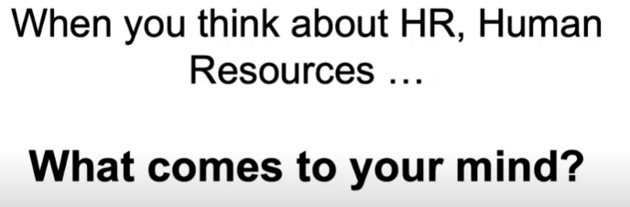
Let’s start with a question…….

Slide 3
HR as an administrative and strategic field
Future business of the company
HR Strategy
Daily, operational issues and topics
HR Administration

Slide 4
Simple difficult cases #1
There is an SME operating as a supplier in the automotive industry (3,500 employees). It is desperately looking for software developers. Relying on job ads only doesn’t seem to lead to expected results anymore. Engaging an executive search consultancy turns out to be too expensive. What to do?

Slide 5
Simple difficult cases #2
In recent years a company had to deal with an increasing turnover among its most talented and most motivated people. Further research and discussions made clear that there is a lack of career prospects among most talented employees. At the same time key positions mainly have been filled with external candidates. What to do?

Slide 6
Simple difficult cases #3
The new externally hired CEO at an insurance company became instantly aware of the lacking ambition and drive for performance in almost all areas and functions. A strong appeal to all managers and employees probably might not be enough. The company is thinking about a new kind of performance management system. Does this make sense? If yes, how could it look like?

Slide 7
Simple difficult cases #4
A company in the retail sector sees a decline in sales and is continuously losing market share. The new corporate strategy now consistently focuses on digitizing the supply and distribution channels as well as all related business processes. An analysis has shown that the workforce has little knowledge of digitization and is rather reluctant to deal with this topic. What is to be done?

Slide 8
HR Strategy
A company’s HR strategy refers to all people-related approaches that address both strategic business challenges and purpose in order to strengthen a company’s competitive advantage. Moreover, the HR strategy defines how all critical approaches are aligned to the structural and cultural context.
Business
Competitive
Advantage
Context
Approaches

Slide 9
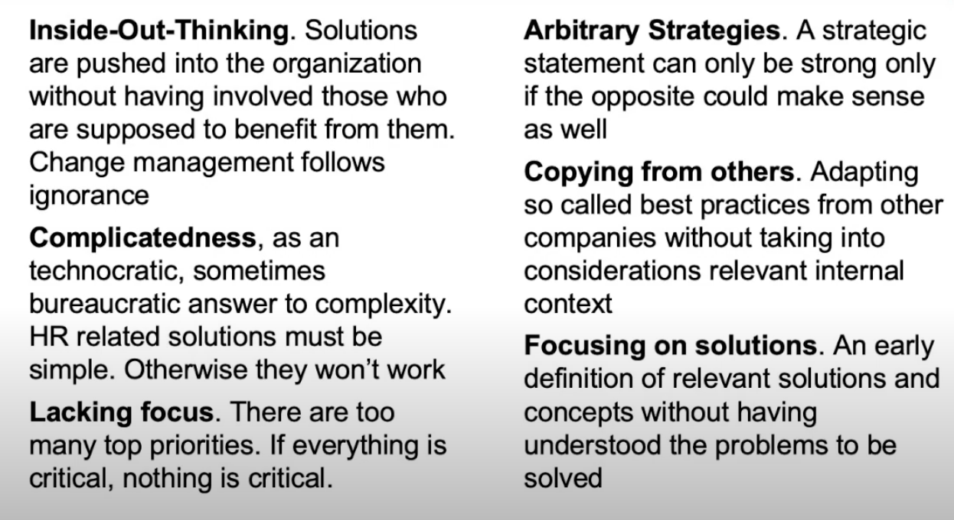
Major pitfalls when developing an HR Strategy

Slide 10
Full-blown central planning and control
HR Org
Job Architecture
HR planning
Succession planning
KPIs
Behavioural anchor
Competency models
Strategy
Development programs
Career paths
Job description
Job profiles
Objective
setting
360-degree feedback
Career planning
Job planning
Job evaluation
Performance
Talent review
Expatriation
Job posting
Remuneration
Performance evaluation
Potential assessment
Training
(off-thejob)
HR Marketing
Personnel selection
Competence
Competence assessment
Development planning
Employee survey
Employee profiles
Performance apraisal
Personnel deployment planning
HRIS

Slide 11
Strategic statements | Example: development
Company and HR
Employees themselves
As a company, we have a responsibility to develop our most talented people.
The responsibility for the development of our employees lies with the employees themselves. We enable them for this where necessary and where desired.

Slide 12
Solution or problem as starting point
?
Solution
Design
Context
Problem
Problem
Context
Solution
Design

Slide 13
What types of Human Resource mnagement in your company?

Slide 14
Company development within two hemispheres
Strategic
management systems
Roles & Structures
Hierarchy und Stability
Responsibility is bundled at
top management level
Culture
Attitude
Institutionalization
Agility und Networks
Responsibility is shared in decentralized networks

Slide 15
Types of HR within the HR playing field (HR triangle)
Central
planning and control
Hierarchy
and stability
Hire
& pay
Institutionalization
Networks
and agility
People-centered
enablement
Attitude of
the founder
Rules & structures
Strategic management systems
Culture

Slide 16
Building an HR strategy
Company Strategy
People-related challenges and critical functions
Strategic HR topics and approaches
Strategic alignment of topics and approaches
Structural & cultural context,
role of HR
Building blocks of an HR strategy
Strategic structural and cultural basis

Slide 17

Business purpose is about meeting customer needs and problems

Slide 18
Critical Business Challenges
Decreasing
Purchase Power
Digitization
Changing Consumer Preferences
Changing consumer segments
Disruptive Technologies
Cost Pressure through
Low-Cost-Suppliers
Shifting Consumer Behavior
Public regulation
Decreasing Willingness to invest
Growing Resource Scarcity
Emerging
aggressive Players
New Business Models
Global Competition
Political Uncertainty

Slide 19
Competitive Advantage
In the future we will be more successful than our competitors because ...
our products and services are more innovative
we are technologically more advanced
we can offer our products at a lower price
our products and services are of higher quality
our products have a better design
we communicate our promise more effectively (brand)
we have a more effective and faster access to markets
we have the largest market share in the world.
…

Slide 20
Potential people-related challenges
Filling key and expert positions
Filling bottleneck functions
Valid selection of the right candidates
Being fair on compensation
Allowing a balance of work and family
Shaping productive working conditions
Identify and leverage people‘s potential
Open long-term development opportunities
Sharing relevant knowledge across the firm
Retaining best and high-potential employees
Ensuring broad-based employability
Building relevant skills and competencies
Keeping level of engagement high
Dealing with various generations
Allowing and building workforce diversity

Slide 21
Potential HR topics and approaches
Talent acquisition and selection
Employer Branding
Candidate sourcing and relation
Selection and fit
Onboarding
Learning and knowledge
Vocational training
Executive education
Continuous learning
Knowledge management
Engagement
and loyality
Working conditions and employer attractivenes
Employee survey
Employee retention
Performance, feedback and appraisal
Objective setting
Feedback
Formal review
Development and careers
Talent identification
Talent development
Expert career
Compensation and reward
Reward strategy
Base pay
Variable pay

