Slide 1
Chapter: 8 Aligning HR with Strategy
By Dr. AKM Mohsin
Add your itle here

Slide 2
Readings
Barney, J. B., & Wright, P. M. (1998). On becoming a strategic partner: The role of human resources in gaining competitive advantage. Human Resource Management, 37(1), 31–46. https://doi.org/3.0.co;2-w">10.1002/(sici)1099-050x(199821)37:1<31::aid-hrm4>3.0.co;2-w
Gomez-Mejia, Balkin & Cardy, Managing Human Resources | Pearson. (2013). Pearson.com. https://www.pearson.com/us/higher-education/product/Gomez-Mejia-Managing-Human-Resources-7th-Edition/9780132729826.html
Performance Management. (n.d.). India.oup.com. Retrieved August 9, 2021, from https://india.oup.com/product/performance-management-9780195693379?
Wright, P. M., & McMahan, G. C. (1992). Theoretical Perspectives for Strategic Human Resource Management. Journal of Management, 18(2), 295–320. https://doi.org/10.1177/014920639201800205
Schuler, R. S., & Jackson, S. E. (1987). Linking Competitive Strategies with Human Resource Management Practices. Academy of Management Executive, 1(3), 207–219. https://doi.org/10.5465/ame.1987.4275740

Slide 3
Let's start with a question................
How to make an impact using Strategic Human Resources Management? In explaining the 'how', we need to touch upon:
💡Creating a Human Resource strategic plan that follows the business
💡 Aligning HR with Strategy
💡Putting more emphasis on data
💡Remembering HR’s other responsibilities
💡Taking an outside-in approach

Slide 4
Strategic theories of HR (Wright, P. M., & McMahan, G. C.,1992)
Resource based view of the firm:
Competetive advantage can only occur in situations of the firm resources heterogeneity and firm resource immobility (inability of competing firms to obtain resorce from others firms)
“.....given resource heterogeneity and resource imobility and satisfaction of the requirments of value, rareness, imperfect immitability, and non-subtitutability, a firm resource can be source of sustained competitive advantage.”

Slide 5
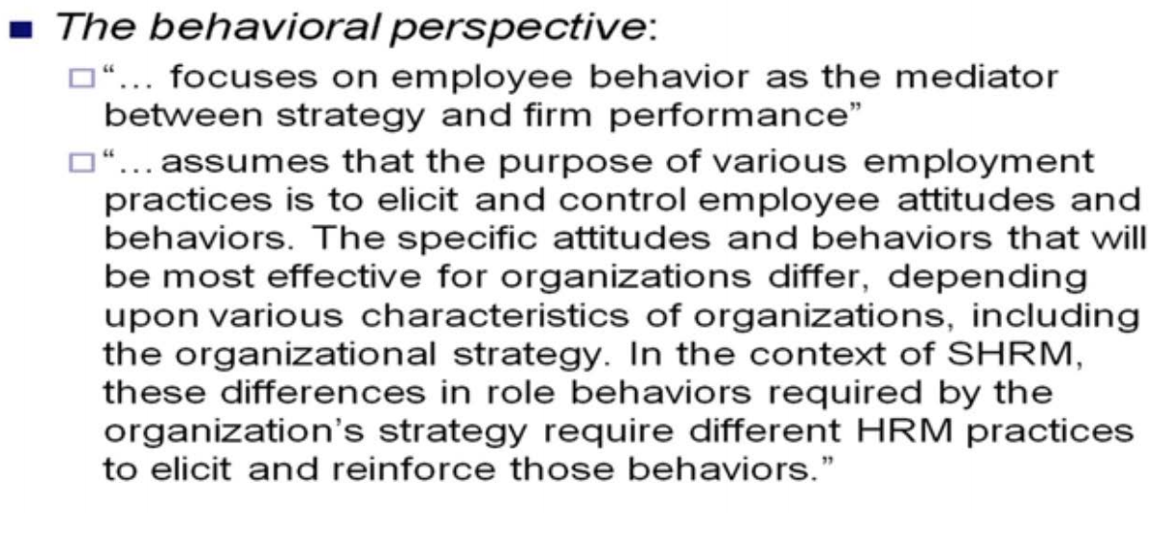
Strategic theories of HR (Contd..)
(Wright, P. M., & McMahan, G. C.,1992)

Slide 6
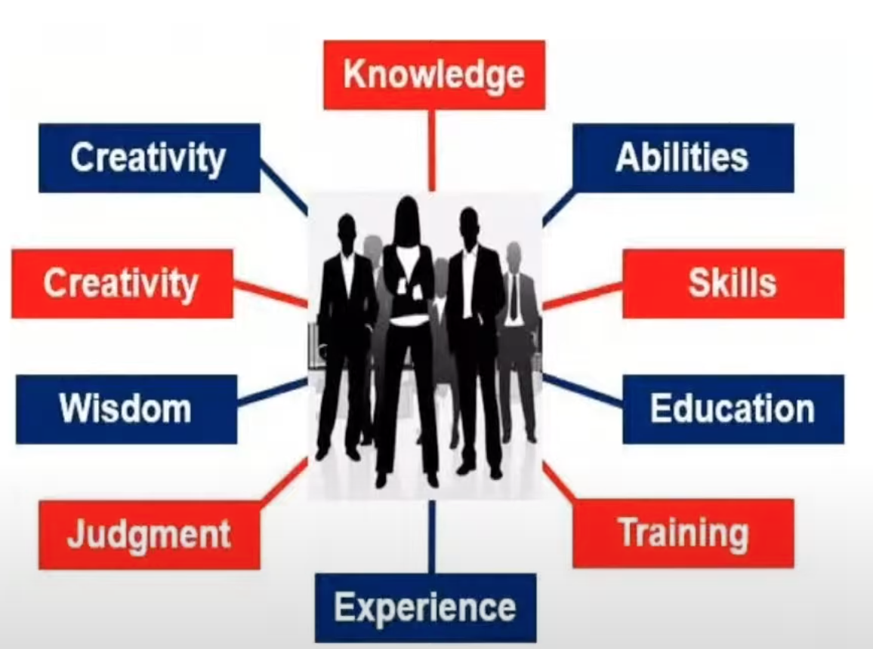
Human Capital Theory
Human capital refers to the collective sum of the attributes, experience, knowledge, and commitment that employees choose to invest in their work
From the perspective of human capital, employees are viewed as a capital resource that requires investment
Human capitals value added can be estimated by:
Total revenue – (operating expenses – total compensation costs)
Total compensation costs

Slide 7
How it’s working like at Google……..

Slide 8
STRATEGIC HUMAN RESOURCES MANAGEMENT ACTIVITIES
Human Resources Philosophy
Expressed in statements defining business values and culture
Express how to treat and value people
Human Resources Policies
Expressed as shared values (guidelines)
Establishes guidelines for action on people-related business issues and HR programs
Human Resources Programs
Articulated as Human Resources Strategies
Coordinates efforts to facilitate change to address major people-related business issues
Human Resources Practices
For leadership, managerial, and operational roles
Motivates needed role behaviors
Human Resources Processes
For the formulation and implementation of other activities
Defines how these activities are carried out

Slide 9
HUMAN RESOURCES PROGRAMS
Shaped by HR policies, HR programs represent coordinated HR efforts specifically intended to initiate, disseminate, and sustain strategic organizational change efforts necessitated by the strategic business needs.

Slide 10
HR policy can link values with a particular people-related business need
Values: high standards of personal performance
Need: to develop communication skills that would foster such performance in a decentralized international environment
HR policy: instant feedback. if you have a problem or an idea about any aspect of the business, or about an individual's performance, then the organization demands that you raise the issue appropriately and discuss it maturely.

Slide 11
Generic questions help to identify the fundamental issues for programs
What is the nature of the corporate culture? Is it supportive of the business?
Will the organization be able to cope with future challenges in its current form?
What kind of people and how many will be required?
Are performance levels high enough to meet demands for increased profitability, innovation, higher productivity, better quality, and improved customer service?
What is the level of commitment to the company?
Are there any potential constraints such as skill shortages or HR problems?

Slide 12
HUMAN RESOURCES PRACTICES
LEADERSHIP ROLES
Establishing direction
Aligning people
Motivating and inspiring individuals
Causing dramatic and useful change

Slide 13
HUMAN RESOURCES PRACTICES
MANAGERIAL ROLES
Make sure that objectives are clearly understood
Level with people on what is not negotiable
Give appropriate orientation to people on new assignments
Deal effectively with performance problems
Give people the information they need to be successful
Give developmental performance feedback in a timely manner
Give people the freedom they need to do their jobs
Give co-workers the opportunity to try out their new ideas
Encourage appropriate collaboration on work assignments
Encourage people to participate when appropriate
OPERATIONAL ROLES
Content is far more specific than for the other roles

Slide 14
HUMAN RESOURCES PROCESSES
This area deals with "how" all the other HR activities are identified, formulated, and implemented.

Slide 15
The 5-P Model
5. HUMAN RESOURCES PROCESSES
This area deals with "how" all the other HR activities are identified, formulated, and implemented.

Slide 16
Strategy - HR fit:
Does it really matter?

Slide 17
Strategy - HR fit
FIT: the effectiveness of any HR practice or set of practices for impacting firm performance depends upon the firm's strategy, or conversely, the effectiveness of any strategy depends upon having the right HR practices.
While some studies provided minor support for the efficacy of fit, overall the results were far from conclusive

Slide 18
Strategy - HR fit
If the facts don't fit the theory, fix the facts.

Slide 19
Thank you!
mohsin@snnu.edu.cn
mohsinakm90@gmail.com

