Slide 1
A Case Study Analysis-A guide to doing it right
By Dr. AKM Mohsin

Slide 2
Why Case Study?
Data driven decision making
Complex real world scenarios
Open ended problems
Discussion & Dialogue

Slide 3
Situation Analysis
Read the case study at least 2 times
Identify the weaknesses and opportunities/resources situation of the firm
Take note of key actors and their issues/perspectives

Slide 4
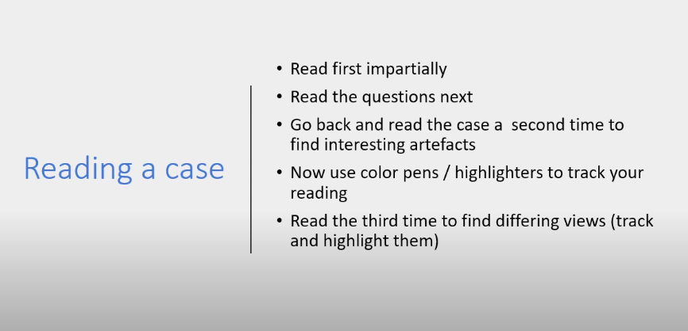

Slide 5
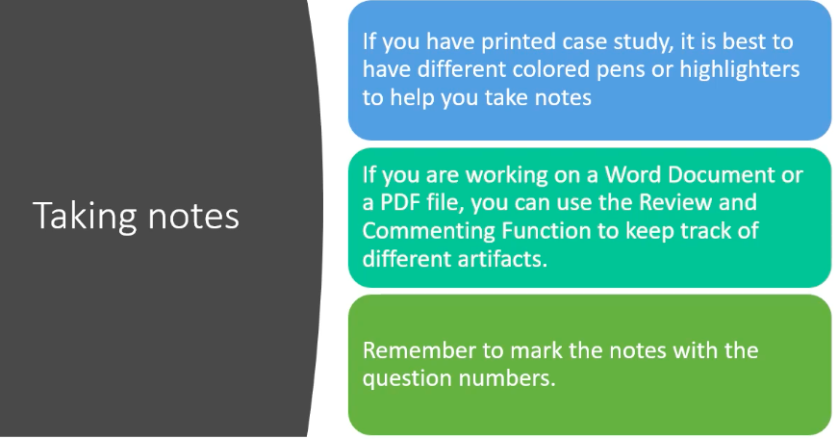

Slide 6
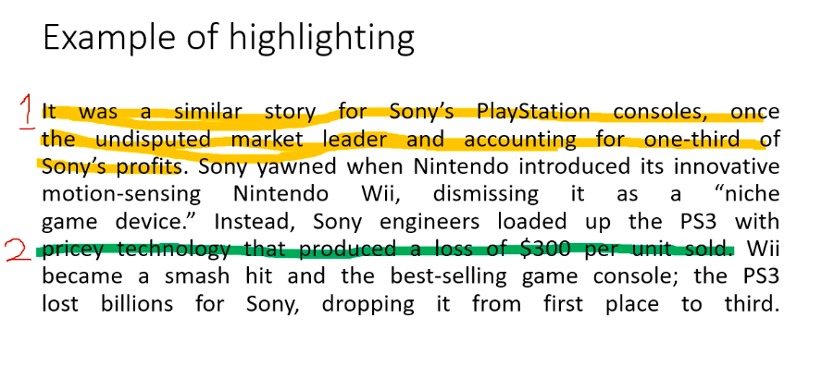

Slide 7
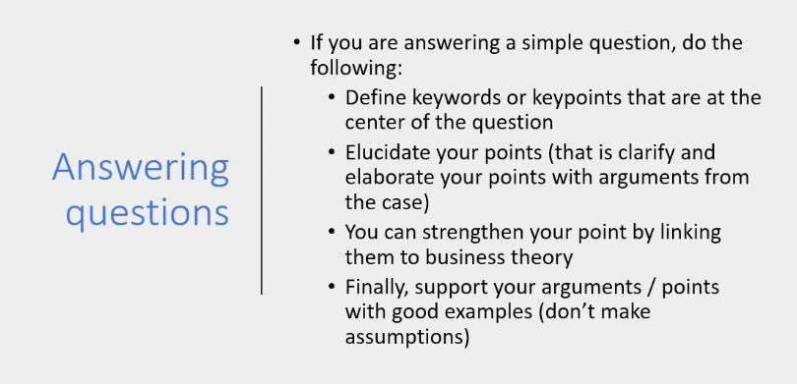

Slide 8
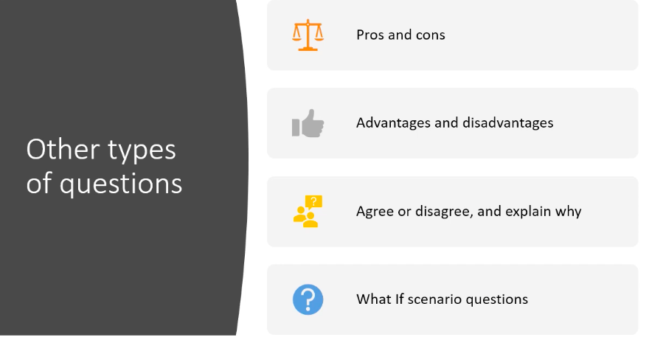

Slide 9
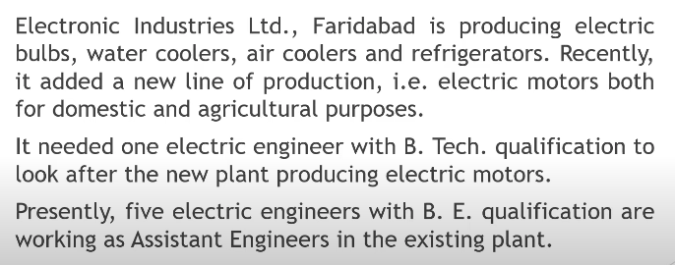
Case Study Analysis

Slide 10
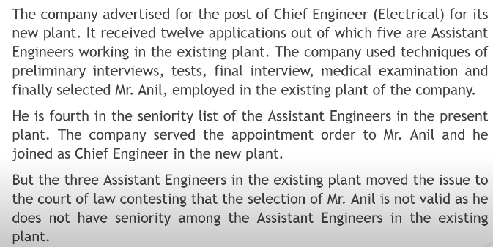
Cont.…..

Slide 11
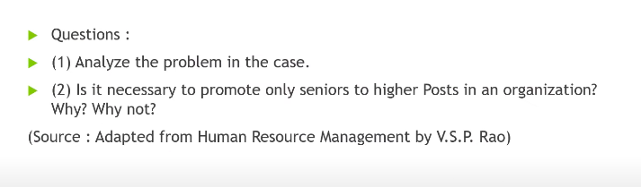
Cont.…..

Slide 12
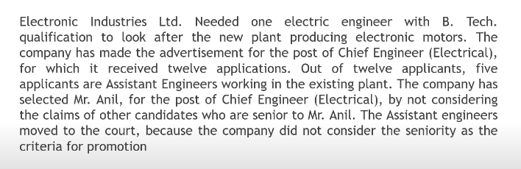
Solutions: Step-1 (Summary)

Slide 13
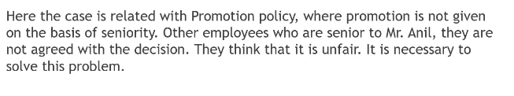
Solutions: Step-2 (Identification of problem)

Slide 14
Solutions: Step-2 (Identification of problem)

Slide 15
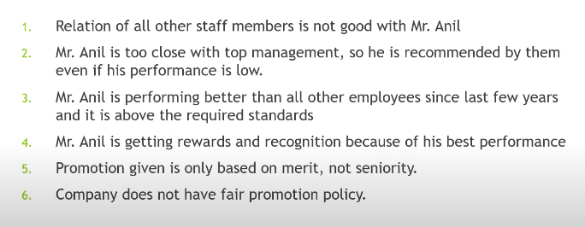
Solutions: Step-3 (Assumptions)

Slide 16
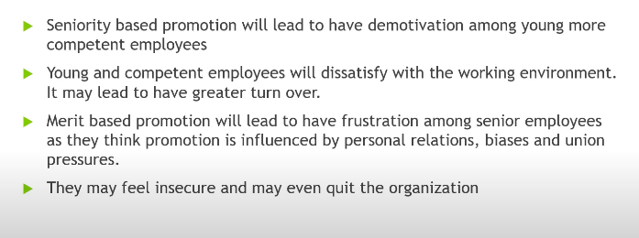
Solutions: Step-4 (Consequences of the problem)

Slide 17
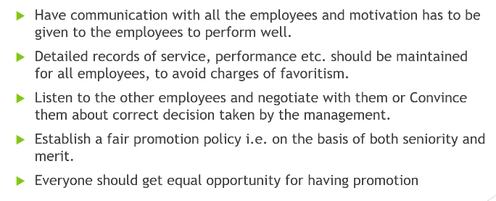
Solutions: Step-5 (Solutions to the problem)

Slide 18
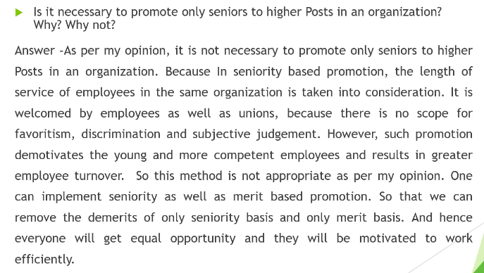
Questions Answer

Slide 19
Thank you!

