Slide 1

WELCOME TO PRESENTATION
Course Title: Advance Textile Management
Course code: TE-511
Course Title: AT A GALANCE OF EPPYLION GROUP
Date : 30 Nov, 2022
SUBMITTED TO:
Asit Gush
Assistant Professor
Department of Textile Engineering
Daffodil International University
SUBMITTID BY:
Name Mahamudul Hasan
Student ID - 0242220014123005

Slide 2

PRESENTATION BY MAHAMUDUL HASAN
MAHAMUDUL HASAN STUDENT ID-0242220014123005

Slide 3
TITAL: AT A GALANCE OF EPPYLION GROUP

Slide 4
Acknowledgement
I am very much grateful to my honorable course teacher, Asit Gush
Assistant Professor - Department of Textile Engineering for her continuous patience, learned direction, continual support, energetic supervision, constructive criticism, valuable advice, all have inspire me to write this assignment on a perfect way.
I would like to give special thanks to my group mate of this Assignment named
Mahamudul Hassan for providing the right information about
I’m highly delighted to
Epylloin Group express our regards & gratitude to honorable Asit Gush for providing her best support. She is very much friendly and cooperative person.

Slide 5
Epyllion Group
HISTORY
Epyllion Group started its journey as a house of Readymade Garments (RMG) engaged in manufacturing and exporting of Knit Apparels since 1994 and has been considered today as one of the biggest conglomerates with substantial establishment of its backward linkage of all kinds of knit garments, textile, wet processing & garments accessories. It has the state of art vertically integrated garments manufacturing facility which ensures one stop service to the buyers. We have established ourselves as an important garments manufacturer for a number of renowned brand apparels of Europe, USA & Australia

Slide 6
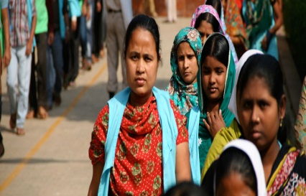
Compliance with all laws and regulations
Epyllion Group shall comply with all laws and regulations of the country where it operates and ratified international conventions.
Prohibition of child labor
Epyllion Group shall not recruit any employee below the mentioned age restricted by the local law.
Prohibition of forced labor
Epyllion Group shall not force any employees for work rather they should be given the opportunity of voluntary work accomplishment.

Slide 7
Compliance with all laws and regulations
Epyllion Group shall comply with all laws and regulations of the country where it operates and ratified international conventions.
Prohibition of child labor
Epyllion Group shall not recruit any employee below the mentioned age restricted by the local law.
Prohibition of forced labor
Epyllion Group shall not force any employees for work rather they should be given the opportunity of voluntary work accomplishment.

Slide 8
Hours of Work
Epyllion Group shall not require workers to work more than the regular and overtime hours allowed by Bangladesh Labor Act, 2006 and Bangladesh Labor Rules, 2015.The regular work week shall not exceed 48 hours and workers shall be granted at least 1(one) day off for every seventh calendar day. In Epyllion worker may work up to 10(ten) hours in a day and overtime work week shall not exceed 12 hours. Provided that the total working hours of such worker shall not exceed60 (sixty) hours in a week, and on the average 56(fifty-six) hours per week in a year. All overtime work shall be voluntary. Epyllion shall not request overtime on a regular basis and shall compensate all overtime work at the rate of twice of worker’s ordinary rate of basic wage.

Slide 9
Compensation and Benefits
Epyllion Group shall pay at least the minimum wages comply with all legal requirements (Bangladesh Labor Act, 2006, Declared Latest Minimum Wage Gazette in Bangladesh & Bangladesh Labor Rules, 2015) on wages. The wages of a worker shall be paid before the expiry of the seventh working days following the last day of the wage period in respect of which the wages are payable. Where the employment of a worker is terminated by retirement or by his retrenchment, discharge, removal by the Epyllion or otherwise, all wages payable to worker’s shall be paid before the expiry of the 30 (thirty) working days following the day of termination of worker’s employment

Slide 10
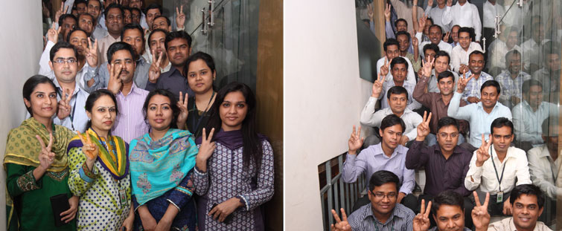
Regular employment
Epyllion Group shall fulfill the responsibility regarding the rights of workers recognized employment relationship established through local law and practice and must try to confront the legal obligations arising from established employment relationship.
Prohibition of sexual harassment & abuseEpyllion Group shall provide a workplace environment which is free of any sexual and/or other form of harassment, abuse and any corporal punishment.

Slide 11
Health & workplace safety Epyllion Group shall ensure healthy work environment for all. The company shall provide a safe and healthy workplace setting to prevent accidents and injury to health arising out of linked with or occurring in course of work or as a result of the operation of employers’ facilities. Company shall adopt responsible measures to mitigate negative impacts that the workplace has on the environment

Slide 12
Acceptance or Giving of Gift & Benefits
a. No employee should ask for or encourage the offer for personal benefits or gifts;
and impartiality, or that of the Department, into question;
b. A gift or benefit may not be kept or used for personal benefit and should be politely refused. If unavoidable, must be reported to the Department Head and such gifts are the property of the Department, or in return for favorable treatment of the donor may be guilty of misconduct;
c. No employee shall provide any gift to any stakeholder for his personal benefit;
d. Due to business requirement, if any gift is allowed as per approval of competent authority that will not be considered as personal benefitted gift.
e. Following acts will be treated as gift:
- Cash, gift certificates, or a gift of package
- Tickets to any events or ticket for travelling other than business contract
- A loan, unless it is from a regular financial institution on normal terms

Slide 13
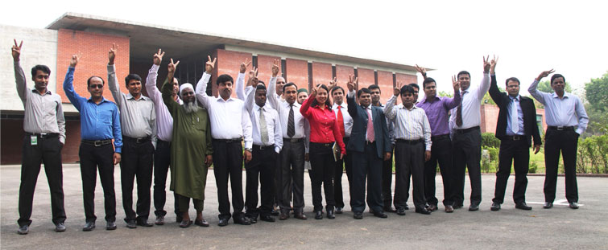
Conclusion:
Epyllion Group started its journey as a house of Readymade Garments (RMG) engaged in manufacturing and exporting of Knit Apparels since 1994 and has been considered today as one of the biggest conglomerates with substantial establishment of its backward linkage of all kinds of knit garments, textile, wet processing & garments accessories

Slide 14
References:
1. www.fibre2fashion.com-web/
2. https://textilelearner.net/category/technical-textile/
3. Crown, E.M. (2001, December). Investigation of Flame Retardance in Nuclear
Biological Chemical (NBC) Protective Clothing
4. onzalez, J.A., King, M.W., & Dhir, A. (2000). Thermal protective textiles/
5. MarketsandMarkets Analysis
THANKS

