Slide 1
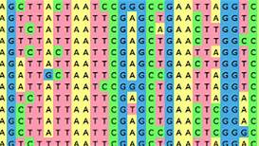
Mulitiple
Sequence
Alignment
Lecture – 6
Department of CSE, DIU

Slide 2
CONTENTS
Multiple Sequence Alignment (MSA)
- Why Multiple Sequence Alignment
- Multiple Sequence Alignment: Motivation
- MSA Challenges
Multiple Sequence Alignment Methods
- Dynamic Method: Impractical
-Greedy Method
- Progressive Method
- Iterative Method

Slide 3
1. Multiple Sequence Alignment (MSA)
Why Multiple sequence, Motivation, Challanges

Slide 4
Multiple Sequence Alignment
A multiple sequence alignment (MSA) is a sequence alignment of three or more biological sequences, generally protein, DNA, or RNA. In many cases, the input set of query sequences are assumed to have an evolutionary relationship by which they share a linkage and are descended from a common ancestor.
VT I S C T G S S S N I G VT LT C T G S S S N I G VT LS C S S S G F I F S VT LT C T V S G T S F D VT I T C V V S D V S H E VT LV C L I S D F Y P G VT LV C L I S D F Y P G VT LV C L VS D Y F P E

Slide 5




Why Multiple Sequence alignment
Up until now we have only tried to align two sequences.
What about more than two? And what for?
A faint similarity between two sequences becomes significant if present in many
Multiple alignments can reveal subtle similarities that pairwise alignments do not reveal
VT I S C T G S S S N I G VT LT C T G S S S N I G VT LS C S S S G F I F S VT LT C T V S G T S F D VT I T C V V S D V S H E VT LV C L I S D F Y P G VT LV C L I S D F Y P G VT LV C L VS D Y F P E

Slide 6
Multiple Sequence Alignment: Motivation
Correspondence. Find out which parts “do the same thing”
  Similar genes are conserved across widely divergent species, often performing similar functions
Structure prediction
  Use knowledge of structure of one or more members of a protein MSA to predict structure of other members
  Structure is more conserved than sequence
Create “profiles” for protein families
  Allow us to search for other members of the family
Genome assembly: Automated reconstruction of “contig” maps of genomic fragments such as ESTs
msa is the starting point for phylogenetic analysis
msa often allows to detect weakly conserved regions which pairwise alignment can’t

Slide 7
MSA Challanges
Computationally Expensive
  If msa includes matches, mismatches and gaps and also accounts the degree of variation then global msa can be applied to only a few sequences
Difficult to score
  Multiple comparison necessary in each column of the msa for a cumulative score
  Placement of gaps and scoring of substitution is more difficult
Difficulty increases with diversity
  Relatively easy for a set of closely related sequences
  Identifying the correct ancestry relationships for a set of distantly related sequences is more challenging
  Even difficult if some members are more alike compared to others

Slide 8
2. Multiple Sequence Alignment
Methods
Dynamic Programming, Greedy, Progressive, Iterative

Slide 9
Global MSA: Dynamic Programming
The two-sequence alignment algorithm (Needleman- Wunsch) can be generalized to any number of sequences.
E.g., for three sequences X, Y, W define C[i,j,k] = score of optimum alignment
among X[1..i], Y[1..j], W[1..k]
As for two sequences, divide possible alignments into different classes, depending on how they end.
  Devise recurrence relations for C[i,j,k]
  C[i,j,k] is the maximum out of all possibilities

Slide 10
MSA for 3 sequences: alignment can end in 7 ways
X₁ | . | . | .
Y₁ | . | . | .
W₁ | . | . | .
X_{i}
^{X}i-1 ^{Y}j-1 ^{W}k-1
X_{i} Y_{j} W_{k}
Y_{j} W_{k}
-
Y_{j} W_{k}
X_{i}
-
W_{k}
X_{i}
-
-
X_{i} Y_{j}
-
-
Y_{j}
-
-
-
W_{k}

Slide 11
Aligning Three Sequences
V
V
W
W
2-D edit graph
Same strategy as aligning two sequences
Use a 3-D “Manhattan Cube”, with each axis representing a sequence to align
X
3-D edit graph

Slide 12
Dynamic programming for 3 sequences
Each alignment is a path through the dynamic programming matrix
V S N — S
S N A —
— — A S
A N S
Start
V S N S

Slide 13
2-D cell versus 3-D Alignment Cell
C(i-1,j-1,k-1) C(i-1,j,k-1)
C (i-1,j-1)
C (i-1,j)
C(i-1,j-1,k)
C (i-1,j,k)
C (i,j-1)
In 2-D, 3 edges in each unit square
C(i,j-1,k-1)
C(i,j,k-1)
In 3-D, 7 edges in each unit cube
C(i,j-1,k)
C(i,j,k)
Enumerate all possibilities and choose the best one

Slide 14
Dynamic Programming msa: General Case
For k sequences of length n, dynamic programming algorithm does (2^{k}-1) n^{k} operations
  Example: 6 sequences of length 100 require 6.4X10¹³ calculations
Space for table is n^{k}
Conclusion: dynamic programming approach for alignment between two sequences is easily extended to k sequences but it is impractical due to exponential running time

Slide 15
Greedy Approach: Example
Consider these 4 sequences
s1 GATTCA s2 GTCTGA s3 GATATT s4 GTCAGC

Slide 16
Greedy Approach: Example
There are 6 possible alignments
s2 GTCTGA
s4 GTCAGC (score = 2)
s1 GATTCA--
s4 G—T-CAGC(score = 0)
s1 GAT-TCA
s2 G-TCTGA
s2 G-TCTGA
s3 GATAT-T
(score = 1)
(score
= -1)
s1 GAT-TCA
s3 GATAT-T
s3 GAT-ATT
= 1) s4 G-TCAGC
(score
(score
= -1)

Slide 17
Greedy Approach: Example
s₂ and s₄ are closest; combine:
s2 GTCTGA
s4 GTCAGC
s GTCt/aGa/c
2,4
(profile)
new set of 3 sequences:
s₁ s₃
^{s}2,4
GATTCA GATATT
GTCt/aGa/c

Slide 18
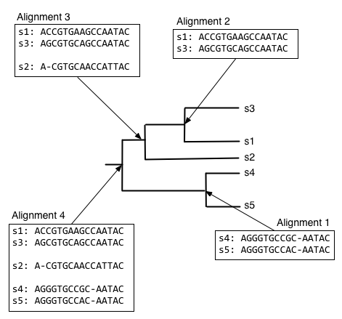
Progressive Method
Two major steps – Guide Tree build up and Multiple Pairwise Alignment
Steps
- Take each pair, align
- Generate consensus of that alignment
- Align new sequence with the consensus of the previous one
- Go back, Until all sequences are finished
Example
- Clustal ω
- MAFFT
- KALIGN
- T-COFFEE

Slide 19
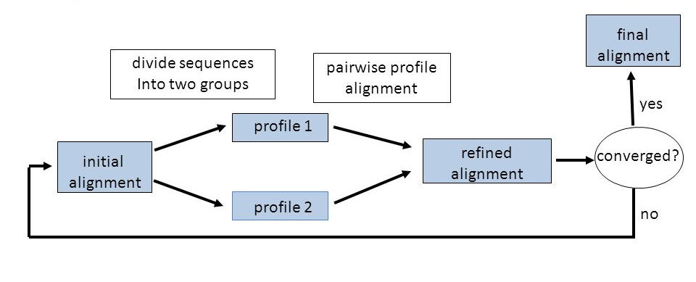
Iterative Method
Works similarly to progressive methods
Repeatedly realign the initial sequences as well as add new sequences to the growing MSA
Example
  - DIALIGN
  - MUSCLE
  - POA

Slide 20


