Slide 2
What is Etiquette?
The customary code of polite behavior in society or among members of a particular profession or group

Slide 3
MANNER & ETIQUETTE- MEANS
Rules of General Behavior, Habits and Customs
That enhances your personality
That ensures smooth relationships

Slide 4
GOOD MANNERS & ETIQUETTE PERSONALITIES
Disciplined & decent outlook
Shows concern for others
Healthy state of mind & body
Good training
Pleasant personality

Slide 5
Why Etiquette?
Avoid misunderstandings
For happy & stress-free work place
Branding of the University/Family
To Exhibit Professionalism and develop a polished image
To communicate effectively with an opposing opinion of another person(s)/customers

Slide 6
What Makes a Difference?
Education and training can make a difference.

Slide 7
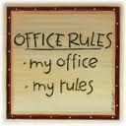
Etiquette Basics
1
UNDERSTAND THE POINT OF OFFICE ETIQUETTE

Slide 8
Etiquette Basics
2
BE PUNCTUAL
Being punctual is very important, especially if you have an appointment. It shows that you respect the time of your colleagues/customers and in turn it will compel them to respect your time too. Lead by example and everything else will fall into place.

Slide 9
Etiquette Basics
3
DRESS APPROPRIATELY
Remember that the office is not a party place
and you will have to dress in a way that commands
respect both from your colleagues and clients.
The dress code has a strong influence in establishing
the trust that your client places in your abilities in
giving them their money’s worth.

Slide 10
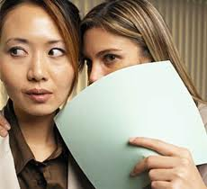
Etiquette Basics
4
STAY AWAY FROM GOSSIP
You would not want someone to gossip about you and neither will the next person. In some cases, if the source of some malicious gossip can be traced back to you, then your job can be in risk.
You may overhear the conversations
of others. Apply the “so what” rule.
Don’t refer to what you’ve heard
and don’t add your own advice.

Slide 11
Etiquette Basics
5
ASK BEFORE BORROWING
It is imperative that you ask first and then borrow. This attitude of yours will ensure that people also treat your things with the same respect.

Slide 12
Etiquette Basics
6
ALWAYS SAY PLEASE, THANK YOU, YOU’RE WELCOME, and I’M SORRY
It’s as old as life itself, but still appropriate. It’s never offensive, often
expected, and easy to do.
With each request – SAY PLEASE
With each completion – SAY THANK YOU
With each gratitude received – SAY YOU’RE WELCOME
With each error – APOLOGIZE
It’s an attitude. Respect those around you and they will return that respect.

Slide 13
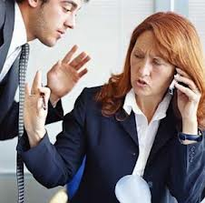
Etiquette Basics
7
DON’T CONSISTENTLY INTERRUPT PEOPLE
Doing so will suggest that your time or opinion is more
important than theirs. If your co-worker is on the phone but you
need to ask a question, don't linger.
If your co-worker is having a
work related conversation don't
interrupt - just wait for them to finish
or ask them to see you when they are
through.

Slide 14
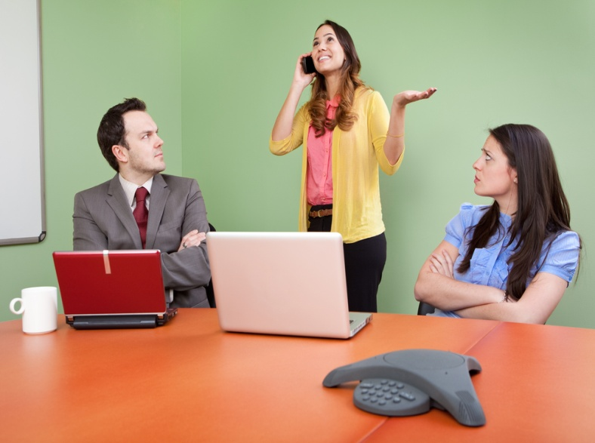
Etiquette Basics
8
REFRAIN FROM BEING LOUD
Whether you're on the phone or talking to a colleague, avoid being loud.
If you have a received a call on your cell phone, it's a good idea to take a walk down to the corridor or find another room.
Use your mobile’s vibrating/silent
feature if you need to leave it on. Avoid
making personal calls at your workstation.
Be especially quiet in areas where
coworkers are on business calls or in
conversations with other coworkers.

Slide 15
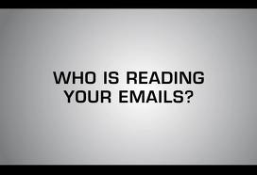
Etiquette Basics
9
BE SENSITIVE TO OTHERS’ NEED FOR PRIVACY
Don’t read someone else’s faxes, emails, mail or
computer screens.
If you need to discuss anything
sensitive or private with another
colleague, find a room where you
can shut the door and nobody else
can overhear you.

Slide 16
Some Professional Etiquette

Slide 17
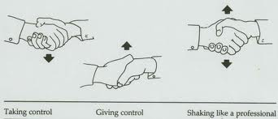
Professional Etiquette
Introducing Yourself
Greeting
Handshakes

Slide 18
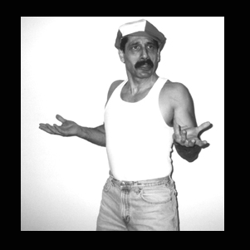
Corporate Dressing Etiquettes
Don’t be informal

Slide 19
Be formal always

Slide 20
Telephone Etiquette
DON’T
Eat when you are on phone
Put someone on speaker phone
Talk with others
Say anything that you don’t want the caller to hear
Answer the phone if you are not prepared
Answer calls when you are in office or in a meeting

Slide 21
Telephone Etiquette (Continue..)
DO
Return calls in a timely manner
Smile when you answer the phone
Answer using your name, title and ask how can you help

