Slide 1
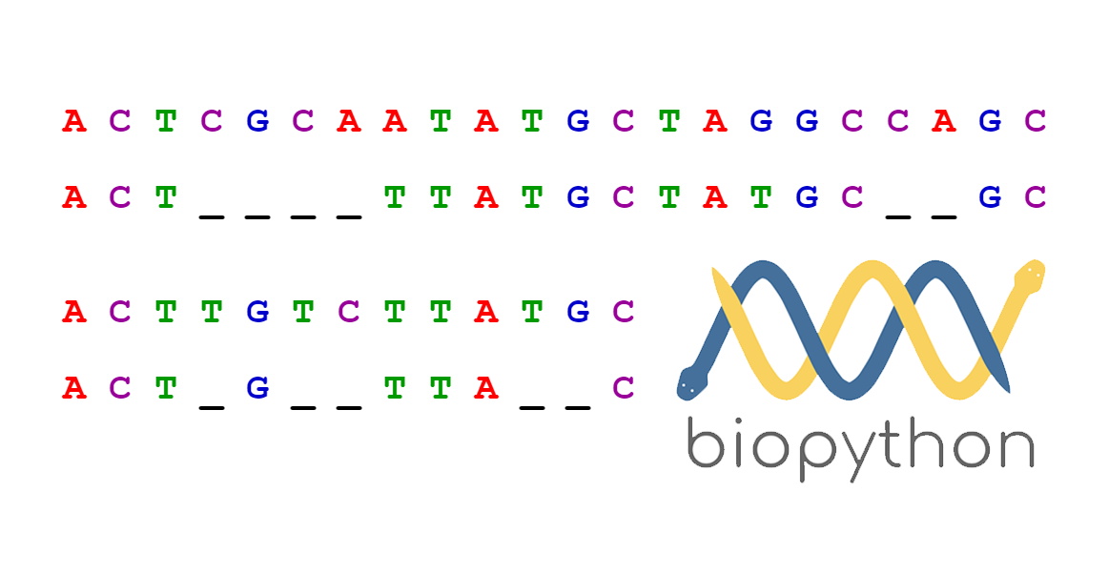
Sequence
Alignment
Lecture – 5
Department of CSE, DIU

Slide 2
CONTENTS
Sequence Alignment
- Why align sequences
2. Sequence Alignment Methods
- Pairwise Alignment
- Multiple Sequence Alignment
3. Pairwise Sequence Alignment Methods
-Global Alignment (Needleman-Wunsch)
- Local Alignment (Smith-Waterman)

Slide 3
1. Sequence Alignment
Why and how align sequences

Slide 4
Sequence Alignment
A way of arranging the sequences of DNA, RNA, or protein to identify regions of similarity that may be a consequence of functional, structural, or evolutionary relationships between the sequences
CTGTCG-CTGCACG
-TGC-CG-TG----

Slide 5
Why align sequences?
Useful for discovering
  Functional
  Structural and
  Evolutionary relationship
For example
  To find whether two (or more) genes or proteins are evolutionarily related to each other
  Two proteins with similar sequences will probably be structurally or functionally similar

Slide 6
2. Sequence Alignment Methods
Pairwise and Multiple

Slide 7
Pairwise Sequence Alignment
A pair of sequences as input
Align them in such a way that, for that particular alignment the assumed region of similarity produces higher score than all the other alignments
Methods
- Global Alignment (Needleman-Wunsch)
- Local Alignment (Smith-Waterman)
CTGTCGCTGCACG--
-------TGC-CGTG

Slide 8
Pairwise Sequence Alignment
Idea:
Display one sequence above another with spaces inserted in both to reveal similarity
A: | C | A | T | - | T | C | A | - | C
 | | |  | | |  |  | | | | |  | |
B: | C | - | T | C | G | C | A | G | C

Slide 9
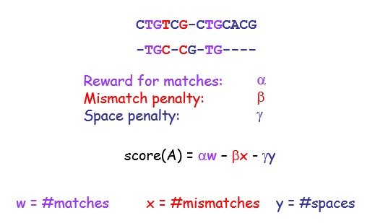
Scoring the alignment

Slide 10
Scoring the alignment
Reward for matches: | 10
Mismatch penalty: | 2
Space penalty: | 5
C | T | G | T | C | G | – | C | T | G | C
- | T | G | C | – | C | G | – | T | G | -
-5 | 10 | 10 | -2 | -5 | -2 | -5 | -5 | 10 | 10 | -5

Slide 11
Optimum Alignment
The score of an alignment is a measure of its quality
Optimum alignment problem: Given a pair of sequences X and Y, find an alignment (global or local) with maximum score
The similarity between X and Y, denoted sim(X,Y), is the maximum score of an alignment of X and Y

Slide 12
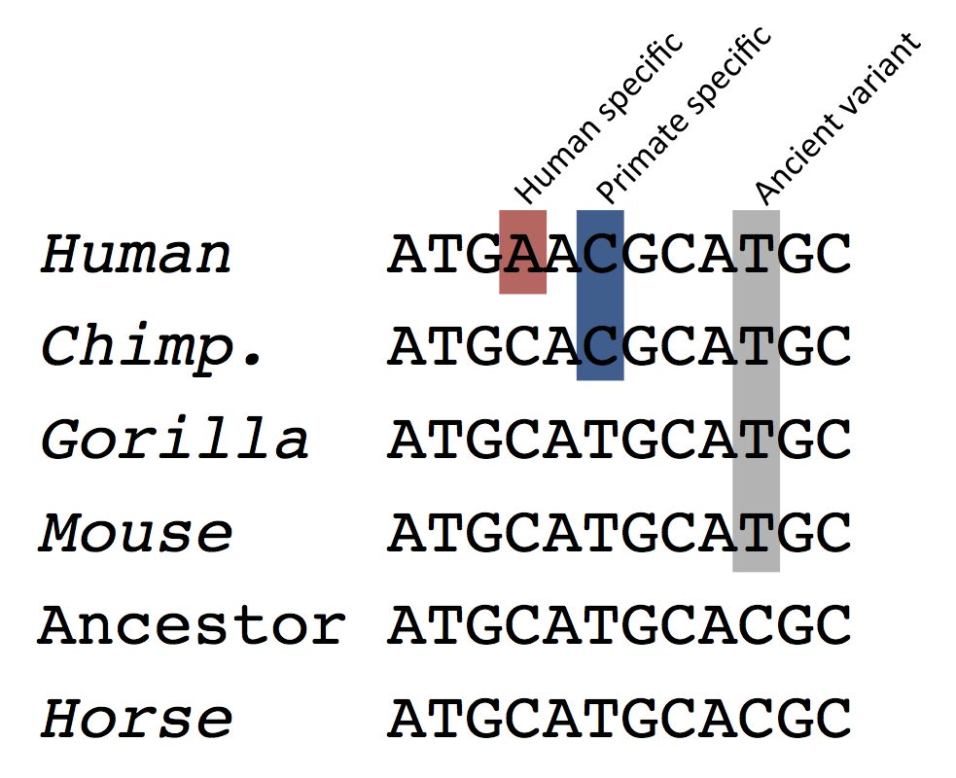
Multiple Sequence Alignment
Three or more than three sequences as input
Align all the sequences altogether in such a manner that the alignment produces highest score

Slide 13
3. Pairwise Sequence Alignment
Global and Local methods

Slide 14
Global VS Local
Global Alignment
  Attempts to align the maximum of the entire sequence
  Suitable for similar and equal length sequences
CTGTCG-CTGCACG
-TGC-CG-TG----
Global alignment
Local Alignment
– Gathers islands of matches
CTGTCGCTGCACG--
-------TGC-CGTG
Local alignment
Stretches of sequences with highest density of matches are aligned
Suitable for partially similar, different length and conserved region containing sequences

Slide 15
Global Alignment (Needleman-Wunsch)
3 Major Steps
-Create 2D Matrix
-Trace back
-Final Alignment
Trace back
- Start from Cell (Row, Col)
- Go back up to Cell (0,0)
Create 2D Matrix
- Row x Col 2D matrix draw (Row , Col size of seq1 and seq2 respectively)
- Place 2 seqs as Row and Column Header
- Cell (0,0) = 0
- Cell (0,1) to Cell (0,Column) and Cell (1,0) to Cell (Row,0) value = delete gap value from previous cell value
- For other cell values, follow equation in (1)
Final Alignment
- Start from Cell (Row, Col)
- If then, place character in both seq
- If or then character in start seq & gap in end seq

Slide 16
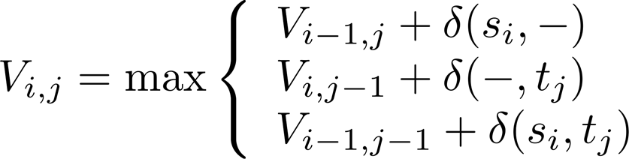
Global Alignment (Needleman-Wunsch) - Example
Input
- seq1 = AAAC
- seq2 = AGC
-AGC
AAAC
 |  | A | G | C
A
A
A
C
0
-2
-4
-6
Scoring Scheme
δ(x, x) = 1 (Match)
δ(x,-) = -2 (Gap)
δ(x, y) = -1 (Mis match)
Final Alignment
-2
1
-1
-3
-4
-1
0
-2
-6
-3
-2
-1
-8
-5
-4
-1
Eq. 1: Cell Value

Slide 17
Local Alignment (Smith-Waterman)
3 Major Steps
-Create 2D Matrix
-Trace back
-Final Alignment
Trace back
- Start from each Cell which has the maximum value in the entire matrix
- Go back up to the Cell where first time 0 occurs
Create 2D Matrix
- Row x Col 2D matrix draw (Row , Col size of seq1 and seq2 respectively)
- Place 2 seqs as Row and Column Header
- First Row, First Column all value = 0
- For other cell values, follow equation in (2)
Final Alignment
- Start from each Cell with max value
- If then, place character in both seq
- If or then character in start seq & gap in end seq

Slide 18
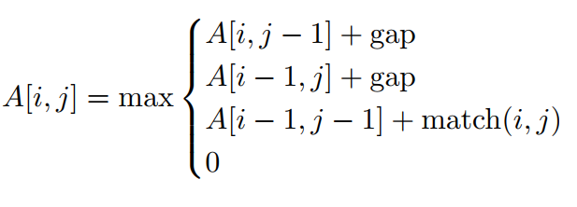
Local Alignment (Smith-Waterman) - Example
Input
- seq1 = AAAC
- seq2 = AAG
-AAG
AAAC
 |  | A | A | G
A
A
A
C
0
0
0
0
Scoring Scheme
δ(x, x) = 1 (Match)
δ(x,-) = -2 (Gap)
δ(x, y) = -1 (Mis match)
Final Alignment
0
1
1
0
0
1
2
0
0
1
2
1
0
0
0
1
Eq. 2: Cell Value

