Slide 1
Number conversion systems

Slide 2
Binary to Decimal conversion
Take each digit in the binary number and multiply it with its place value.
The sum of all the above products will give the equivalent decimal number.
Ex :- (1011)₂ to decimal number.
Solution :- (1011)₂ = (1 x 2³) + ( 0 x 2²) + (1 x 2¹) + (1 x 2⁰ )
= (1 x 8) + ( 0 x 4) + (1 x 2) + (1 x 1)
= (11)₁₀

Slide 3
Fractional Binary number to Decimal number
For the fraction (after the decimal point) the place value starts with negative power of 2. This negative power value increases from left to right.
The place value of the first left digit in fraction is (2^{–1})
The place value of the next right digit in fraction is (2^{–2})
The place value of the next right digit in fraction is (2^{–3}) ……. so on

Slide 4
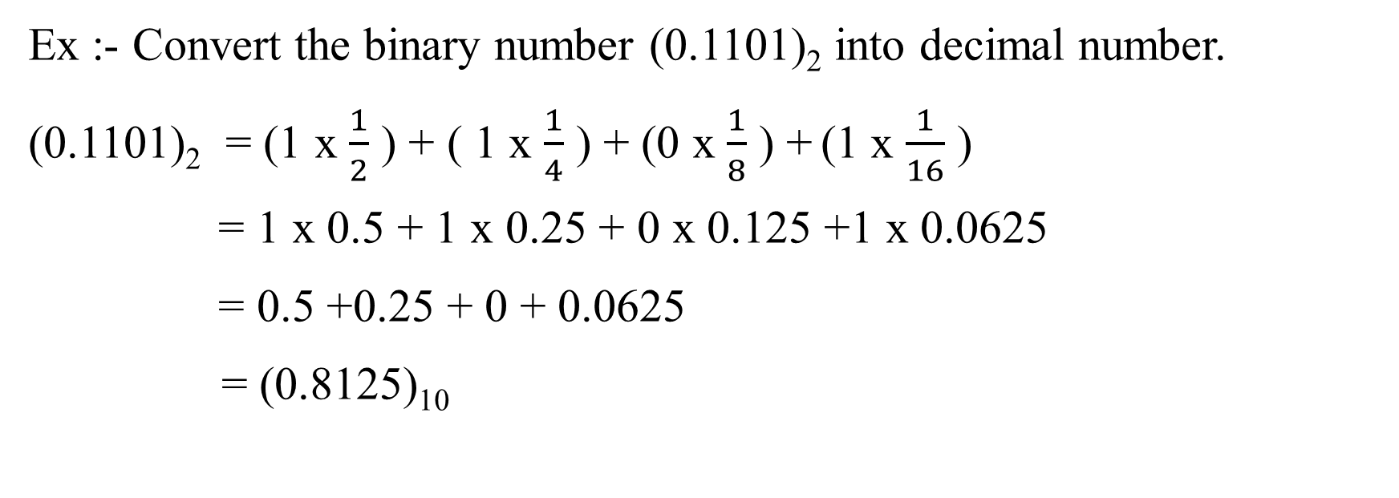
Ex :- Convert the binary number (0.1101)₂ into decimal number.
(0.1101)₂ = (1 x $\frac{1}{2}$ ) + ( 1 x $\frac{1}{4}$ ) + (0 x $\frac{1}{8}$ ) + (1 x $\frac{1}{16}$ )
= 1 x 0.5 + 1 x 0.25 + 0 x 0.125 +1 x 0.0625
= 0.5 +0.25 + 0 + 0.0625
= (0.8125)₁₀

Slide 5
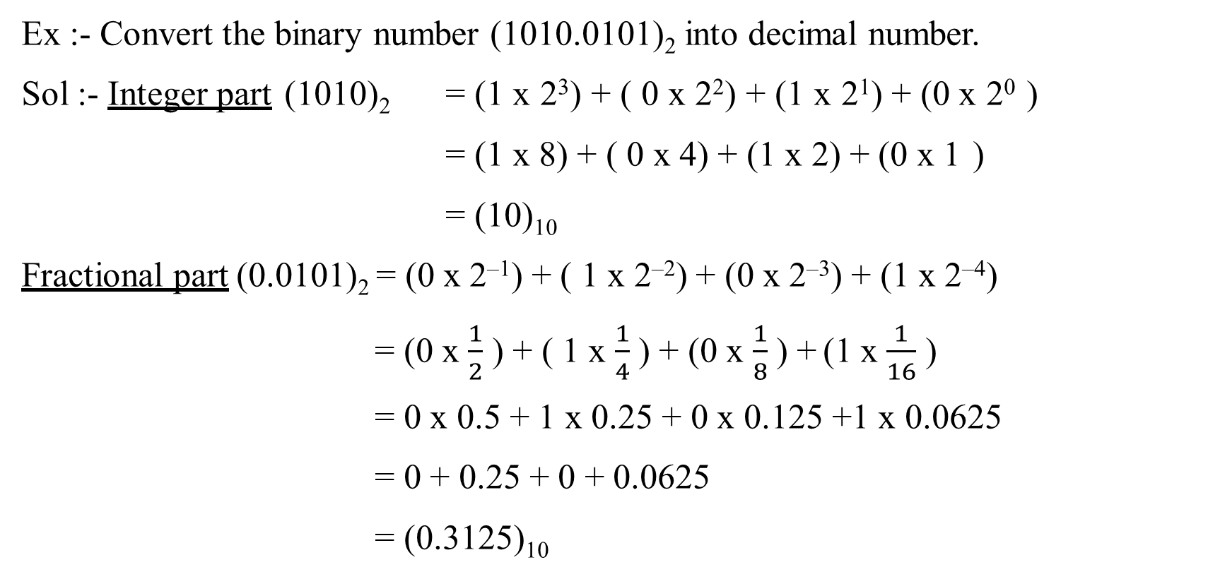
Ex :- Convert the binary number (1010.0101)₂ into decimal number.
Sol :- Integer part (1010)₂ = (1 x 2³) + ( 0 x 2²) + (1 x 2¹) + (0 x 2⁰ )
= (1 x 8) + ( 0 x 4) + (1 x 2) + (0 x 1 )
= (10)₁₀
Fractional part (0.0101)₂ = (0 x 2^{–1}) + ( 1 x 2^{–2}) + (0 x 2^{–3}) + (1 x 2^{–4})
= (0 x $\frac{1}{2}$ ) + ( 1 x $\frac{1}{4}$ ) + (0 x $\frac{1}{8}$ ) + (1 x $\frac{1}{16}$ )
= 0 x 0.5 + 1 x 0.25 + 0 x 0.125 +1 x 0.0625
= 0 + 0.25 + 0 + 0.0625
= (0.3125)₁₀

Slide 6
Binary to Octal number system
Ex :- Convert the binary number (1110101)₂ into octal number.
(1110101)₂ = 001 110 101
= (165)₈

Slide 7
Binary to Hexadecimal number system
Ex :- Convert the binary number (1010101010)₂ in to hexadecimal number.
(1010101010)₂ = 0010 1010 1010
= (2AA)₁₆

Slide 8
Decimal to Binary conversion
The decimal number is converted in to binary number by using successive divisions method.
The decimal number (i.e. dividend) is divided by 2 (i.e. divisor).
If ‘1’ or “0” occurs as remainder, transfer that ‘1’ or “0” to the binary record.
Now take quotient as dividend and divide it by 2 and transfer the remainder to the binary record.
The same procedure is continued until the quotient becomes zero
The last remainder is taken as most significant bit (MSB).
The first remainder is taken as least significant bit (LSB).
The equivalent binary number comprises with all the remainders in successive divisions method in the order from MSB (bottom) to LSB (top).

Slide 9
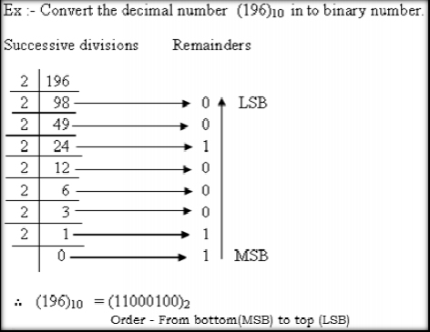

Slide 10
Fractional Decimal number to binary
The fractional decimal number is converted in to binary number by using successive fraction multiplications method.
The fractional decimal number is multiplied with 2 by successive fraction multiplications method.
If ‘1’ or ‘0’ occurs in units place in the product, transfer that ‘1’ or ‘0’ to the binary record.
The multiplication is continued with the remaining fraction.
The same procedure is followed in each multiplication.
The first transferred number (1 or 0) to binary record is taken as most significant bit (MSB).
The last transferred number (1 or 0) to binary record is taken as least significant bit (LSB).
If the multiplication does not end, it can be stopped at any of our desired level.

Slide 11
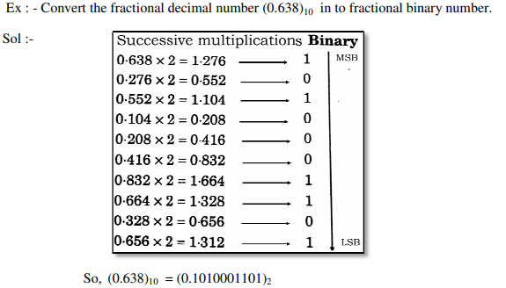

Slide 12
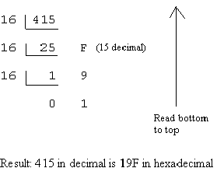
Decimal to Hexadecimal Conversion
Ex :- Convert the decimal number (415)₁₀ in to hexadecimal number.

Slide 13
Hexadecimal to Decimal Conversion
Ex: (5C7)₁₆ to decimal
Sol:- (5C7)₁₆ = (5x16²) + (C x16¹) + (7 x16⁰)
= 1280 + 192 + 7
= (1479)₁₀

Slide 14
All the Best

