Slide 1



INTERNATIONAL FLOW OF FUNDS
PROFESSOR DR. MD. AMINUL ISLAM
FACULTY OF APPLIED AND HUMAN SCIENCES
UNIVERSITI MALAYSIA PERLIS
amin@unimap.edu.my
WhatsApp: +60164049087
MY YOUTUBE CHANNEL:
PLATFORM FOR RESEARCH AND DEVELOPMENT
Knowledge Sincerity Excellence UniMAP

Slide 2

  After this session participants will be able to:
    Explain the key components of the balance of payment
    Explain how international trade flows are influenced by economic factors and other factors
    Explain how international capital flows are influenced by country characteristics

Slide 3
Introduction
    Global tendencies and movements in the world are great challenges and also important opportunities for individual economies.
    Globalization of the markets and the internationalization of the production present the most significant features of the world economic development during the last decades.
    Globalization impacts have changed the rules of the world competition.

Slide 4
Introduction
    Global strategy is based on the search of the balance between the local adaptation and global standardization.
    Growth of the international trade has been influenced by many factors followed-up on globalization, such as the development of the technology, governments decisions, institutions activities, consumers behaviour, increasing competition, new trade agreements, etc.

Slide 5
Balance of Trade
  Balance of trade is defined as a nation's net exports, or its exports minus imports.
  When exports exceed imports, the nation has a trade surplus, and when imports exceed exports, the nation has a trade deficit.
  International trade is largely affected by the demand for a nation's goods and services.
  Exporting is defined as the sale of products and services in foreign countries that are sourced or made in the home country.
  Importing refers to buying goods and services from foreign sources and bringing them back into the home country. Importing is also known as global sourcing.

Slide 6
Balance of Payments
  BOP is the Summary of transactions between domestic and foreign residents for a specific country over a specified period of time.
  Current Account:
  Summary of flow of funds due to purchases of goods or services or the provision of income on financial assets.
  Payments for merchandise and services
  Factor income payments
  Transfer payments

Slide 7
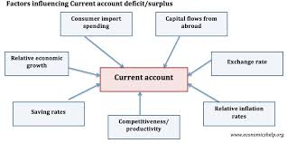
Balance of Payments

Slide 8
Capital and Financial Accounts
  Capital Account:
  Summary of flow of funds resulting from the sale of assets between one specified country and all other countries over a specified period of time.
  Direct foreign investment
  Portfolio investment
  Other capital investment

Slide 9
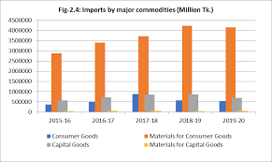
FOREIGN TRADE STATISTICS OF BANGLADESH 2019-20

Slide 10
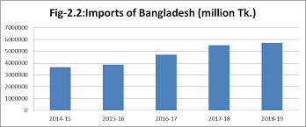
FOREIGN TRADE STATISTICS OF BANGLADESH 2018-19

Slide 11
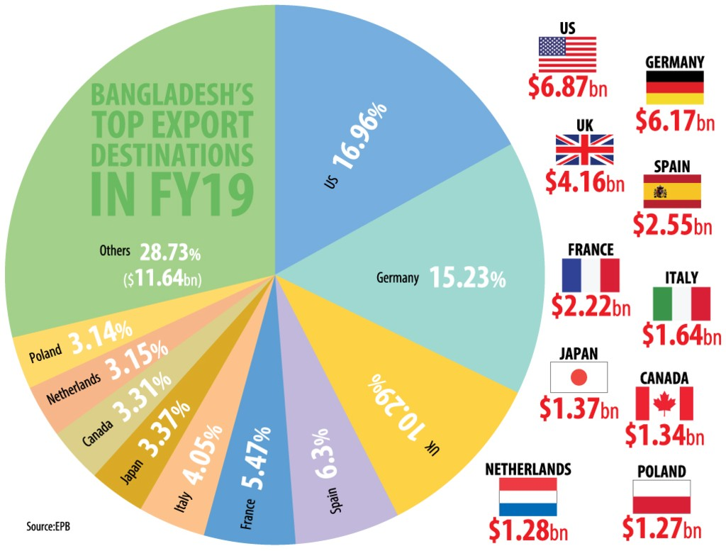
Over 71% Bangladesh's exports limited to only 10 countries (As of 2019)

Slide 12
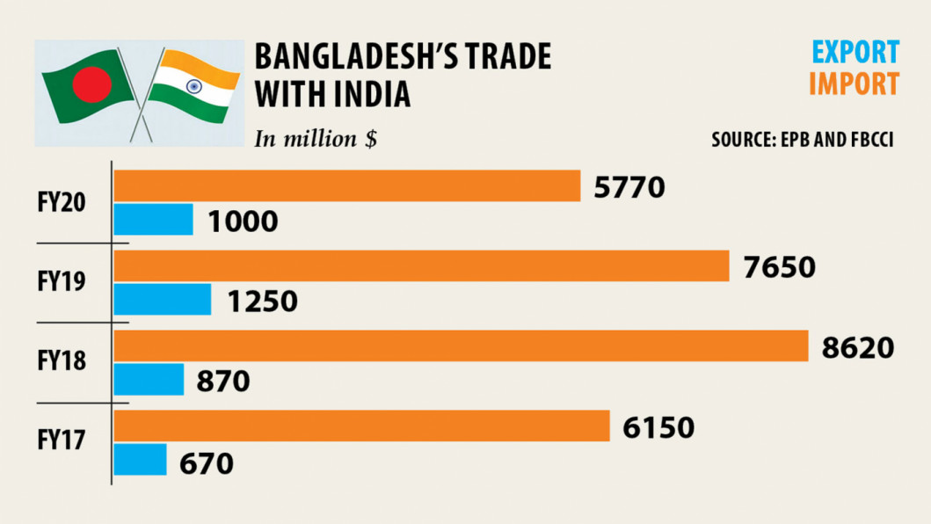
Bangladesh’s Trade with India

Slide 13
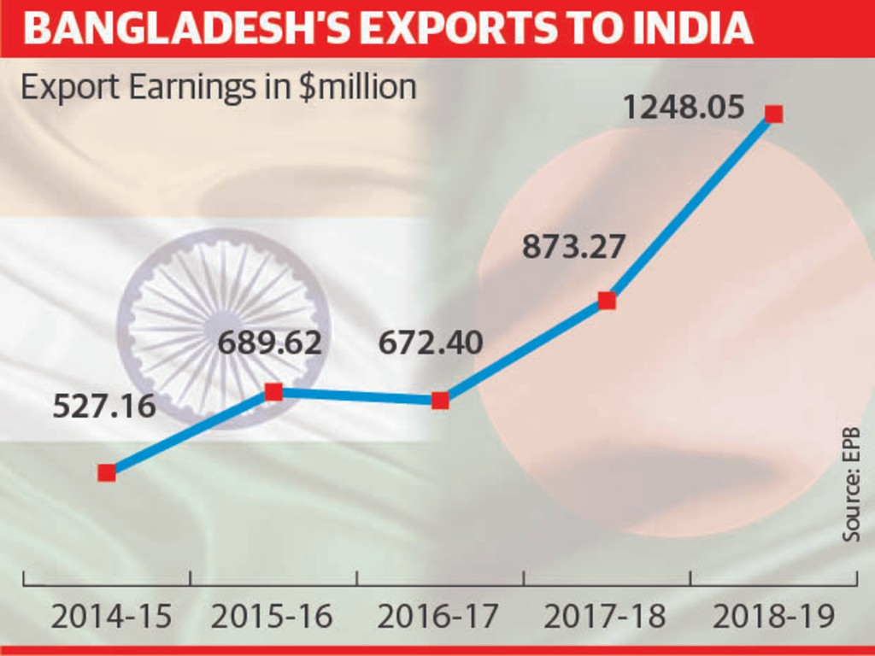
Bangladesh’s Trade with India

Slide 14
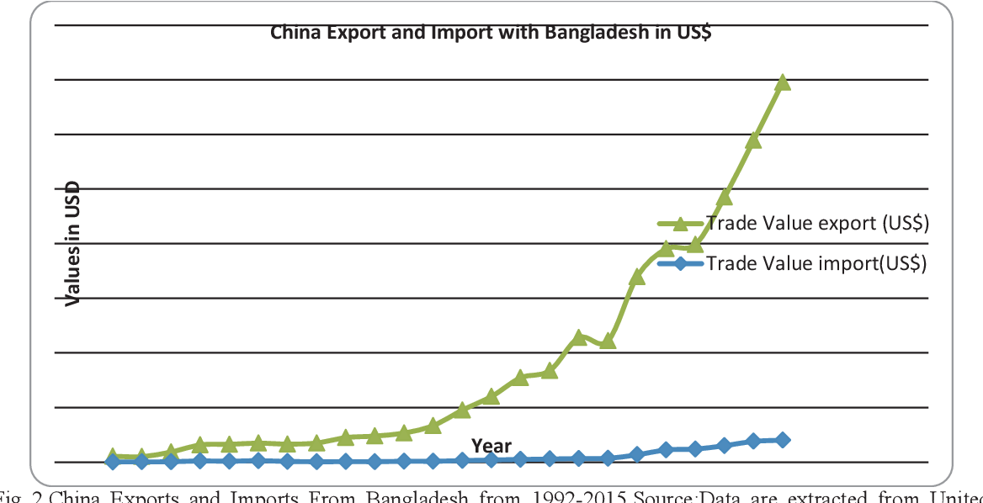
Exports and Imports With China)

Slide 15
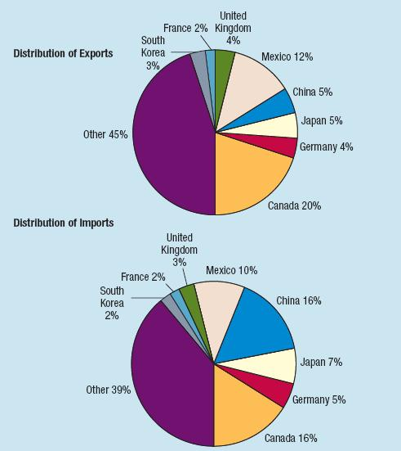
Exports and Imports (USA)

Slide 16
International Trade Flows (USA)
Distribution of U.S. Exports and Imports: Canada, China, Mexico, and Japan are the key exporters to the United States.
U.S. Balance-of-Trade Trend: value has grown substantially over time.
Impact of Huge Balance-of-Trade Deficit: could lead to higher U.S. unemployment but increases competition leading to more efficient production.

Slide 17
Events That Increased International Trade
  Removal of the Berlin Wall
  Single European Act of 1987
  North American Free Trade Agreement (NAFTA)
  General Agreement on Tariffs and Trade (GATT)
  Inception of the Euro
  Expansion of the European Union
  Other Trade Agreements
  Containerisation. The costs of ocean shipping have come down, due to
  containerisation, bulk shipping, and other efficiencies
  Technological change
  Economies of scale
  Differences in tax systems
  Less protectionism
  Growth Strategies of Transnational and Multinational Companies.

Slide 18
Trade Frictions - Examples
  Environmental restrictions
  Labor laws
  Bribes
  Government subsidies
  Tax breaks

Slide 19
Trade Policies
  Using the exchange rate as a policy
  Outsourcing
  Managerial decisions about outsourcing
  Using trade policies for security reasons
  Using trade policies for political reasons

Slide 20
Factors Affecting International Trade Flows
  Inflation: current account decreases if inflation increases relative to trade partners.
  National Income: current account decreases if national income increases relative to other countries.
  Government Policies
    Subsidies for exporters
    Restrictions on imports
    Lack of restriction on piracy
  Exchange Rates: current account decreases if currency appreciates relative to other currencies

Slide 21
Limitations of a Weak Home Currency Solution
  Counterpricing by competitors
  Impact of other weak currencies
  Prearranged international transactions
  Intracompany trade

Slide 22
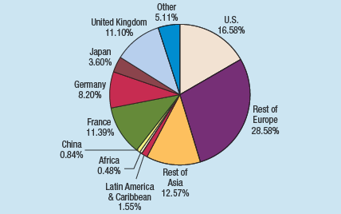
Distribution of Global DFI across Regions in 2007-2008

Slide 23
Factors Affecting International Portfolio Investment
Tax rates on Interest or Dividends
Interest Rates
Exchange Rates

Slide 24
Agencies that Facilitate International Flows
  International Monetary Fund (IMF)
  World Bank
  World Trade Organization (WTO)
  International Financial Corporation (IFC)
  International Development Association (IDA)
  Bank for International Settlements (BIS)
  Organization for Economic Cooperation and Development (OECD)
  Regional development agencies

Slide 25

Knowledge Sincerity Excellence UniMAP

Slide 26
Factors Affecting FDI
  Changes in Restrictions
  Privatization
  Size of the Economy and potential for Growth
  Tax Rates
  Exchange Rates
  Political Stability and Copyrights
  Size of the Total Local Market
  Access to Free Trade Areas
  Infrastructure and access to raw materials
  Communication and transport links.
  Labor Skills
  Wage Rates

