Slide 1
Methods of Computational Chemistry
Prepared By-
Faisal Imran
Sr. Lecturer
CSE, DIU

Slide 5
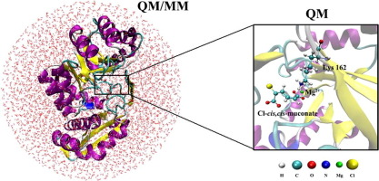
What is Computational Chemistry?
Application of computational methods and algorithms in chemistry
Quantum Mechanical
i.e., via Schrödinger Equation
also called Quantum Chemistry
Molecular Mechanical
i.e., via Newton’s law F=ma
also Molecular Dynamics
Empirical/Statistical
e.g., QSAR, etc., widely used in clinical and medicinal chemistry
Focus Today

Slide 6
Differences Between Molecular Mechanics & Quantum Mechanics

Slide 13
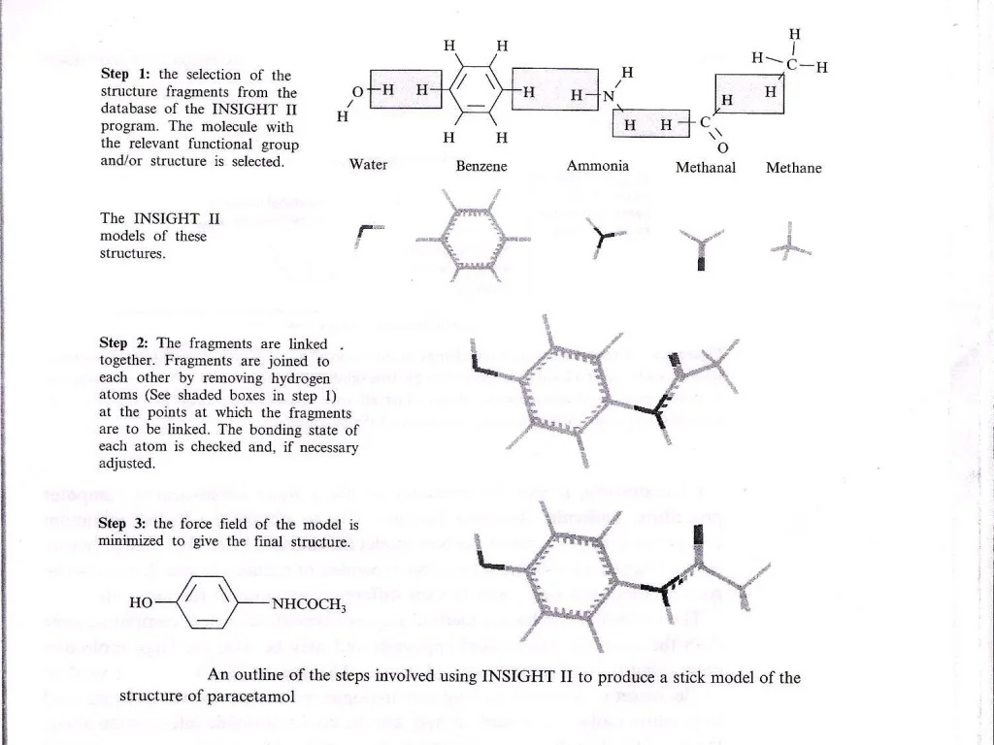

Slide 15
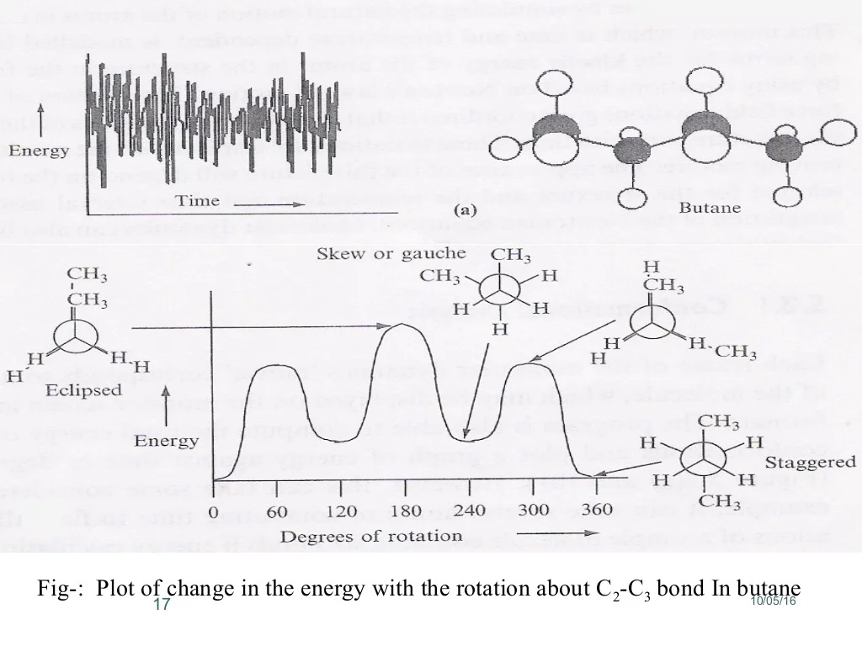

Slide 29
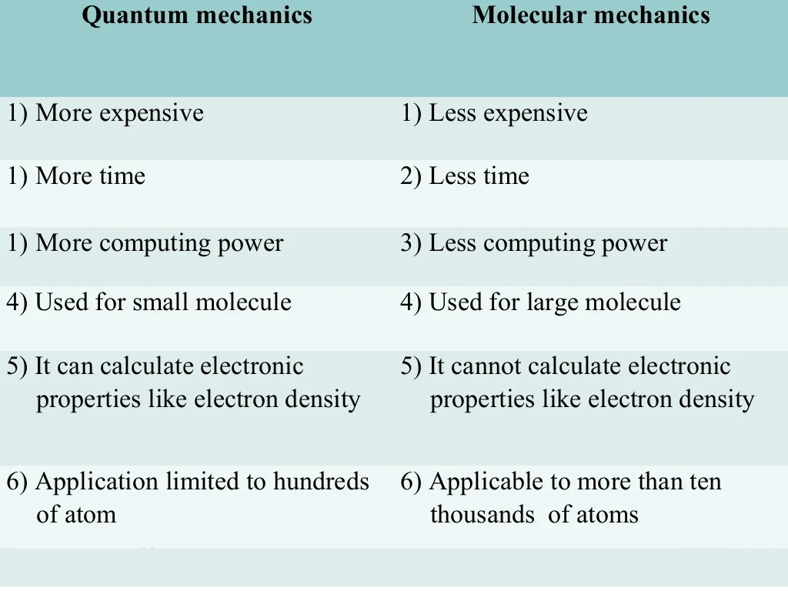

Slide 30
Multiscale Hierarchy of Modeling

Slide 31
How Big Systems Can We Deal with?
Assuming typical computing setup (number of CPUs, memory, disk space, etc.)
Ab initio method: ~100 atoms
DFT method: ~1000 atoms
Semi-empirical method: ~10,000 atoms
MM/MD: ~100,000 atoms

Slide 33
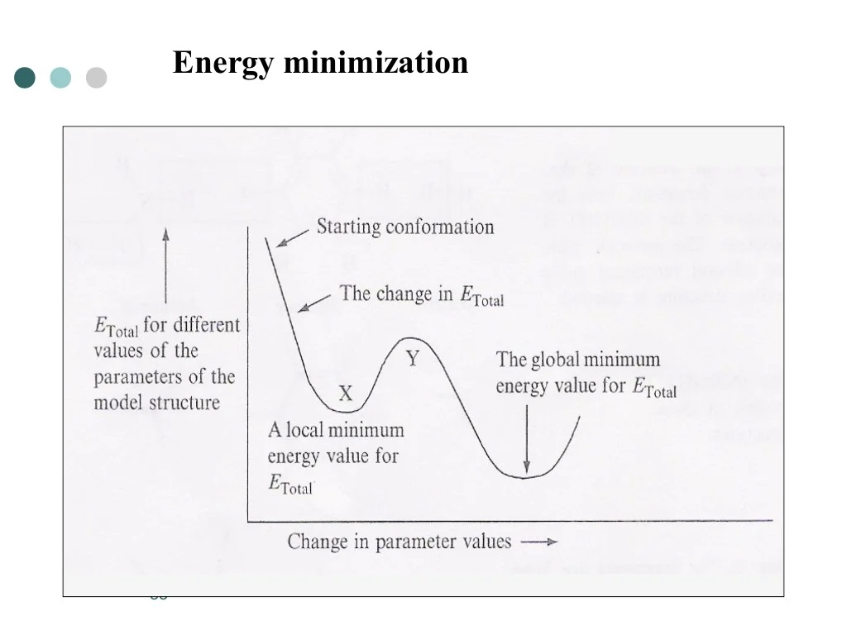

Slide 37
