Slide 1
Direct marketing
Chapter 11

Slide 2
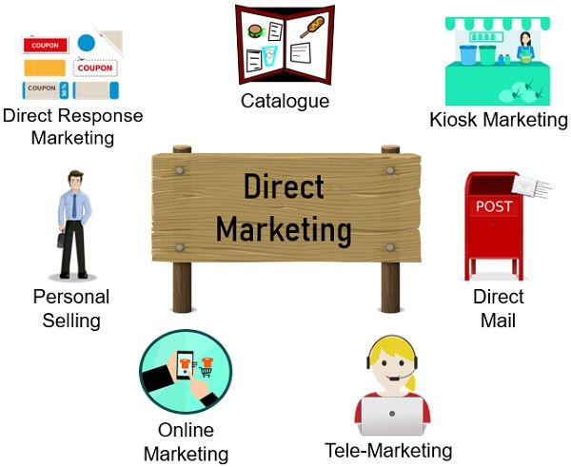
What is direct marketing?
Direct marketing attempts to acquire and retain customers by contacting them without the use of an intermediary. The objective is to achieve a direct response which may take one of the following forms:
a purchase over the telephone or by post;
a request for a catalogue or sales literature;
an agreement to visit a location/event (e.g. an exhibition);
participation in some form of action (e.g. joining a political party);
a request for a demonstration of a product;
a request for a salesperson’s visit.

Slide 3
Smith and Taylor outline five factors that have fuelled the rise in direct marketing activity
Market fragmentation: The trend towards market fragmentation has limited the application of mass marketing techniques. As market segments develop, the capacity of direct marketing techniques to target distinct consumer groups is of increasing importance.
Computer technology. The rise in accessibility of computer technology and increasing sophistication of software, allowing the generation of personalized letters and messages, has eased the task of direct marketing.
The list explosion. The increased supply of lists and their diversity (e.g. 25,000 Rolls-Royce owners, 20,000 women executives and 100,000 house improvers) have provided the raw data for direct marketing activities.
Sophisticated analytical techniques. By using geo-demographic analysis, households can be classified into neighborhood type (e.g. ‘modern private housing, young families’ or ‘private flats, single people’).
Coordinated marketing systems. The high costs of personal selling have led an increasing number of companies to take advantage of direct marketing techniques such as direct response advertising and telemarketing, to make the Salesforce more cost-effective.

Slide 4
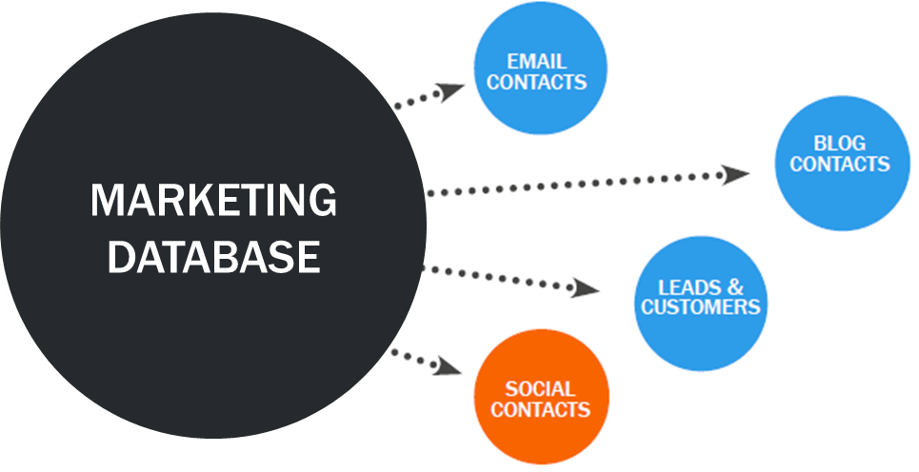
Database marketing
Database marketing is defined as an interactive approach which uses individually addressable marketing media and channels (such as mail, telephone, mobile phone and the salesforce) to:
provide information to a target audience;
stimulate demand;
stay close to customers by recording and storing an electronic database memory of customers, prospects and all communication and transactional data

Slide 5
Information on actual and potential customers.
Transactional information.
Promotional information.
Product information
Geo-demographic information
Typical information stored on a database includes the following:

Slide 6
The importance of database marketing is reflected in its applications
Direct mail. A database can be used to store customer information for mailings.
Telemarketing. A database can store telephone numbers of customers and prospects. Also when customers contact the supplier by telephone, relevant information can be held, including when the next contact should be made.
Loyalty marketing. Highly loyal customers can be drawn from the database for special treatment as a reward for their loyalty.
Campaign planning. The database can be used as a foundation for sending consistent and coordinated campaigns and messages to individuals and businesses.
Target marketing. Specific groups of individuals or businesses can be targeted as a result of analyzing the database. For example, customer behavior data stored by supermarkets can be used to target special promotions to consumers who are likely to be receptive to them.
Distributor management systems. A database can be the foundation upon which information is supplied to distributors and their performance monitored.
Marketing evaluation. By recording responses to marketing mix activities – for example, price promotions, special offers on products and direct mail messages

Slide 7
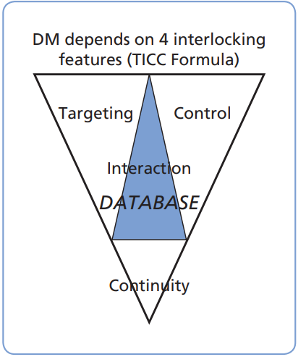
Managing a direct marketing campaign
The direct marketing mix is made up of four components. These are: Targeting, Interaction, Control and Continuity (TICC).

Slide 8
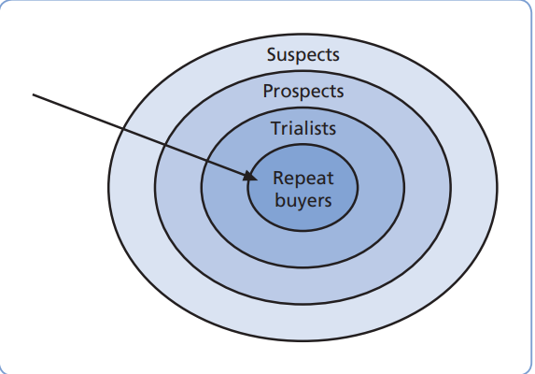
Identifying and understanding the target audience
The target audience is the group of individuals at which the direct marketing campaign is aimed. For consumer markets the target audience may be described using market segmentation variables such as age, gender, social class and lifestyle.
The bull’s eye model

Slide 9
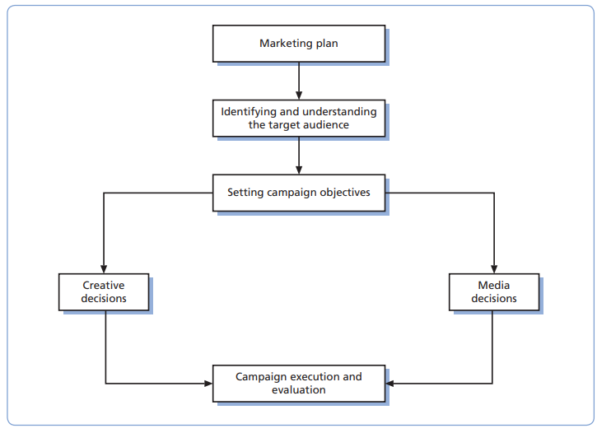
Managing a direct marketing campaign

Slide 10
A usual objective of direct marketing is immediate sales generation, recipients of messages (particularly through direct mail and telemarketing) need to perceive a clear benefit in responding. In order to achieve their level of success, companies need to produce an effective creative brief which includes the following:
Creative decisions
Communication objectives. This spells out what the campaign is hoping to achieve, such as sales volume and value, number of orders, customer retention and/or acquisition and lead generation.
Target market analysis. Target consumers will be identified, profiled and their needs and buyer behavior analyzed.
Brand benefits (and weaknesses). The customer benefits that the brand’s features create need to be identified.
Development of the offer. Potential offers should be pre-tested with the target audience to establish their attractiveness.
Message communication. In direct mail the offer can be communicated by the envelope as well as the internal contents.
Action plan. An action plan focusing on when the campaign is to run, how often, and with recommendations regarding the most appropriate media to use needs to be drawn up

Slide 11
Direct mail
Direct mail is material sent by post to a home or business address with the purpose of promoting a product and/or maintaining an ongoing relationship. Direct mail is considered to be the most important tool of direct marketing.
Telemarketing
Telemarketing is a marketing communications system where trained specialists use telecommunications and information technologies to conduct marketing and sales activities.

Slide 12
Mobile marketing
Cost-effective
Personalized
Targeting
Interactive
Customer relationship building
Time flexible
Immediate and measurable
Database building
The sending of short text messages direct to mobile phones. Marketers now send out messages to potential customers via their mobile phones to promote such products as fast food, movies, banks, alcoholic drinks, magazines and books. The advantages of this approach for marketers are as follows.

Slide 13
Direct response advertising
Direct response advertising appears in the prime media such as television and the press but is different from standard advertising since it is designed to elicit a direct response such as a request for further information, an enquiry or an order.
Catalogue marketing
Catalogue marketing is the promotion and sale of goods through catalogues distributed to agents and customers by mail or at outlets if the catalogue marketer is a store owner. Traditionally, catalogue marketing was a form of mail order where agents passed the catalogue to relatives and friends who ordered through the agent.

