Slide 1

Environmental Degradation and
Climate Change: Bangladesh Perspective
Jannatul Ferdowsee Disha
Lecturer
Department of Development Studies
Daffodil International University (DIU)

Slide 2
Objectives of this lecture
Define the concepts environment, eco-system, environmental degradation, climate change
Examine various factors of environmental degradation and climate change in Bangladesh and Identify the major environmental problems of Bangladesh.
Investigate the impact on climate change and what would be the way out for development.
Know about international initiatives for sustainable environment as well as government initiatives for environmental protection and Development in Bangladesh.

Slide 3

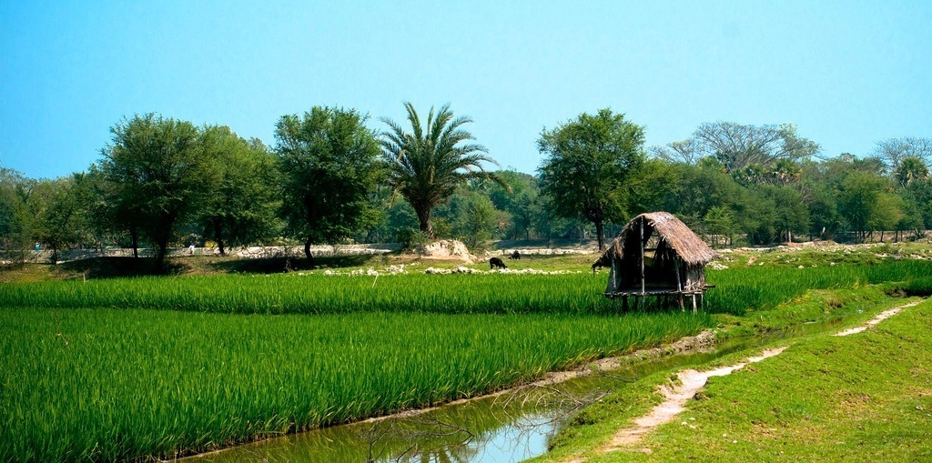
Conceptual Analysis
Environment
The term environment has been derived from french word “environia” means to surround. It refers to both abiotic (physical or non-living) and biotic (living) environment.
Environment is surrounding atmosphere or condition for existence. It is an essential natural process or an outcome of occurrence.

Slide 4
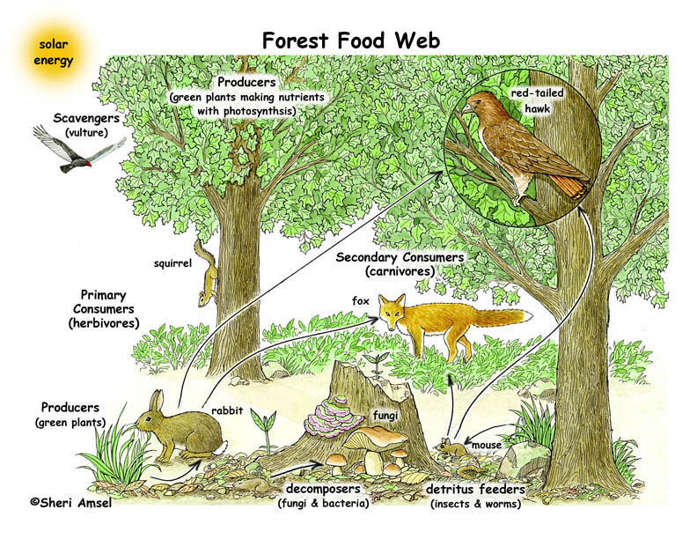
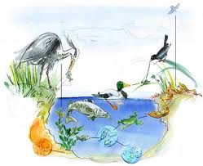
Ecosystem
Ecosystem is a biological environment consisting of all the organisms living in a particular area, as well as all the nonliving, physical components of the environment with which the organisms interact, such as air, soil, water, and sunlight.
Some ecosystems are very large. For example, many bird species nest in one place and feed in a completely different area. On the other hand, some ecosystems may be physically small, such as you would find in a meadow at the edge of a forest, or in a coral reef in the ocean.

Slide 5
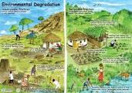
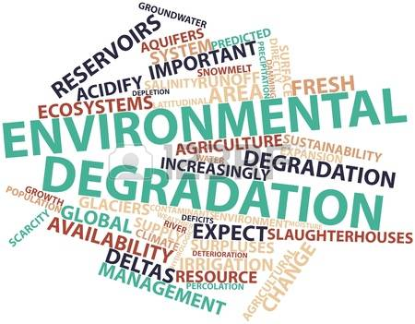
Environmental Degradation
Environmental degradation is the deterioration of the environment through depletion of resources such as air, water and soil; the destruction of ecosystems and the extinction of wildlife. The United Nations International Strategy for Disaster Reduction defines environmental degradation as “the reduction of the capacity of the environment to meet social and ecological objectives, and needs”.

Slide 6
Climate Change
The climate of a region or city is its typical or average weather. Climate change, therefore, is a change in the typical or average weather of a region or city. The United Nations Framework Convention on Climate Change (UNFCCC) defines it as a change of climate that is attributed directly or indirectly to human activity, altering the composition of the global atmosphere. Human activity includes the pollution that arises from industrial activity and other sources that produce greenhouse gases. These gases, such as carbon dioxide, have the ability to absorb the spectrum of infrared light and contribute to the warming of our atmosphere.
Source: Alexandra Simon-Lewis (2017). What is climate change? The definition causes and effects.
http://www.wired.co.uk/article/what-is-climate-change-definition-causes-effects

Slide 7
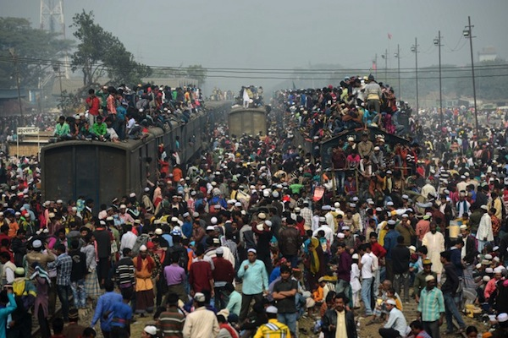
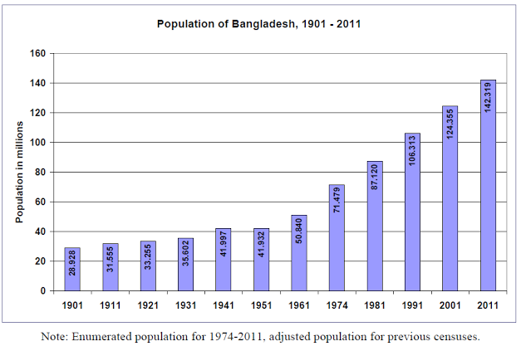
Causes of Environmental Degradation
I. Social Factors
a) Population
Population impacts on the environment primarily through the use of natural resources and production of wastes and is associated with environmental stresses like loss of biodiversity, air and water pollution and increased pressure on arable land.
World population Growth
Year | World Population
1800 | 1 Billion
1950 | 2.5 Billion
2000 | 6 Billion
2011 | 7 Billion

Slide 8
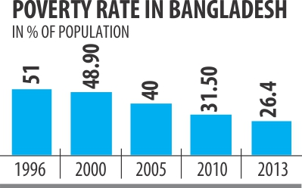
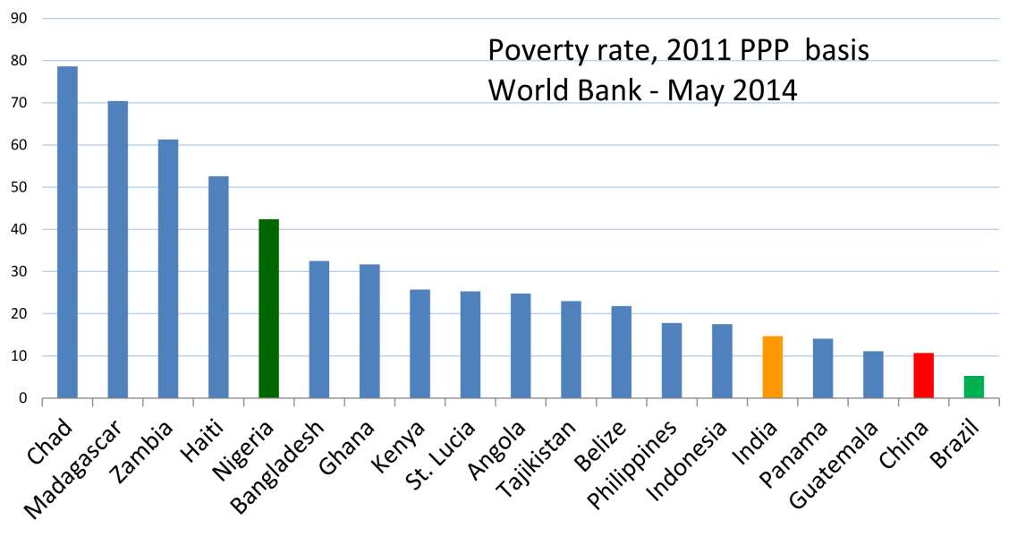
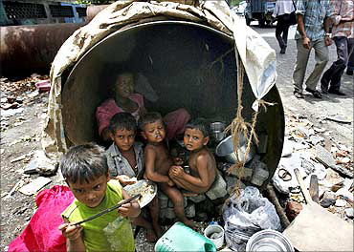
b) Poverty
Poverty is said to be cause and effect of environmental degradation. When people not have the basic necessities for survival. For instance, they may be starving for clean water, proper housing, sufficient clothing or medicines and be struggling to stay alive.

Slide 9
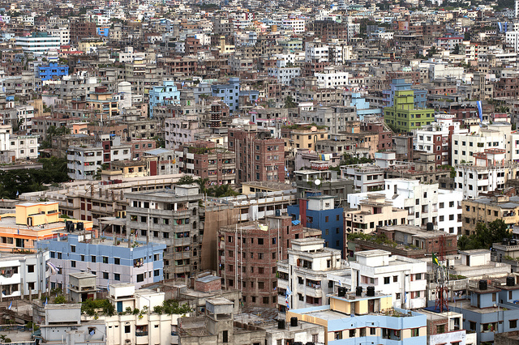
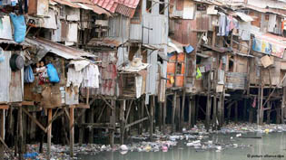
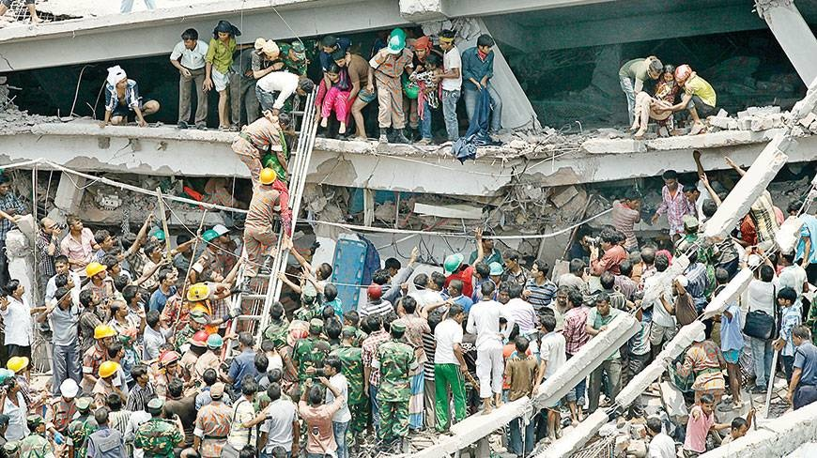
c) Urbanization
Lack of opportunities for gainful employment in villages and the ecological stresses is leading to an ever increasing movement of poor families to towns. Mega cities and unplanned urbanisation are emerging and urban slums are expanding.

Slide 10
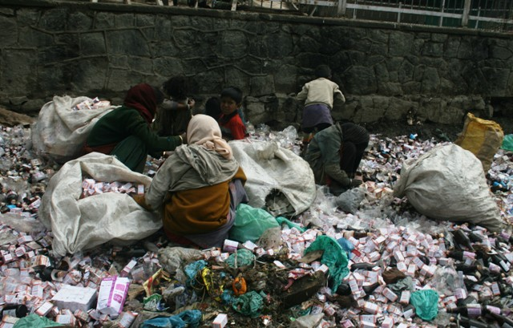

II. Economic Factors
a) Market Failure
To a large extent, environmental degradation is the result of market failure, that is, the non-existent or poorly functioning markets for environmental goods and services. This context, environmental degradation is a particular case of consumption or production externalities reflected by divergence between private and social costs. Lack of well defined property rights may be one of the reasons for such market failure. On the other hand, Market distortions created by price controls and subsidies may aggravate the achievement of environmental objectives.

Slide 11
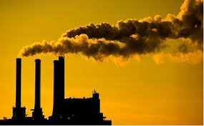
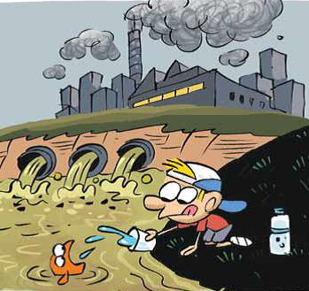
b) Economic development
The level and pattern of economic development affect the nature of environmental problems. Especially Industrialization based economic development has resulted in environmental degradation. The manufacturing technology adopted by the industries has played load on environment through intensive resource and energy use which resulted the water, air and land contamination, and degradation of natural eco-systems.

Slide 12
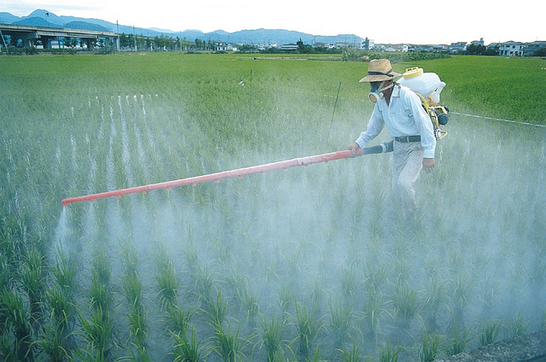
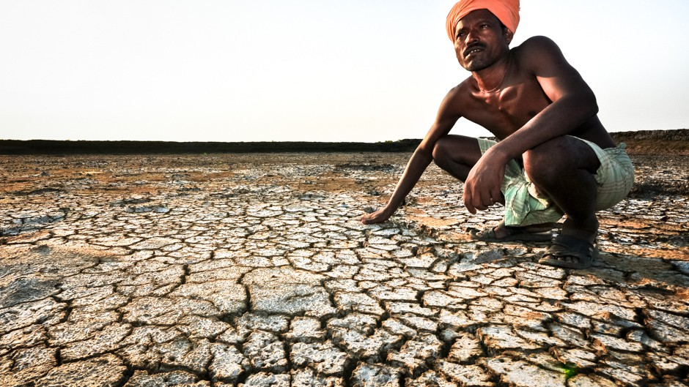
c) Impacts of Agriculture Development
Agricultural development contribute to soil erosion, land salination and loss of nutrients. For example, U.S. Environmental Protection Agency (EPA) identifies agriculture as the primary source of water pollution. Shifting cultivation has also been an important cause of land degradation. Leaching from extensive use of pesticides and fertilizers is an important source of contamination of water bodies. Intensive agriculture and irrigation contribute to land degradation also.

Slide 13
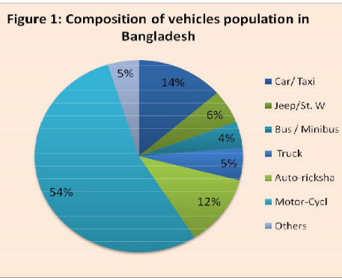
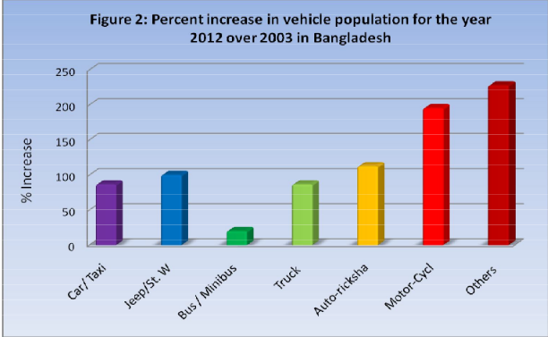
d) Transport activities
Transport activities have a wide variety of effects on the environment such as air pollution, noise from road traffic and oil spills from marine shipping. The World Health Organization (WHO) says vehicular air pollution is a major cause of respiratory distress in urban Bangladesh. World Bank (2007) estimated about 15,000 premature deaths due to poor air quality in Dhaka city. The total population of registered motorized vehicles in the Bangladesh stands at 1.75 millions.
Source: CASE Report ‘Emission Inspection of In use Vehicle in Bangladesh (2012)

Slide 14
III. Political and Administrative Factors
Lack of visionary leadership quality, traditional policy making role of politicians and improper practice of environmental policy which approved by the government of Bangladesh are responsible for environmental degradation. As well as the administrative reasons are:
Lack of expansion of regulatory activity and growing complexity
Lack of growing environmental awareness
Lack of growing impact of environmental law
Lack of changing environmental problems
Lack of changing patterns of public administration

Slide 15
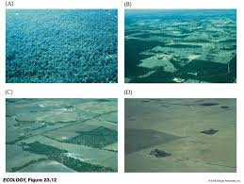
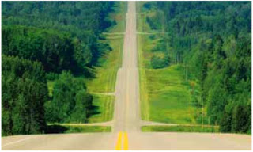
IV. Environmental Factors
a) Habitat Fragmentation
Habitat fragmentation carries long term environmental impacts some of which can destroy entire ecosystems. Where an ecosystem is a distinct unit and includes all the living and non-living elements that reside within it. Plants and animals are obvious members, but it will also include other components on which they rely on such as streams, lakes, and soils. Habitats become fragmented when development breaks up solid stretches of land. Examples include roads which may cut through forests or even trails which wind through prairies. While it may not sound all bad on the surface, there are serious consequences.

Slide 16
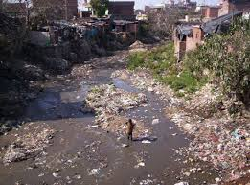
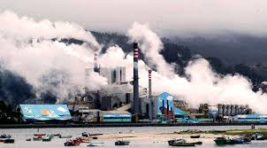
b) Water and Air Pollution
Water and air pollution are unfortunately the common causes of environmental degradation. Pollution introduces contaminants into the environment that can maim or even kill plant and animal species. The two often go hand in hand. Water, air and soil pollution, along with other environmental factors, contribute to 40 percent of deaths worldwide each year.

Slide 17
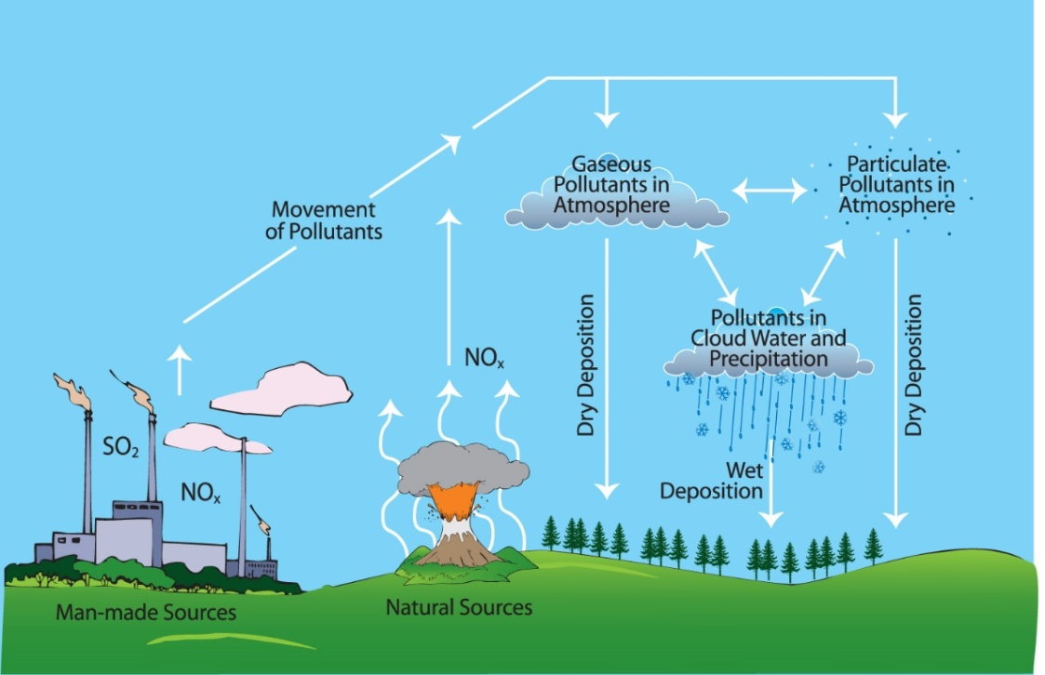
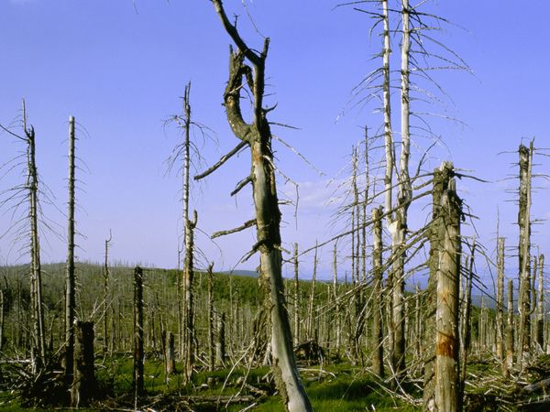
c) Acid Rain
Acid rain occurs when sulfur dioxide SO2 from coal plant emissions combines with moisture present in the air. A chemical reaction creates this acid rainfall. Acid rain can acidify and pollute lakes and streams. It causes similar effects to the soil. Acid rain causes acidification of lakes and streams and contributes to the damage of trees at high elevations and many sensitive forest soils.

Slide 18
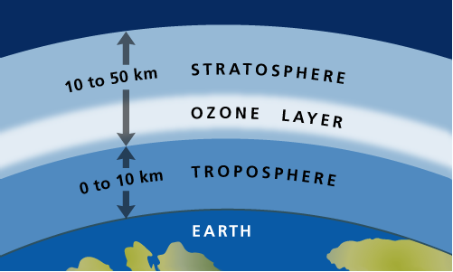

d) Distraction of Ozone Layer
Ozone layer, a region of the atmosphere from 19 to 48 km (12 to 30 mile) above earth’s surface. Ozone concentrations of up to 10 parts per million occur in the ozone layer. The ozone forms there by the action of sunlight on oxygen.
This action has been taking place for many millions of years, but naturally occurring nitrogen compounds in the atmosphere apparently have kept the ozone concentration at a fairly stable.

Slide 19
Major Environmental Problems in Bangladesh
Because of its geographical location, Bangladesh suffers from a range of environmental problems, arising from drought, flood and other natural hazards. Frequencies of hazards are on the increase day by day. Like other third world countries, Bangladesh is facing a number of different environmental crises such as:
Water Pollution
Air Pollution
Sound Pollution
River Pollution
Depletion of Biodiversity
Natural Disaster
Deforestation
Soil erosion

Slide 20
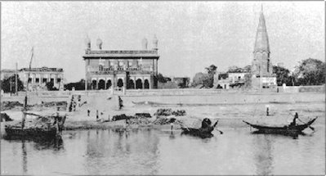
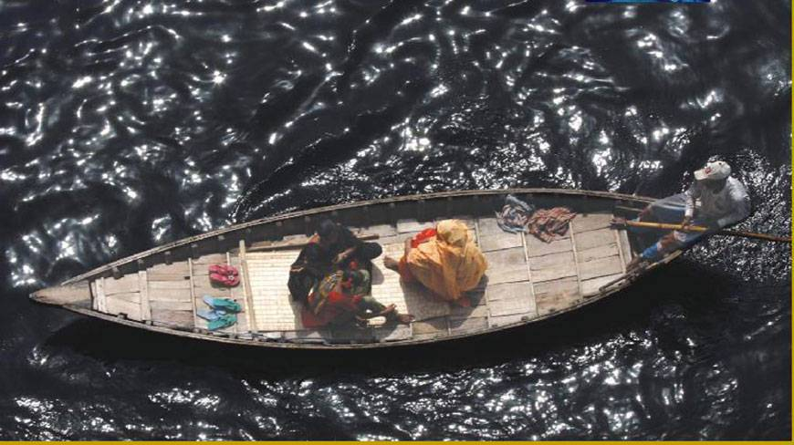
1. Water Pollution
The increasing urbanization and industrialization of Bangladesh have negative implications for water quality. The pollution from industrial and urban waste effluents, and from agrochemicals in some water bodies and rivers have reached alarming levels. Among the surface water, the worst polluted water are in the River Buriganga situated in Dhaka. The 2nd most polluted river is the Shitalakhya, flowing from the east of Dhaka.
Groundwater was treated as the best source of safe water, before arsenic contamination. But today 54 per cent of tubewells were found to have fecal contamination, due to poor wellhead design, faulty construction and management. (Haque, B.A. (1998) Biological Contamination of Tube well Water, ICDDRB, Bangladesh)
Buriganga river in 1980’s
Buriganga river in present

Slide 21
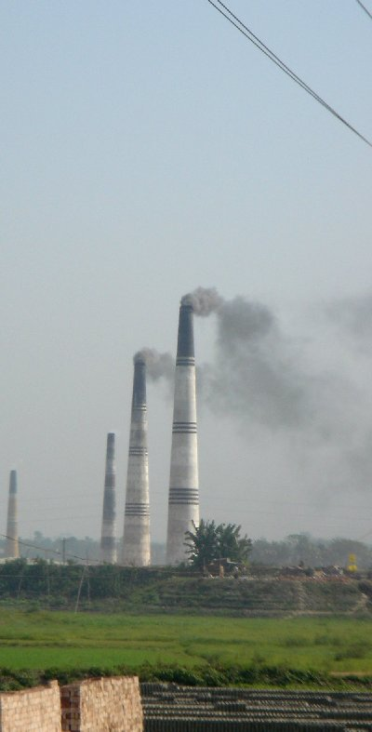
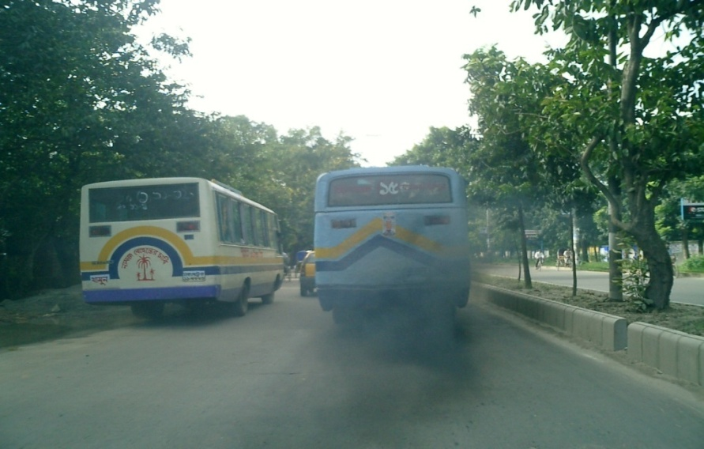
2. Air Pollution
Air pollution is a big environmental concern in Bangladesh particularly its big cities including capital Dhaka.
World Bank has estimated that almost 15, 000 premature death with million cases of sickness occur annually in Bangladesh due to air pollution and its economic cost is around US$200-800 million per year which is almost o.7 to 3 % of country’s total GDP.
(World Bank Report 2007)
Vehicle emission, emission from traditional brick kiln, re-suspension of road dust, construction work, biomass burning etc. are the main sources of air pollution in Bangladesh.

Slide 22
3. Sound Pollution
The incidence of sound pollution in Bangladesh is becoming a problem of far-reaching consequences. In the absence of a traffic rule curbing the use of horns, the noise problem has become acute in many parts of the cities and towns. Motor cars, trucks, buses, trains, construction works and noises from industrial plants are sources of noise pollution. The level of noise pollution in 10 representative areas in Dhaka city has been specified as follows:
Areas | Type of area | Observed db | Permissible limit | Level of pollution
Shakahry patty | Residential area | 75.5 db | 45 db | 25.5
Dhaka medical college hospital | Silent zone | 70.8 db | 45 db | 25.8
Nabisco biscuit factory | Industrial area | 89 db | 75 db | 14
Mohakhali bus terminal | Busy traffic | 89 db | 85 db | 04
New market | Commercial area | 86.4 db | 70 db | 16.4
Mouchak | Mixed area | 92.6 db | 60 db | 30.6
Source: (Bangladesh State of Environment Report 2000)

Slide 23
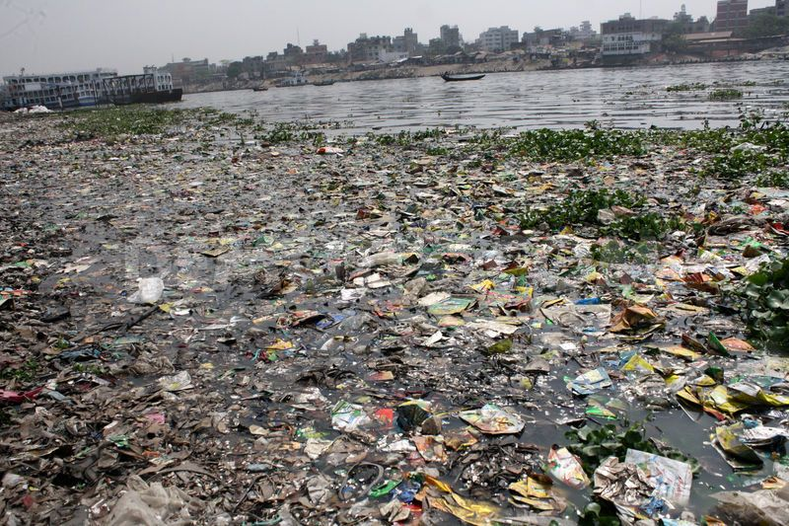
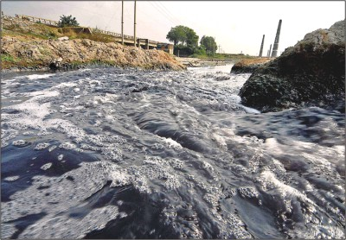
4. River Pollution
Bangladesh has about 230 small and large rivers, and a large portion of the country’s people depend on them for a living and for transportation. But experts say that many of them are drying up because of pollution and encroachment. Buriganga was once the lifeline of the Bangladesh capital. But the once mighty buriganga river, is now one of the most polluted rivers in Bangladesh because of rampant dumping of industrial and human waste.
A world bank study said four major rivers near Dhaka – the buriganga, Shitalakhya, Turag and Balu receive 1.5 million cubic metres of waste water every day from 7,000 industrial units and another 0.5 million cubic metres from other sources.
25

Slide 24
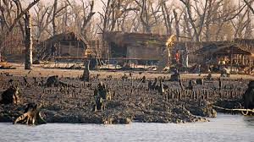
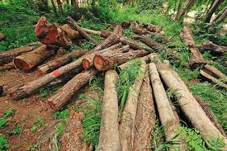
5. Depletion of biodiversity
The depletion of biodiversity is the result of various kinds of human development interventions and activities, especially in the areas of agriculture, urbanization, industries, chemicals, transport and energy. Once Bangladesh had rich species diversity. The natural forests were undisturbed and used to support a heterogeneous vegetation. Due to the raising of plantations with single crops, now the floral diversity has been reduced and forests have decreased significantly over the last few decades. The annual deforestation rate is estimated to be around 3.3 percent. It was identified 12 species of wildlife as extinct in Bangladesh (Source: Husain, K.Z. 1974. An introduction to the wildlife of Bangladesh. Dhaka, Page: 78).

Slide 25
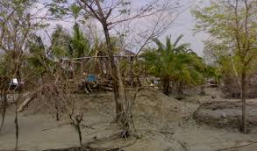
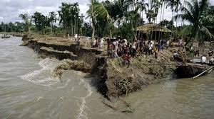
6. Soil Erosion
Soil erosion is the most serious and prevalent disease of the land that arises environmental degradation. Vast areas of hill districts of Bangladesh have been so damaged due to soil erosion that they no longer can be used to grow anything of value to human beings. The loss of soil fertility and potential production, watershed siltation through erosion and soil degradation facilitates natural disaster. Global temperature will rise up to 2 degree Celsius in the South Asian region including Bangladesh and it is predicted that millions of peoples living in low lying coastal areas in Bangladesh could be come displaced as sea level rise by up to 15 cm by 2030. Soil erosion in the hilly areas resulted adverse effect on water bodies like rivers, canals, ponds, wetlands etc.

Slide 26
7. Natural disaster
Bangladesh is most vulnerable to several natural disasters and every year natural calamities upset people's lives in some part of the country. The major disasters concerned here are the occurrences of flood, cyclone and storm surge, flash flood, drought, riverbank erosion, and landslide.
The effects of natural the calamities beggar description. Floods hits our country during the rainy season when there is excessive rainfall. Cyclone and drought occur in summer when the weather is extremely hot and dry.
And earthquakes also occasionally occur in our country. They cause heavy damage to our life and properties. Houses are destroyed, cattle are washed away, crops are greatly damaged and trees are uprooted.
Major Cyclones that hit Bangladesh Coast
Year | Cyclone type | Causality
October 1960 | Severe Storm | 10,000 people died
November 1970 | Severe Storm | The official death toll was 500,000
April 1991 | Severe Storm | 150,000 people died
November 2007 | Cyclone Sidr | causing over 2,000 deaths
May 2009 | Cyclone Aila | 330 people died
Source: Bangladesh Meteorological Department 1988, BBS, 1998 and Wikipedia

Slide 27
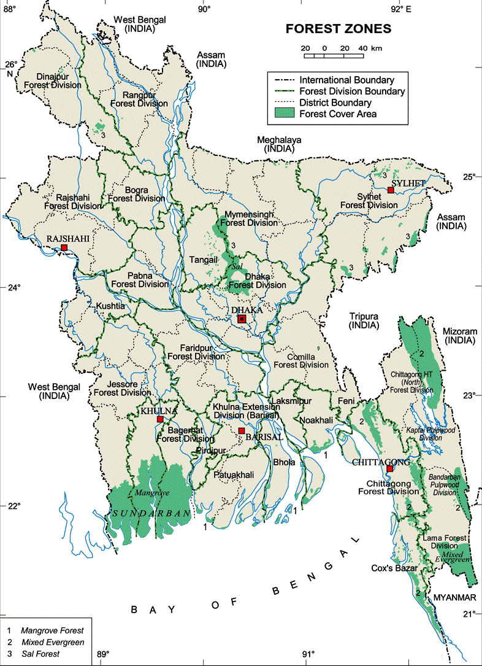
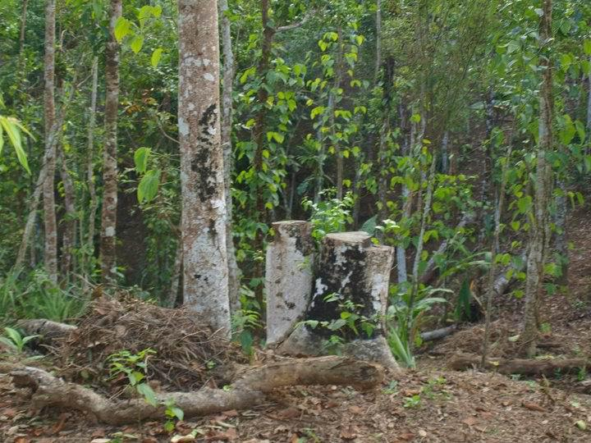
8. Deforestation
Deforestation is a major threat of Bangladesh. According to the ecologists, for livable environment there should be forest on the 25% land of the total area. In Bangladesh there is 16% forest of the total land. So, if we destroy trees at random, one day Bangladesh will turn into a great desert. All living animals and birds will not find any food or shelter to live in, they will destroyed. There will be no rain and as a result Bangladesh’s agriculture will face a great crisis. The temperature will rise and it will cause green house effect. Bangladesh will be unsuitable for living and natural calamities like flood, drought, storm will visit our country.
In 1910, the country’s population was 40 million but now it has more than 150 million. In the 1980s, the rate of destruction of forests in the country was 8,000 hectares per year. Now it has gone up to 37,700 hectares per year. The annual deforestation rate is 3.3%.
29

Slide 28
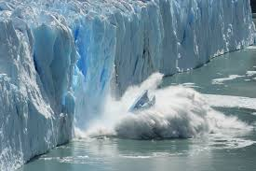
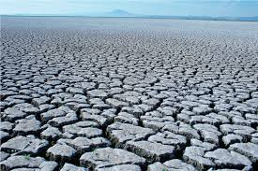
Impact of Climate Change: Global Perspective
On Climate Change, the Earth’s temperature is likely to increase by 2 to 4.5 degrees Celsius by the end of the century. According to the Intergovernmental Panel on Climate Change (IPCC), sea levels are expected to rise by 0.18 to 0.59 meters during that time.
The US Environmental Protection Agency states that if polar ice continues to melt in step with global average temperature, sea levels could increase by 0.49 to 0.79 meters by 2100.

Slide 29
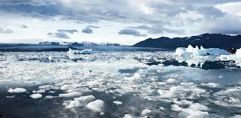
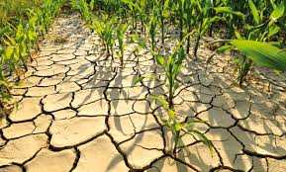
Impact of Climate Change: Global Scenario
It is anticipated that, by 2020, from 500 to 750 million people will be affected by water stress caused by climate change around the world.
Sea level will rise 2% in the year 2020, 4% by 2050 and 17.5% by 2100.
It will affect agriculture, hamper food security, create health hazard, and aggravate poverty. Around 40% - 45% of Green House Gas (GHG) emissions are required to be reduced by 2020 and 90–95% by 2050.

Slide 30
Climate Change and its Impact on Bangladesh-1
Unless action is taken now to limit carbon release in the atmosphere, South Asia would suffer more droughts and floods, rising sea levels and declines in food production. IPCC findings also states that a 45 cm sea-level rise will inundate almost 10.9% of the territory of Bangladesh and will displace 5.5 million population of coastal regions. In Bangladesh, 40% of productive land is projected to be lost in the southern region of Bangladesh for a 65cm sea level rise by the 2080s.
Flood areas could increase by as much as 29% for an increase of 2.5°C in Bangladesh. With the rise of sea-level up to one meter only, Bangladesh could lose up to 15% of its land area under the sea water and around 30 million people living in the coastal areas of Bangladesh could become Refugees because of Climate Change impacts.

Slide 31
Climate Change and its Impact on Bangladesh-2
In Bangladesh, climate change will affect many sectors, including water resources (surface and ground water), agriculture and food security, ecosystems and biodiversity, human health and coastal zones. Many environmental and developmental problems will be worsened by climate change. Predicted rainfall increases, particularly during the summer monsoon, could increase flood prone areas in Bangladesh.
These and the many other adverse effects of climate change will have profound repercussions for the economy and development of the country. It is predicted that climate change could have devastating impact on agriculture which is a key economic driver in Bangladesh, accounting for nearly 20 percent of the GDP and 65 percent of the labor force.

Slide 32
Climate Change and its Impact on Bangladesh-3
Rising sea levels will gradually inundate Bangladesh’s coast and river erosion will destroy land and homes, property and livelihoods. It is estimated that rising sea levels alone will displace 18 million Bangladeshis within the next 40 years.
Bangladeshis have already started to move away from the lowest-lying villages in the river deltas of the Bay of Bengal; 1.5 million of the five million slum inhabitants in Dhaka, moved from villages near the Bay of Bengal. Most migrants end up in urban slums, particularly in Dhaka and this constant influx of people is contributing to rising crime and insecurity in these areas.

Slide 33
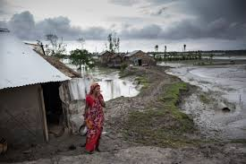
Climate Change and its Impact on Bangladesh-4
The regular and severe natural hazards already batter the country like tropical cyclones, river erosion, flood, landslides and drought to increase in intensity and frequency as a result of climate change.
About 20 million people in the coastal areas of Bangladesh are already affected by salinity in drinking water and Salinity intrusion into the country side reached 100km and degrades land resources

Slide 34
Mitigation and Adaptation
Bangladesh has established the Bangladesh Climate Change Trust Fund (BCCTF) and the Bangladesh Climate Change Resilience Fund (BCCRF)
'National Action Plan on Adaptation' (NAPA) of 2005, and the 'Bangladesh Climate Change Strategy and Action Plan' (BCCSAP) of 2009. In an effort to be a ’Middle Income Country’ by 2021,
The Copenhagen Accord (COP 15) pledges $100 million of public and private finance by 2020.
Maintaining SDG goals by focusing on environmental protection (2016-30)

Slide 35
Climate induce Challenges
Country’s large food security–limits of rice cultivation
Arsenic contamination poses major threat to health
Two dimensional problem during dry season: Salinity and drought
implementation of National Water Management Plan
Enhancing coastal defence system
Community-based disaster risk reduction
Increased risks to human health and nutrition
Safeguarding infrastructure
Ensuring livelihood
Addressing climate induced displacements

Slide 36
Initiatives for Sustainable Environment
International initiatives
World Environment Movement
The Stockholm conference on environment is a milestone in world environment movement. The concept of environment was expanded in the larger areas of social, economic and political sectors through this conference held in 1972. Around 113 countries, 19 international organizations and 400 non-government organizations took part in the conference. Following the decision of the conference, United Nation Environmental Programme (UNEP) and International Union for Conservation of Nature (IUCN) were established.
Role of IPCC
The International Panel on Climate Change (IPCC), coming into existence in 1988, has since been in relentless in undertaking research on the various phenomena related to changes in the global climatic conditions and arousing public opinion and awareness toward undertaking required steps in confronting the potential challenges. For such an outstanding research, IPCC was honored by awarding Nobel Prize.

Slide 37
Kyoto Protocol
The Kyoto Protocol signed to reduce carbon dioxide and greenhouse gas emission responsible for increasing global warming. It came into force from 16 February 2005. Till now, 137 developing countries have ratified the Kyoto protocol, including Brazil, China and India. On December 11, 1997, the negotiations on the Kyoto Protocol under the United Nations Convention on Climate Change Framework were completed. The Kyoto Protocol put 36 industrialized nations under obligation to meet specific legally binding targets for emissions of six-greenhouse gas like carbon dioxide, methane, nitrous oxide etc.
Clean Development Mechanism (CDM) Activities
The Clean Development Mechanism (CDM) is an important part of Kyoto Protocol. As per CDM, industries in developed countries may earn Certified Emission Reduction (CER) credit by investing in the developing countries. As a result, both developed and developing countries may be benefited. With a view to developing management of waste of the city of Dhaka under the auspices of CDM, 700 MT of decomposable waste will be collected from kitchen markets of various locations to prepare compost fertilizers. Such a programme will facilitate the Dhaka City Corporation in saving its cost in respect of waste collection and transportation.

Slide 38
Role of UN
The UN has consistently taken the lead in taking on climate change. In 2007, the Nobel Peace Prize was awarded jointly to former US Vice-President Al Gore and the IPCC "for their efforts to build up and disseminate greater knowledge about man-made climate change".
The Kyoto Protocol set standards for certain industrialized countries.
In Dec. 2010, climate change talks in Cancún concluded with a package of decisions to help countries advance towards a low-emissions future.
In 2011 the UN Climate Change Conference in Durban, South Africa produced the Durban Platform . In Durban, governments decided to adopt a universal legal agreement on climate change as soon as possible.
In December 2012, after two weeks of negotiations at Doha conference, nations moved forward on climate change and extended the Kyoto Protocol. The renewal will keep existing climate targets until a new international agreement comes into effect in 2020.
UNEP has more than 20 years of experience working on climate change. UNEP has launched a major worldwide tree planting campaign – The Billion Tree Campaign. UNEP has established CN Net to assist those interested in achieving big cuts in greenhouse gas emissions to reach their goals.

Slide 39
Role of IUCN AND Greenpeace
IUCN Coordinating climate change work across 12 major programmes, 10 regions, 6 Commissions and member organizations. It is working to include biodiversity concerns in adaptation and mitigation polices and practice, as well as furthering natural resource management strategies that help species and humans adapt to the impacts of climate change. On the other hand Climate change is a priority issue for Greenpeace. It inspires people to join the energy revolution by reducing energy consumption and promoting renewable energy.
Conference of the Parties (COP)
In 2015, France will be hosting and presiding the 21st Session of the COP to the United Nations Framework Convention on Climate Change. COP21 will be a crucial conference, as it needs to achieve a new international agreement on the climate, applicable to all countries, with the aim of keeping global warming below 2°C.

Slide 40
National Initiatives
The following national policy documents developed by the Government of Bangladesh have addressed the issues of climate change:
1. The Constitution: through its 15th amendment, considered the issue of climate change. Constitutional Amendment included the following article 18 A Protection and improvement of environment and biodiversity: The State shall Endeavour to protect and improve the environment and to safeguard the natural resources, biodiversity, wetlands, forests and wild life for the present and future citizens.
2. Vision 2021: Vision 2021 that provides political directions to all national policy documents states, “ All measures will be taken to protect Bangladesh, including planned migration abroad, from the adverse effects of climate change and global warming.”

Slide 41
National Initiatives
3. SDG Goals: In September 2015, the UN General Assembly adopted a new development agenda for the period 2016-2030 supporting three pillar of sustainability e.g. social equity, economic development and environmental protection.
4. Sixth Five Year Plan : ‘Bangladesh Sixth Five Year Plan FY2011-15’ provides strategic directions and policy framework of Climate Change adaptation for accelerating growth and reducing poverty of the country.
5. Bangladesh Climate Change Strategy and Action Plan approved by the Government in 2009 with wide consultation with Government and NGO sector, development partners, experts, academia etc. It is a one of the first landmark document among the developing countries.

Slide 42
5. Other Policy Documents
It has been observed that other national sectoral policy documents that are being reviewed currently also considering the effects of climate change and directing policy propositions to combat those. These are: The National Environment Policy, Air Pollution Control, Conservation of Ecology, Control of Industrial Pollution , Control of Noise Pollution, Conservation of Biodiversity, Protection of Ozone Layer, National water policy.

Slide 43
Overview of Initiatives Undertaken
High level of awareness among people
7000 km Coastal Embankments
2700 Cyclone shelters
Early warning system for cyclones and floods
42000 volunteers in coastal areas
Coastal Green Belt through A forestation
Salinity and submergence tolerant rice, shorter maturity rice developed
NAPA prepared in 2005
Climate Change Trust Fund established
Bangladesh Climate Change Strategy and Action Plan (BCCSAP) prepared in 2009

Slide 44
Reference
Ahmed, Yasmeen (1995), “Environmental Degradation and Natural Disasters: Who are the worst victims?”
Gain, Philip (1998), Bangladesh Environment : Facing the 21st Century, Dhaka : Society for Environment and Human development (SHED).
Rahman, A. Atiq, et.al., (1994), Environment and Development in Bangladesh, Vol II , Dhaka : UPL.
Bangladesh State of Environment Report, 2001, Department of Environment/UNEP
Bangladesh Environment 2001, Unnyan Shamannay, UPL
Rahman, A. Atiq, et.al., Environment and Poverty, Dhaka, UPL.
Munir uz Zaman, M., Aspects of Environmental Degradation in Bangladesh
Study by Environmental Protection Department of Bangladesh 2008, Air Quality Management Project, Department of Environment, GoB.

Slide 45
Thank You

