Slide 1

Urban & Rural Development in Bangladesh
Jannatul Ferdowsee Disha
Lecturer
Department of Development Studies
Daffodil International University

Slide 2
Objectives of the Class
Define the concept urbanization’ and evaluate the development of trend of it in both national and international perspective.
Find out the causes of urbanization in Bangladesh and scratch out the reasons for migration.
Explore the impact or consequences of urbanization in Bangladesh.
Reveal some challenges and problems which are available in urban area of Bangladesh and how to meet these challenges.
Define the concept rural development and evaluate the development of trend of it in BD.
Identify the rural development model e.g. BARD and evaluate the role of government and NGOs
Reveal some challenges and problems which are available in rural area of Bangladesh and how to meet these challenges.

Slide 3
Urbanization: The Concept
Urbanization means the concentration of people in cities and towns. Urbanization refers to the number of people who migrate from rural areas to urban areas, resulting in growth. It describes the transition of rural conditions (farms and small towns) to urban conditions (cities). It is the process where increasing percentage of a population lives in cities and suburbs. The social work dictionary simplifies Urbanization as a ‘social trend in which people adopt the life styles, residential patterns and cultural values of those who live in or near cities.’ According to Cambridge dictionary, Urbanization is the process by which more and more people leave the countryside to live in cities.

Slide 4
Urbanization: Development Trend
Globally, more people live in urban areas than in rural areas, with 54 per cent of the world’s population residing in urban areas in 2014. In 1950, 30 per cent of the world’s population was urban, and by 2050, 66 per cent of the world’s population is projected to be urban.
Today, the most urbanized regions include Northern America (82 per cent living in urban areas in 2014), Latin America and the Caribbean (80 percent), and Europe (73 per cent). In contrast, Africa and Asia remain mostly rural, with 40 and 48 percent of their respective populations living in urban areas. All regions are expected to urbanize further over the coming decades. Africa and Asia are urbanizing faster than the other regions and are projected to become 56 and 64 per cent urban, respectively, by 2050.
Source: World Urbanization Trends 2014: Key Facts

Slide 5
Urbanization: Development Trend
The urban population of the world has grown rapidly since 1950, from 746 million to 3.9 billion in 2014. Asia, despite its lower level of urbanization, is home to 53 per cent of the world’s urban population, followed by Europe (14 per cent) and Latin America and the Caribbean (13). Continuing population growth and urbanization are projected to add 2.5 billion people to the world’s urban population by 2050, with nearly 90 per cent of the increase concentrated in Asia and Africa.
Source: World Urbanization Trends 2014: Key Facts

Slide 6
Urbanization: Development Trend
International Perspective
The United States and most European nations began to urbanize heavily in the 19th century. One of the most profound effects of the Industrial Revolution, which developed rapidly in England during 1750-1850 and spread to the continent after the Napoleonic Wars, was to stimulate the growth of cities. Throughout Europe, only 17% of the population lived in cities in 1801. By 1851, the percentage increased to 35%, and by 1891, it was 54%. On the other hand, in 1800, only about 5% of the U.S. population lived in cities. By the late 1900s, this number had climbed to 80%. Today, more than half of the world's population lives in cities.
World Urbanization, 2011
World 52.1 Africa 39.6 Asia 45.0
Eastern Asia 55.6
South-Central Asia 32.8
South-Eastern Asia 44.7
Western Asia 67.9
Southern Asia 32.6
India 31.2
Pakistan 36.2
Bangladesh 28.4
Europe 72.9
Latin America 79.1
North America 82.2
Oceania 88.7
Source: World Urbanization Prospects: The 2011 Revision.

Slide 7
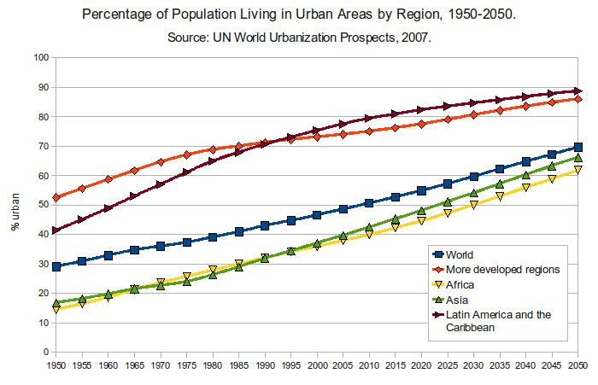
International Perspective : Urbanization Prospects
Urbanization: Development Trend

Slide 8
Rural Development : Global Scenario
The rural population of the world has grown slowly since 1950 and is expected to reach its peak in a few years. The global rural population is now close to 3.4 billion and is expected to decline to 3.2 billion by 2050. Africa and Asia are home to nearly 90 per cent of the world’s rural population. India has the largest rural population (857 million), followed by China (635 million).
Source: World Urbanization Trends 2014: Key Facts

Slide 9
Bangladesh Perspective
Urbanization: Development Trend
With over 150 million people Bangladesh is the world’s eighth most populous country and also one of the densest. The population of the country possibly, 2060, might be 230 million, with more than 70 percent being urban.
As per recent UN data, 25 percent of Bangladesh current population lives in urban areas. Of this urban population, more than half lives in the largest four cities: Dhaka, Chittagong, Khulna and Rajshahi. Dhaka mega city currently ranks as the world’s 11th largest city .

Slide 10
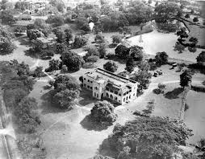
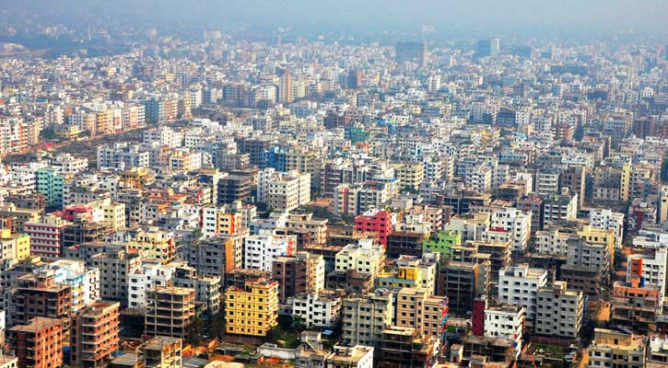
Bangladesh Perspective
Urbanization: Development Trend
The World Bank says Dhaka, with its current population of 15 million people, bears the distinction of being the fastest-growing in the world. Between 1990 and 2005, the city doubled in size — from 6 to 12 million. By 2025, the U.N. predicts Dhaka will be home to more than 20 million people.
The total urban area of Dhaka spans about 1530 square kilometers (Islam 2005). About 80% of the garments industry in Bangladesh is located in Dhaka city (World Bank 2005). Dhaka city contributes to about 13% of the country’s GDP.

Slide 11
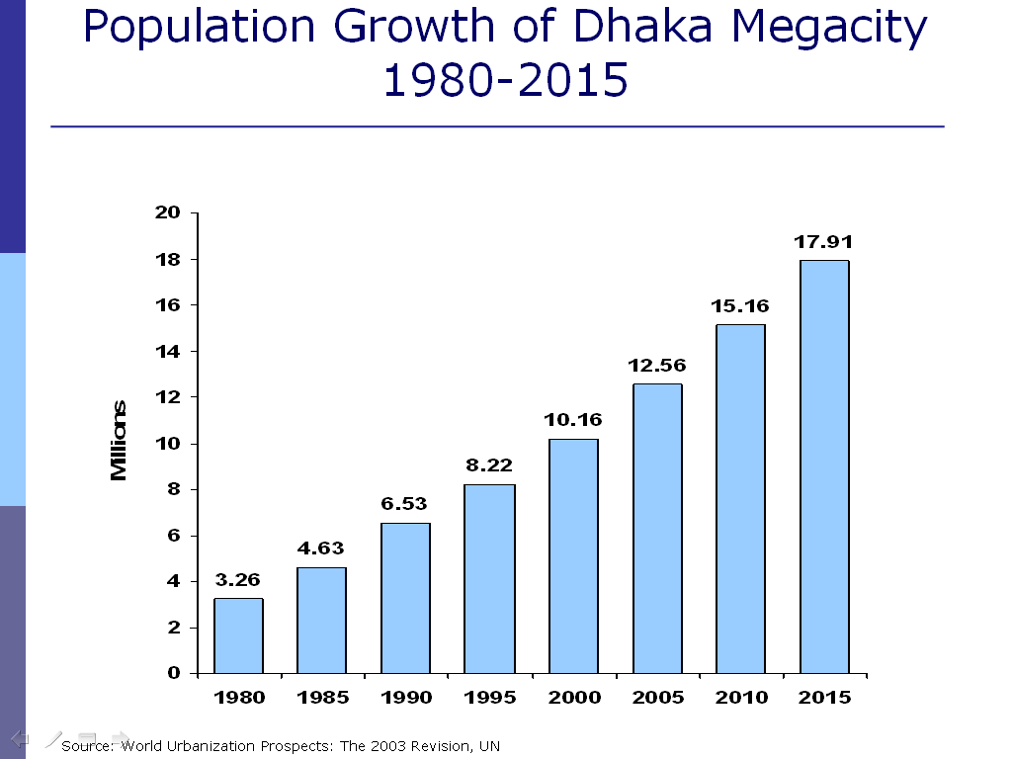

Slide 12
Rural-Urban Migration: Push-Pull model
The Push-Pull model pioneered was by Everett S. Lee in 1996. Migration is the combined effect of both push and pulls factors and it is often difficult to separate the role of the two. Within the Push-Pull model,
Push factors may be identified for Bangladesh as:
1.Population pressure, adverse person-land ratio, landlessness and poverty.
2. Frequent and severe natural disasters (particularly river bank erosion).
3. Law and order situation.
4. Lack of social and cultural opportunities (applicable for rural rich)
5. Cyclone, famine, flood, river erosion.

Slide 13
Rural-Urban Migration: Push-Pull model
The pull factors may be identified for Bangladesh as:
1. Real or perceived job Opportunities and
2. Higher wages in the city are the main pulls.
3. Rural-urban disparities, opportunities and services are also responsible.
4. Rural-urban migrations are due to marriage and other familial reasons.
      5. Educational facilities pull rural people to the cities

Slide 14
Causes of Rural-Urban Migration
ECONOMIC | ENVIRONMENTAL | FAMILY | SOCIO POLITICAL
Landless and poverty | Natural Hazards | Loses of husband | Social Factors
Unemployment Poverty | Mostly river bank erosion | Dissolution of family | Brought by relative
Economic crisis |  | Dependents | Village politics
Job opportunities Getting charity |  |  | Communal riot

Slide 15
Impact of Migration and Urbanization (Positive)
According to UN centre for human settlements, 50 percent of GNP comes from urban areas in the developing countries. Some positive consequences of urbanization in Bangladesh are:
1. Economic benefits: growth of GDP, higher productivity, better income etc.
2. Demographic benefits: lowering of age at marriage, reduction of fertility rate.
3. Socio-cultural benefits: modernization
4. Political benefits: Women empowerment, democracy etc.
5. Improved access to information technology.
6. Infrastructural development benefits: Improvement of communication and transportation
    7. Socio-economic development: Employment opportunities, Increase literacy rate, improvement in the quality of education, and better health indicators.

Slide 16
Impact of Migration and Urbanization (Negative)
Urbanization is not an unmixed blessing. Its negative consequences are of great concern. The negative consequences can be grouped as the following:
1. Rapid growth of urbanization on a massive scale within a city is in the form of degradation of the urban environment.
2. Environmental consequences: pollution
3. Encroachment on productive agricultural land and forests
4. Extreme pressure on housing, growth of slums and the pressure on services
5. Economic consequences, leading to income inequality and poverty, ill effects of globalization
7. Cultural consequences: entry of alien culture, loss of national cultural identity
8. Political consequences: Criminalization of politics.
9. Socio-economic problems: High density of population, House and slum problems, Scarcity of utility services, Social discrimination & inequality, Terrorism and crime.

Slide 17
Major Problems in Urban Area
Urbanization is the movement of people from a rural to an urban area. During the Industrial Revolution, people began moving into the cities to work in the factories and industries that would change or eliminate their previous jobs in rural communities. While this helped cities to grow exponentially, it brought with it a number of social problems and conflicts. Such as,
1. Transport problem
2.Climate change
3.Unplanned urbanization
4.Water logging
5.Environment pollution
6.River pollution
7.Air pollution
8. Imbalance administrative development
9. Over population Problem

Slide 18
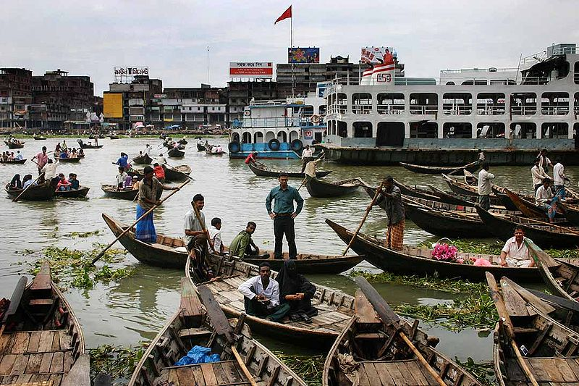
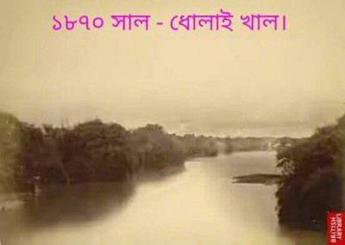
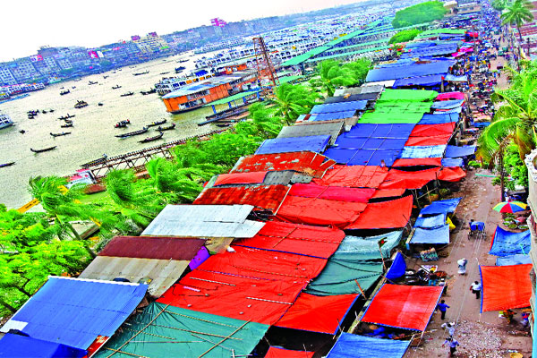
River Pollution
Most industrial enterprises are dumping their toxic effluents into neighboring water bodies and rivers. The erroneous, Cordon Approach towards rivers, pursued for decades under foreign advice, is disrupting the rivers. Buriganga river, which flows by Dhaka, is now one of the most polluted rivers in Bangladesh because of rampant dumping of industrial and human waste.

Slide 19
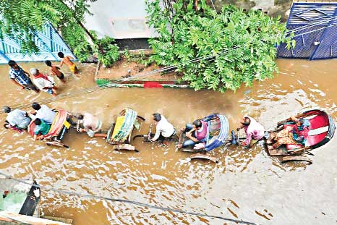
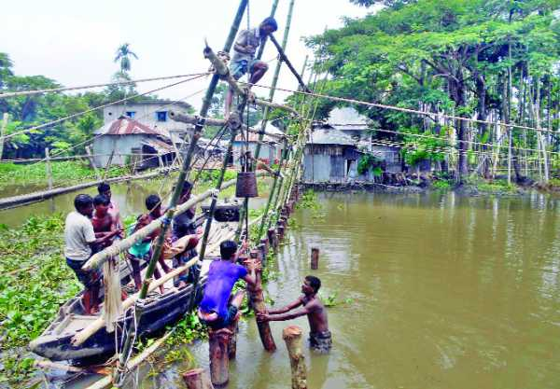
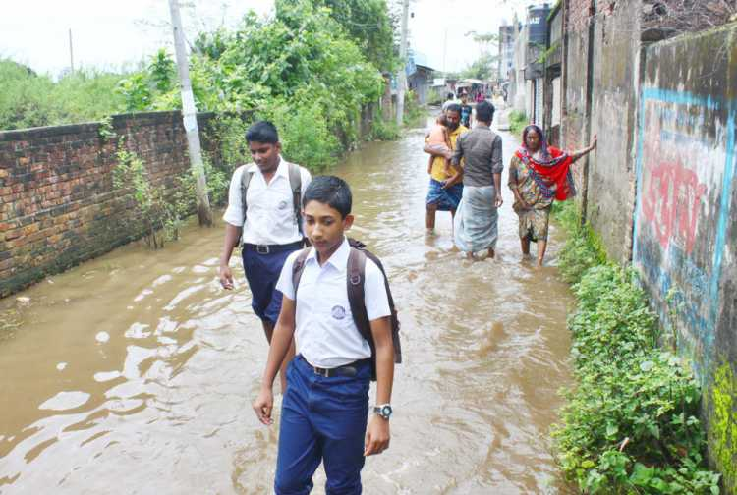
Water logging
Dhaka, the capital city of Bangladesh, is an example of unplanned urbanisation. Every year the city dwellers of Dhaka face extensive water-logging during the monsoon. Water-logging is not a new problem rather it is one of the old problems of the capital.

Slide 20
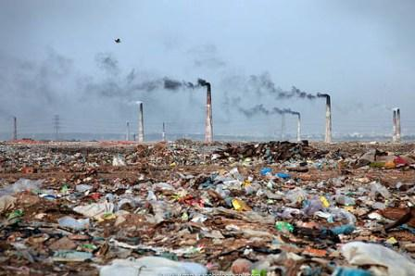
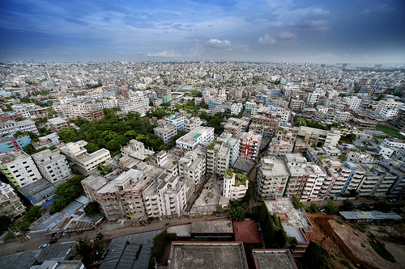
Air pollution
Unfit traffic, industries, dust, particles of paints and wood are extremely high in Dhaka city what causes uncountable air pollution. Childs and women are highly vulnerable in this pollution. For example, Air pollution in capital city Dhaka has gone higher than Mexico City. According to the Department of Environment, the density of airborne particulate matter reaches 463 micrograms per cubic meter.
Imbalance administrative development
The Dhaka-centric development has resulted in relative Neglect of divisional, district and upazilla cities and towns. The country faces a vicious circle, whereby lack of development in district and upazilla towns is causing their affluent residents to flock to Dhaka.

Slide 21
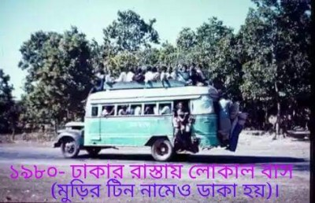
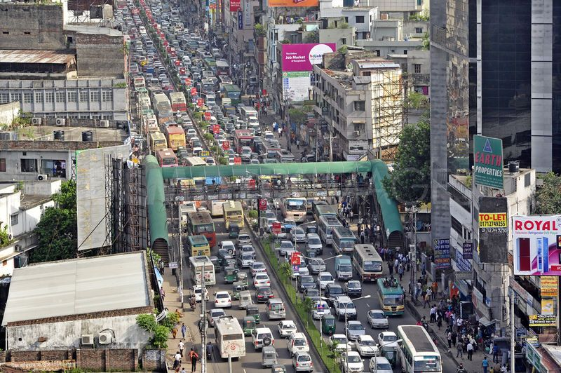
Transport problem
Over the last few years the transportation problem of Dhaka City has visibly been deteriorating steadily. Citizens constantly complain about the unbearable twin problems of traffic jam and air pollution. Narrow roads, broken roads and unplanned repairs appeared as the 3 main causes of traffic jam.

Slide 22
Unplanned urbanisation
An unplanned urbanization across the country leads to discrimination between the capital Dhaka and other metropolitan cities and district towns. Unplanned growth of cities is increasing the risks of fire hazard, building collapse, water logging, drainage congestion and road accidents.

Slide 23
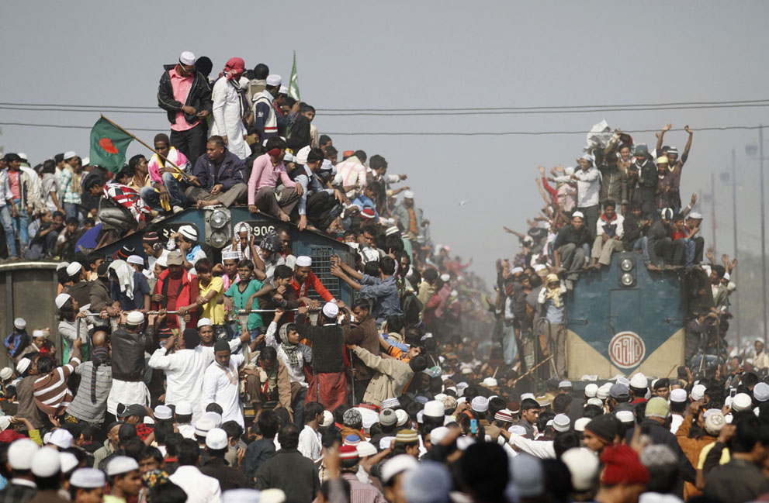
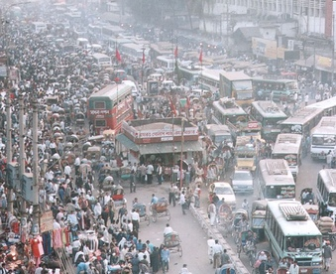
Overpopulation problem
Bangladesh has the highest density of population. Some problems associated with overpopulation are shortage of food, inadequate fresh water, crowding, traffic, unemployment, high crime rates. Dhaka has grown so crowded that existing infrastructure make it impossible to lead a comfortable life. Titled "World Urbanization Prospects: The 2014 Revision", the UN report projected Dhaka would become the 6th most crowded city by 2030 with a population of over 2.7 crore.

Slide 24
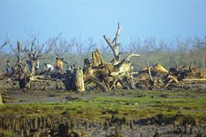
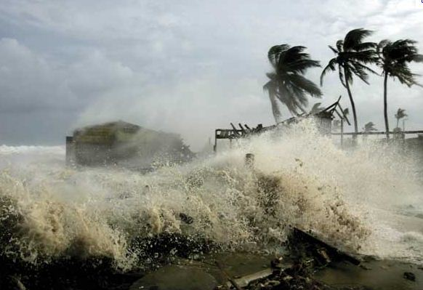
Climate Change & Environmental Pollution
Bangladesh has been considered as one of the most vulnerable country because of the climate change. In a nut shell, coastal areas of Bangladesh are being converted into a unproductive, unfit for human habitat, harsh, deserted and disaster prone area due to climate change. So thousands of work-less families are rushing towards cities to live hand to mouth. So new and temporary shelters are being built in each day, which are converting to slums in next day. Severe environmental pollution is threatening human health and economic growth of Bangladesh. Air pollution effects the urban children. Industrial emissions cause different waterborne disease and damage to health.

Slide 25
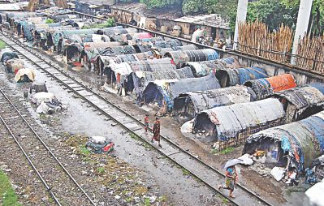
Housing scarcity
The housing shortage is so acute that one third of the city's population lives in slums. The influx of migrants from rural areas and deprived towns continues. The city authorities can neither respond to the problems nor coordinate their work. There is an estimated 4966 slum settlements scattered all over the city (Islam, 2005).
Housing scarcity: Slums in Dhaka
Years of survey | Number of slums | Number of slum households | Slum population
1974 | - | - | 275,000
1986 | - | 121328 | -
1991 | 2,156 | - | 718,143
1996 | 3,007 | - | 1500000
1997 | 1579 | 185917 | 754866
2005* | 4966 | 673883 | 3286770

Slide 26
Meeting the Challenges (1)
Urbanization is a compelling and growing reality. Managed or ignored, the process will soon come to determine our economic prospects and the quality of our social lives. So we have to meet the challenges by following steps:
1. Decentralization
2. Rural Entrepreneurship
3. Ensuring the lodging for the urbanized people
4. Enhancement of opportunities
5. Focus on good governance
6. Improving City Governance: the Principal Strategy
Source: Overview of Urbanization in Bangladesh by Nazrul Islam, Chairman, (CUS), Dhaka

Slide 27
Meeting the Challenges (2)
7. Decentralization of Functions and Responsibilities
8. Good Urban Planning and Sound Incentives
9. Developing a Sound Real Estate Market
In implementing the above ideas, at least one thing will be essentially required and this is quality governance. It implies adequate i) transparency ii) accountability iii) responsiveness iv) decentralization v) participation vi) coordination vii) authority and control viii) Planning and productivity , efficiency and leadership
Source: Overview of Urbanization in Bangladesh by Nazrul Islam, Chairman, (CUS), Dhaka

Slide 28
Rural Development and Indicator
Rural development is the betterment in the totality of life for rural people. It is the process of improving the quality of life and economic well-being of people living in relatively isolated and sparsely populated areas. It actions are mainly aim to the social and economic development of the rural areas.
Indicators of Rural Development
Changes in agricultural productivity.
Changes in rural employment, unemployment and under employment
Changes in income of different income groups
Changes in the distribution of power, influence and participation.
Changes in literacy, schooling, literacy rate and life expectancy
Changes in values, believes and attitudes of members of state agencies as well as the rural policy making.

Slide 29
History of Rural Development
British Period:
The British created a loyal landed class of Zamidars through the Permanent Settlement Act of 1793.
Pakistan Period:
In 1950 Zamidari system was abolished. There had several programs on that time as like Village Agricultural and Industrial Development (V-AID) program. In 1959, A four-tier local government system was launched by the military government of Mohammad Ayub Khan.

Slide 30
History of Rural Development
Bangladesh Period:
In 1952 Bangladesh government activated the Integrated Rural Development Program (IRDP) to replicate and expand The Comilla Model in other parts of the country. Now it is worked as Bangladesh Rural Development Board (BRDB). CIRDAP was established as an inter-governmental organization to facilitate IRD in the Asia-Pacific region.

Slide 31
Rural Development Model: BARD:
Bangladesh Academy for Rural Development (BARD) or The Comilla Model was a rural development program launched in 1959 by Akhter Hameed Khan in Comilla. The Features of the Comilla Model:
  The promotion of development of various institutions, both public and private, and establishing a system of interrelationships between them;
  Involvement of public and private sectors in the rural development;
  Development of leadership in every village, including managers, model farmers, women organizers, youth leaders to sustain the development;
  Development of three basic infrastructures;
  Priority on decentralized and coordinated rural administration;
  Ensure education, organization and discipline.
  Focus on economic planning and technology.

Slide 32
Role of Government: Rural Development
The Comprehensive Village Development Program was launched by BARD in 1975.
The Small Farmers Development Program was introduced in 1993.
Major governmental rural development projects: (i) The Vulnerable Group Development, (ii) Thana Resource Development and Employment Project, (iii) Rural Social Service Program, (iv) Community Development Program, (v) Self-reliance Program for Rural Women, (vi) Technologies for rural employment.
Poverty Reduction Strategy Paper (PRSP)

Slide 33
Role of NGOs: Rural Development
NGO covers an wide range of rural development activities including: development of income and employment, health and sanitation, agriculture and rural craft, vocational education, relief and rehabilitation, family planning, mother and childcare.
Prominent NGOs are: The Bangladesh Rural Advancement Committee (BRAC), Grameen Bank, Proshika, Manobik Unnayan Kendra, ASA, Rangpur-Dinajpur Rural Service etc.

Slide 34
Problems and Challenges of Rural Development
Tell me what problems and challenges did you observe in your rural area.

Slide 35
Your Answer!!!!
Education problem!
Financial problems!!
Poor health facilities!!!

Slide 36
How to meet the Problems and Challenges!
Give your suggestions how to meet these problems and challenges.

Slide 37
Your Answer!!!!
Sustainable development of rural area!
Agricultural development !!
Establishment of agriculture based industry!!!

Slide 38
References
Ahmed A., J.K. Ahmed, and A. Mahmud, (2006), Making Dhaka Livable, World Bank Mimeo.
Bangladesh Bureau of Statistics, Statistical Year Book, from the year of 1996 to 2008.
Islam, N., Urbanization, Migration and Development in Bangladesh: Recent Trends and Emerging Issues.
World Bank (2007),Improving Living Conditions for the Urban Poor.
Urbanization in Bangladesh: Present Status and Policy Implications -By A.K.M. Helal uz Zaman
Agriculture in Bangladesh: Performance Problems and Prospects -By Mosharaff Hossain.
Rural Development in Bangladesh: Trends and Issues By Mohammad Mohabbat Khan, Habib Mohammad Zafarullah
World Urbanization Prospects: The 2014 Revision, United Nations New York, 2014
Bangladesh Studies: Politics, Administration, Rural Development, and Foreign Policy -By Mohammad Mohabbat Khan, Saiyada Anoyara Hosena

