Slide 1
Industrial Sector in Bangladesh
ICT Industry
Textile Industry
Pharmaceutical Industry

Slide 2
Objectives of this Class
Investigate the contribution of the industrial sector of Bangladesh.
Explore the ICT/pharmaceutical industrial scenario in BD.
Identify the weaknesses of the industrial sectors in BD.
Please suggest measures to develop the industrial sector in Bangladesh.

Slide 3
Concept of Industrialization
Industrialization is the process in which a society or country transforms itself from a primarily agricultural society into an industrial one based on the manufacturing of goods and services. Characteristics of industrialization include the use of technological innovation to solve problems as opposed to superstition or dependency upon conditions outside human control such as the weather, as well as more efficient division of labor and economic growth.
Industrialization is part of a process where people adopt easier and cheaper ways to make things. Using better technology, it becomes possible to produce more goods in a shorter amount of time.
Modernization and structural transformation of the economy and diversification of the economic base, increasing returns and economies of scale, technological progress and productivity increase, accelerated economic growth and employment creation, increase in incomes and standard of living of the people are the universally recognized dynamic benefits arising from industrial development.

Slide 4
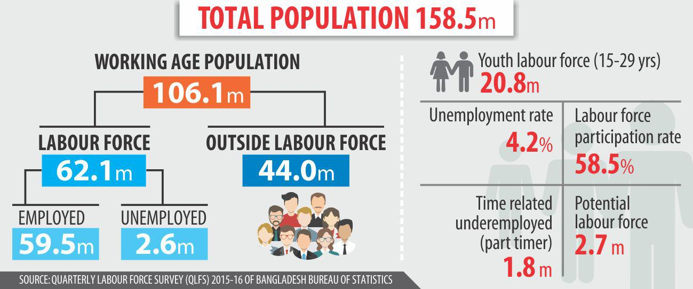
Demographic Dividend
Labor Force
Demographic Dividend is a phenomenon which occurs when the proportion of working population out of the total population is high. Since 2007 Bangladesh has had more people of working age than non-working, known as demographic dividend. Demographic dividend usually continues for 30 to 35 years. We have to transform it into economic dividend.
The labor force or work force is the population of able-bodied, willing people who are currently employed or looking for work. Labor Force is one of the most important indicators for development of a country. The total labor force of Bangladesh is 62.1 million in 2015, according to BBS Statistics. Labor force, total in Bangladesh was reported at 66.6 million in 2017, according to the World Bank Statistics.

Slide 5
Objectives of Industrialization
Macro objectives of industrialization are-
Play a major role in economic development
To increase GDP
Provide a secure basis for a rapid of growth of income.
Help in raising the standard of living
Provide employment, meeting high income demands
Brings in technological progress and change in the outlook of the people
Decrease the dependency on foreign resources
Micro objectives of industrialization are-
To provide employment to working labor force
To supply consumer, capital and intermediary goods
To support agriculture and service sectors
To improve balance of payment positive by promoting export industry and import substitute industries

Slide 6
Contribution of Industrial Sectors
Industrial Sector in GDP
Industrial Sector has given the opportunity of employment to millions of unemployed, especially innumerable uneducated women of the country. It is making significant contribution in the field of our export income.
The contribution of the industry sector to the economy of Bangladesh has been increasing day by day.
Contribution of Industrial sector in GDP is 35.36% (Fiscal year 2020-2021)
Year | Contribution of Industrial sector in GDP (%)
1941-1950 | 4
1951-1960 | 5
1961-1970 | 10
1971-1980 | 11
1981-1990 | 12
1991-2000 | 15
2001-2011 | 30
2020-2021 | 35.36
Source: World Bank Report and Ministry of Finance, Bangladesh

Slide 7
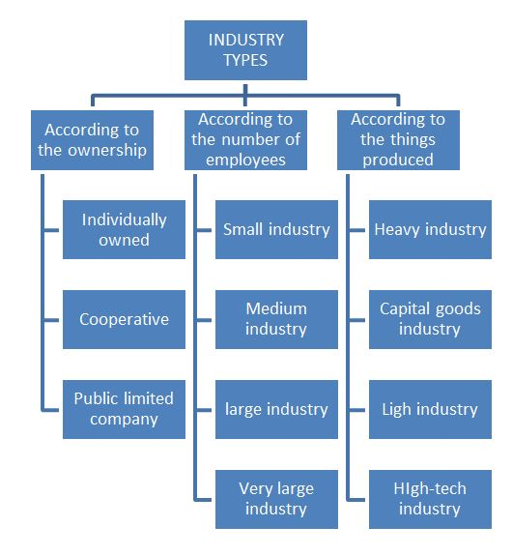
Classification of Industries in Bangladesh
Large Industry
Medium Industry
Small Industry
Micro Industry
Cottage Industry
Reserved Industry
Thrust Sector Industries
SME

Slide 8
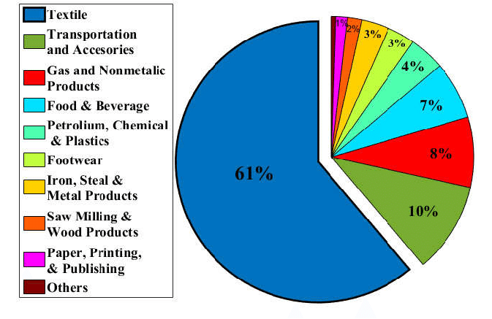
Common Industries in Bangladesh
Others:
Ceramics
Plastics
Ship building

Slide 9
Focused Industry: ICT
Information and communications technology (ICT) is often used as an extended synonym for information technology (IT). The term ICT is used to refer to the convergence of audio-visual and telephone networks with computer networks. It covers the vast area of information technology, communication technology and the telecommunication technology. ICT industries are broadly engaged in:
Producing, selling and supporting computing and communications equipment, peripherals and components.
Producing, selling and supporting software for computing and communications equipment and enterprise and user systems.
Providing, selling and supporting computing, information, communications, software and hardware services.
ICT industries are a big and strategically important part of developing as well as developing economies. It provides meaningful and comfortable livelihoods for many people, generates good returns for investors, pays lots of taxes, and generate lots of business for other industries.

Slide 10
Development of ICT Industry
First Computer: Bangladesh has about six decades of experience in using computers. In its early days, the ICT sector in Bangladesh was mainly focused on hardware operations. The first ‘second generation" mainframe computer was installed in 1964 at Dhaka University. Soon after this, several banks and industrial concerns started using computers, mainly for accounting.
First Computer Center: In 1982, a computer center was established at the Bangladesh University of Engineering and Technology. This center, later renamed the Department of Computer Science and Engineering, has played a pivotal role in Bangladeshi IT education since its inception.
The Innovation of Bangla Writing: The innovation of software concerning "Bangla writing" on computers materialized in 1987. Mainul Islam managed to write Bangla on an Apple Macintosh computer. With the ability to use Bangla on computers, the value of computers in offices quickly rose.
Introduction of the Internet: After the introduction of the internet in 1996, the development of exportable software and multimedia systems commenced.

Slide 11
Development of ICT Sector
Journey of BCS: The Bangladesh Computer Society (BCS), an association of the IT professionals, for instance, was formed in 1979. BCC, the Bangladesh Computer Council, is the consequence of the evolution of the National Computer Committee constituted in 1983.
Journey of many Organizations: In 1997 It is recognized that the ICT industry is a potential sector and it has an impact on the economy. After that in collaboration with industry associations (BCS, BCC, BASIS, and BACCO) and international trade support institutions the government has taken both short and long term measures to support and enhance the development of the domestic sector and increase the export of ICT products. BASIS, established in 1997, promotes the ICT sector through awareness building, practical education for new graduates and paid internships, and training programs for mid-career employees.
Connected with Submarine Cable: Bangladesh got connected with its first undersea cable, SEA-ME-WE 4, in 2006.

Slide 12
Development: ICT Policy 2009
In order to translate the vision for digital Bangladesh into a reality, it is necessary to have an appropriate ICT policy. ICT Policy 2009 has been framed to meet this need. The objectives, as set out in the policy to ensure the role of ICT in national development, are to:
maintain social equity,
increase productivity,
ensure data integrity,
assist education and research,
generate employment,
increase export,
enhance the quality of health services,
ensure access to information for all,
protect the environment and strengthen disaster management,
support expansion of ICT.

Slide 13
Development of ICT Sector
Software Park: Software Technology Park (STP) at Janata Tower was established in Dhaka in 2015.
High Tech Park: Bangladesh Hi-tech Park Authority is a government agency in Bangladesh dedicated to establish, manage and operate technology business parks throughout the country. Formed in 2010, BHTPA is now implementing the projects including the Kaliakoir Hi-Tech Park in Gazipur District and Jessore Software Technology Park. Planned projects include Mohakhali IT Village in Dhaka, Barendra Silicon City in Paba Upazila of Rajshahi District, and Sylhet Electronic City in Companiganj Upazila, Sylhet. BHTPA is also approving private hi-tech park to implemented by private companies. Thus far, 39 hi-tech parks have been under constructions and approved for construction by BHTPA in different regions in Bangladesh.
A2I Project: Aspire to Innovate (a2i) of the ICT Division supported by UNDP, a special program of the government’s Digital Bangladesh agenda, is a key driver of the nation’s goal of becoming a developed country by 2041 and in achieving the 2030 Sustainable Development Goals.

Slide 14
Prospects or Strengths of ICT Industry
One of the biggest strengths of the ICT sector is the young and educated workforce.
The technical knowledge of the Bangladeshi workforce is considerably high.
Bangladesh's prices are roughly 40% lower than those of India and the Philippines.
Due to the large population, the wages are still very competitive. Bangladesh is even cheaper than competing countries such as Sri Lanka and the Philippines.
The ultimate good looks of the Bangladesh market are employee readiness to work and lower costs.
Bangladeshi services and products are better priced than in other ICT offshore destinations.
Hardware platforms necessary for IT development are available.
The demand for computers and peripherals is increasing at a rate of 20%.

Slide 15
Problems of ICT Industry
As a developing market, Bangladesh has a fair set of weaknesses. Most of them come from a lack of skills. The main weaknesses are:
1.The main weaknesses of the Bangladeshi market remain infrastructure and power shortages.
2.Another weakness is the lack of reliable infrastructure.
3.Internet speed, bandwidth, and electricity are key problems that regularly affect daily operations.
4. The Bangladesh ICT sector also suffers from poor international visibility and a lack of brand recognition as a global off-shoring destination.
5.The ICT sector in Bangladesh is comprised of mainly small companies that seem to lack the focus and scale to take up large-scale long-term projects.
6.There is a major lack of soft skills in Bangladesh. If you have 100 candidates for the job, probably just 2 will have the right soft skills.
7.There is a gap between what the industry needs and IT graduates. To solve the problem, companies need to offer training and internships.
8.Due to the lack of investment, the competition is not tough and the turnover of employees is lower than in other countries.
9.Political instability hampers the development of the ICT industry.

Slide 16
Problems of Industrial Sector
High Competition and impact of free market economy
Malpractices in providing industrial loan
Highly dependency on jobs in place of entrepreneur mind
Lack of FDI and capital for investment and reinvestment mind
Workers do not receive their right benefits
Labor unrest due to some needs
Poor presence of labor rights advocacy
Instable political situation
High rate of corporate tax
Lack of raw materials in various industries
Uncertainly of power and fuels
Lack of well trained up manpower
Lack of technological knowledge and skills
Lack of disruptive thinking
Red Tapism (Bureaucratic behavior)
Absences of compliances
Inadequate port facilities
Withdrawn quota advantage
Lack of research and innovation
Imbalance trade and business

Slide 17
Thing to do for development
Role of policy-makers
Capacity-building of the workforce.
Prepare FTP, Bi-lateral, Multi-lateral Business alliance.
Imparting training to make skilled workers.
Stabling the Political Situation.
Private sectors development
Developing ICT Capacity.
Reducing High Rate of Corporate Tax.
ICT access opportunity for the citizen
Reducing tax on technologies, hand sets and other equipments related to the telecommunication
Conducting more research works for developing telecom sector
Use of cost reduction strategy of internet
Removals of export problems etc.
Removing infrastructural bottlenecks
Building additional supply capacity,
Use of cost reduction strategy, and
Increase in value-addition through backward integration
Production of sufficient raw materials in the country.
Assurance of safety, salary and other facilities of the workers
More advanced of EPZ
Technology and efficiency
Friendship to all, business to all…………………………..

Slide 18
Chapter Related Questions
What do you mean by the ICT industry?
Mention the development history of the IT sector in Bangladesh.
What kinds of steps have been taken by the government of Bangladesh to develop the ICT sector?
What are the problems with the ICT industry in Bangladesh?
Thank You

