Slide 1
PROJECT DOMAIN
Software Project II (CSE -216)

Slide 2
Clear out the confusion-1
Internet Protocol, or IP :
An Internet Protocol, or IP, address is different than a domain name. The IP address is an actual set of numerical instructions. It communicates exact information about the address in a way that is useful to the computer but makes no sense to humans.
Domain Name :
The domain name functions as a link to the IP address. Links do not contain actual information, but they do point to the place where the IP address information resides.

Slide 3
Clear out the confusion-2
There is also another term referred as DOMAIN in compute science.
It is a part of Computer Networking
N.B. Domain and Application/Project domain are two different piece in computer science and engineering

Slide 4
What is project domain ?
A domain is a field of study that defines a set of common requirements, terminology, and functionality for any software program constructed to solve a problem in the area of computer programming, known as domain engineering.
The word domain is also taken as a synonym of application domain.
Domain is nothing but the subject area in which you project belongs to. It may be banking, finance, sales, health, media, telecom, Insurance, Medical, Advertising, Travel, etc.

Slide 5
Project Domain
Domain Types
Web development
Scientific development
Business development
Medical devices
Embedded systems
Industrial and process control
Big Data
Defense systems
Tools (Assemblers, Compilers, Linkers, etc.)
Systems software (Operating Systems & such)
Mobile devices
Desktop computers
Server
Super-computers
There is no such rule for classifying project domain.

Slide 6
Popular Project Domain
Project Domain(s)
Mobile Computing / Android Projects
Big Data
Artificial Intelligence
Data mining
IoT Projects / Embedded
Web Application
Cloud
System Security
Image Processing
Block Chain
Robotics
Machine Learning
Machine Transformation
Natural Language Processing
Where future belongs

Slide 7
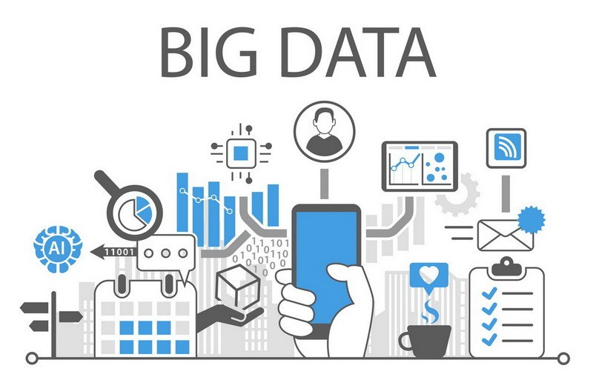
Big Data

Slide 8
What is Data?
Data is distinct/single pieces of information
People have used the word data to mean computer information that is transmitted or stored.

Slide 9
Data vs Information
Data
N.B. Data is stored in tabular format
Information

Slide 10
What is big data?
Big Data is also data but with a huge size.
Big Data is a term used to describe a collection of data that is huge in size and yet growing exponentially with time.
In short such data is so large and complex that none of the traditional data management tools are able to

Slide 11
Why Big data?
The New York Stock Exchange generates about one terabyte of new trade data per day
Facebook generates about 500+terabytes every day
A single Jet engine can generate 10+terabytes of data in 30 minutes of flight time. With many thousand flights per day, generation of data reaches up to many Petabytes.

Slide 12
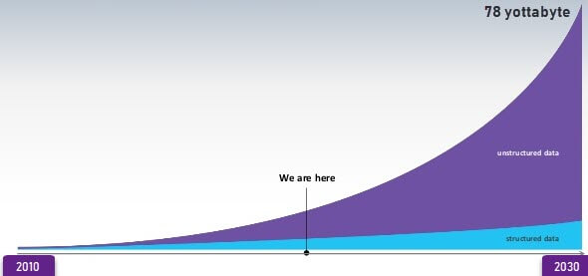
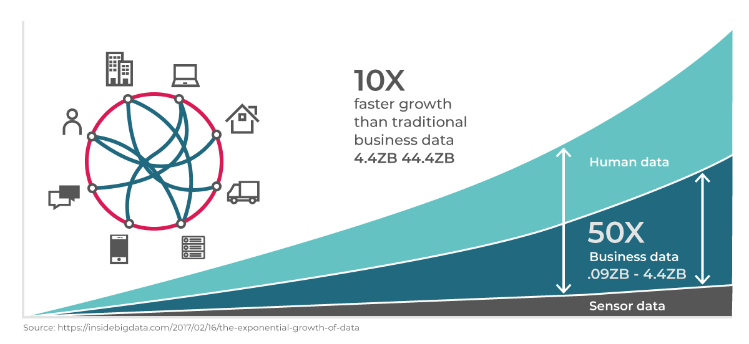
Data Growth over years

Slide 13
Types Of Big Data
Big Data could be found in three forms:
1. Structured
2. Unstructured
3. Semi-structured

Slide 14
Structured Data
Any data that can be stored, accessed and processed in the form of fixed format is termed as a 'structured' data.

Slide 15
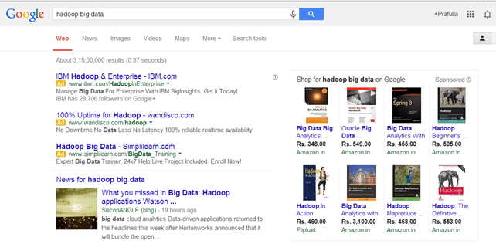
Unstructured Data
Any data with unknown form or the structure is classified as unstructured data.

Slide 16
Semi-structured Data
Semi-structured data can contain both the forms of data. We can see semi-structured data as a structured in form but it is actually not defined with e.g. a table definition in relational DBMS.

Slide 17
Characteristics Of Big Data
(i) Volume – The name Big Data itself is related to a size which is enormous.
(ii) Variety – Nowadays, data in the form of emails, photos, videos, monitoring devices, PDFs, audio, etc. are also being considered in the analysis applications. This variety of unstructured data poses certain issues for storage, mining and analyzing data.
(iii) Velocity – The term 'velocity' refers to the speed of generation of data. (iv) Variability – This refers to the inconsistency which can be shown by the data at times, thus hampering the process of being able to handle and manage the data effectively.

Slide 18
Characteristics Of Big Data
(i) Volume – The name Big Data itself is related to a size which is enormous.
(ii) Variety – Nowadays, data in the form of emails, photos, videos, monitoring devices, PDFs, audio, etc. are also being considered in the analysis applications. This variety of unstructured data poses certain issues for storage, mining and analyzing data.
(iii) Velocity – The term 'velocity' refers to the speed of generation of data. (iv) Variability – This refers to the inconsistency which can be shown by the data at times, thus hampering the process of being able to handle and manage the data effectively.

Slide 19
Objectives of Big Data Processing
The primary objective is to ensure the data is of high quality and accessible for business intelligence along with big data analytics applications.

Slide 20
Ways to effectively handle Big Data
Outline Your Goals.
Secure the Data.
Keep the Data Protected.
Do Not Ignore Audit Regulations.
Data Has to Be Interlinked.
Know the Data You Need to Capture.
Adapt to the New Changes.
Identify human limits and the burden of isolation.

Slide 21
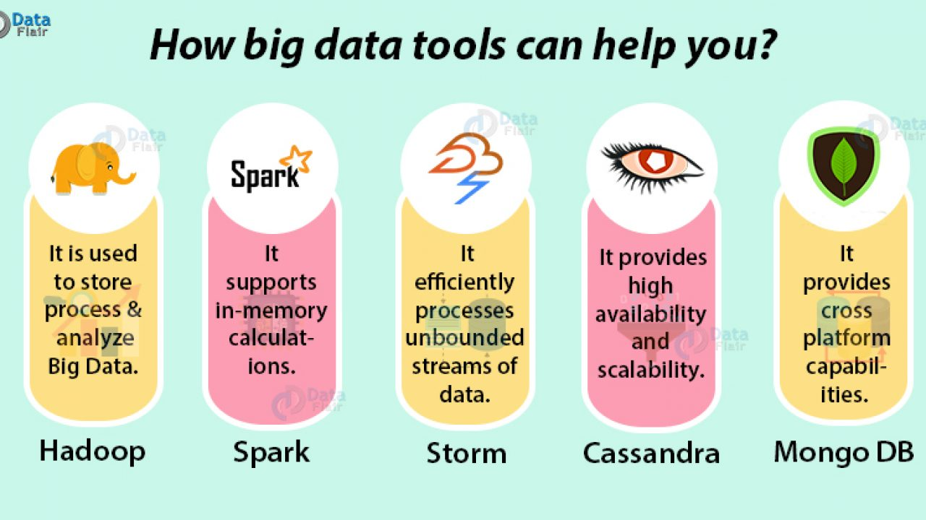
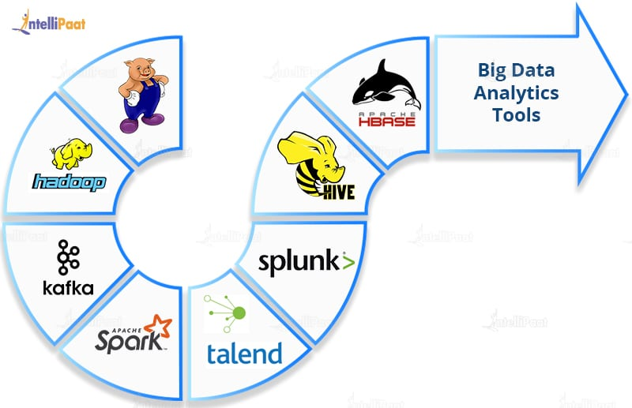
Big Data Tools
For curious mind:
https://www.whizlabs.com/blog/big-data-tools/

