Slide 1
Project Domain-2 Software Project- II (CSE-216)

Slide 2
Data Mining

Slide 3
What is Data Mining ??
Data mining is the process of discovering patterns in large data sets involving methods at the intersection of machine learning, statistics, and database systems.
In other words, practice of examining large pre-existing databases in order to generate new information.

Slide 4
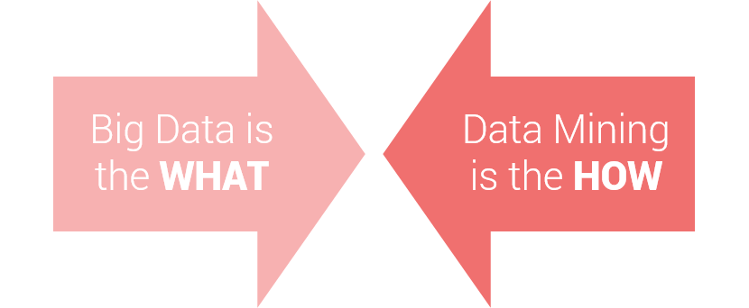
Interconnection Between Big Data & DATA MINING
What to process?
Means Data/Data Sets
How to process Data/Data Sets for your target result from those Data
Big data is a term which refers to a large amount of data whereas data mining refers to deep drive into the data to extract the key knowledge/Pattern/Information from a small or large amount of data.

Slide 5
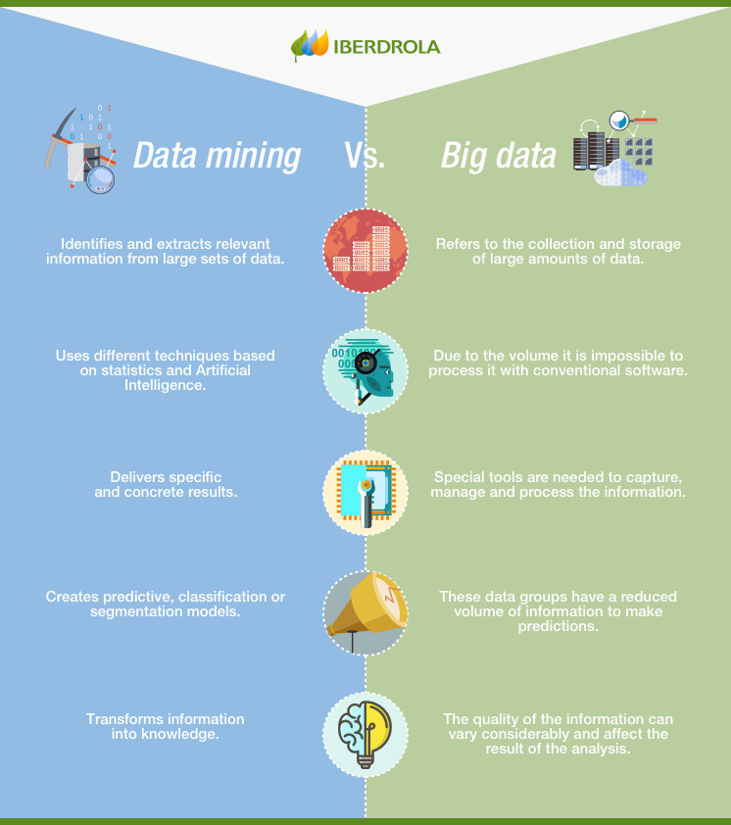
Interconnection Between Big Data & DATA MINING

Slide 6
Applications of Data Mining:
Marketing:
Sports Analysis
Super Shop Goods Management
Banking Sector
Medical Sector
Media
Share Market
Business Analysis
Human Activity Identification

Slide 7
Data Mining Example:

Slide 8
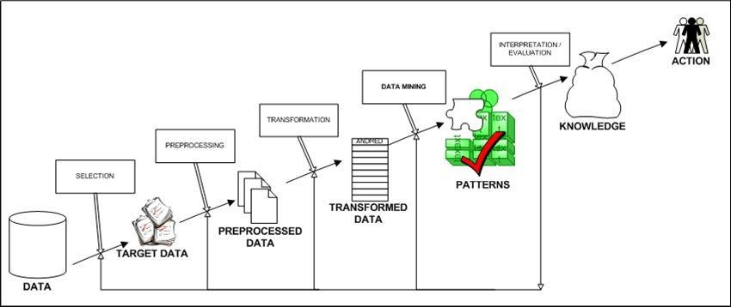
Data Mining Steps:

Slide 9
Data Mining Process:

Slide 10
Data Mining Methodologies:
Cross-Industry Standard Process for Data Mining (CRISP-DM)
SEMMA (Sample, Explore, Modify, Model, Assess)

Slide 11
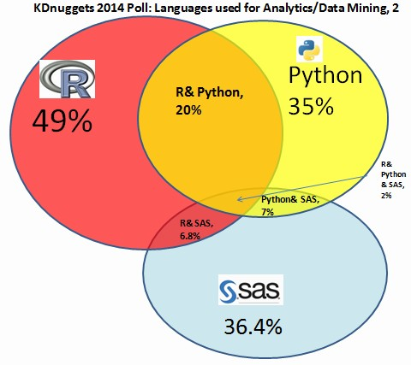
Programming Language for Data Mining:
R-Language
Python
SAS
SQL

Slide 12
Tools used for Data Mining:
Rapid Miner.
Orange.
Weka.
KNIME.
Sisense.
SSDT (SQL Server Data Tools)
Apache Mahout.
Oracle Data Mining.

Slide 13
Challenges in Data Mining:
Data Mining needs large databases and data collection that are difficult to manage.
The data mining process requires domain experts that are again difficult to find.
Integration from different databases is a complex process.
Requires effort and cost.

Slide 14
Data Mining in Job Market
LinkedIn's 2017 annual report on emerging jobs noted that three of the most in-demand jobs in the United States were positions related to big data. Likewise, IBM forecasts that the demand for this type of professionals will grow by 28% between now and 2020.

Slide 15
Thanks!
Any questions?

