Slide 1
PROJECT DOMAIN
Software Project II (CSE -216)

Slide 2
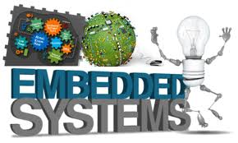

Slide 3
What is Embedded Systems?
Embedded systems are computer hardware and software that are embedded into everyday things .
They are dedicated to a particular function and are difficult to update once they are shipped.
Embed means to set/organize separated parts(HW or SW)

Slide 4
What is IoT?
IoT are computer hardware, software and networking capabilities that are embedded into everyday things.
They are often updated using their network capabilities and may act as a

Slide 5
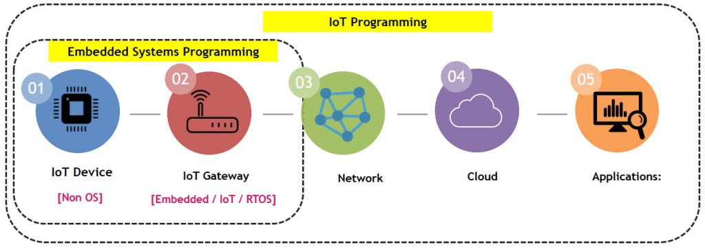
Embedded Systems vs IOT
Embedded System | IoT
Embedded systems are electronic system, not necessarily connected things to internet | IoT are the systems which are connected things to internet. IoT is a big model that tries to integrate multiple thing together.

Slide 6
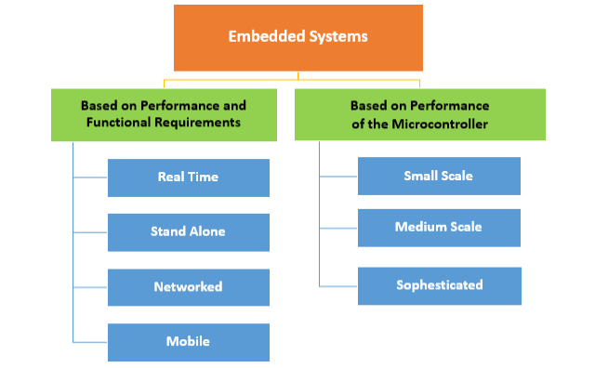
Types of ES:
Performance and Functional requirements
Performance of the Microcontroller

Slide 7
Application Sectors of Embedded System:
Electronics Device
Industrial
Automotive
Home
Medical
Commercial Use
Military applications
Telecommunication

Slide 8
Key aspects of Embedded System:
Hardware of an embedded-system is used for security and performance.
The Software is used for features.

Slide 9
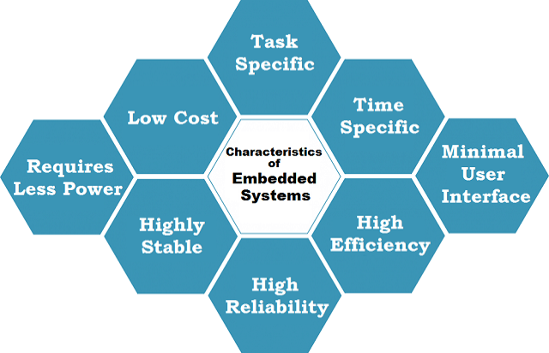
Characteristics of Embedded Systems:

Slide 10
Characteristics of Embedded Systems:
All Embedded Systems are task specific
Embedded systems are created to perform the task within a certain time frame. It must therefore perform fast enough. A car’s brake system, if exceeds the time limit, may cause accidents.
They have minimal or no user interface (UI). A fully automatic washing machine works on its own after the program is set and stops once the task is over.
Are built to achieve certain efficiency levels
Small sized, can work with less power and are not too expensive.
Embedded systems cannot be changed or upgraded by the users
They are expected to function for long durations without the user experiencing any difficulties.
Microcontroller or microprocessors are used to design embedded systems.
Embedded systems need connected peripherals to attach input & output devices.

Slide 11
Embedded systems talk with the outside world via peripherals, such as:
Serial Communication Interfaces (SCI): RS-232, RS-422, RS-485, etc.
Synchronous Serial Communication Interface: I2C, SPI, SSC and ESSI (Enhanced Synchronous Serial Interface)
Universal Serial Bus (USB)
Multi Media Cards (SD cards, Compact Flash, etc.)
Networks: Ethernet, LonWorks, etc.
Fieldbuses: CAN-Bus, LIN-Bus, PROFIBUS, etc.
Timers: PLL(s), Capture/Compare and Time Processing Units
Discrete IO: aka General Purpose Input/Output (GPIO)
Analog to Digital/Digital to Analog (ADC/DAC)
Debugging: JTAG, ISP, BDM Port, BITP, and DB9 ports.

Slide 12
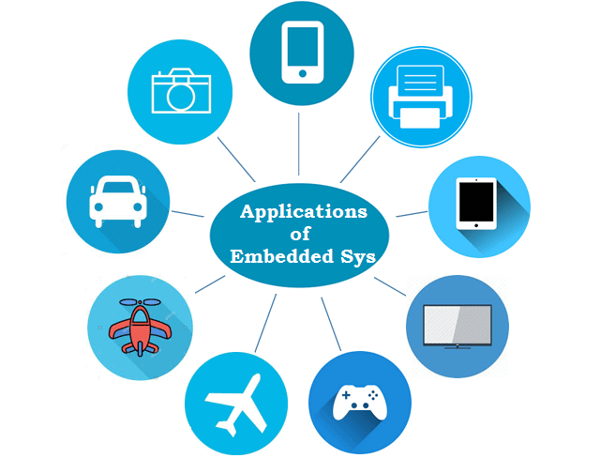
Examples of Embedded Systems:

Slide 13
Examples of Embedded Systems:
Vehicles Brake
Toys
Electronics device: Washing Machine, game Controller
Home Automation : Automatic Door
Infrastructure: Canal gate controlled by operator
Power Systems: Solar System transmits performance information to a management system
Supply Chain: Temperature-Controlled Container
Industrial: Factory Equipment i.e. Robot
Networking : Router
City: Smart City with automatic solar lighting self manages its power capacity

Slide 14
Examples of Embedded Systems:
11. Theme Parks : A car on a roller coaster that monitors vibrations and seat belts that can slow and stop the attraction if it finds a problem.
12. Fashion: could use computers to implement features such as shoes that change colors and patterns on command.
13. Medicine: Computers in medical devices such as a heart monitor.
So on………….

Slide 15
Tools & Architecture:
Embedded system designers use
Compilers
Assemblers
Debuggers to develop embedded system software.
In the automotive sector:
AUTOSAR is a standard architecture for embedded software.

Slide 16
Advantages of Embedded System:
Advantages of Embedded System
They are convenient for mass production. This results in low price per piece.
These systems are highly stable and reliable.
Embedded systems are made for specific tasks.
The embedded systems are very small in size, hence can be carried and loaded anywhere.
These systems are fast. They also use less power.
The embedded systems optimize the use or resources available.
They improve the product quality.

Slide 17
Disadvantages of Embedded System
Once configured, these systems cannot be changed. Hence, no improvement or upgradation on the ones designed and created can be made.
They are hard to maintain. It is also difficult to take a back-up of embedded files.
Troubleshooting is difficult for embedded systems. Transferring data from one system to another is also quite problematic.
Because these systems are made for specific tasks, hardware is limited.

