Slide 1
PROJECT DOMAIN
Software Project II (CSE -216)

Slide 2
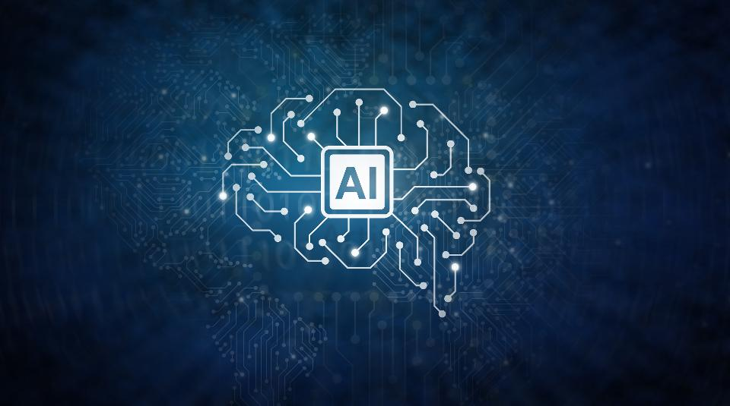
Artificial Intelligence

Slide 3
What is AI ?
Intelligence demonstrated by machines, in contrast to the natural intelligence displayed by humans and animals.
refers to the simulation of human intelligence in machines that are programmed to think like humans and mimic their actions.
The term may also be applied to any machine that exhibits traits associated with a human mind such as learning and problem-solving.

Slide 4
Idea of AI?
"Can machines think?"

Slide 5
Approaches involved in AI
Thinking humanly
Thinking logically/rationally
Acting humanly
Acting logically/rationally
The first two ideas concern thought processes and reasoning, while the others deal with behavior.

Slide 6
Modified Definition
AI is "the study of agents that receive percepts from the environment and perform actions.“
(Russel and Norvig viii)

Slide 7
Agents in Artificial Intelligence
An agent is anything that can observe its environment through sensors and acts upon that environment through effectors.
A human agent has sensory organs such as eyes, ears, nose, tongue and skin parallel to the sensors, and other organs such as hands, legs, mouth, for effectors.

Slide 8
Agents in Artificial Intelligence-2
An AI system can be defined as the study of the rational agent and its environment.
The AGENTS sense the environment through sensors and act on their environment through actuators.
An AI agent can have mental properties such as knowledge, belief, intention, etc.

Slide 9
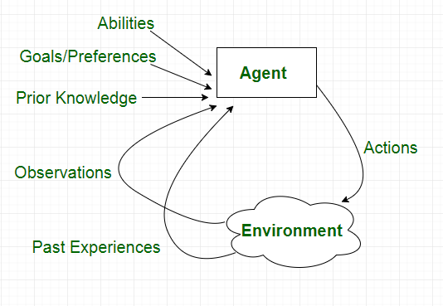
Features/Functionality of Agents in AI:

Slide 10
Types of Agents in AI:
Agents can be grouped into four classes based on their degree of perceived intelligence and capability :
Simple Reflex Agents
Model-Based Reflex Agents
Goal-Based Agents
Utility-Based Agents
Learning Agent

Slide 11
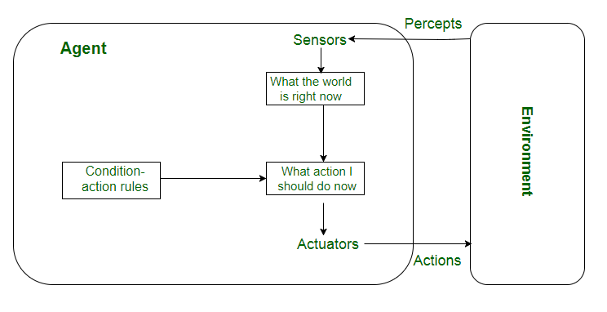
Simple reflex agents
Very limited intelligence.
No knowledge of non-perceptual parts of state.
Usually too big to generate and store.
If there occurs any change in the environment, then the collection of rules need to be updated.

Slide 12
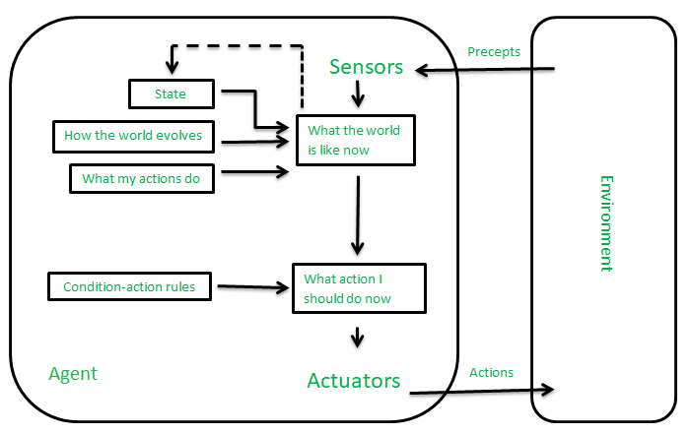
Model-based reflex agents
how the world evolves in-dependently from the agent
how the agent actions affects the world.

Slide 13
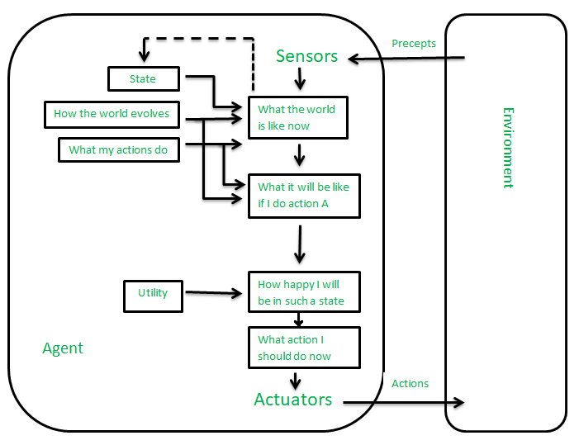
Utility-based agents:
Sometimes achieving the desired goal is not enough. We may look for a quicker, safer, cheaper trip to reach a destination. Agent happiness should be taken into consideration. Utility describes how “happy” the agent is.

Slide 14
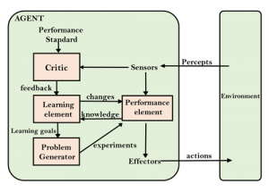
Learning Agent:
A learning agent in AI is the type of agent which can learn from its past experiences or it has learning capabilities

Slide 15
Technical definition of Intelligence:
Intelligence is defined as “The ability to acquire and apply knowledge and skills”.

Slide 16
Types of AI:
Narrow Artificial Intelligence:
I.e. Playing a chess game, Controlling traffic signals, Driving a car
General Artificial intelligence:
provided with knowledge about many sorts of fields and it is also completely open to learning new things by itself. Which can go against Human in sever ways.

Slide 17
Cause of danger in AI:
The poor designing of Artificial Intelligence could lead to machines/system go against human.

Slide 18
Consideration aspects while designing AI algorithm:
Basically an AI algorithm should be made in such a way that:
It never goes out of control
It gets Knowledge related to only a specific domain

Slide 19
Apply Sectors of AI:
Natural Language Generation
Speech Recognition
Virtual Agent: A Virtual Agent is a computer generated, animated, artificial intelligence virtual character (usually with anthropomorphic appearance) that serves as an online customer service representative. Home
Machine Learning
Deep Learning Platforms
Biometrics
Robotic Process Automation
Text Analytics and NLP
Healthcare
Business
Autonomous vehicles
Robotics
Cyborg Technology

Slide 20
Examples of AI:
Google’s AI-Powered Predictions-Google Maps (Maps)
Ridesharing Apps Like Uber and Lyft
Commercial Flights Use an AI Autopilot
Email Spam filtering
Smart Email Categorization
Plagiarism Checkers
Robo-readers
Banking Fraud Prevention
Banking Credit Decisions
Facebook
Instagram
Snapchat
Alexa, Siri, Google Home

Slide 22
Programming Language Used in AI development:
Python
C++
Java
Lisp
Prolog
R Language

Slide 23
References:
https://builtin.com/artificial-intelligence - idea building on AI
https://www.geeksforgeeks.org/agents-artificial-intelligence/ - Requirements of AI
https://www.geeksforgeeks.org/dangers-of-artificial-intelligence/?ref=rp
https://www.valluriorg.com/blog/artificial-intelligence-and-its-applications/
https://emerj.com/ai-sector-overviews/everyday-examples-of-ai/ eaxmples

