Slide 1

Software Dev: Best Practices

Slide 2

Access Point
Maintain a single point of access
Benefits?
Easy to maintain
Easy to update
Less redundant code
Single point of control
Software
project III

Slide 3
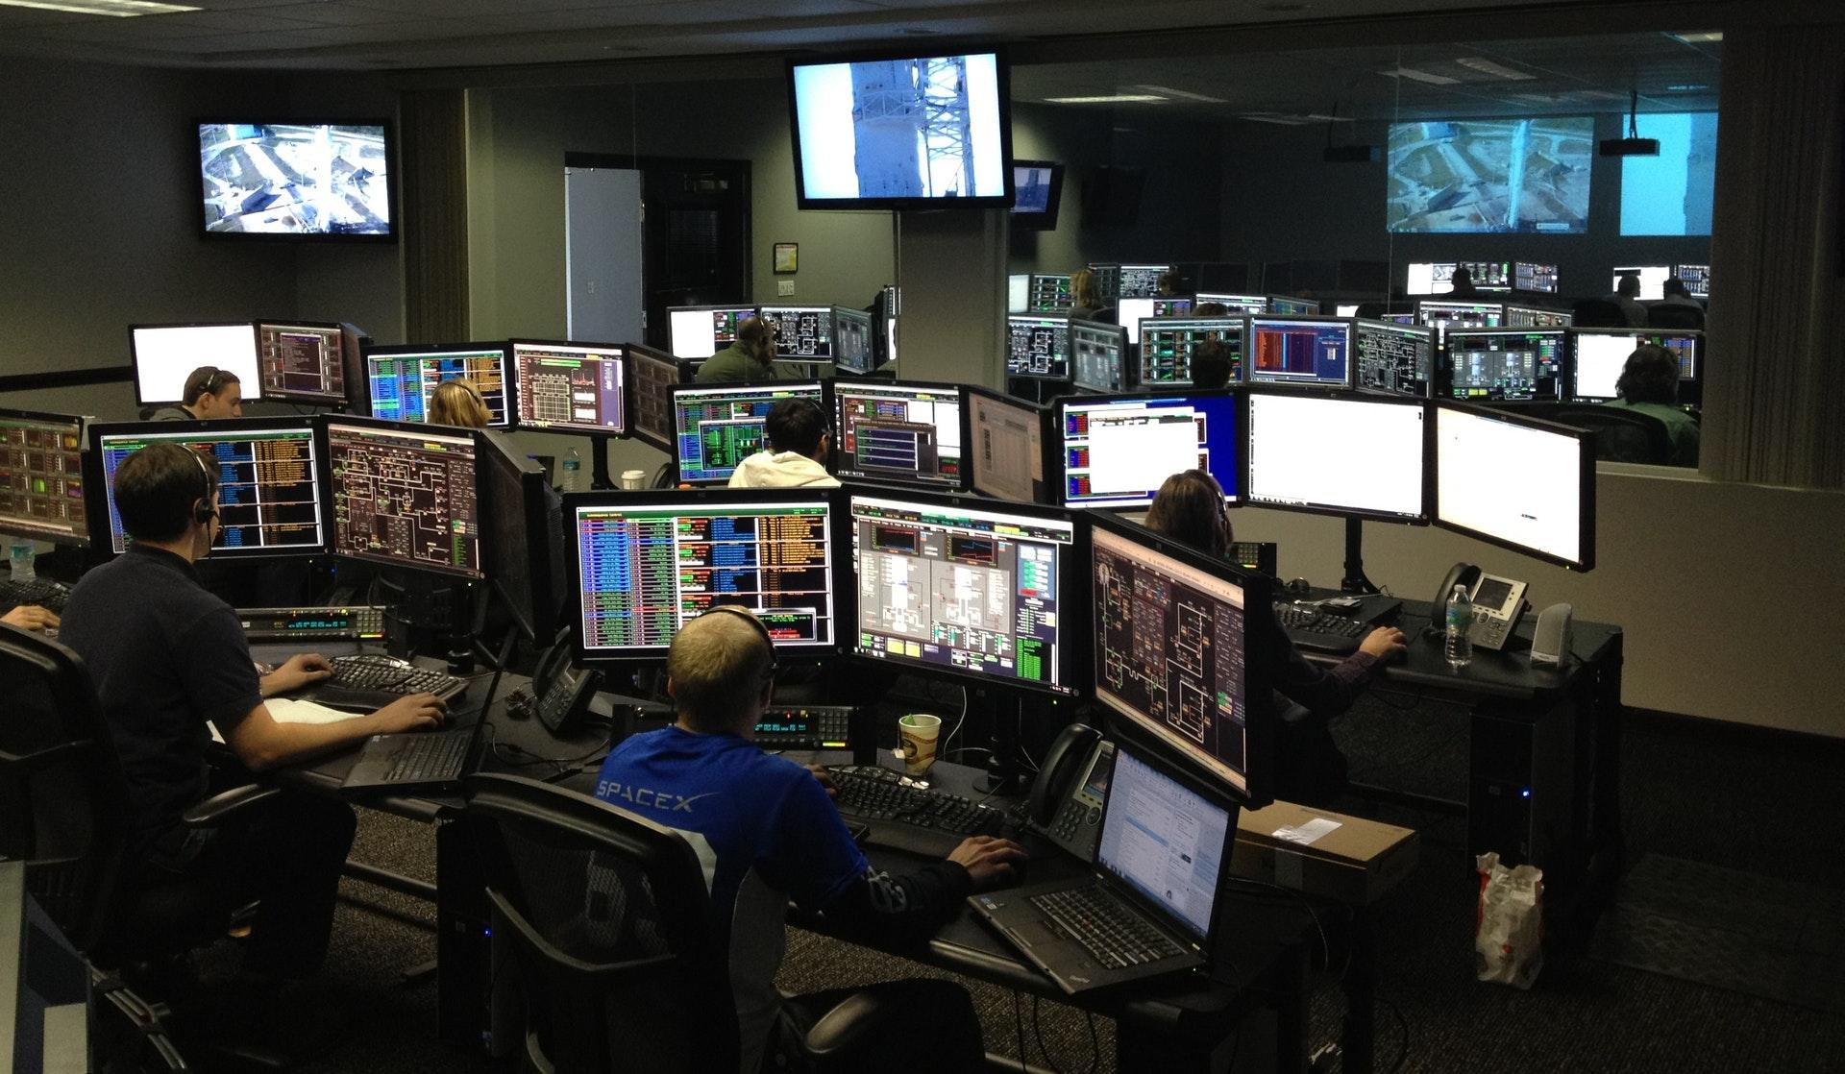
Environment
Maintain constant data using environment
Benefits?
Easy to locate and update
Less redundant code
Single point of control
Software
project III

Slide 4

Speed or Time?
First make it work, then make it work right and finally make it fast.
Saving time requires optimization but and requires time.
Software
project III

Slide 5

MVP
Minimum Viable Product
Steps?
List out the functional requirements
Label as Easy, Medium, Hard based on Difficulties
Label as Critical, Major, Minor Based on Priority
Sort and filter according to labels
Software
project III

Slide 6

Rabbit Hole
Don't go down on a rabbit hole
Software
project III

