Slide 1
Lecture-9
Chapter - 8
Computer Organization and Architecture Designing - William Stallings
Virtual Memory

Slide 2
Virtual Memory
Virtual memory – separation of user logical memory from physical memory.
  Only part of the program needs to be in memory for execution
  Logical address space can therefore be much larger than physical address space
  Allows for more efficient process creation
  Virtual memory takes program address and maps them to RAM addresses
  With no virtual memory: the program crash if we try to access more RAM that we have
  With virtual memory: mapping gives us flexibility in how we use the RAM
  Virtual memory mapping let us use our disk to give the illusion of unlimited memory
Virtual memory can be implemented via:
  Demand paging
  Demand segmentation

Slide 3
Virtual Memory Diagram
virtual memory
page 0
page 1
page 2
page 3
secondary
storage
memory
map
physical
memory
page n

Slide 4
What is Virtual Memory
Program:
  ....
  Mov AX, 0xA0F4
  ....
Table
(one per
Process)
0xA0F4
Mapping
Unit
(MMU)
0xC0F4
Virtual
Address
„Piece“ of Virtual Memory
Physical Memory
„Piece“ of Physical Memory
Physical
Address
Virtual Memory
Supporting Video Link
Notes:
4
Not only address to address mapping, but piece to piece
VAS usually much larger than PAS

Slide 5
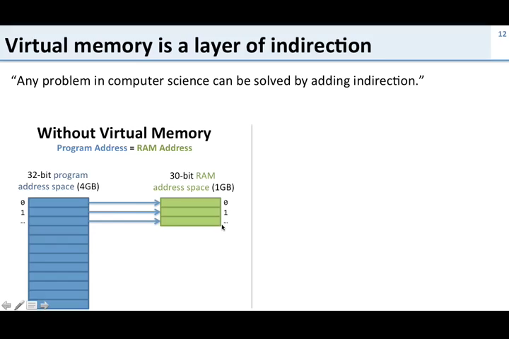
What is Virtual Memory
Notes:
5
Not only address to address mapping, but piece to piece
VAS usually much larger than PAS

Slide 6
Why Virtual Memory (VM)
Shortage of memory
  Efficient memory management needed
  Process may be too big for physical memory
  More active processes than physical memory can hold
Requirements of multi-programming
  Efficient protection scheme
  Simple way of sharing
Process 3
Process 2
Process 4
Process 1
OS
Memory
Notes:
6
Mention external fragmentation

Slide 7
The Mapping Process Flowchart
Usually every process has its own mapping table
Not every „piece“ of VM has to be present in PM
  „Pieces“ may be loaded from HDD as they are referenced
  Rarely used „pieces“ may be discarded or written out to disk (→ swapping)
check using mapping table
piece
in physical
memory?
OS brings
„piece“ in
from HDD
virtual
address
memory
access fault
yes
OS adjusts
mapping
table
physical
address
translate
address
MMU

Slide 8
Demand Paging
Bring a page into memory only when it is needed
  Less I/O needed
  Less memory needed
  Faster response
  More users
Page is needed ⇒ reference to it
  invalid reference ⇒ abort
  not-in-memory ⇒ bring to memory

Slide 9
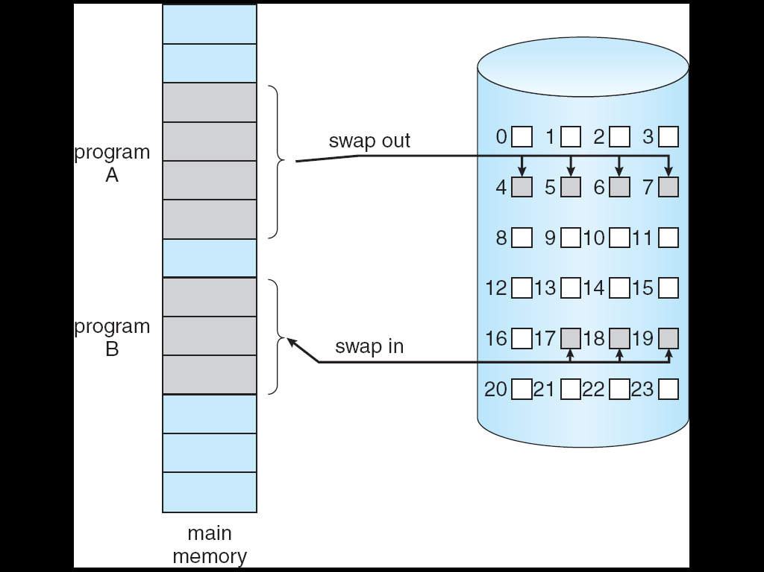
Transfer of a Paged Memory to Contiguous Disk Space

Slide 10
Transfer of a Paged Memory to Contiguous Disk Space
To replace pages or segments of data in memory. Swapping is a useful technique that enables a computer to execute programs and manipulate data files larger than main memory.
When the operating system needs data from the disk, it exchanges a portion of data (called a page or segment ) in main memory with a portion of data on the disk.
DOS does not perform swapping, but most other operating systems, including OS/2, Windows, and UNIX, do. Swapping is often called paging.
When set of paged data sets moved from auxiliary storage to real storage during execution of any job is called swap-in. Reverse is swap out.

Slide 11
What is a process
We typically mean that a process is a running program
A better definition is that a process is the state of a running program
Now we have a really good definition of the state of a running program
  A program counter
  A page table
  Register values

Slide 12
Address Translation
Physical Memory
CPU
A.1
@8190
B.1
C.1
A.2
virtual
addresses
0-4095
4096-8191
8192-12287
12288-16384
C.4
address
translation
C.6
Process A
B.2
A.1
B.3
A.2
A.3
A.4
A.3
A.4
C.2
Disk
C.3
C.5
. . .
. . .
Supporting Video Link

Slide 13
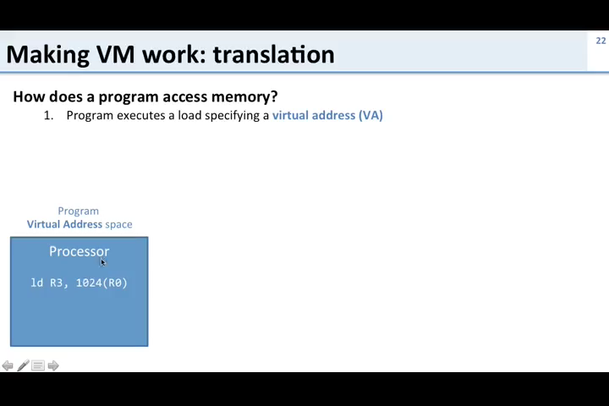
Address Translation

Slide 14
Example
Physical Memory
Process A
A.1
A.2
A.3
A.4
Process B
B.1
B.2
B.3
Process C
C.1
C.2
Disk
C.3
C.4
C.5
C.6

Slide 15
Example: Memory Snapshot
Physical Memory
Process A
A.1
A.1
A.2
B.1
A.3
C.1
A.4
A.3
C.4
C.6
Process B
B.2
B.1
B.3
B.2
B.3
Process C
A.2
A.4
C.1
C.2
Disk
C.2
C.3
C.3
C.5
C.4
. . .
C.5
. . .
C.6

Slide 16
Memory Protection
Virtual memory ensures protection
Process A cannot read/write into the memory of process B
As we’re going to see, this is easily enforced by the virtual memory address translation scheme
Process A
Physical Memory
A.1
A.2
A.1
A.3
B.1
A.4
C.1
A.3
Process B
C.4
C.6
B.1
B.2
B.2
B.3
B.3
Process C
C.1
A.2
C.2
A.4
C.3
C.2
Disk
C.4
C.3
C.5
C.5
C.6
. . .
. . .

Slide 17
Paging
Each process has its own page table
Each page table entry contains the frame number of the corresponding page in main memory
A bit is needed to indicate whether the page is in main memory or not

Slide 18
Page Tables
The entire page table may take up too much main memory
Page tables are also stored in virtual memory
When a process is running, part of its page table is in main memory

Slide 19
Page Size
Smaller page size, less amount of internal fragmentation
Smaller page size, more pages required per process
More pages per process means larger page tables
Larger page tables means large portion of page tables in virtual memory

Slide 20
Page Faults
A miss in the page table is called a page fault
When the “valid” bit is not set to 1, then the page must be brought in from disk, possibly replacing another page in memory

Slide 21
VM:Sharing
Pieces of different processes mapped to one single piece of physical memory
Piece 0
Piece 0
Piece 0
Piece 1
Piece 1
Piece 1
Piece 2
Piece 2
Piece 2
Physical
memory
shared
memory
Virtual memory
Process 1
Virtual memory
Process 2
Supporting Video Link
Notes:
21
Shared Code must be reentrant (non-self-modifying)

Slide 22
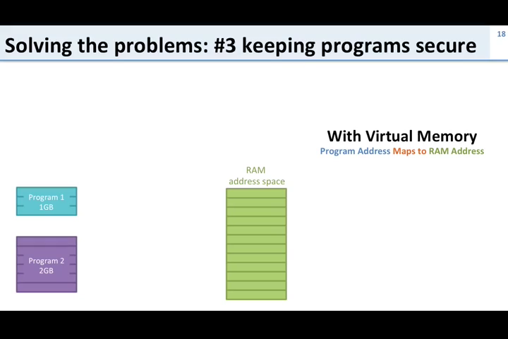
VM:Sharing
Notes:
22
Shared Code must be reentrant (non-self-modifying)

Slide 23
Advantages of Virtual memory
VM supports
  Swapping
    Rarely used pieces can be discarded or swapped out
    Piece can be swapped back into any free piece of physical memory large enough, mapping unit translates addresses
  Protection
  Sharing
    Common data or code may be shared to save memory
Code can be placed anywhere in physical memory without relocation (adresses are mapped!)

Slide 24
Disadvantages of Virtual memory
Memory requirements (mapping tables)
Longer memory access times (mapping table lookup)
Notes:
24

Slide 25
That’s All
Thank You

