Slide 1
Public Interest Litigation
Constitutional Law of Bangladesh (LAW 215)

Slide 2
Introduction
The concept of litigation pro bono public or public interest litigation (PIL) is not new. In the last few decades, this concept has assumed a new dimension throughout South Asia and in other developing countries.

Slide 3
Origin of the Concept
Initially, Public Interest Litigation began in the United States. During the late 1960s, there emerged certain public interest law firms to provide legal representation to unrepresented or underrepresented groups or interests. These firms specialized in different disciplines such as environment, consumerism, civil liberties, minority rights etc.
PIL owes its origin to the need to respond to the helplessness of a person or group of persons due to financial inability, lack of awareness of the existence of rights, either constitutional or legal, or the disadvantaged social position of such a person or group of persons, which obstructed them from obtaining legal redress in cases of the infringement of their rights. A recognition of this helplessness has led others, motivated by a sense of public spiritedness, to attempt to vindicate their rights.

Slide 4
PIL in India
In early 1980's the Indian courts seemed poised to entertain cases of public interest and issue appropriate directions in such matters.
These cases were initiated for the benefit of the deprived, dispossessed and disadvantaged sections of society.
Such proceedings were part of the legal aid movement initiated by certain public spirited groups.
Free legal aid movement was sympathized with by the executive and supported by the judiciary.
While deciding public interest cases the judiciary was willing to relax the rules, deviate from the standard procedures and ditch formalities and technicalities that stood in the way of providing substantive justice to the poor and downtrodden.
The courts adopted this strategy so as to secure the blessings of the rule of law for the weak and vulnerable members of society who had traditionally been deprived of its benefits.
It was a unique and singular event in the judicial history of India when the judiciary extended its support to the poor and expressed its solidarity with them.
It was, of course, a purely indigenous response to address the problems of the underprivileged and give them access to justice. It was indeed a native recipe for making socio-economic justice accessible to all.

Slide 5
What is Locus Standi?
Locus standi is a Latin phrase meaning place to stand.
According to Black’s Law Dictionary, locus standi means the right to bring an action or to be heard in given forum. In simple words, locus standi may use it as standing or legal standing.
Locus standi is influenced by a number of factors for a given person or situation and legal standing can vary depending on the level of the court.
As a general rule, a person has locus standi in a given situation if it is possible for such a person to show that the issue at hand causes harm and that an action undertaken by the court could redress that harm.
Lord Denning in R v. Paddington (1966) as observed that the court would not listen, of course, to a mere busybody who was interfering in things which did not concern him. But it will listen to anyone whose interests are affected by what has been done.
For instance, if a citizen wants to challenge a law, the citizen must first show that he or she is experiencing harm as a result of that law. This means that people cannot challenge laws just on the principle of the matter or because they think that those laws might harm other people.
These individuals must also be able to show that when the case is filed, their interest is also affected by the law which is commonly known as locus standi.

Slide 6
What is Locus Standi?
The traditional rule of standing has been that a petition for a legal remedy can ordinarily moved only by an aggrieved person. This principle is based on theory that remedies and rights are correlative and therefore, only a person whose own right is in jeopardy is entitled to seek a remedy.
This basic rule gives rise to three propositions of law.
Only he can take recourse to the writ jurisdiction whose own legal rights of person or property are directly and substantially injured.
When a person suffers along with other members of the public by administrative action, he cannot challenge the action in question unless he can show some special injury to himself over and above, what others have suffered.
Where a person challenging an administrative action is a total stranger (whom the courts call as a meddlesome interloper), the court will not ordinarily entertain his petition.

Slide 7
Why was Locus Standi narrower?
The underlying reason being that, the third parties who have no interest in the case should not be allowed to take interest in the case because they would drag the case unnecessarily. Therefore, the rule of locus standi is based on a sound policy, that is, judicial time as well as energy ought not to be wasted over hypothetical or abstract questions or questions at the instance of a professional litigant or busybody or meddlesome interloper.

Slide 8
Liberalization of Locus Standi
The concept of locus standi is being liberalized and the scope of the concept is being expanded day to day.

Slide 9
S. P. Gupta v. Union of India (1982)
According to initial interpretation of Article 32 of the Constitution of India [Article 102 of the Constitution of Bangladesh], only aggrieved party had the right to seek redress. Justice P. N. Bhagwati in S. P. Gupta v. Union of India (1982) articulated the concept of PIL as follows:
“Where a legal wrong or a legal injury is caused to a person or to a determinate class of persons by reason of violation of any constitutional or legal right or any burden is imposed in contravention of any constitutional or legal provision or without authority of law or any such legal wrong or legal injury or illegal burden is threatened and such person or determinate class of persons by reasons of poverty, helplessness or disability or socially or economically disadvantaged position to approach the court for relief, any member of public can maintain an application for an appropriate direction, order or writ in the High Court under Article 226 and in case any breach of fundamental rights of such persons or determinate class of persons, in this court under Article 32 [Article of the Constitution of Bangladesh] seeking judicial redress for the legal wrong or legal injury caused to such person or determinate class of persons.”

Slide 10
Justice P. N. Bhagwati
“The weaker sections of Indian humanity have been deprived of justice for long years; they had no access to justice on account of their poverty, ignorance and illiteracy. They are not aware of the rights and benefits conferred upon them by the Constitution and the law. On account of their socially and economically disadvantaged position they lack the capacity to assert their rights, and they do not have the material resources with which to enforce their social and economic entitlements and combat exploitation and injustice.” //Justice Bhagwati in Bihar Legal Support Society v Chief Justice of India (1986)

Slide 11
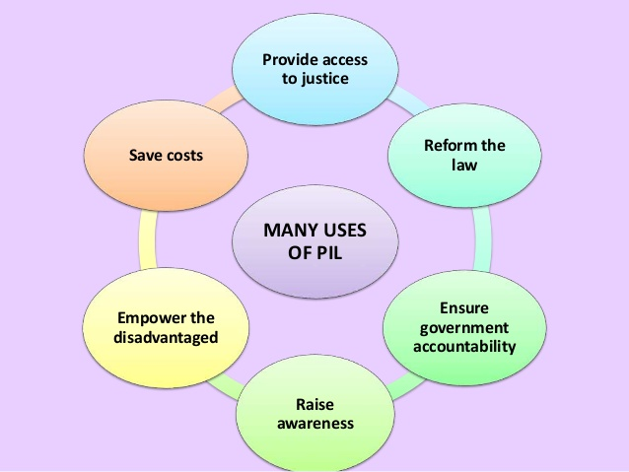
Uses of PIL

Slide 12
PIL in Bangladesh
The concept of PIL got its root in Bangladesh through the landmark case named Dr. Mohiuddin Farooque v Bangladesh (Civil Appeal No. 24 of 1995). The judgment was delivered on 26th of July, 1996.

Slide 13
Dr. Mohiuddin Farooque v Bangladesh (1996)
FACTS
Dr. Mohiuddin Farooque was Secretary General of Bangladesh Environmental Lawyers Association (BELA). He filed the writ petition both under Article 102 (1) and Article 102(2)(a) of the Constitution praying for issuance of a Rule Nisi upon the respondents to show cause as to why all the activities and implementation of FAP-20 undertaken in the District of Tangail should not be declared to have been taken without lawful authority and to be of no legal effect.

Slide 14
Chief Justice ATM Afzal
The liberalized view as expounded by [my colleagues] is an update … of the liberalization agenda which was undertaken in the case of Kazi Mukhlesur Rahman, 26 DLR (SC) 44. It is a matter of some pride that quite early in out Constitutional Journey the question of locus standi was given a liberal contour in that decision by this Court at a time when the Blackburn cases were just being decided in England which established the principle of "sufficient interest" for a standing and the doctrine of public interest litigation or class action was yet to take roots in the Indian Jurisdiction.
Two principles were established in that case: (1) that when there is a threat to a fundamental right of the citizens any one of them can invoke the jurisdiction under article 102 of the Constitution, that any citizen from any part of the country may become a petitioner and (2) that if a constitutional issue of grave importance is raised (in that case it was an international treaty affecting territory of Bangladesh) a petitioner qualifies himself to be a person aggrieved.

Slide 15
Justice Mustafa Kamal
With the power of the people looming large behind the constitution horizon it is difficult to conceive of Article 102 as a vehicle or mechanism for realising exclusively individual rights upon individual complaints. The Supreme Court being a vehicle, a medium or mechanism devised by the Constitution for the exercise of the judicial power on behalf of the people, the people will always remain the focal point of concern of the Supreme court while disposing of justice or propounding any, judicial theory or interpreting any provision of the Constitution. Viewed in this context interpreting the words "any person aggrieved" meaning only and exclusively individuals and excluding the consideration of people as a collective and consolidated personality will be a stand taken against the constitution.
The enlargement is writ large on the face of the Constitution. In a capitalist laissez faire concept of private ownership of the instruments and mans of production and distribution, individual rights carry the only weight and the judiciary exists primarily to protect the capitalist rights of the individuals, but in our Constitution Article 13, a Fundamental Principle of State Policy, provides that the people shall own control the instruments and means of production and distribution under three forms … . When there is a State ownership on behalf of the people of the instruments and means of production an distribution the concept of exclusive personal wrong or injury is hardly appropriate.
The High Court Division cannot under the circumstances adhere to the traditional concept that to invoke its jurisdiction under Article 102 only a person who has suffered a legal grievance or injury or an adverse decision or a wrongful deprivation or wrongful refusal of his title to something is a person aggrieved.

Slide 16
Justice Latifur Rahman
The traditional rule to locus standi is that judicial remedy is available only to a person who is personally aggrieved. This principle is based on the theory that the remedies and rights are correlative and therefore only a person whose own right is violated is entitled to seek remedy.
In case of private individual and private law this principle can be applied with some strictness, but in public law this doctrine cannot be applied with the same strictness as that will tantamount to ignoring the good and well being of citizens, more particularly from the view point of public good for whom the state and the Constitution exist.
BELA is actively working in the field of environmental problems of the Bangladesh. It is to be kept in mind that BELA has got no direct personal interest in the matter. Strictly speaking it is not an aggrieved person if, we just give a grammatical construction to the phrase aggrieved person which means person personally aggrieved.
In conclusion, I hold that the appellant may not have any direct personal interest but it has sufficient and genuine interest in the matter complained of and it has come before the court as a group of public spirited young lawyers to see that the public wrong or public injury is remedied and not merely as a busy body perhaps with a view to gain cheap popularity and publicity.

Slide 17
Justice Bimalendu Bikash Roy Choudhury
It cannot be conceived that its interpretation should be purged of the spirit of the constitution as clearly indicated in the Preamble and other provisions of our Constitution, as this is unthinkable that the framers of the Constitution had in their mind that the grievances of millions of our people should go un-redressed, merely because they are unably to reach the doors of the court owing to abject poverty, illiteracy, ignorance and disadvantaged condition. It could never have been the intention of the framers of the constitution to outclass them. In such harrowing conditions of our people is general if socially conscious and public-spirited persons are not allowed to approach the court on behalf of the public or a section thereof for enforcement of their rights the very scheme of the Constitution will be frustrated. The inescapable conclusion, therefore, is that the expression "person aggrieved" means not only any person who is personally aggrieved but also one whose heart bleeds for his less fortunate fellow beings for a wrong done by the Government or a local authority in not fulfilling its constitutional or statutory obligations. It does not, however, extend to a person who is an interloper and interferes with things which do not concern him. This approach is in keeping with the constitutional principles that are being evolved in the recent times in different countries

Slide 18
How to Stop Flood of PIL?
As to the apprehension of floodgate, the people have no doubt a flood and the Constitution is the sluice-gate through which the people control its own entry. Our Courts will be prudent enough to recognize the people when the people appear through an applicant as also those who masquerade, under the name of the people. Taking up the people’s causes at the expense of his own is a rare phenomenon, not a common place occurrence.
The subsequent judgments have established the practice of scrutinizing the track record of the organization.

Slide 19
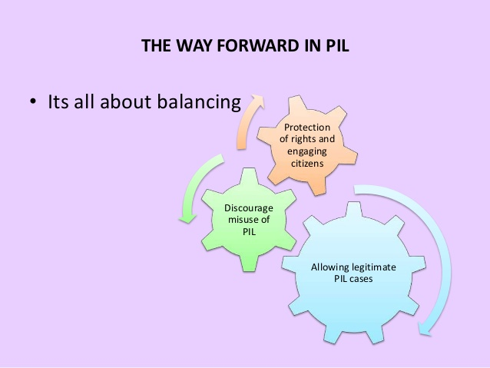
Balanced PIL

Slide 20
Important NGOS Lodging PIL Cases
BELA
BLAST
ASK
Madaripur Legal Aid Association (MLAA)

